Slide 1

5th International Swift Conference
Tel Aviv, 11th – 15th March 2018
What do we know about Swifts’ nest boxes?
Dick Newell, Action for Swifts, Cambridge, UK

Slide 2
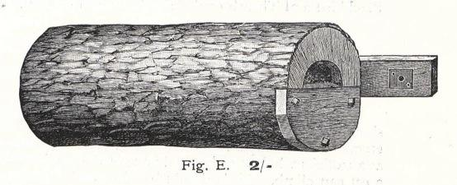
1908: RSPB Swift box, 2 shillings

Slide 3
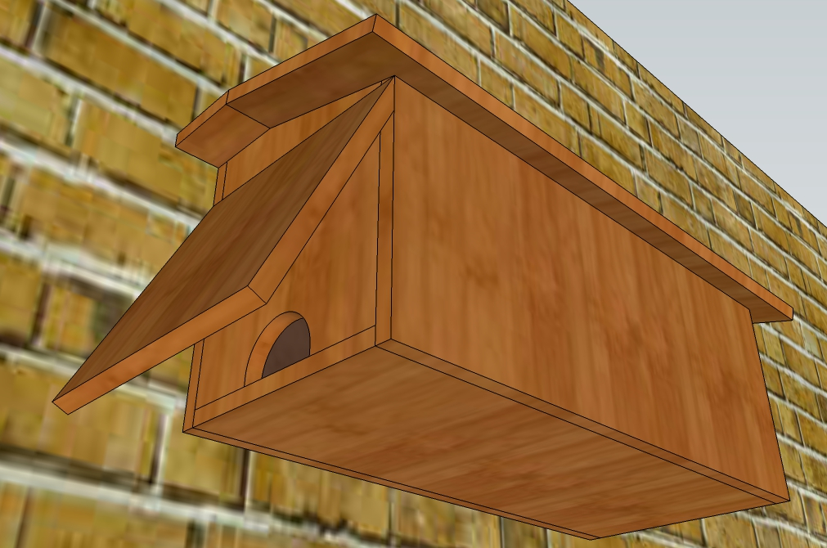
The Hirsel Swift box 1950

Slide 4
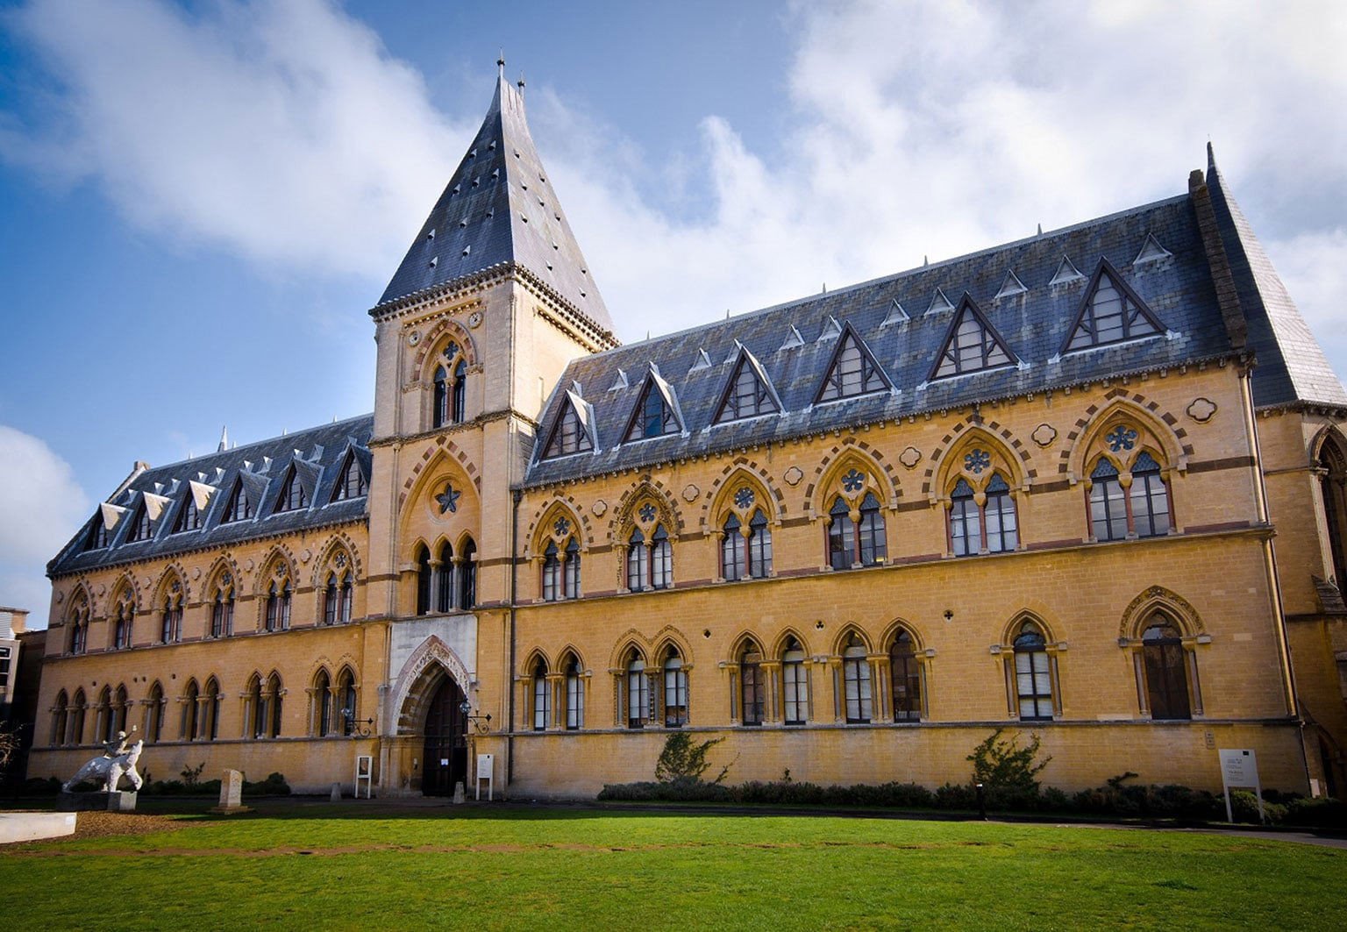
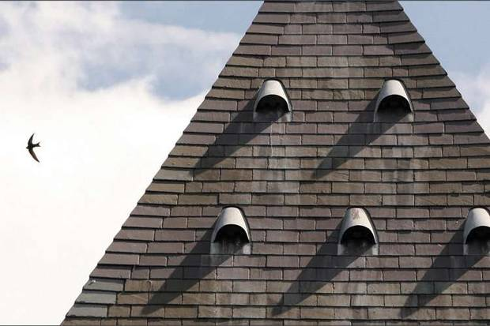
Oxford University Museum of Natural History

Slide 5
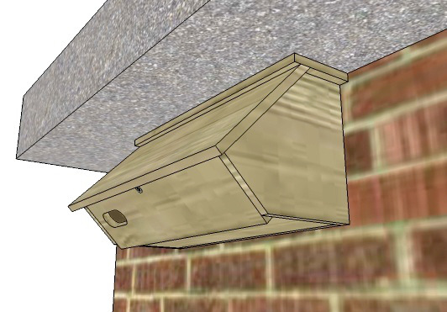
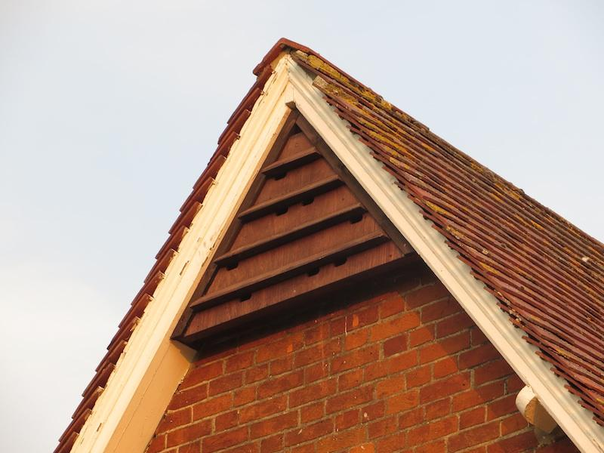
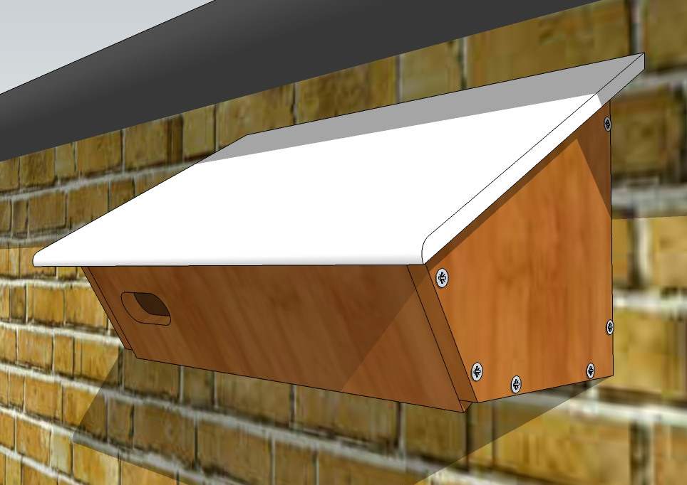
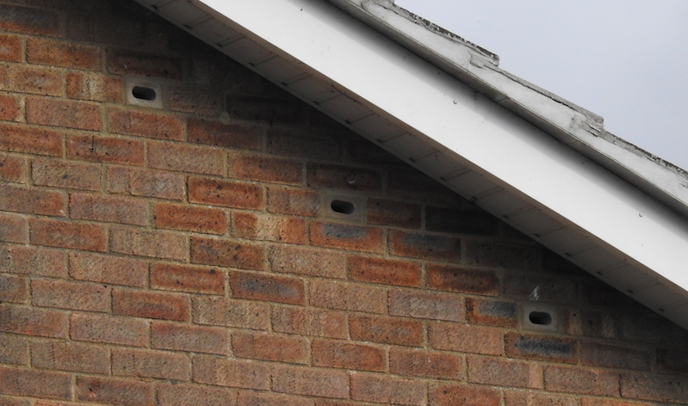
2017: Things that have worked well

Slide 6
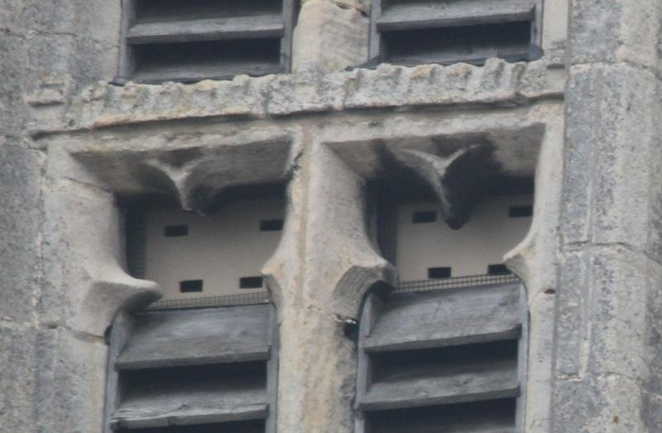
Churches

Slide 7
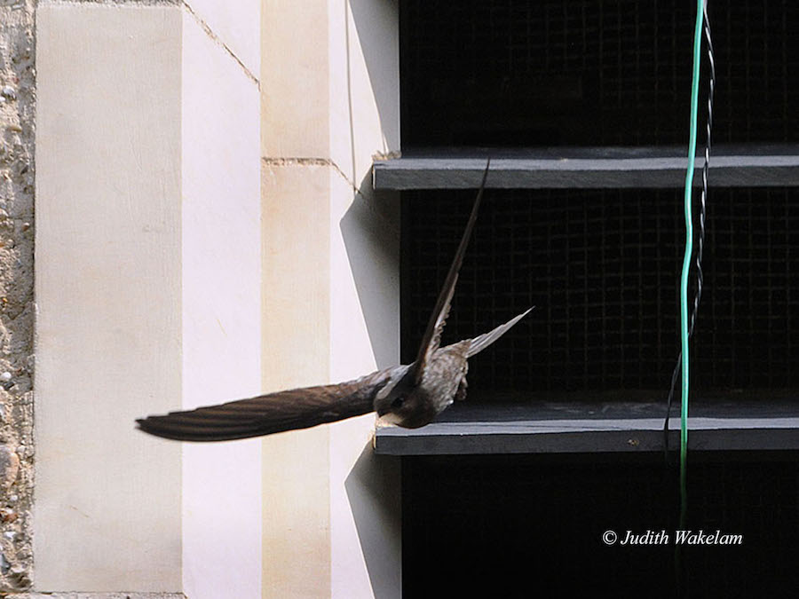
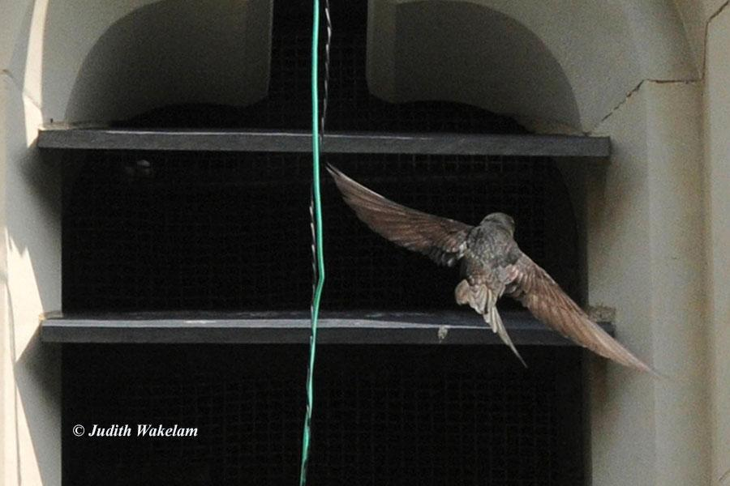
Churches

Slide 8
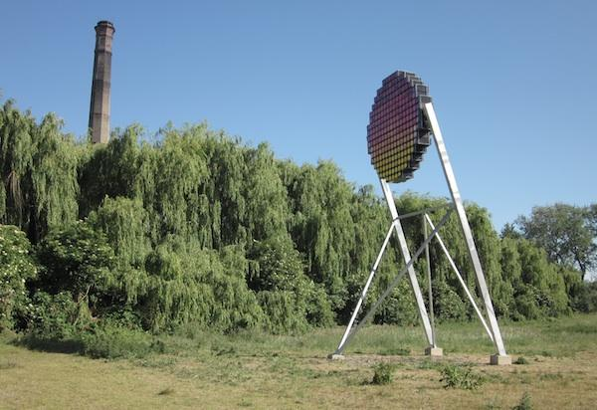
Things that have not worked so well

Slide 9
Two questions
What is the optimum Swift nest box?
  Position
  Design
Where are the limits?

Slide 10
What is optimal?
Maximum occupancy rate
Maximum productivity
Number of opportunities x occupancy rate
Number of opportunities x average productivity

Slide 11
Common advice
Higher than 5 metres
Not on south-facing walls
No obstructions
walls/trees/wires
Better with Swifts already present

Slide 12
Occupancy vs Height
Occupancy
2M 5M 10M

Slide 13
Occupancy vs Height
Potential missed
opportunities
Occupancy
2M 5M 10M

Slide 14
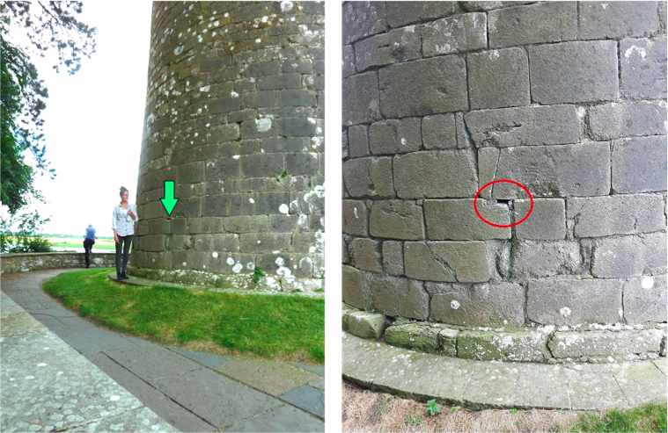
Clonmacnoise photos Birdwatch Ireland

Slide 15
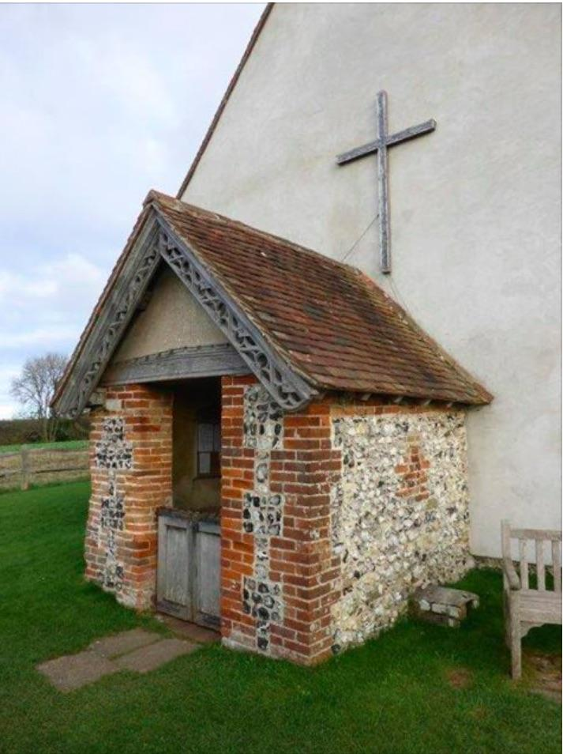
St Huberts Church, Idsworth
Photo Hampshire Swifts

Slide 16
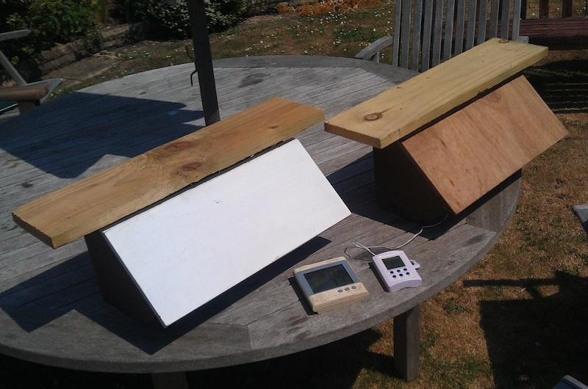
Zeist temperature experiment

Slide 17
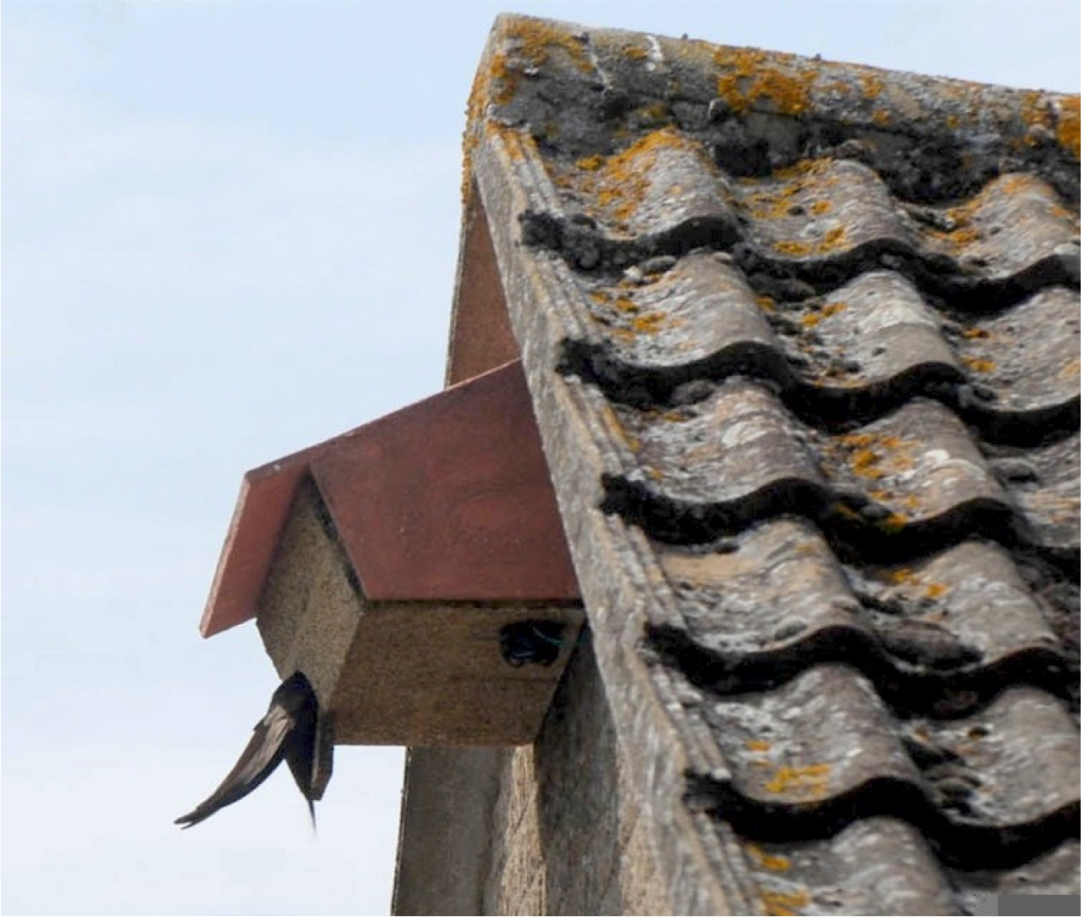
Swiftbox in the sun 2013
2 pairs of
chicks raised
2013 - 2017

Slide 18
Model 30

Slide 19
Nest box parameters
Larger is better?
Headroom?
Entrance size?
Entrance shape?
Entrance orientation?

Slide 20
How do we find the optimum?
Survey existing nest sites
Perform controlled experiments

Slide 21
Tonio Schaub et al 2014
Sample size: 477 nest boxes
Occupied: 116 (24.3%)
Box types: 7 (5 Schweglers, 2 Strobel)
8 Variables:
Box type, no of Neighbouring boxes, absolute height, height relative to roof edge, manner of installation, orientation, box age and city district

Slide 22
Tonio Schaub et al 2014
Conclusions (what Swifts prefer)
Mount boxes a few metres apart
Close to the roof edge
North-facing facades
Above 11M
Schwegler 17 single boxes preferred to Schwegler 17a treble box
External preferable to internal

Slide 23
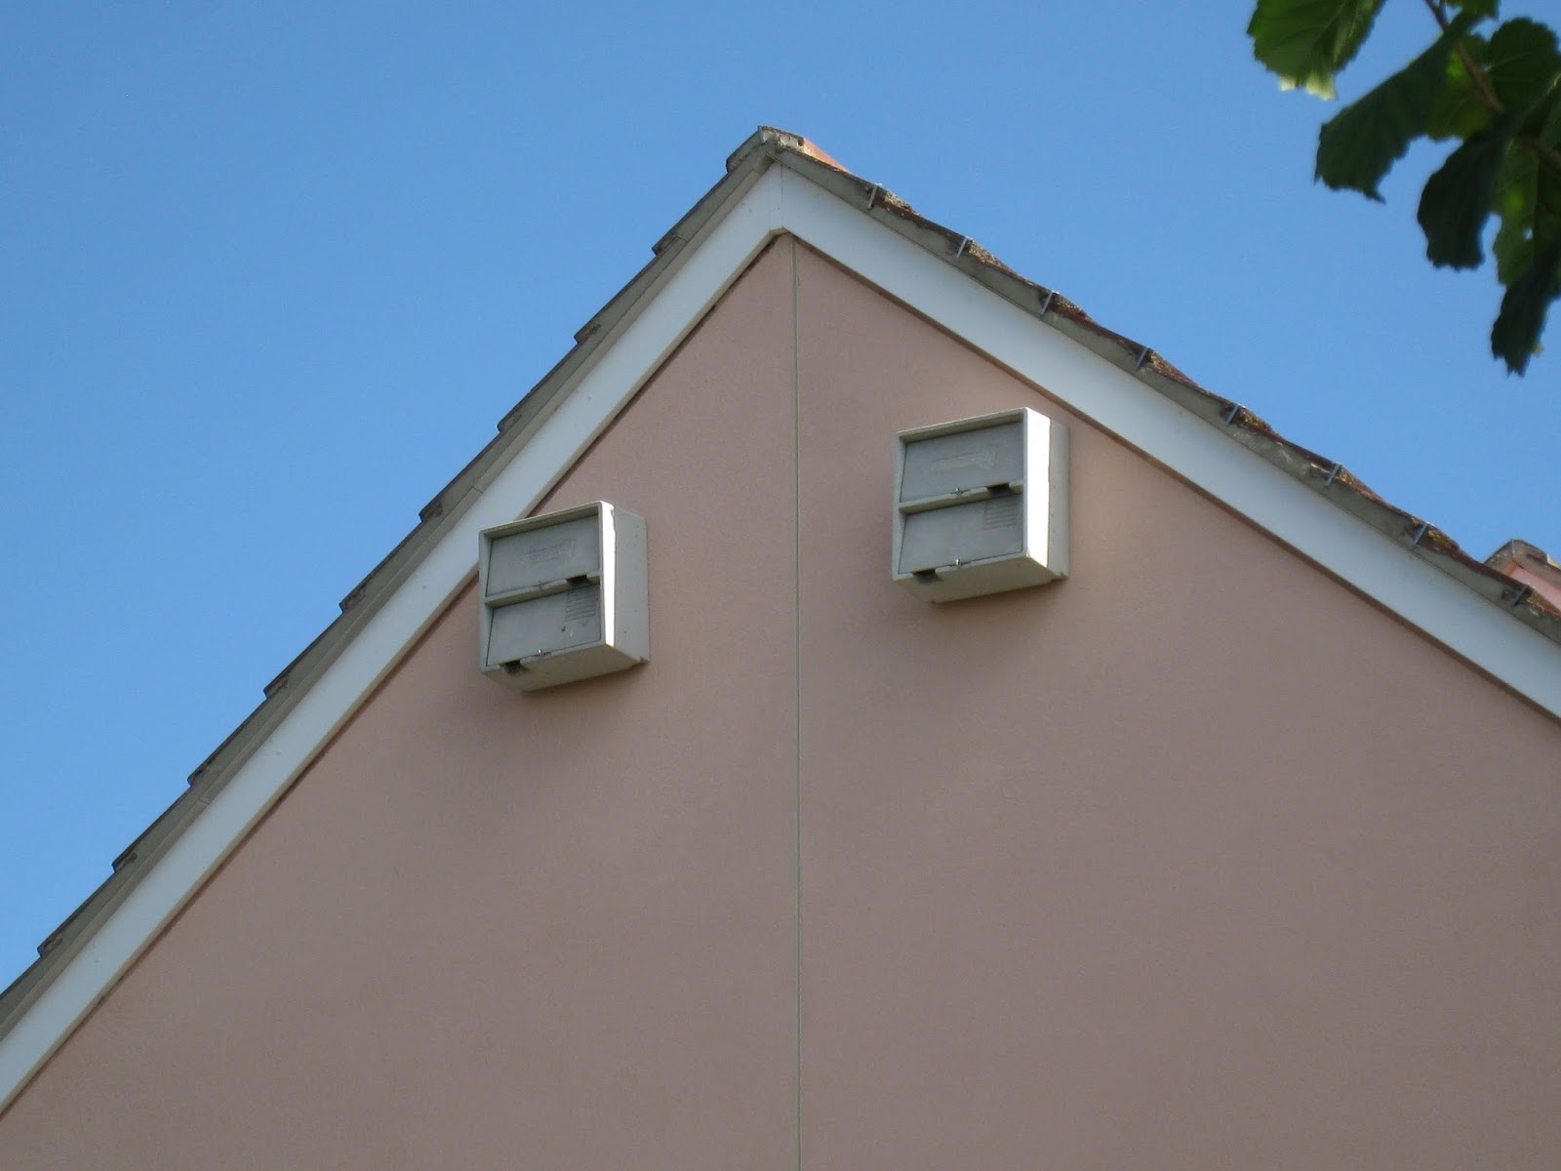
Fulbourn external boxes
Schwegler 1MF

Slide 24
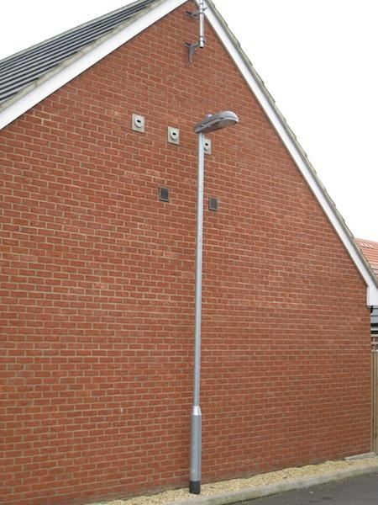
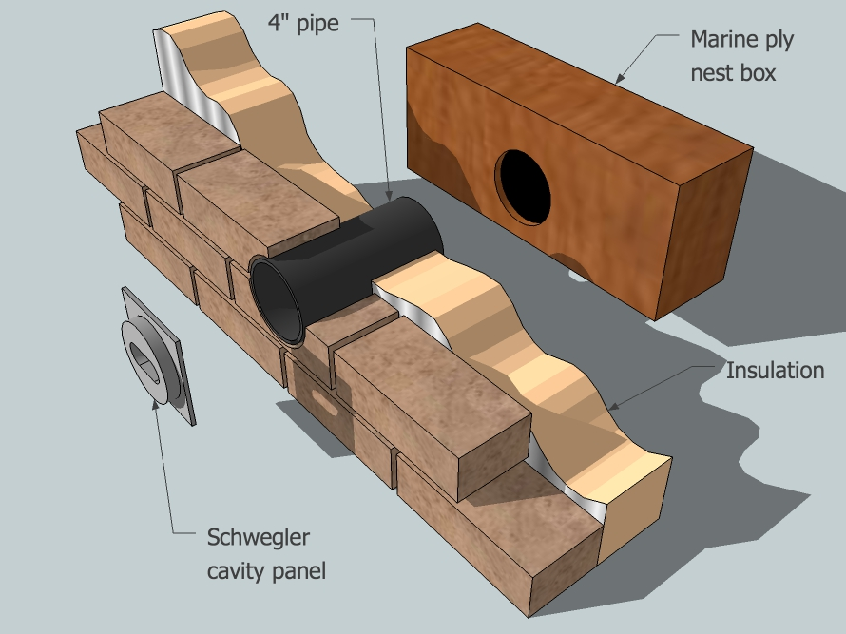
Fulbourn
Internal
boxes

Slide 25
Fulbourn statistics
 |  | 2012 | 2013 | 2014 | 2015 | 2016
Internal | Available | 111 | 139 | 159 | 186 | 186
 | Occupied | 26 | 51 | 72 | 83 | 84
 | %occupied | 23.4% | 36.7% | 45.3% | 44.6% | 45.2%
Schwegler 1MF | Available | 46 | 88 | 98 | 108 | 108
 | Occupied | 1 | 3 | 4 | 4 | 5
 | %occupied | 2.2% | 3.4% | 4.1% | 3.7% | 4.6%
Total | Available | 157 | 227 | 257 | 294 | 294
 | Occupied | 27 | 54 | 76 | 87 | 89
 | %occupied | 17.2% | 23.8% | 29.6% | 29.6% | 30.3%

Slide 26
The problem of confounding factors
Habituation & founder effects
- what do Swifts expect?
Poor randomisation of sample
Small sample size

Slide 27
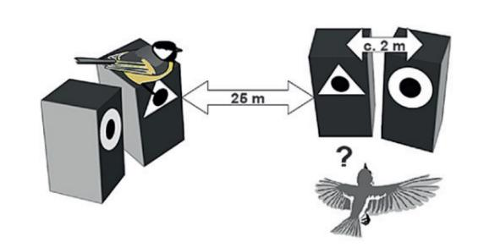
Great Tits and Pied Flycatchers
Seppänen and Fordman 2007 & 2010

Slide 28
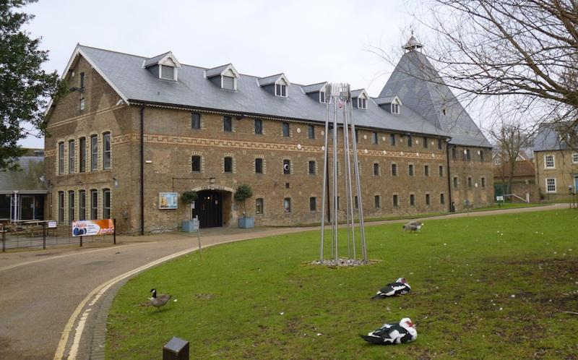
Ely Maltings

Slide 29
Ely Maltings 2009
F1 G1G2G3H1H2H3H4 I1 I2
10 boxes installed 2009

Slide 30
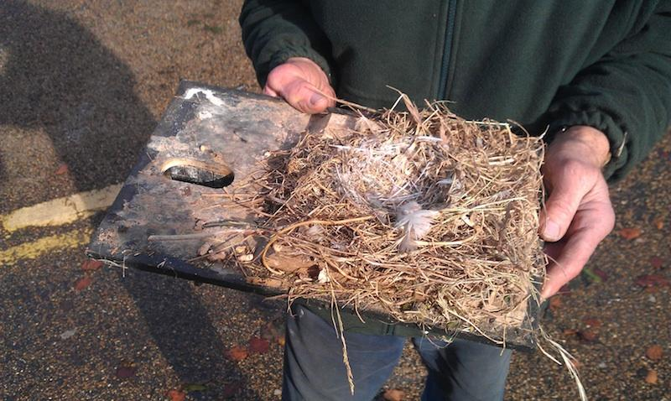
Ely Maltings 2012
F1 G1G2G3H1H2H3H4 I1 I2
10 boxes installed 2009

Slide 31
Ely Maltings 2013
A1 A2 A3 A4 D1 D2 D3 E1 E2 E3
10 boxes installed 2013
F1 G1G2G3H1H2H3H4 I1 I2
10 boxes installed 2009

Slide 32
The Need for
well-designed
Experiments

Slide 33
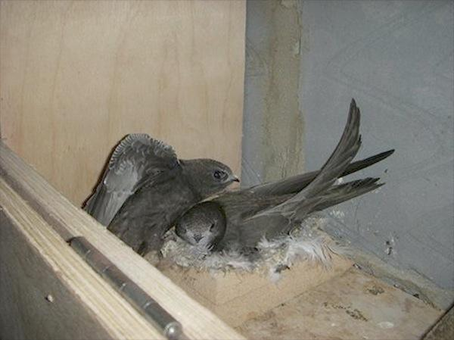
2017: Nest concave statistics:
P = 0.4%
Common odds ratio 4.7
 | Boxes | Occupied | With concave | No concave | P
St Mary’s Ely | 24 | 10 | 7/12 | 3/12 | 10.7%
All Saints Worlington | 18 | 6 | 5/9 | 1/9 | 16.7%
Oxford Museum Tower | 52 | 6 | 3/12 | 3/40 | 12.7%

Slide 34
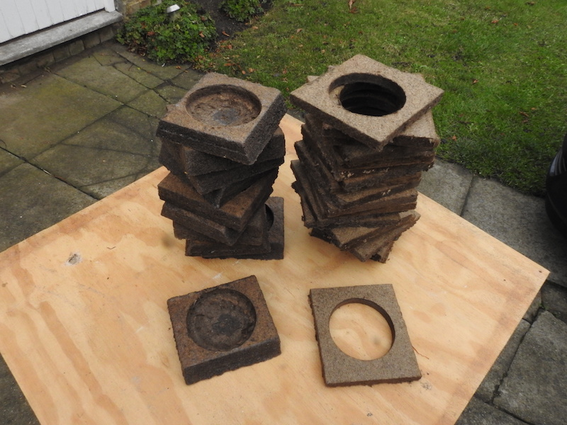
New concave experiment
St John’s church, Bury St Edmunds

Slide 35
Minimum Headroom?

Slide 36
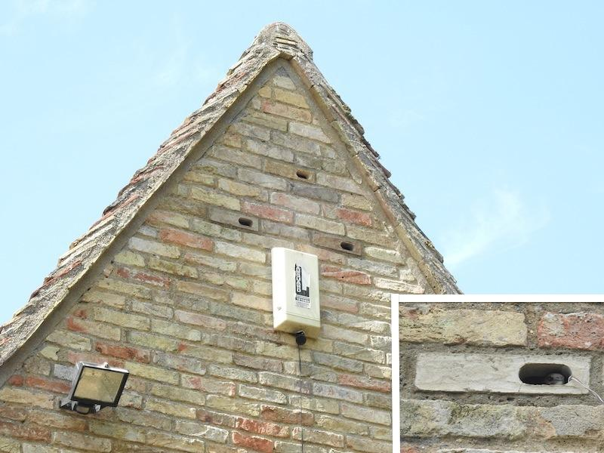
Retrofitted nest boxes

Slide 37
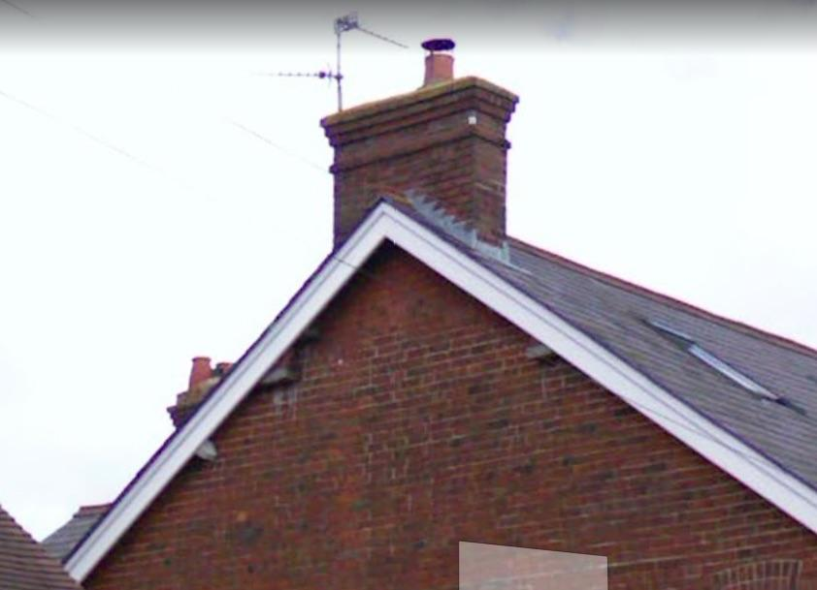
~1980: Chris Mead, 4 Beaconsfield Road, Tring

Slide 38
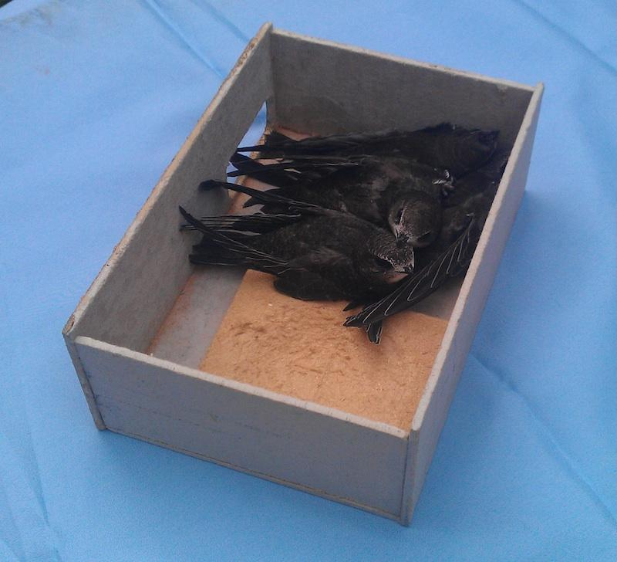
4 Swift
Chicks
Photo:
Judith
Wakelam

Slide 39
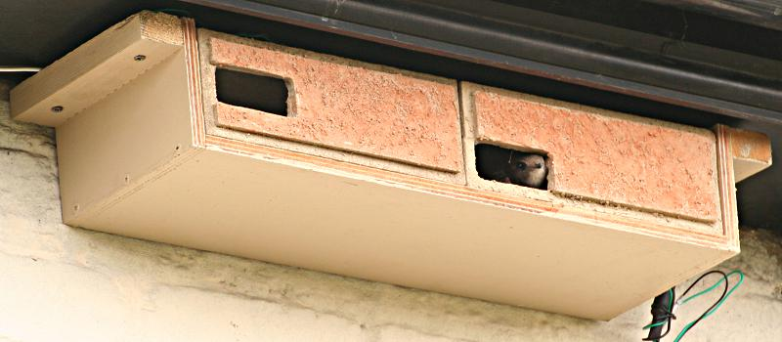
Small box experiment
Floor 15cm x 22cm, headroom 7.5cm
3 pairs of boxes on 3 houses
4 boxes with breeding pairs in 2017

Slide 40
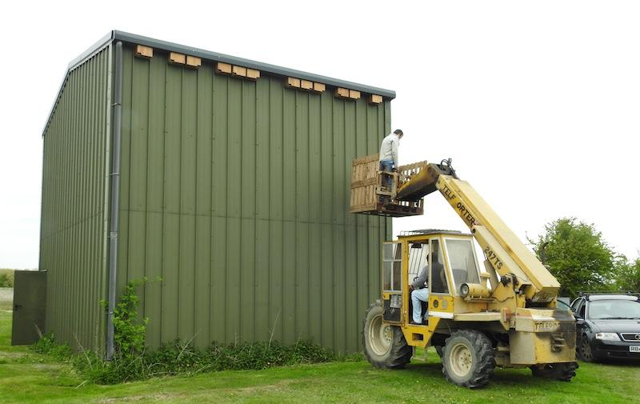
More headroom experiments

Slide 41
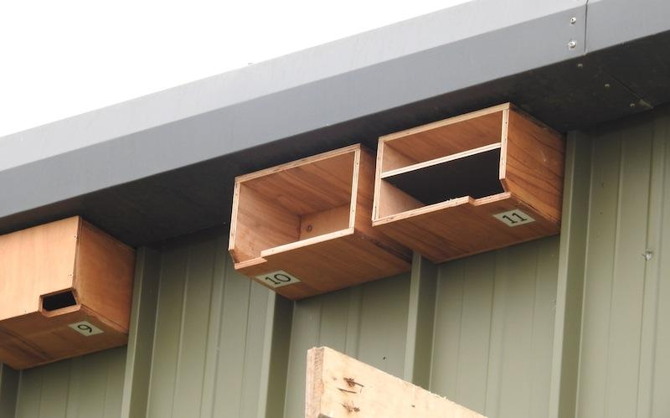
Headroom Experiment

Slide 42
Things we think we know
Spaced out boxes better than dense clusters
Nest concaves are a good idea
  More likely first time breeding
  Less likely to eject eggs
  Higher occupancy rate
65mm x 28mm entrance excludes Starlings

Slide 43
What we don’t know
Do Swifts have a preferred entrance direction?
Do Swifts prefer one entrance shape over another?
How is occupancy rate affected by floor size and headroom?
Does interior size impact on the number of chicks fledged?
Notes:
Cut Paras
Swifts like a dark or light interior?

Slide 44
Questions you can help answer
Floor area: try 2 sizes with a false partition
e.g. compare 30cm x 10cm with 30 cm x 15cm or 30cm x 15cm with 25cm x 15cm
Headroom: try 2 heights with a false ceiling
e.g. 7.5cm and 15cm
Entrance shape: Compare rectangle with obround
Dark vs light (unpainted) interiors

Slide 45
Methodology
Keep everything constant except for 1 parameter.
You are forced to put boxes in different positions, so alternate boxes to reduce as a confounding factor.

