Slide 1

Some aspects of the breeding biology of the swifts of
County Mayo, Ireland
Chris & Lynda Huxley

Slide 2

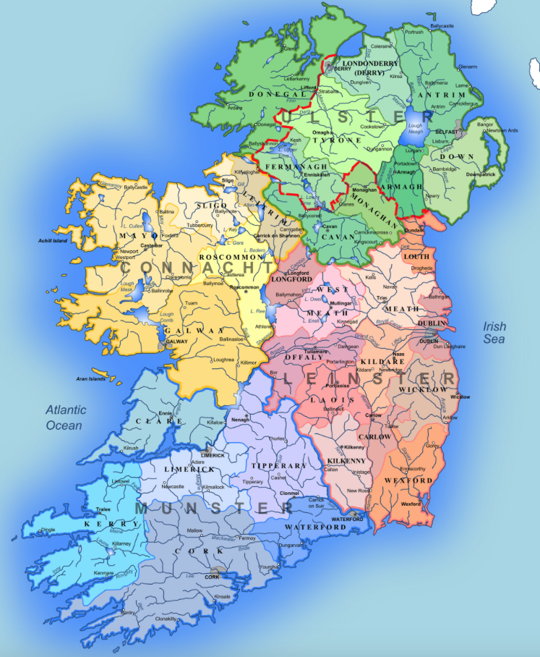

Slide 3
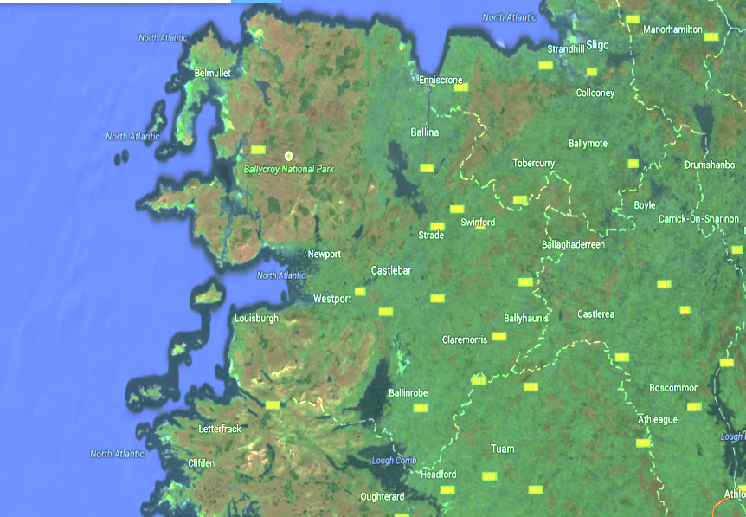
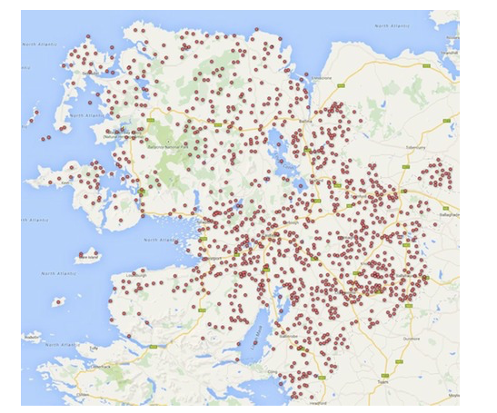
3rd largest Irish county covering 5,585 square kilometers (after Cork and Galway), and with a reputation for being one of the wetter western counties, a total of 1116 wetland sites have been identified in the county.

Slide 4
Project Objectives
To investigate the breeding biology of swifts in County Mayo
To assess the impact of weather on parental feeding patterns
To determine the likelihood that inclement weather significantly affects the adults’ ability to rear young
To assess the possibility that low population numbers are a result of weather conditions and proximity to the Atlantic Ocean.

Slide 5
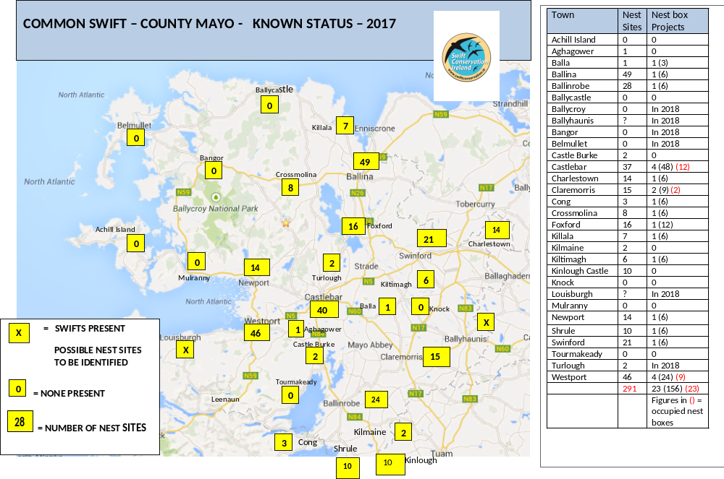

Slide 6
Population Information - 1
Information on swift numbers & distribution in Mayo until recently
General belief that swifts are less abundant in the west of Ireland because of the weather and proximity to the Atlantic
But, as long ago as 1890, W.H.Good in his “Notes on the Birds of County Mayo” wrote about swifts :
“ “Rare in the West of Ireland” is wholly incorrect”
Comment in 1976 Atlas of Breeding Birds that ”impressions of an increase” was noticeable in1932 was repeated by R. F. Ruttledge in 1989 “Birds in Counties Galway and Mayo - an Account of their Status and Distribution”
The various atlases since 1989 have probably reflected more the distribution and abundance of observers rather than that of swifts
The latest Atlas (2013) reports a 46% decline in Ireland’s swifts.

Slide 7
Population Information - 2
Lack’s 1956 statement that “swifts rarely breed on the western coasts” because “the weather is usually wet or windy” and because “the prevailing winds carry no insects” was presumably an assumption and not supported by evidence
We have concluded that Mayo has had a reasonable population of swifts for at least the last 130 years and that there has never been a careful, systematic attempt to quantify this, until now
  Our survey work has shown that, prior to the erection of any nest boxes, Mayo had around 290 occupied ‘natural’ nest sites
  The establishment of nest boxes has, within the first six years, increased this figure by 8%
  We conclude that weather and proximity to the Atlantic Ocean are not limiting factors for Mayo’s swifts.

Slide 8
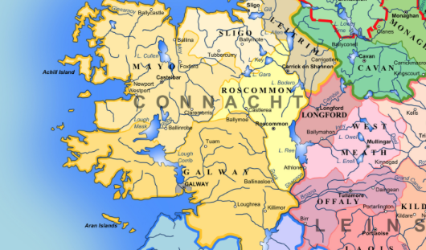
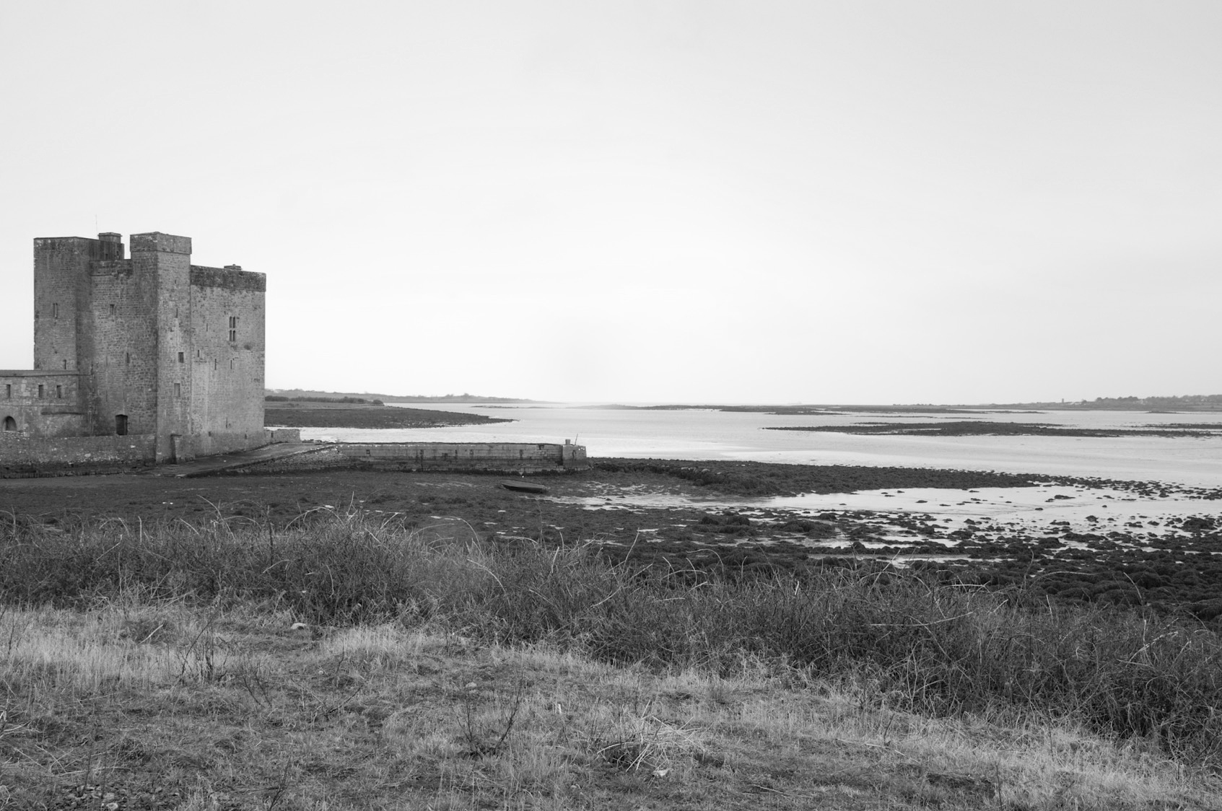
“the north and west coasts of Ireland are two of the windiest areas in Europe”. Met Eireann

Slide 9
Methods
4 triple cavity Schwegler 17a boxes erected 2012 at Galway-Mayo Institute of Technology in Castlebar (GMIT)
IR cameras in all 12 nest boxes
Activity in some occupied boxes recorded 24 hours per day
Several thousand hours of recording available
Recordings viewed later and feeding activity recorded on data sheets
Data transferred to Excel spreadsheet
Weather data from Met Éireann added to spreadsheet
Analysis of data (2,011 feeding events) using Excel.

Slide 10
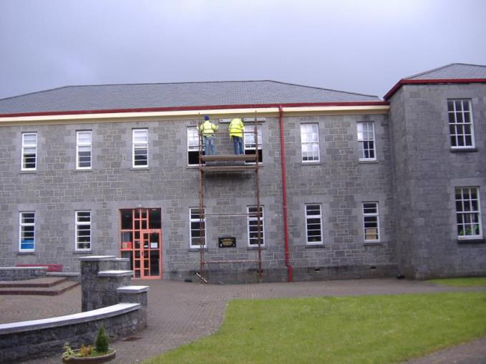

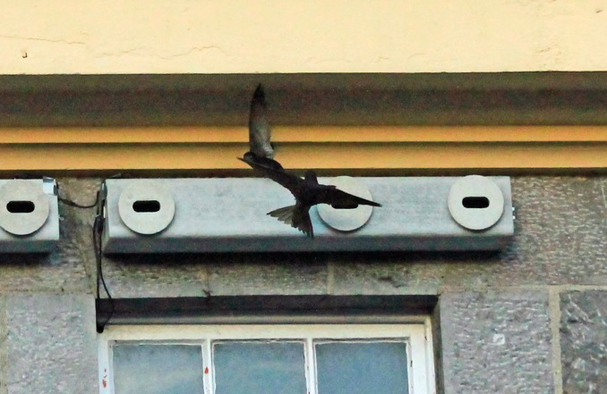

GMIT (now third level college) building dates from 1860 was St Mary’s District Psychiatric Hospital

Slide 11

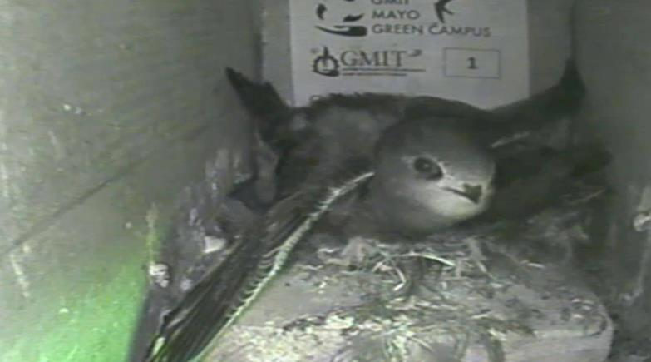

Slide 12
Some assumptions and weaknesses
No information available on food supply and its relationship to weather and season
Amount of food brought in each bolus is unknown
Only three years of data analysed so far
Weather data are daily records, more detailed (hourly?) data would be likely to show clearer effects
It is assumed that chicks have received sufficient food to ensure adequate weight on fledging

Slide 13
Weather summary
 | Rainfall (mm) | Mean min temp (degrees C) | Mean max temp (degrees C) | Mean temp (degrees C) | Mean windspeed (knots)
May | 91 | 7 | 16 | 12 | 8.2
June | 82 | 10 | 18 | 14 | 7.9
July | 87 | 12 | 20 | 16 | 7.4
August | 94 | 12 | 19 | 16 | 7.6
n.b. Windspeed of 7 – 10 knots is Beaufort Force 3 “Gentle Breeze”.

Slide 14
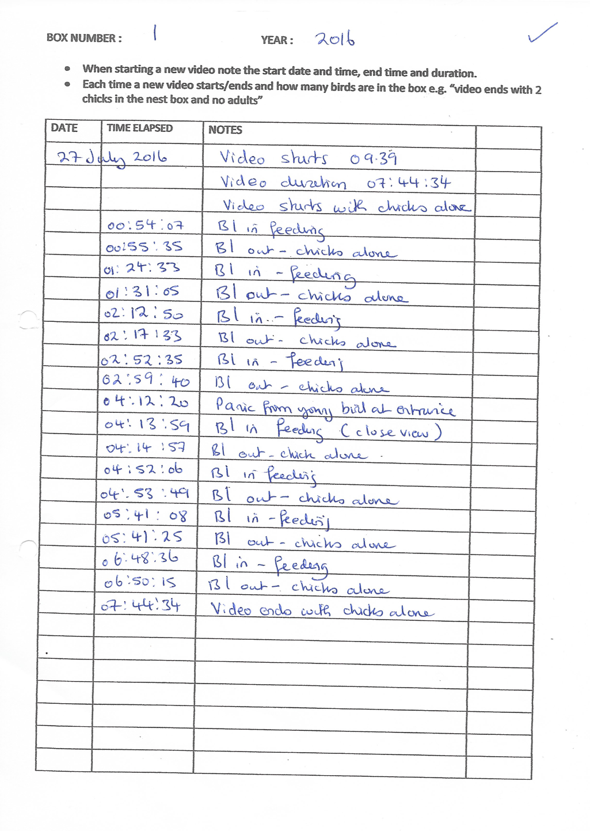
Sample data sheet

Slide 15
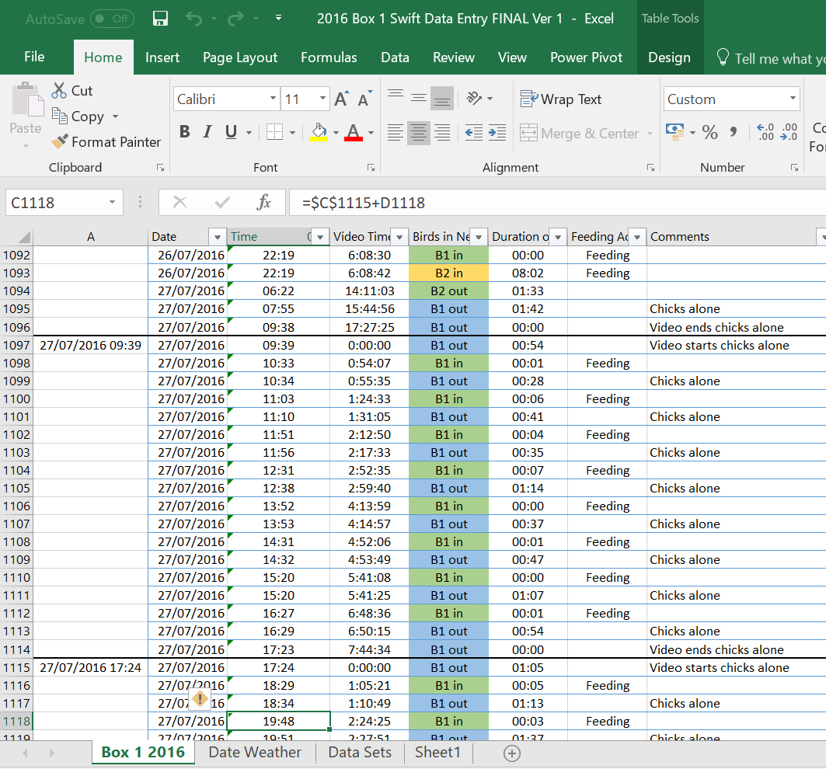
Sample excel spreadsheet

Slide 16
Results
Fledging periods
Number of chicks with known fledging periods = 17
Range of fledging periods = 39 – 46 days
Mean fledging period = 41.6 days

Slide 17
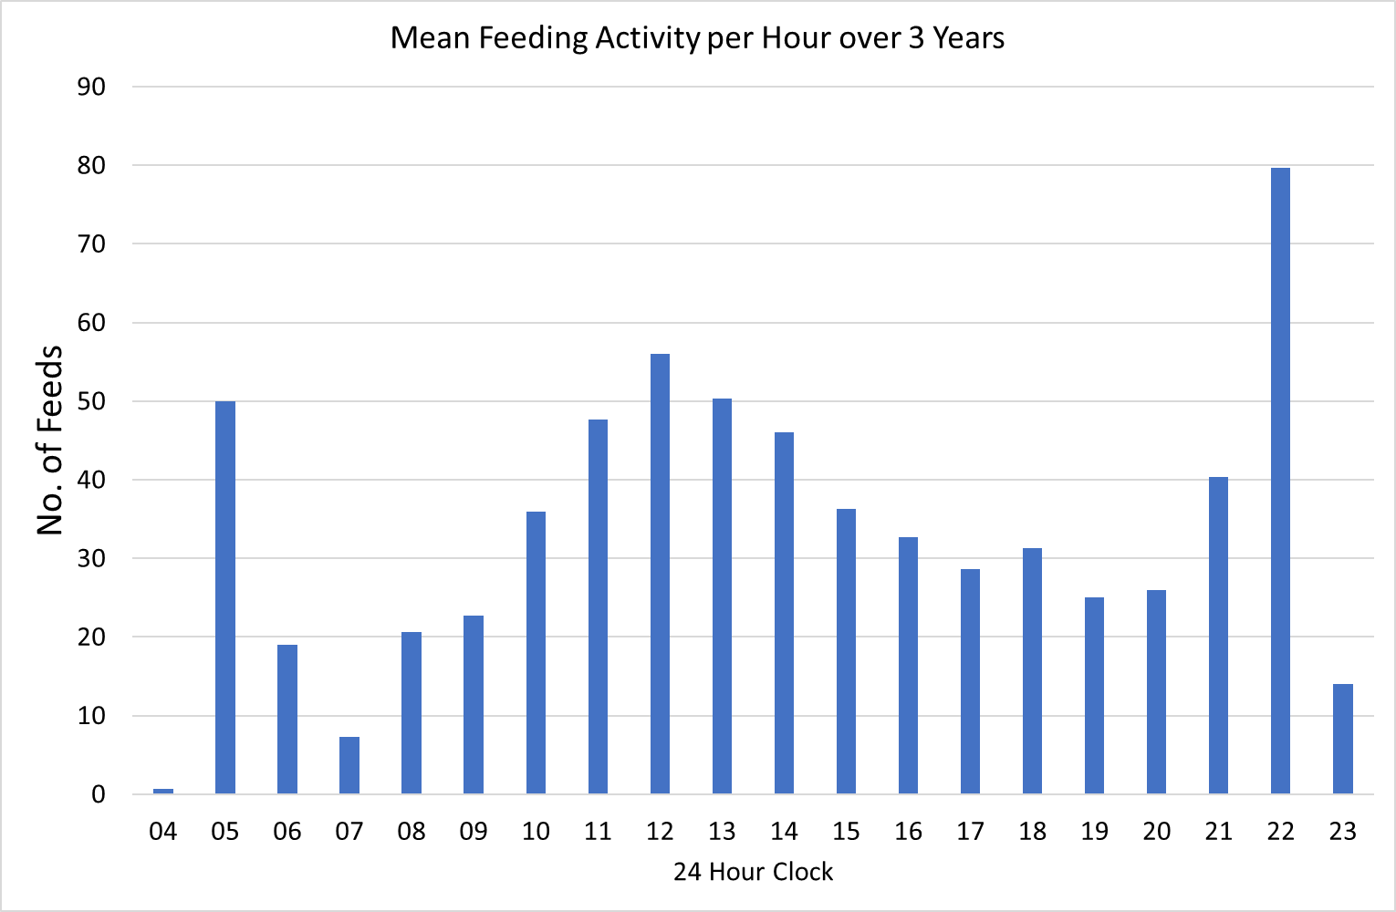
Daily pattern of feeding activity

Slide 18
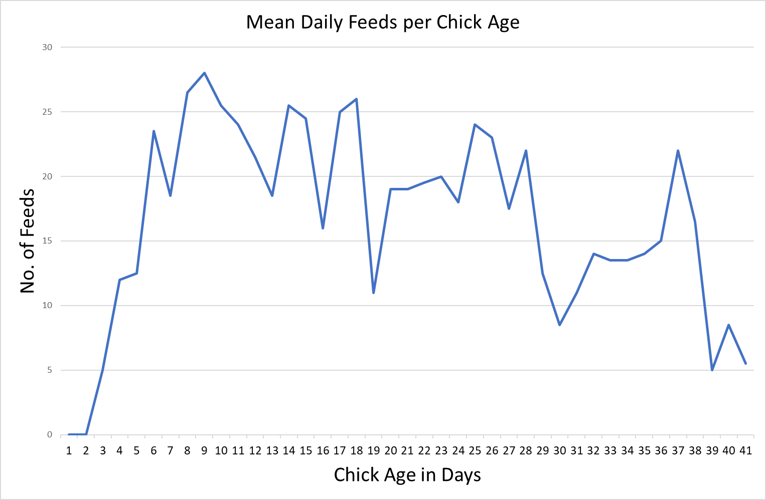
Feeding activity in relation to age of chicks

Slide 19
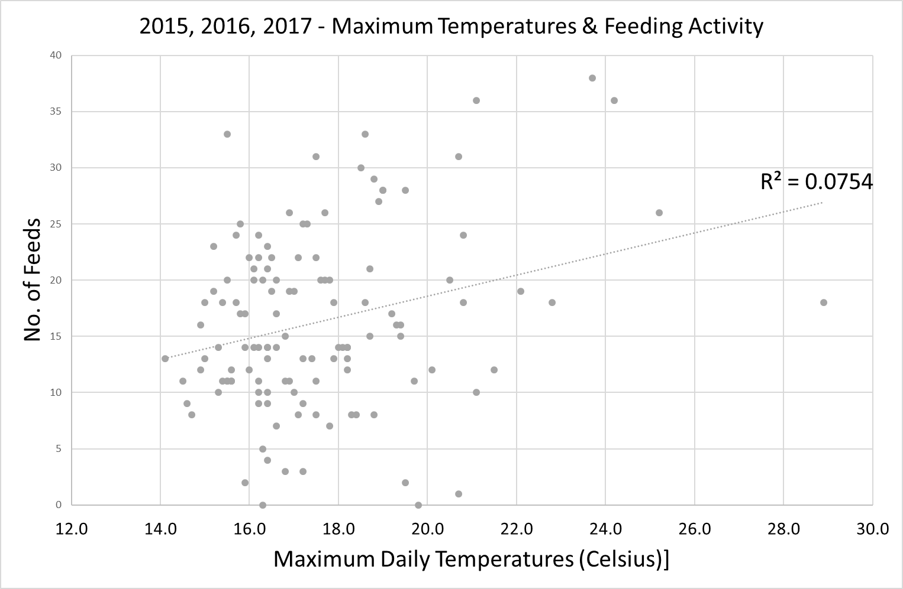
Feeding activity and temperature

Slide 20
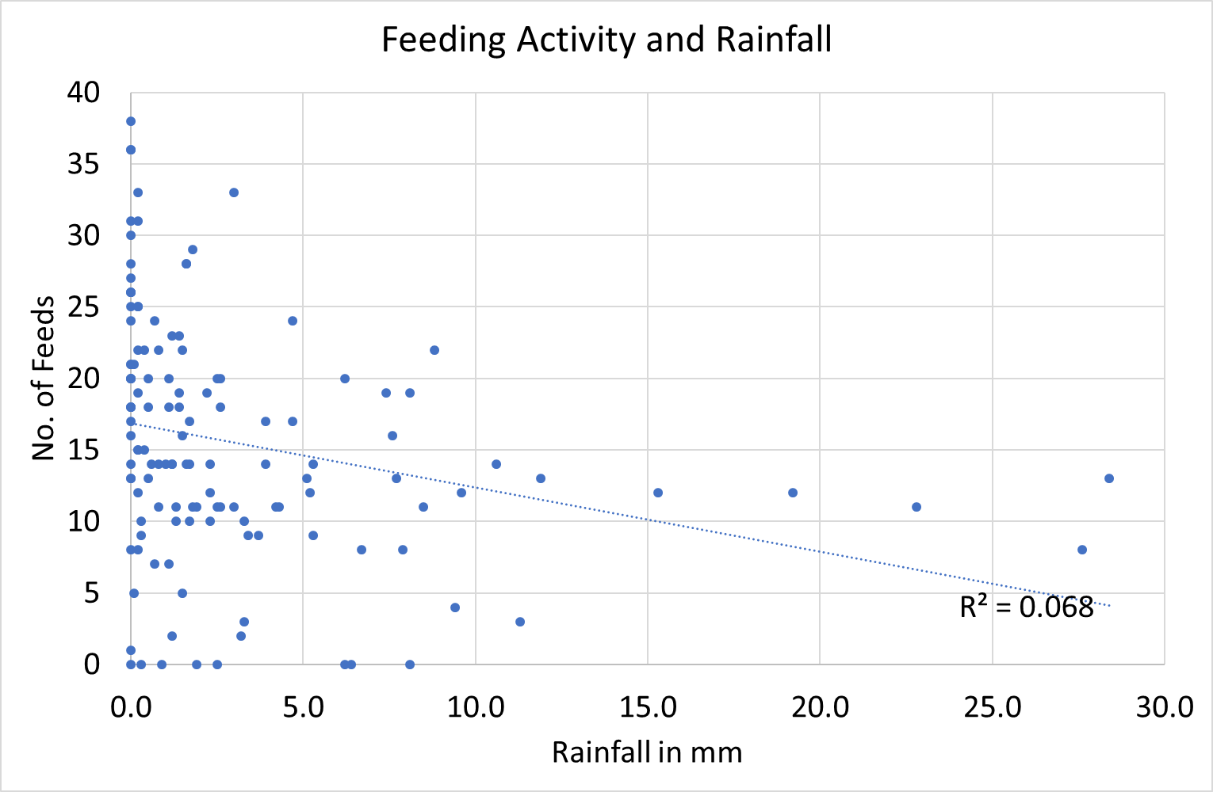
Feeding activity and rainfall

Slide 21
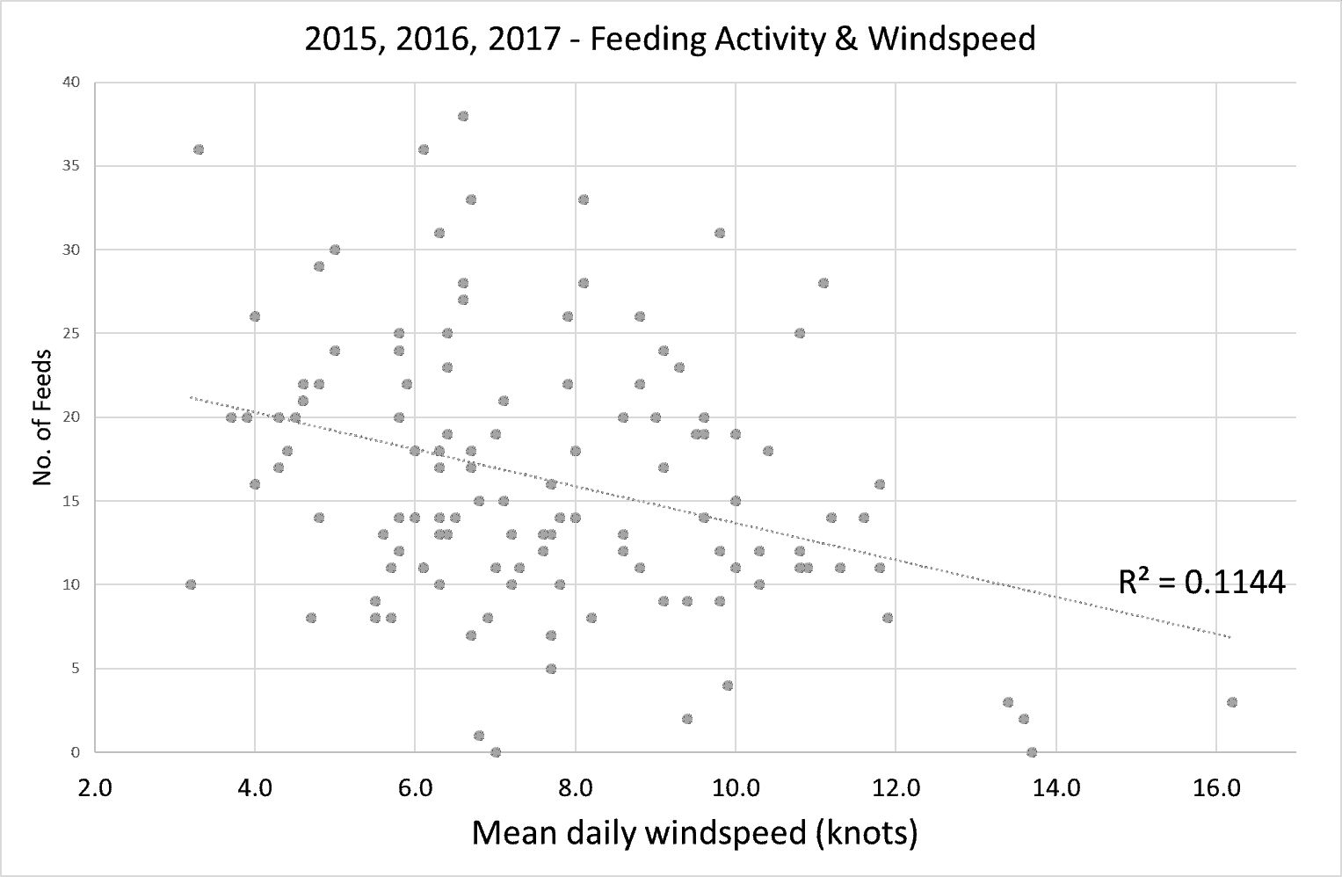
Feeding activity and windspeed

Slide 22
Some tentative conclusions
While bad weather may temporarily prevent Mayo’s swifts from optimal chick feeding frequency, the rapid changes in weather are such that the overall impact is not significant
The presence of abundant food sources, especially in association with the extensive wetlands in Mayo, probably accounts for the local swifts’ ability to fledge within six weeks of hatching
We do not subscribe to the view that bad weather stimulates the adults to eject eggs from the nest, but think that these are accidental events caused by clumsiness
The population decline in the West of Ireland has not been caused by poor breeding performance as a result of bad weather.

Slide 23
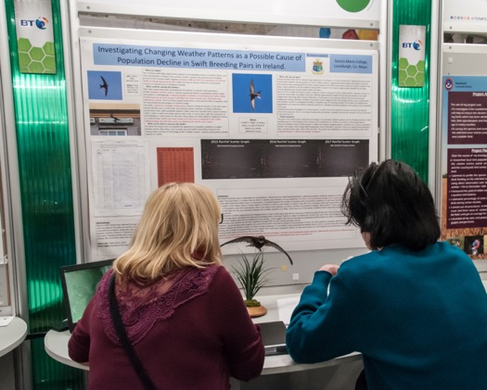
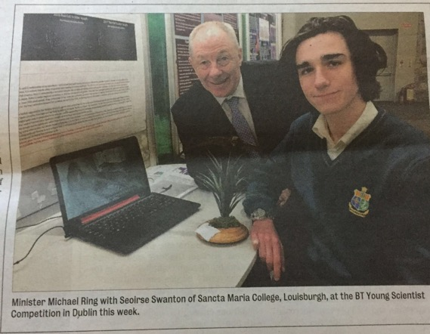
Acknowledgements
A number of individuals have contributed to this work in various ways, especially :
Brian Cahalane for helping with initial setting up of nest boxes and camera info.
Terence McConway has provided essential computer expertise
Deaglan O’Riain has developed the use of Excel in Power Query for us
Videos have been examined with the assistance from GMIT student’s Angela Boyce and Gita Buse but also particularly by Seoirse Swanton and Mary Roberts
There are more questions than answers!

