Slide 1
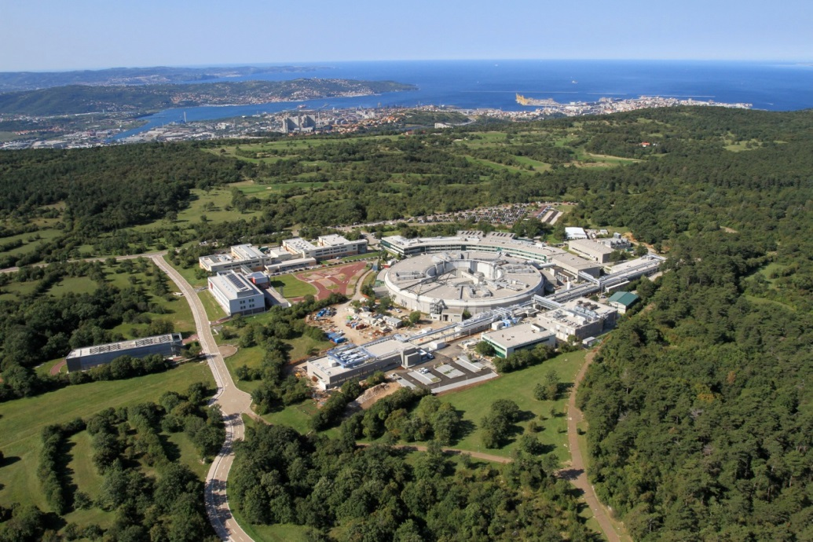
Elemental distribution in feathers of the Common Swift: an x-ray fluorescence study
K. C. Princeª, A. Gianoncelliª, H-J. Shin^{a,b}, I. Zamboni^{c}, M. Jaksic^{c}, M. D. de Jonge^{d}, M. W. M. Jones^{d,e}, M. Sola^{f}, S. Pesaro^{g}
^{(a)} Elettra – Sincrotrone Trieste, Basovizza, Trieste, Italy. ^{(b)} Pohang Light Source, Pohang, South Korea. ^{(c)} Ruder Boskovic Institute, Zagreb, Croatia. ^{(d)} Australian Synchrotron, Clayton, Melbourne, Victoria, Australia. ^{(e)} Faculty of Health and Institute of Health and Biomedical Innovation, University of Technology, Brisbane, Australia. ^{(f)} Liberi di Volare, Strada per Fiume 527, Trieste Italy. ^{(g)} University of Udine, Udine, Italy.

Slide 2
Motivation
Chemical analysis of bird feathers is used to monitor environmental pollution.
Advantages: feathers are dead protein, and so are a “snapshot” of heavy metal content in the diet of the bird when the feather was grown. The protein, keratin, has a high sulfur content (cysteine) and so concentrates metals. Non-intrusive.
However: sample is usually destroyed (unsuitable for museum and historical feathers).
Little is known of the distribution of elements within the feather. Can we learn more?
Goal: examine the microscopic distribution of elements in feathers.
Compare microscopic images of feathers from juveniles, adults and birds
raised in captivity.
S. Valladares et al, “Evaluating cleansing effects on trace elements and stable isotope values in feathers of oiled birds,” Ecotoxicology 19 (2010) 223.
J. L. Lavers et al, “Linking at-sea mortality of a pelagic shearwater to colonies of origin using biogeochemical markers,” Mar. Ecol. Prog. Ser. 491 (2013) 265.
S. Jerez et al, “Concentration of trace elements in feathers of three Antarctic penguins: Geographical and interspecific differences “ Environmental Pollution 159 (2011) 2412.

Slide 3
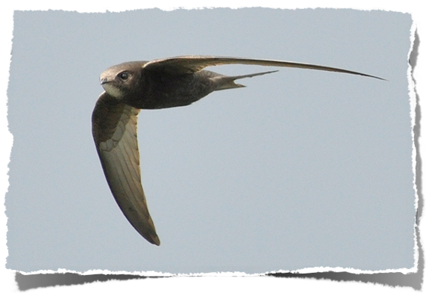
Samples
Feathers were obtained from the common swift (apus apus). Supplied by the bird recovery centre Liberi di Volare in Trieste.
Three kinds of feather examined:
Adults, who have migrated to Africa several times.
Juveniles, young birds born in Trieste, but have not yet reached maturity
Raised in captivity, nestlings fallen from their nest before first flight.

Slide 4
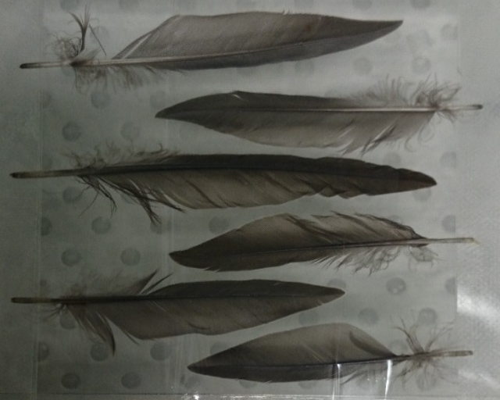
Methods
Analytical non-destructive methods
PIXE elemental mapping ➔ Ruder Boskovic institute, Zagreb, Croatia
Hard X-rays XRF elemental mapping ➔ XFM beamline @ Australian Synchrotron
(Melbourne, Australia)
Soft X-rays XRF elemental mapping ➔ TwinMic beamline @ Elettra Synchrotron
(Trieste, Italy)
Basic method: feathers irradiated with a
small spot of high energy x-rays.
The elements present emit lower energy
x-rays characteristic of the elements present.
These are measured. The spot is scanned and
the map of the low energy x-rays shows which
elements are present and their concentration.

Slide 5
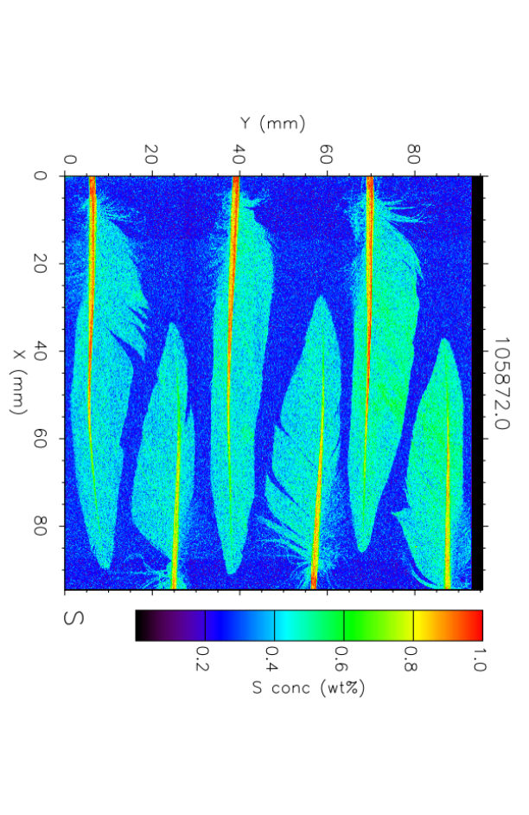
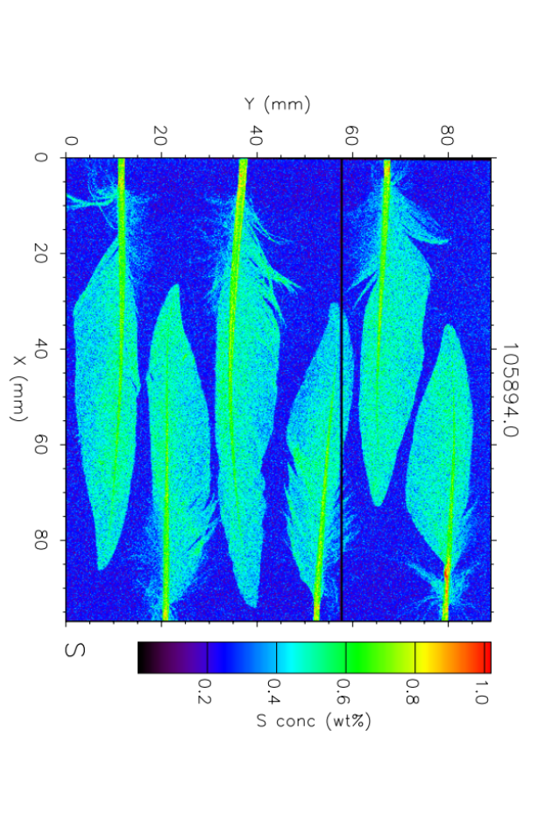
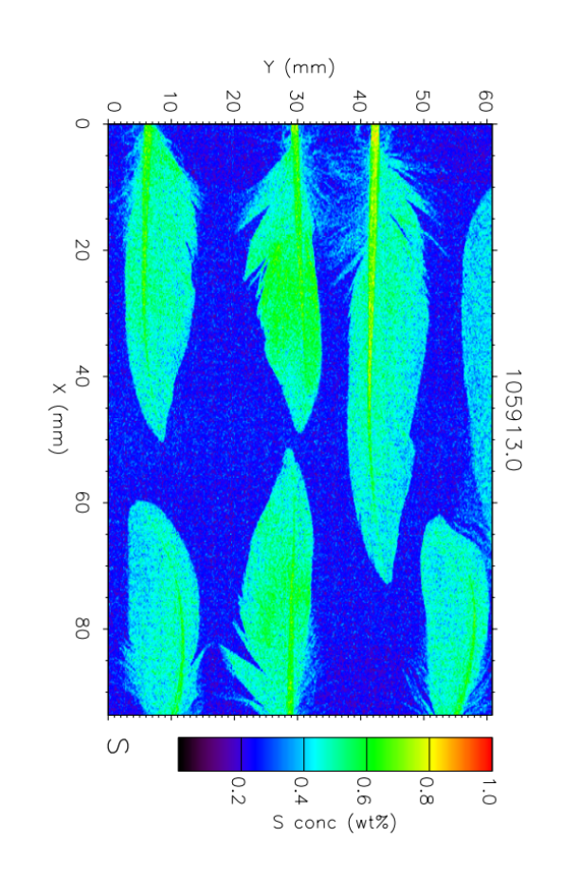
XRF measurements
Sulfur
Adult
Juvenile
Captivity
Same concentration of Sulfur
in all type of feathers

Slide 6
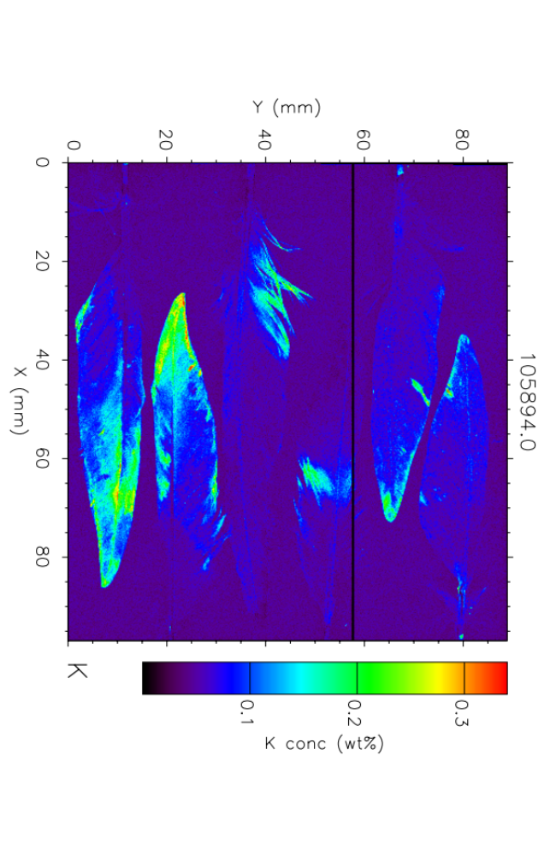
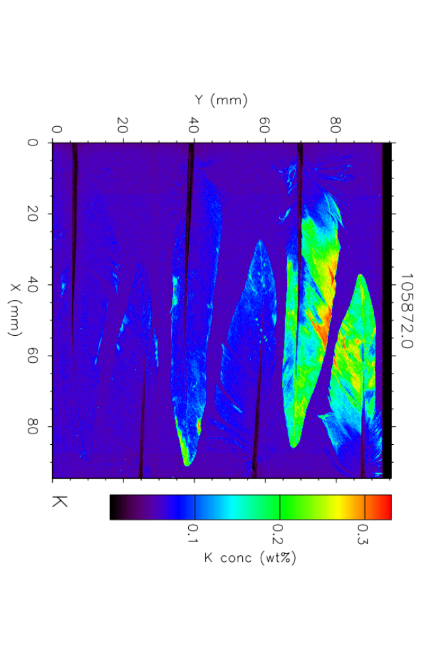
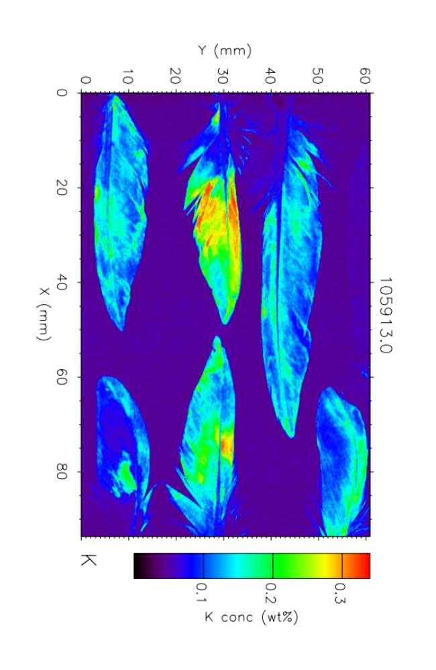
XRF measurements
Potassium
Adult
Juvenile
Captivity
Captivity
Same concentration of Potassium
in all type of feathers, even though
K seems more uniformly distributed in
captivity samples.

Slide 7
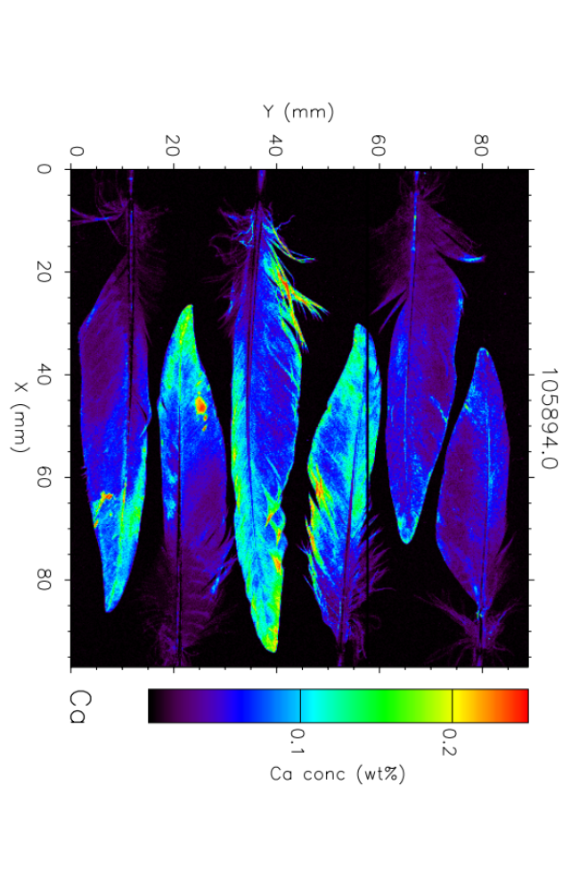
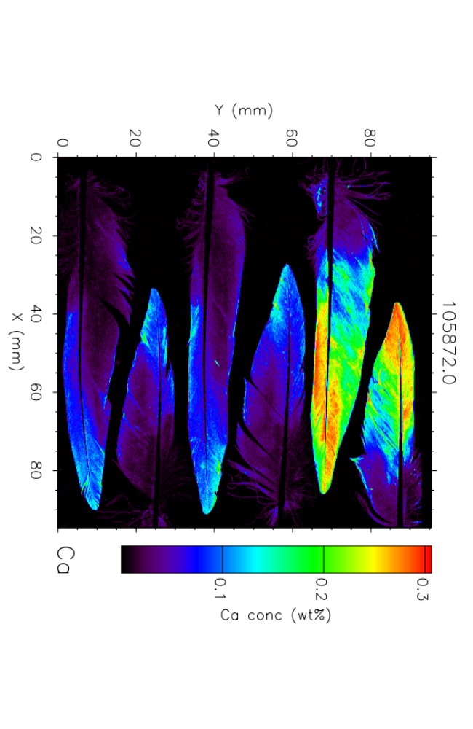
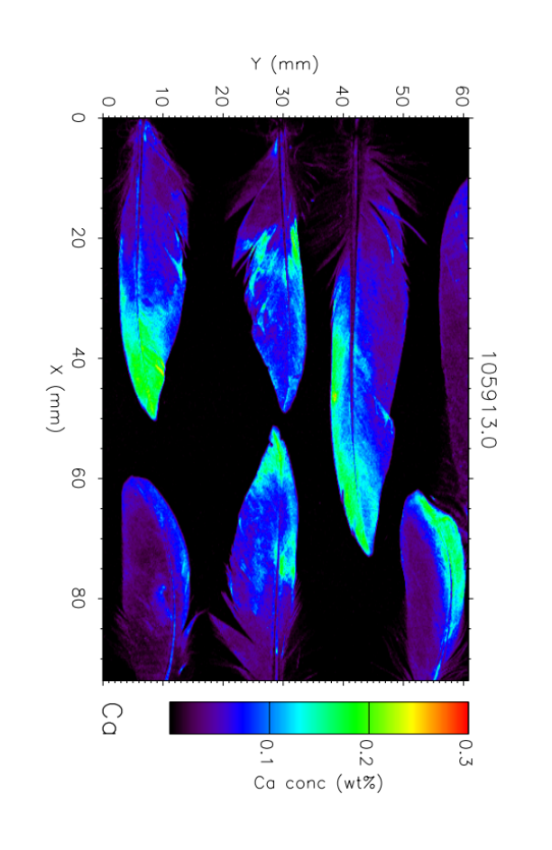
XRF measurements
Calcium
Adult
Juvenile
Captivity
More Ca in adult feathers, less in juvenile and in Captivity ones.

Slide 8
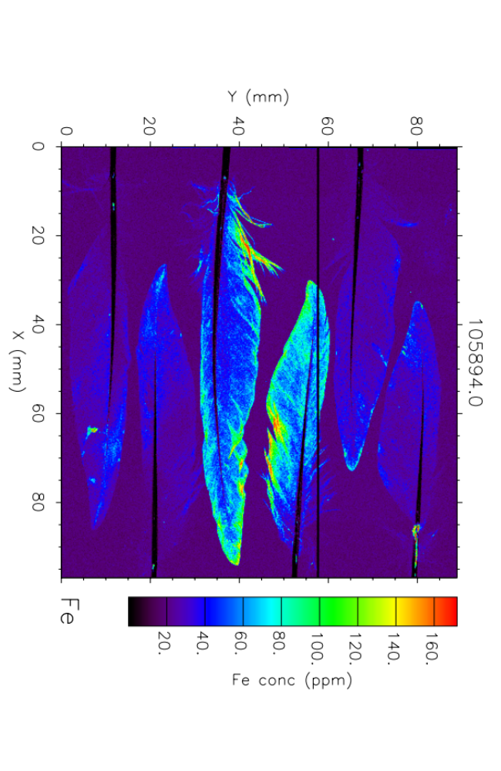
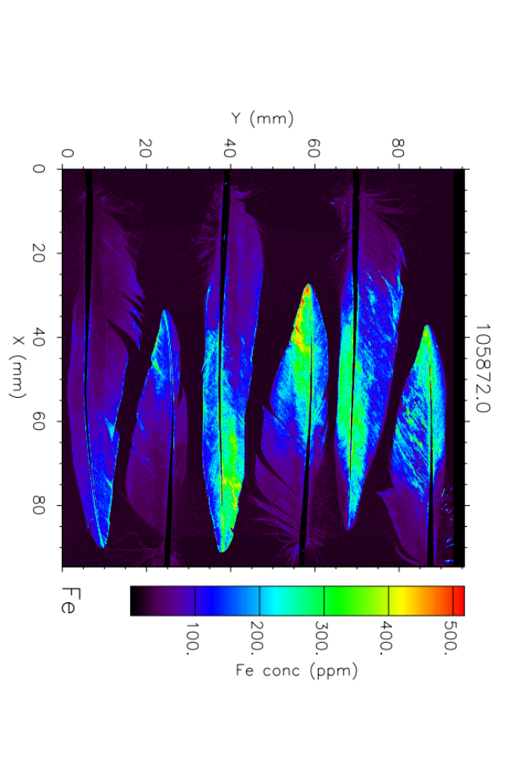
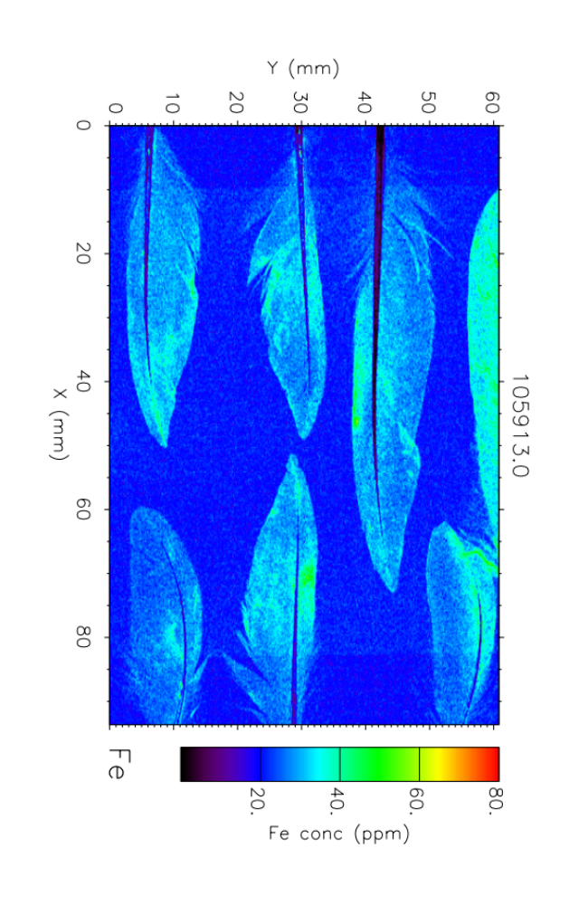
XRF measurements
Iron
Adult
Juvenile
Captivity
Fe is present in diffuse and particulate form in adult feathers, a little less in juveniles ones and even less frequent in feathers of birds raised in captivity

Slide 9
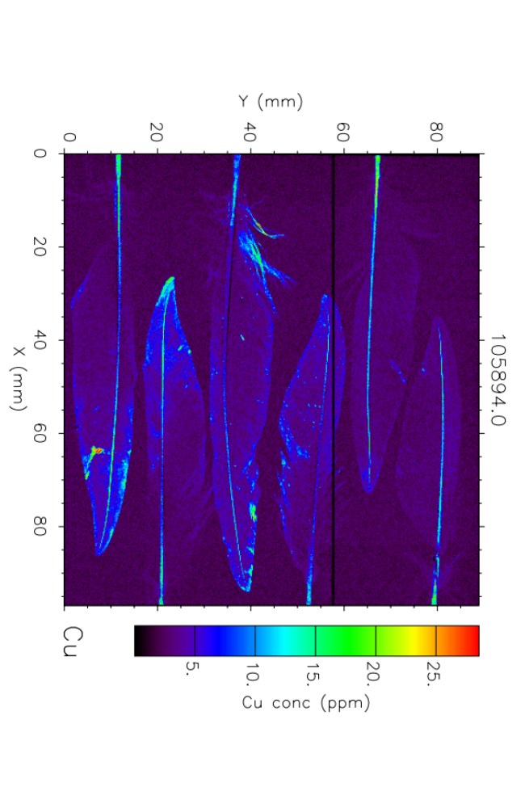
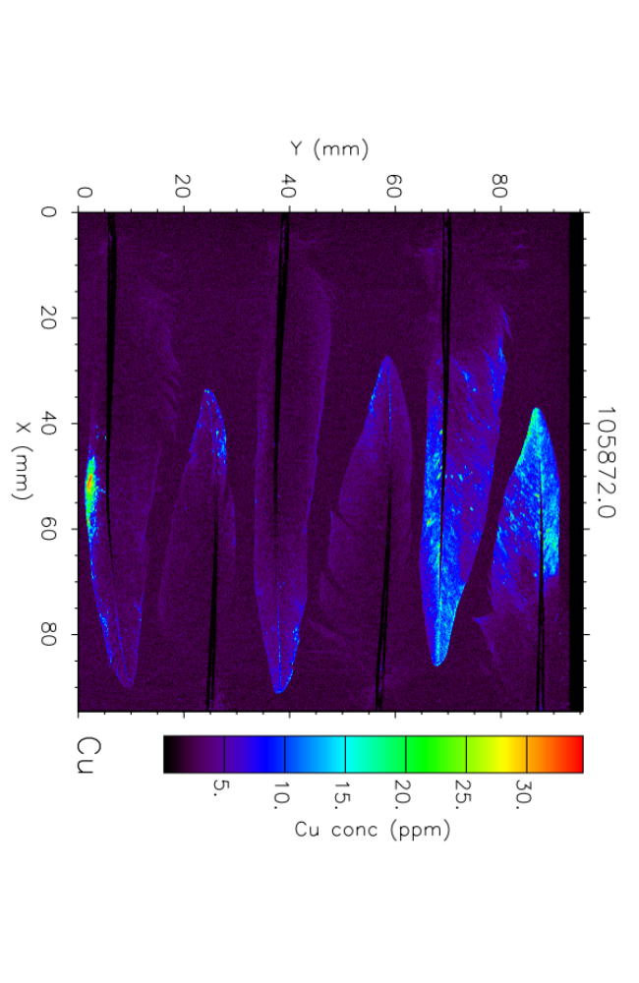
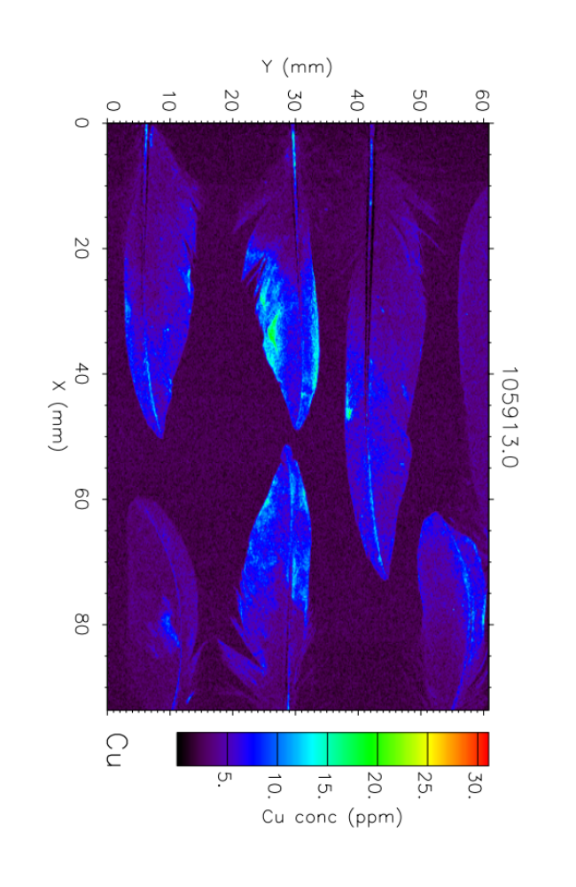
XRF measurements
Copper
Adult
Juvenile
Captivity
Cu is present as particulate in adult feathers, a little less in juveniles ones and even less frequent in feathers of birds raised in captivity

Slide 10
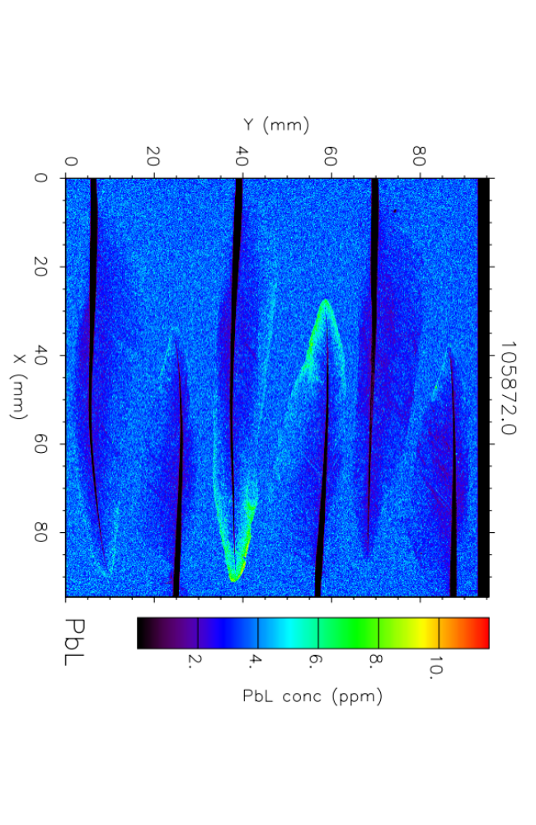
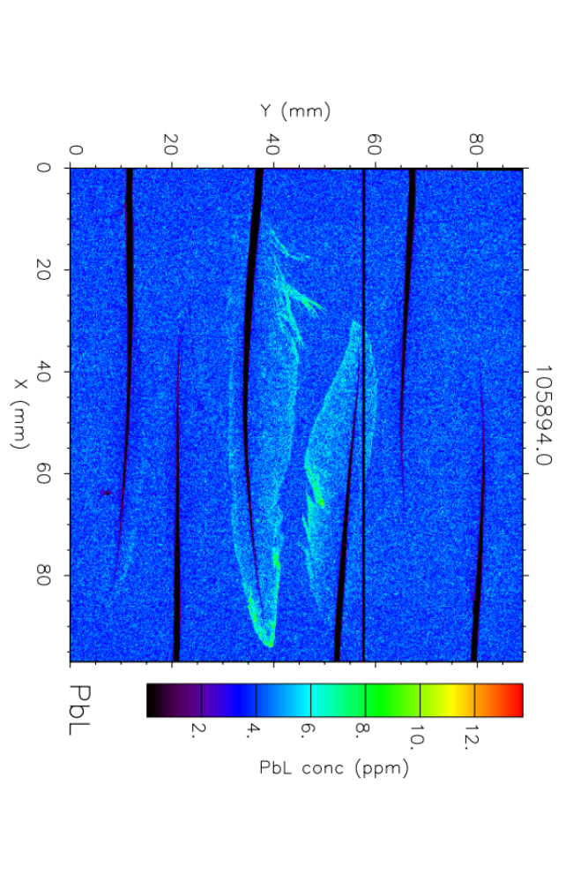
XRF measurements
Lead
Adult
Juvenile
A little bit more Pb in adult feathers compared to Juvenile ones
No Pb found in Captivity (or anyway below detection limits)

Slide 11
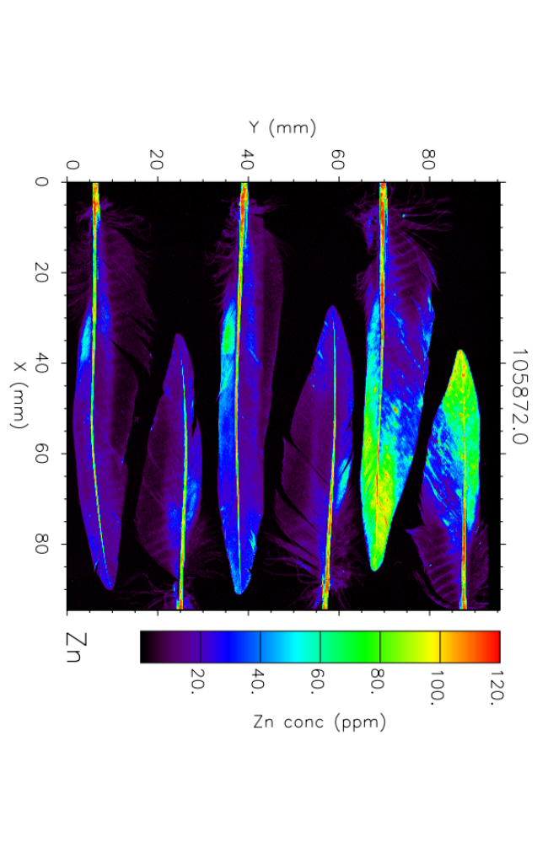
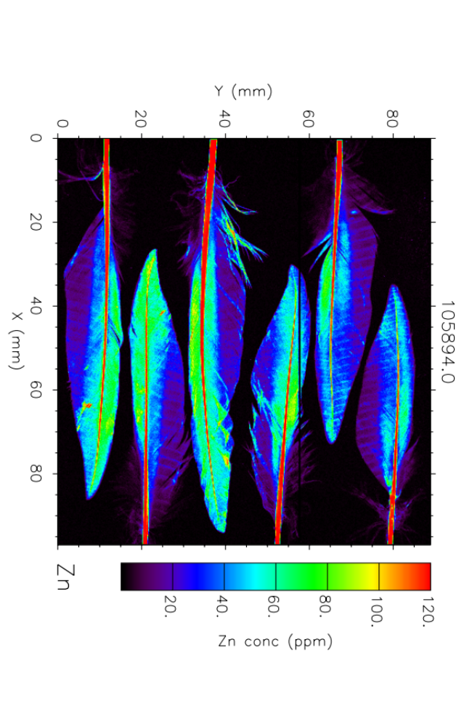
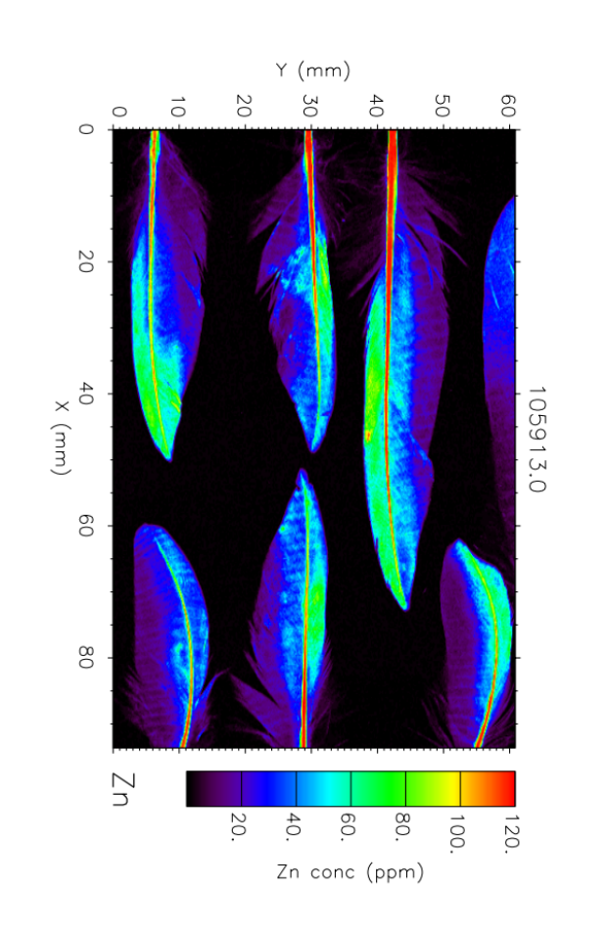
XRF measurements
Zinc
Adult
Juvenile
Captivity
Juvenile and “captivity” feathers show similar distribution of Zn; in adult ones Zn is less uniform and more particulate-like distributed

Slide 12
XRF measurements
Zinc
Adult
Juvenile
Captivity
Bands of Zinc are interpreted as
growth bars. These are visible to the naked eye in some species, but not in swifts.

Slide 13
Conclusions
- No fine microstructural features were observed on the micron scale.
Zinc shows banding on the mm scale, attributed to growth bars,
which are not visible to the naked eye.
- X-ray fluorescence is useful for non-destructive analysis of rare or precious
samples, but not suitable for large scale routine analysis.
- The feathers of birds raised in captivity on a diet mainly of crickets is similar
in chemical composition to that of birds in their natural habitat. The main
differences are in elements arriving from the environment after growth,
rather than during growth.
Liberi di Volare thanks the Anglo Italian Society for the Protection of Animals
(AISPA) for support.

Slide 14
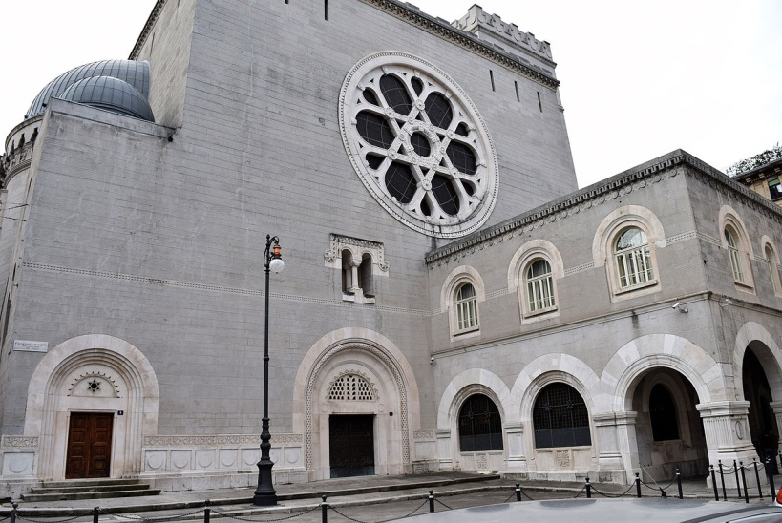
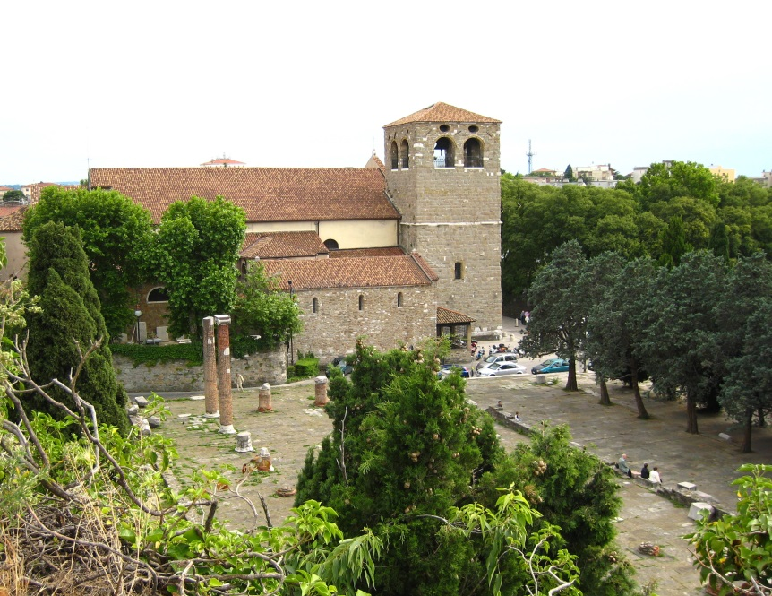
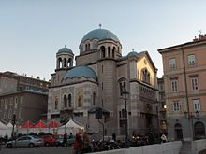
2020: 6th International Swift Conference: Trieste, Italy, the ideal location!
Trieste, also a cultural and linguistic cross-road.
"…is recognised as one of the largest and most
important places of worship for Jews in Europe."
By Zacqary Adam Xeper - Own work, CC BY-SA 4.0, https://commons.wikimedia.org/w/index.php?curid=35002115
St. Justus cathedral,
next to the Roman forum.
St. Spyridion Serbian
Orthodox church.
* In 2020, Trieste will be
the City of Science.*

Slide 15
2020: 6th International Swift Conference: Trieste, Italy, the ideal location!
Costs.
Accommodation: there are many small hotels and B&Bs in the zone where we
intend to hold the event. Booking.com offers:
25 properties, <50 Euro; 102 properties, 50-100 Euros in City centre.
Meals: a wide range of trattorie, pizzerie and restaurants provide typical Triestine,
Italian, seafood and other styles of food, at moderate prices. Three-course meals
with drinks can be found for about 25 to 30 Euros; pizza is much less.
Transport: many low cost flights to Venice (2 hours by train). Some low cost to Trieste
airport, plus Alitalia and Lufthansa flights.
Conference fee: same as for the present conference. We will actively seek sponsorship.
Indications of support from representatives of:
- the City of Trieste
- the Region of Friuli Venezia Giulia
- Gruppo Rondoni Italia
- FVG Veterinary Association
- University of Udine
- etc.

