Slide 1
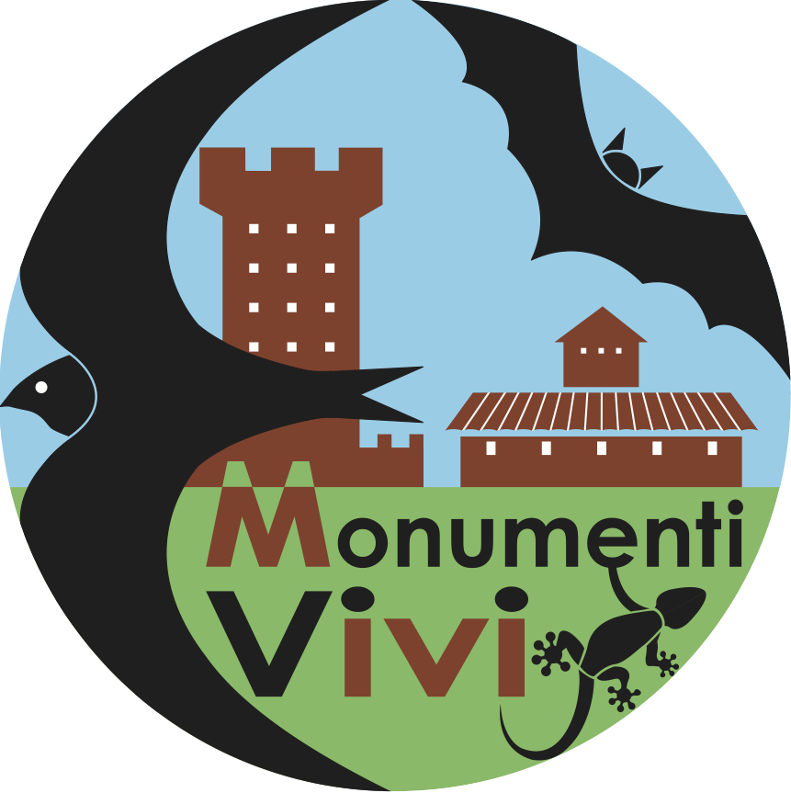
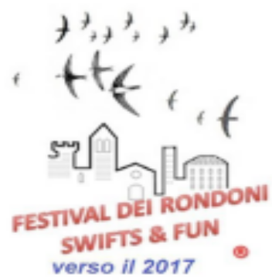
5th International Swifts Conference
Applying citizen-science data
and long term studies to swift's conservation in Italy
Cucco M., Boano G., Ferri M., Lardelli R., Pellegrino I., Pinoli G., Pirovano A., Tinarelli R.
Tel Avil, Israel, 11-16/3/2018

Slide 2
Databases
Apus pallidus and A. apus breeding in Italy and Canton Ticino (CH) are facing increasing difficulties and pose conservation and management problems
What is going on?
We must analyze official data,
collected using standard methods
Europe: EBCC 1980-2016 – www.ebcc.info
Italy: MITO2000 2000-2016 – mito2000.it
Note - the EBCC method requires point-census in the countryside: is it suitable for "aerial feeders"? Only indices are obtained ...

Slide 3
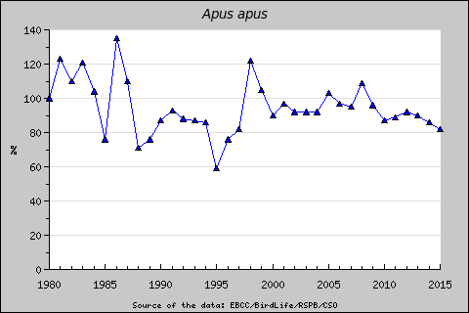
http://www.ebcc.info – European Bird Census Council
EUROPE - Apus apus according to EBCC
Base year Slope Slope SE Trend classification
1980 -0.9969 0.0037 -18% Stable
Stable
Notes:
EBCC = European

Slide 4
Trend in Europe
Apus apus according to EBCC
http://www.ebcc.info
Trend classification
Strong increase - increase significantly more than 5% per year (5% would mean a doubling in abundance within 15 years). Criterion: lower limit of confidence interval > 1.05.
Moderate increase - significant increase, but not significantly more than 5% per year. Criterion: 1.00 < lower limit of confidence interval < 1.05.
Stable - no significant increase or decline, and most probable trends are less than 5% per year. Criterion: confidence interval encloses 1.00 but lower limit > 0.95 and upper limit < 1.05.
Uncertain - no significant increase or decline, and unlikely trends are less than 5% per year. Criterion: confidence interval encloses 1.00 but lower limit < 0.95 or upper limit > 1.05.
Moderate decline - significant decline, but not significantly more than 5% per year. Criterion: 0.95 < upper limit of confidence interval < 1.00.
Steep decline - decline significantly more than 5% per year (5% would mean a halving in abundance within 15 years). Criterion: upper limit of confidence interval < 0.95.

Slide 5
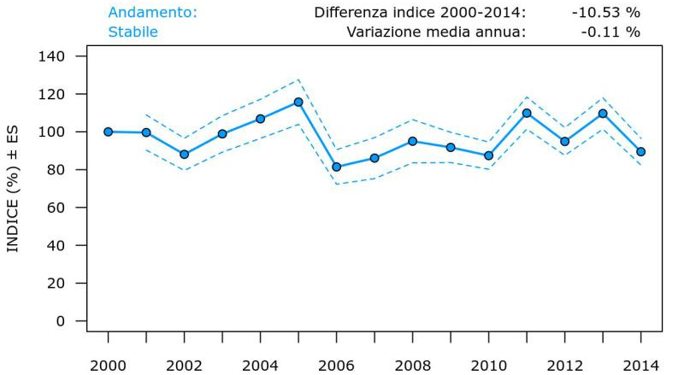
https://mito2000.it – Monitoraggio ITaliano Ornitologico
ITALY Apus apus according MITO
Stable

Slide 6
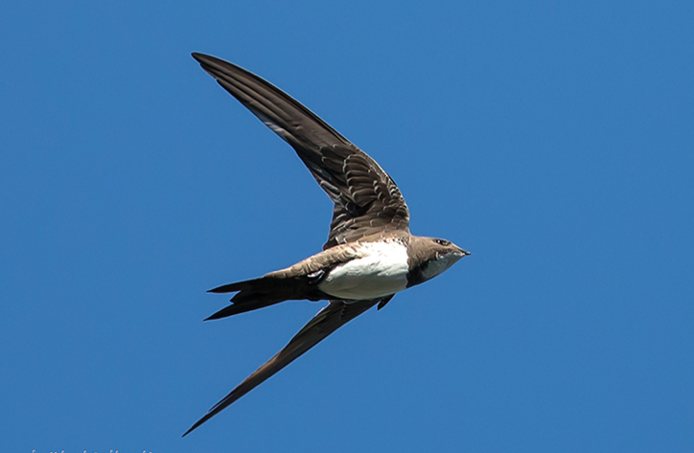
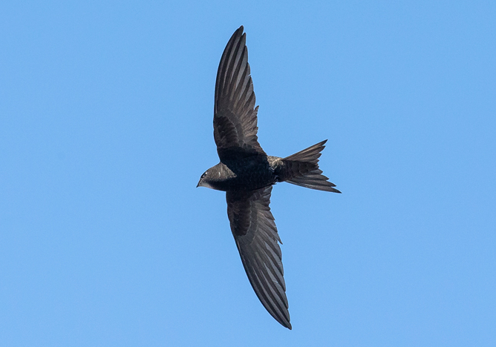
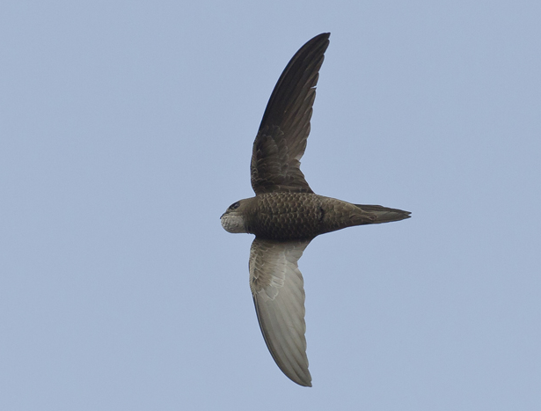
Swift's trends
Conclusion & doubts
is everything really good (stable) for Apus apus in Europe and in Italy?
what about the other species of Swifts?
Three species ..
Commom swift Apus apus
Pallid swift Apus pallidus
Alpine swift Tachymarptus melba

Slide 7
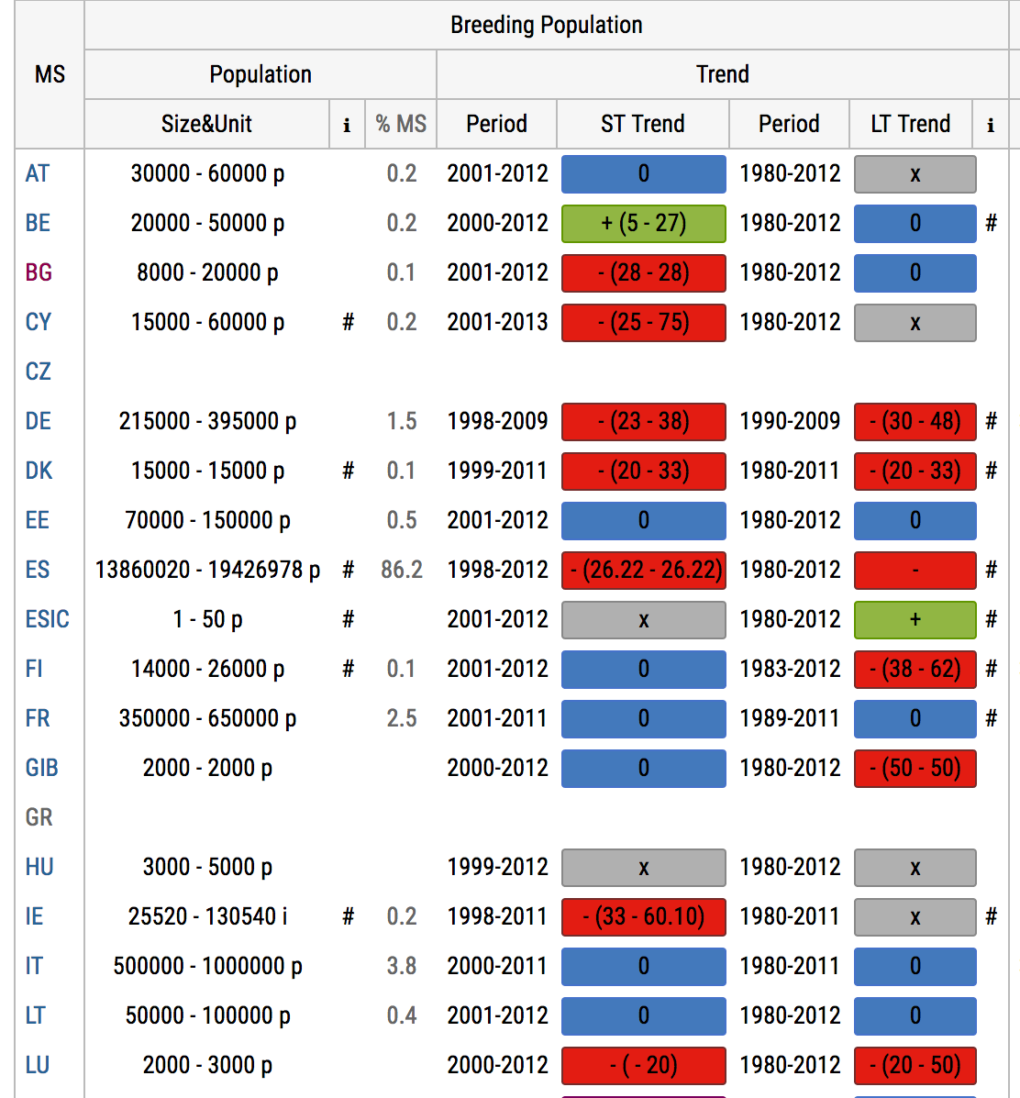
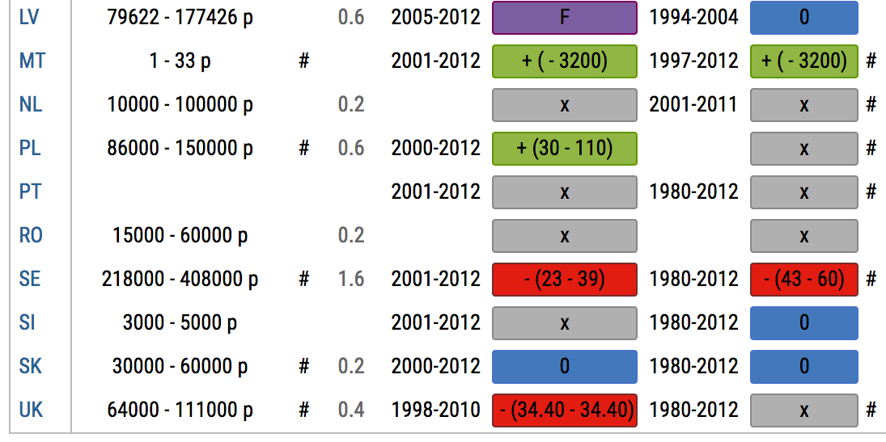
European Union (EIONET)
Apus apus
Report on Directive 147/2009/CE (Birds Directive)
!!! Several RED flags !!!

Slide 8
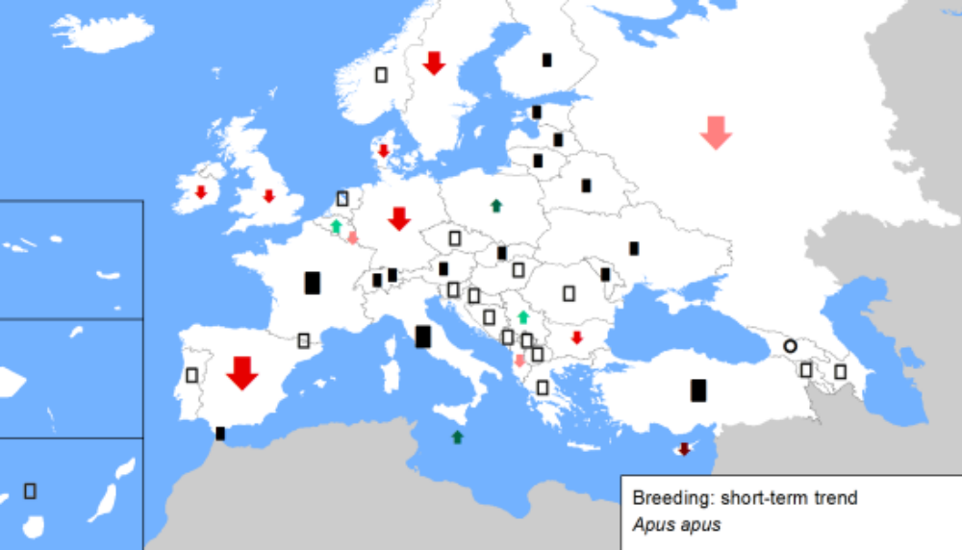
BirdLife
Birdlife International
Redlist
Common swift Apus apus

Slide 9
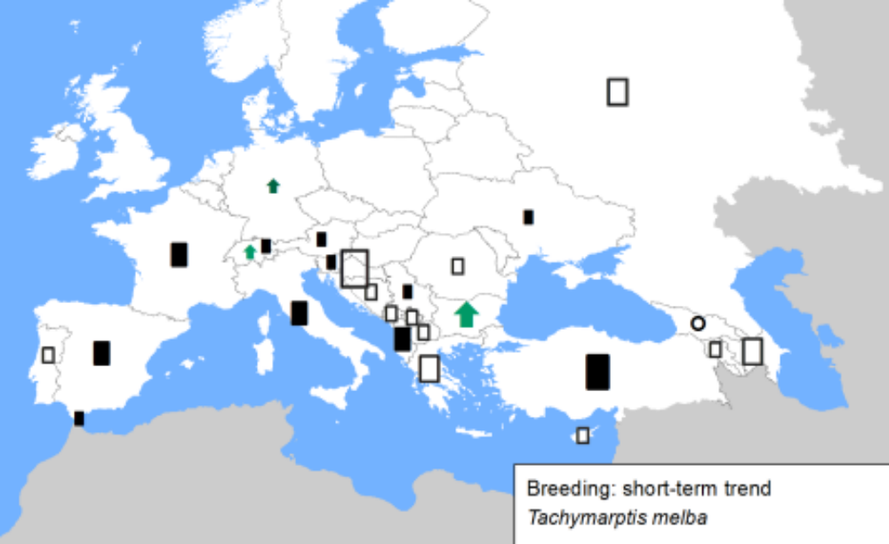
BirdLife
Birdlife International
Redlist
Alpine swift Tachymarptis melba
Notes:
http://www.ebcc.info/index.php?ID=631

Slide 10
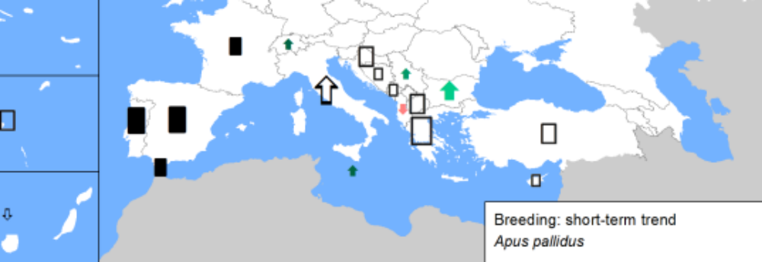
BirdLife
Birdlife International
Redlist
Pallid swift Apus pallidus

Slide 11
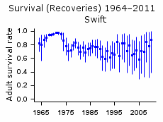
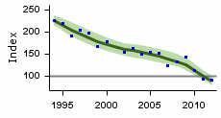
UK - Breeding Bird Survey (BTO) https://app.bto.org/birdtrends/species.jsp?s=swift&year=2017
Brexit for the Swifts too?

Slide 12
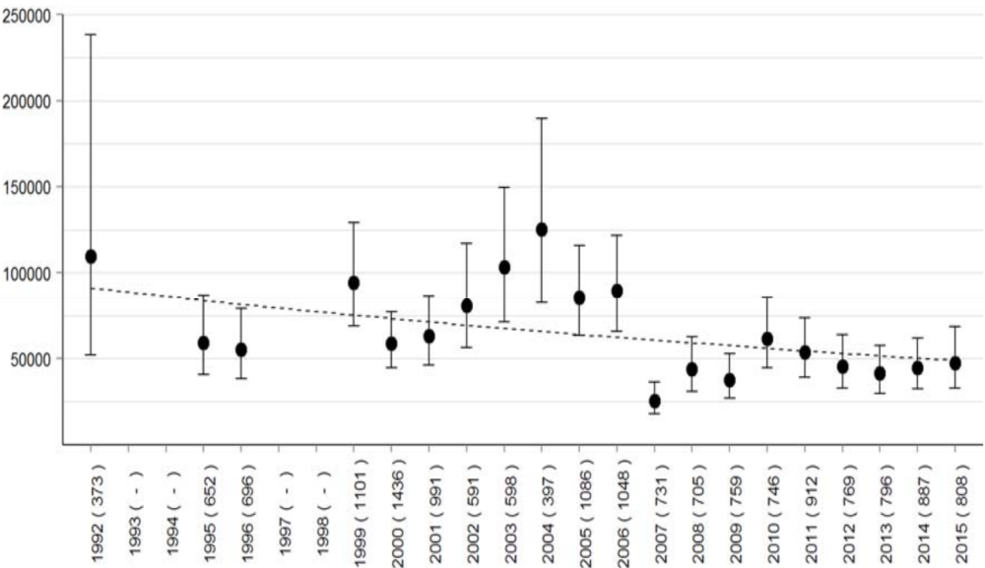
Italy, Lombardy – Bani L. et al. (2015) – Univ. Milano Bicocca
MAX
Estimated number
min
Italy - The longest series: Lombardy

Slide 13
Threats ...
Threats – the nest cavity
Both the Common Apus apus and the Pallid swifts Apus pallidus utilizes as nest cavities the roof tiles and holes that are found on buildings.
They prefer monumental towers, castles, churches located mainly downtown, or special towers that were built centuries ago solely to favour breeding of swift.

Slide 14
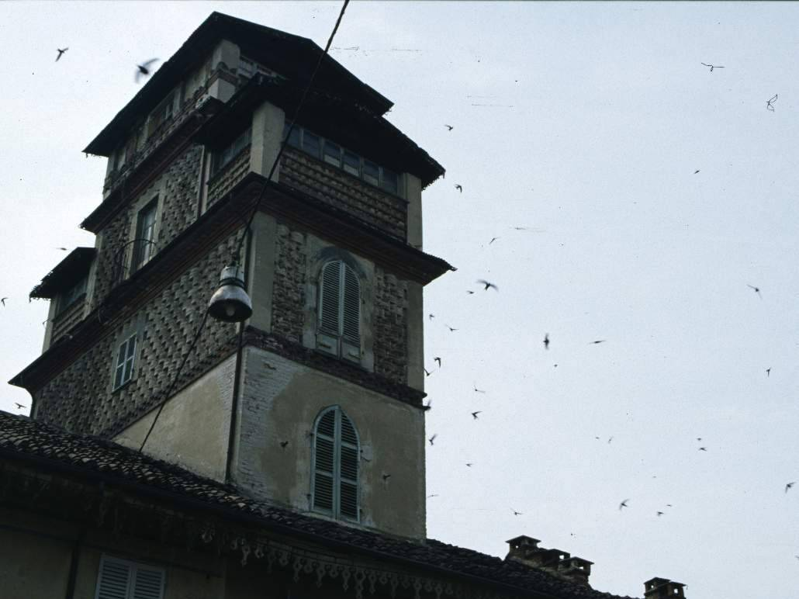

NW-Italy - key for Swift's presence on buildings
Scaffolding holes
on the walls
Probability
100%
YES
"Coppo" tiled
roof
Probability
100%
No holes,
No "coppo"
Probability
0%
Monumental
building?
"Coppo" tiled
roof
Probability
30%
NO
Holes
under the cornice
Probability
50%
No "coppo», no holes
under the cornice
Probability
0%
Giovanni Boano

Slide 15
Swift's conservation in Italy
The role of citizens
In the last decades, there is an increasing pressure on swifts due to removal or obstruction of nest cavities to prevent the utilization by feral pigeons. In order to contrast this problem, we have developed four projects for the conservation of swifts involving citizens, birdwatchers and scientists collaboration.
(1) Festival - Swifts & Fun: festivaldeirondoni.info
(2) Website for collection of bird data in Italy – www.ornitho.it
(3) Association "Progetto Natura" conservation project for the city of Milano.
(4) Association for the protection of "Living monuments" - monumentivivi.it
The activities include conservation and monitoring of swift colonies, as well as educational events with schools and general public and development of “good practices” with architects and stakeholders who operates on building restoration.

Slide 16
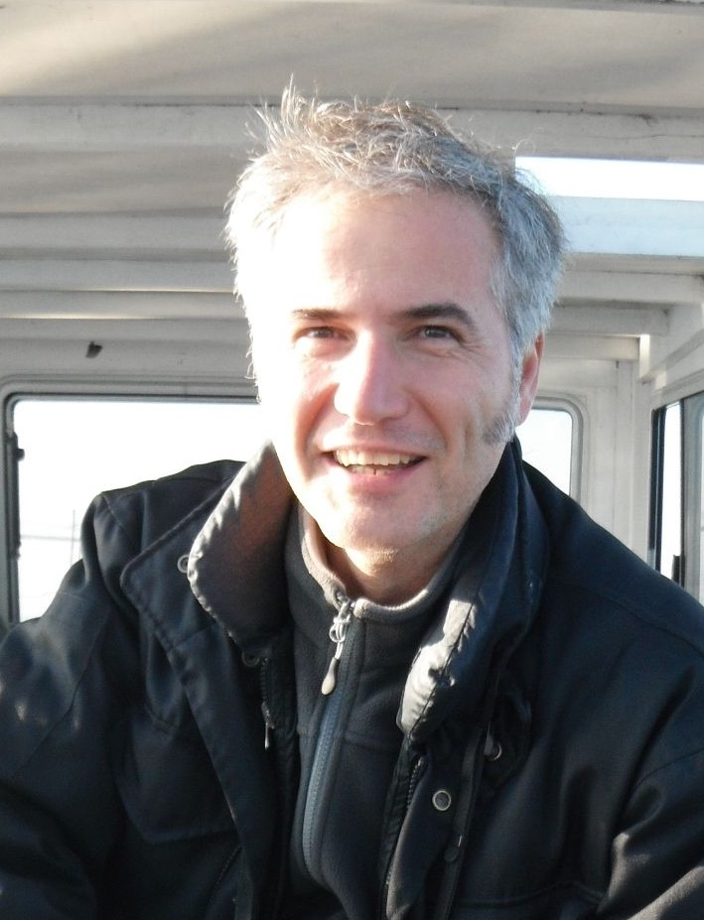
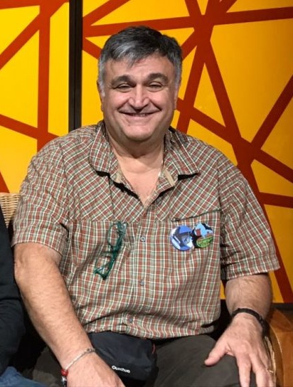
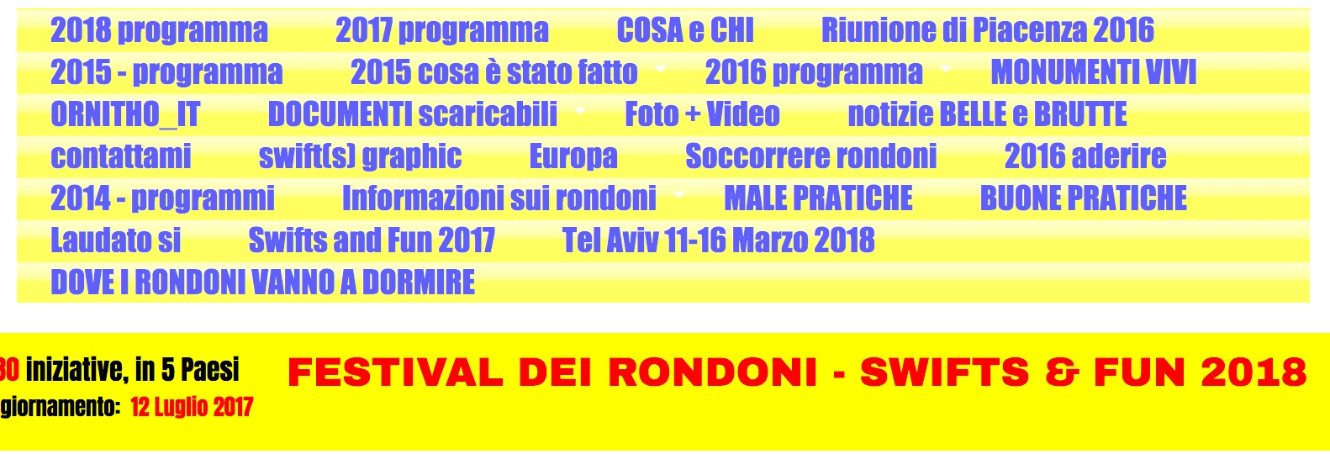
Swift's conservation in Italy
(1) FESTIVAL
The Swifts & Fun is a festival aimed to encourage citizens participation through events organized near large swift colonies. The festival occurs in late June.
First edition: 2013
Last edition: 2017 with 80 different events.
R. Tinarelli
Mauro Ferri
www.festivaldeirondoni.info

Slide 17


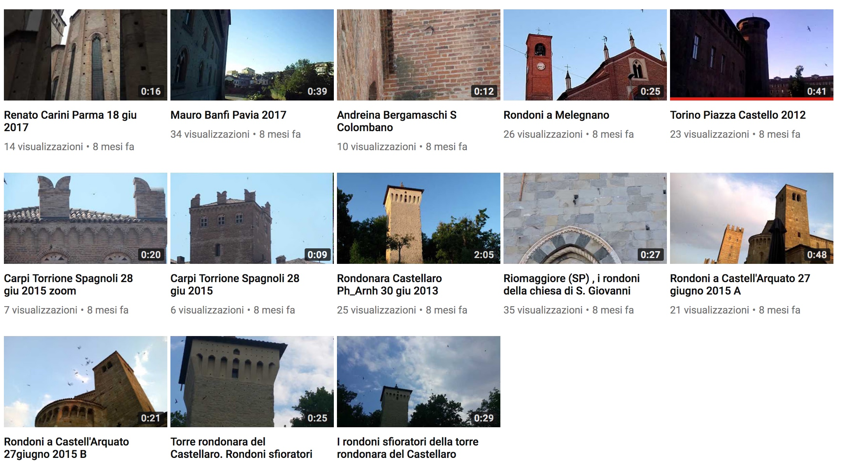

Conservation in Italy
Swifts & Fun:
website, facebook, youtube

Slide 18
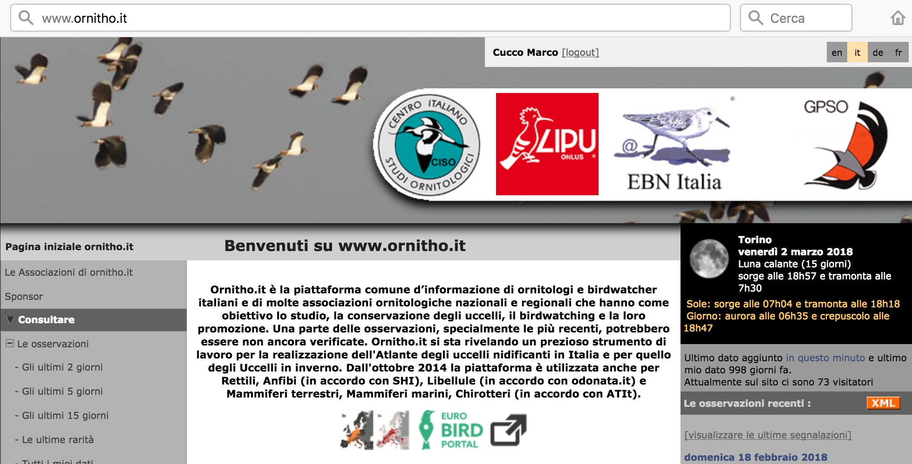
Swift's conservation in Italy
(2) Website for collection of bird data in Italy – www.ornitho.it
With over one million records per year, Ornitho.it is the main platform for collection of bird data in Italy. The management team has included a special window for the input of detailed data in case of swift colonies.

Slide 19
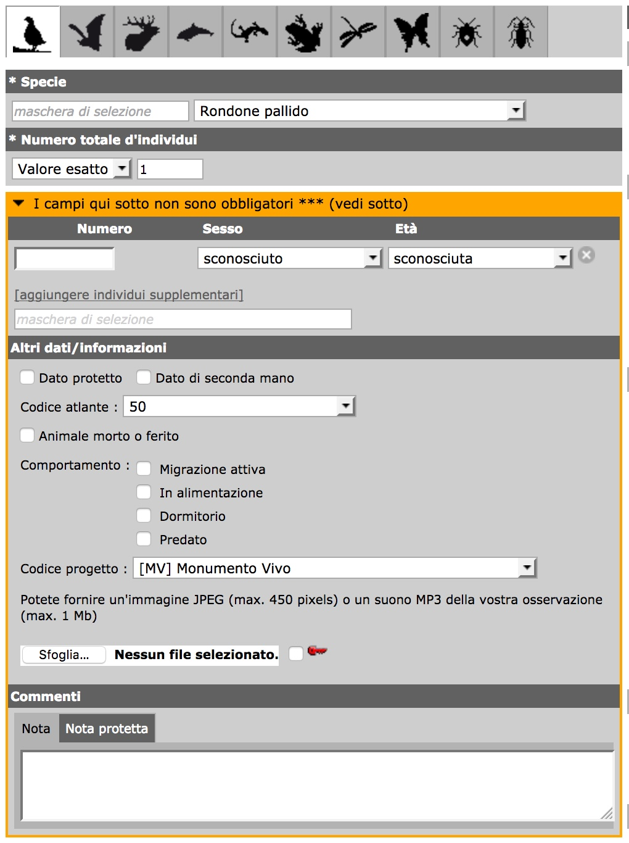

Swift's conservation in Italy
Ornitho.it
The project code "MV"
(i.e. Monumento Vivo)
is designed for any indication of buildings of special interest for animal conservation.
2013-2016: 194 sites
2017: many more!
Roberto Lardelli

Slide 20
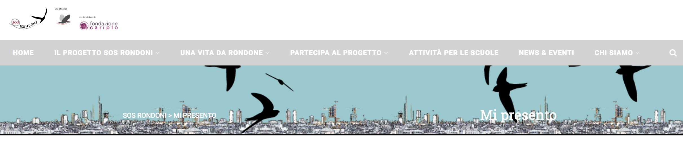
Swift's conservation in Italy
3) The Association Progetto Natura has developed SOS Rondoni, a conservation project for the city of Milano
Milan is the 2nd largest city in Italy, after Rome. The urban area is the largest in Italy and includes 7-8 million persons.
The activities include conservation and monitoring of swift colonies, as well as educational events with schools and general public and development of “good practices” with architects and stakeholders who operates on building restoration.
www.sosrondoni.it

Slide 21
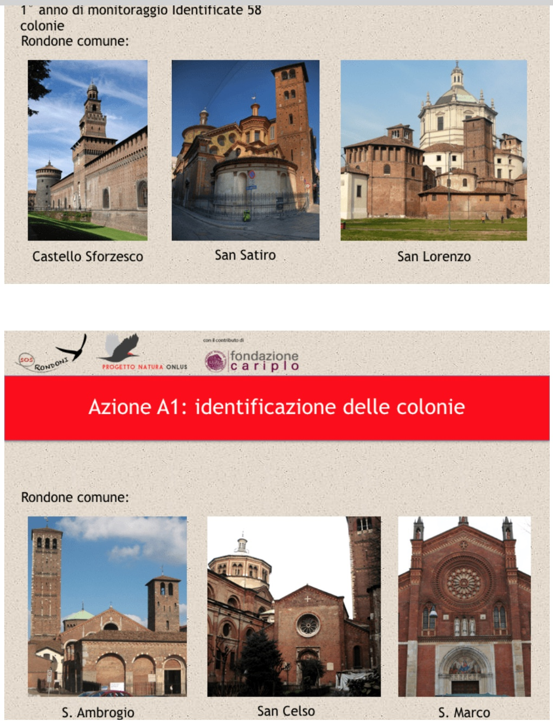
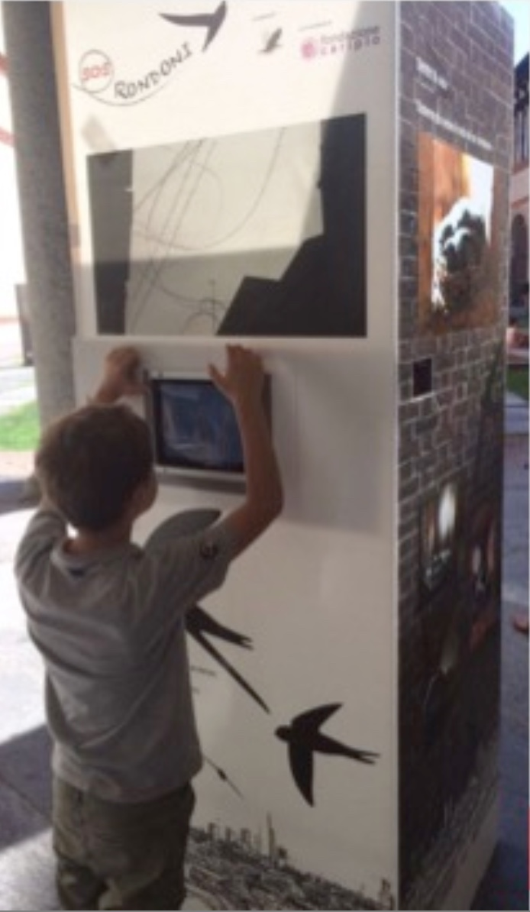
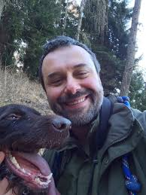
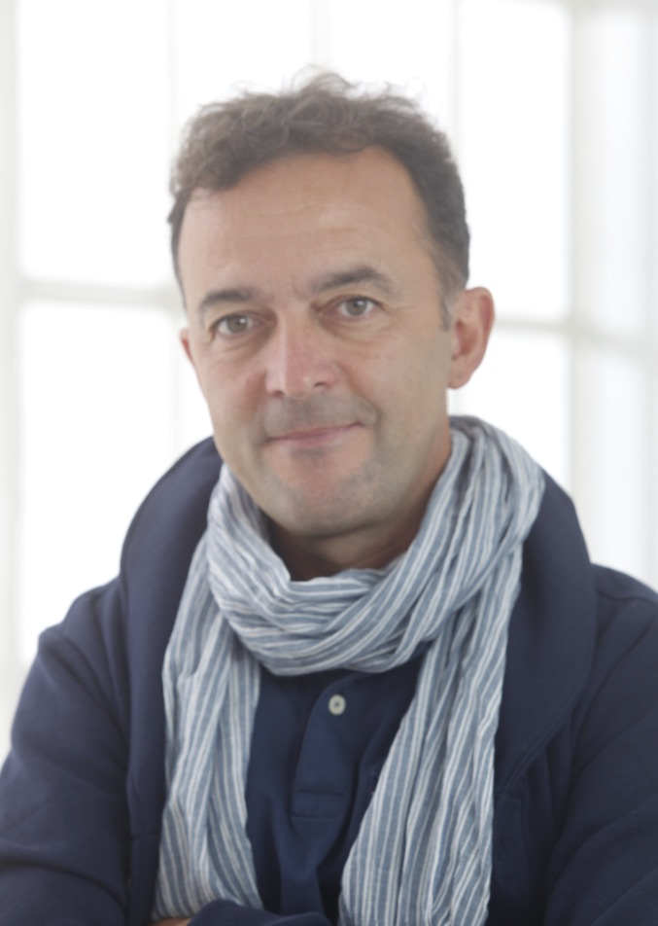
Swift's conservation in Italy
Actions
- mapping colonies in Milan
- buildings: study group with architects, bishop and city-major delegates: good practices and regulations.
- education: package
of activities
for schools.
Andrea Pirovano – Guido Pinoli

Slide 22
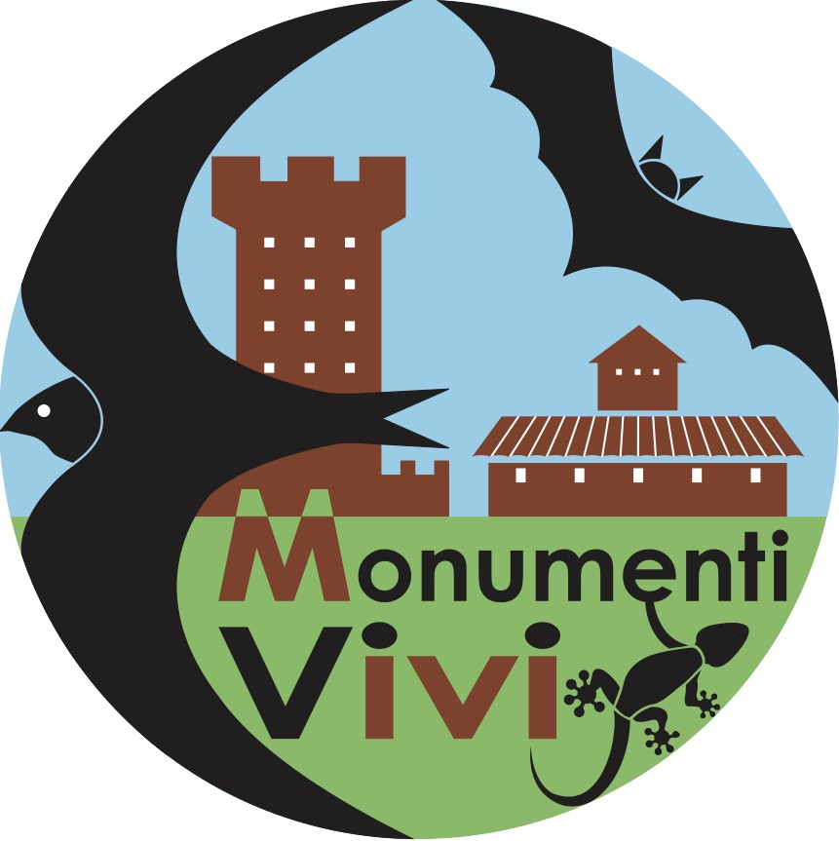
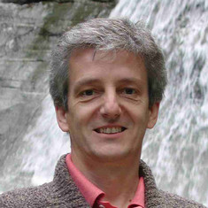
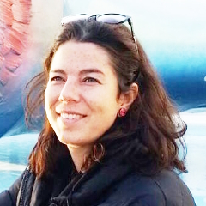
Swift's conservation in Italy
4) Association for the protection of Living monuments Monumentivivi.it
Living monument: a building that houses animal species of conservation interest.
The association manages a website who provides: data, localities, information and documents utilizable for the conservation of swifts, bats and other animals living on buildings.
Ideas
Not only swifts, inclusion of other species who have similar interests
Three lines for actions
- biology
- architecture
- green tourism
Marco Cucco – Irene Pellegrino

Slide 23
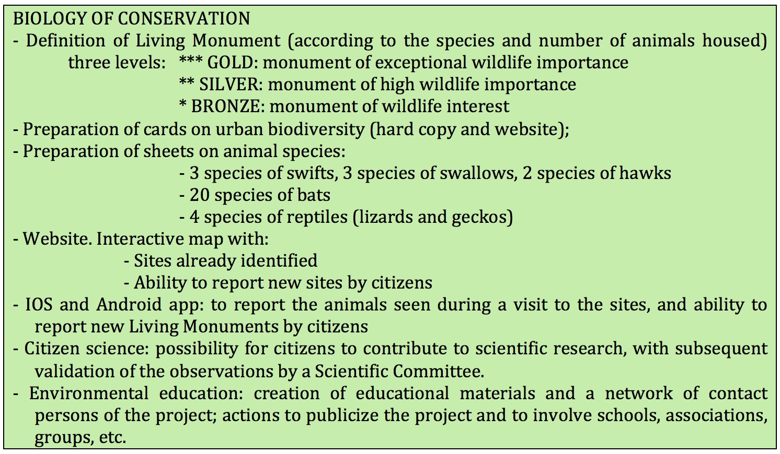
Swift's conservation in Italy
- Biology: ranking the sites, citizen science, education

Slide 24
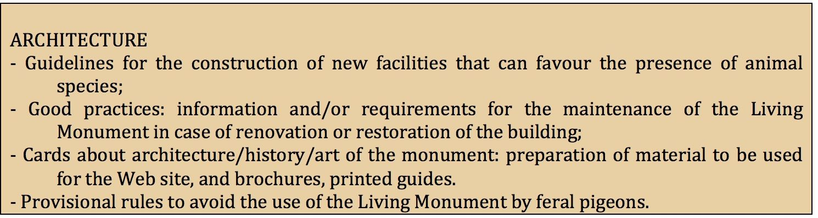
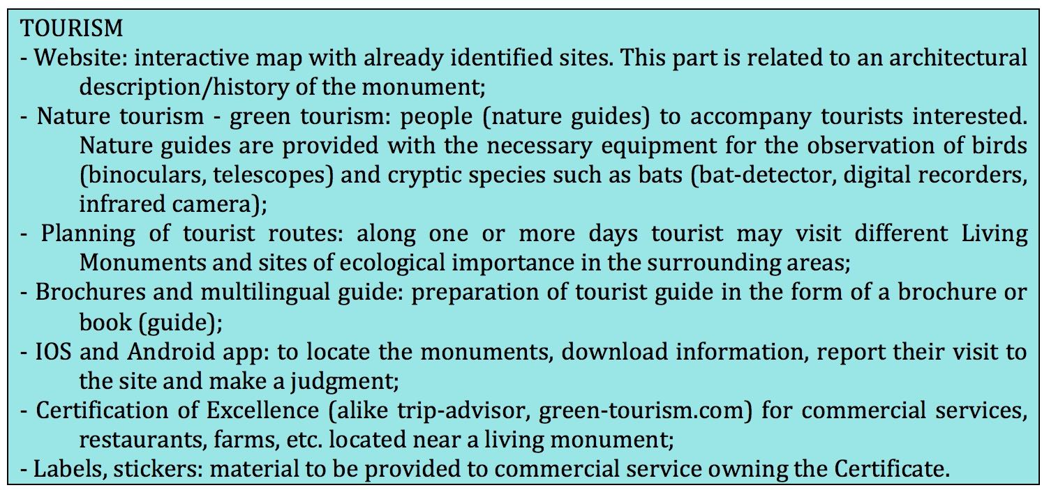
Swift's conservation in Italy

Slide 25
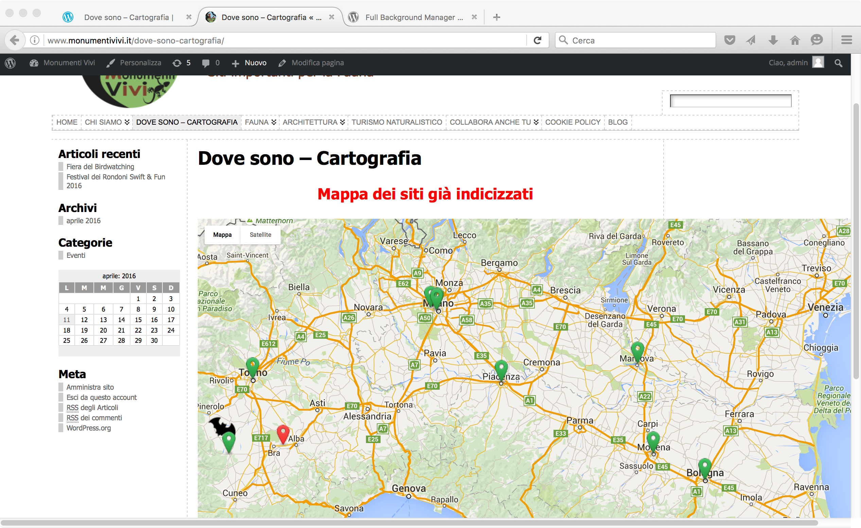
Website Monumenti Vivi
Where? – Maps

Slide 26
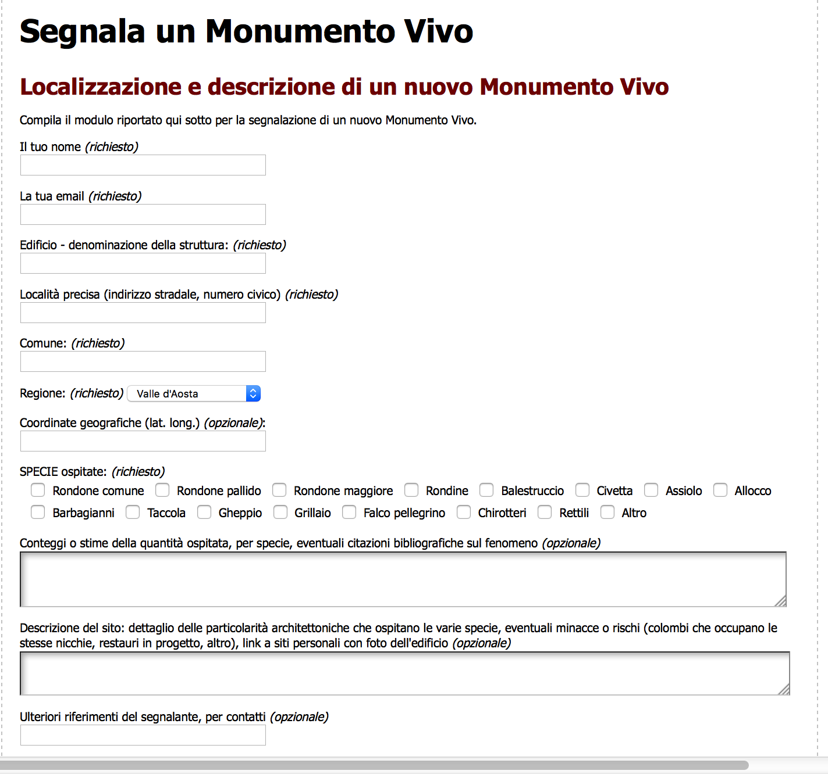
Website Monumenti Vivi
Citizen Science
The form can be filled from desktop PC, tablets, phones.

Slide 27
Future ...
Future? Work in progress!
Swift & Fun – more cities
Ornitho – more sites
Sos rondoni – a good example for local activities
Monumenti Vivi – more sites
... and ...
Science
- New data on breeding biology. Some colonies have been studied for decades and have provided detailed long-term data on survival, moult, breeding success and swift' behaviour.
- Long term trends. We need to pay particular attention to the most important sites, with the largest colonies. There we can go back to the same sites after some years to monitor trends on swift's abundance.

Slide 28
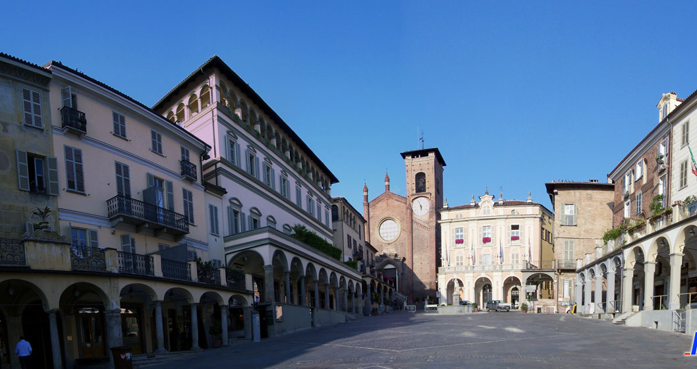
Main colonies
Moncalieri - Santa Maria della Scala cathedral

Slide 29
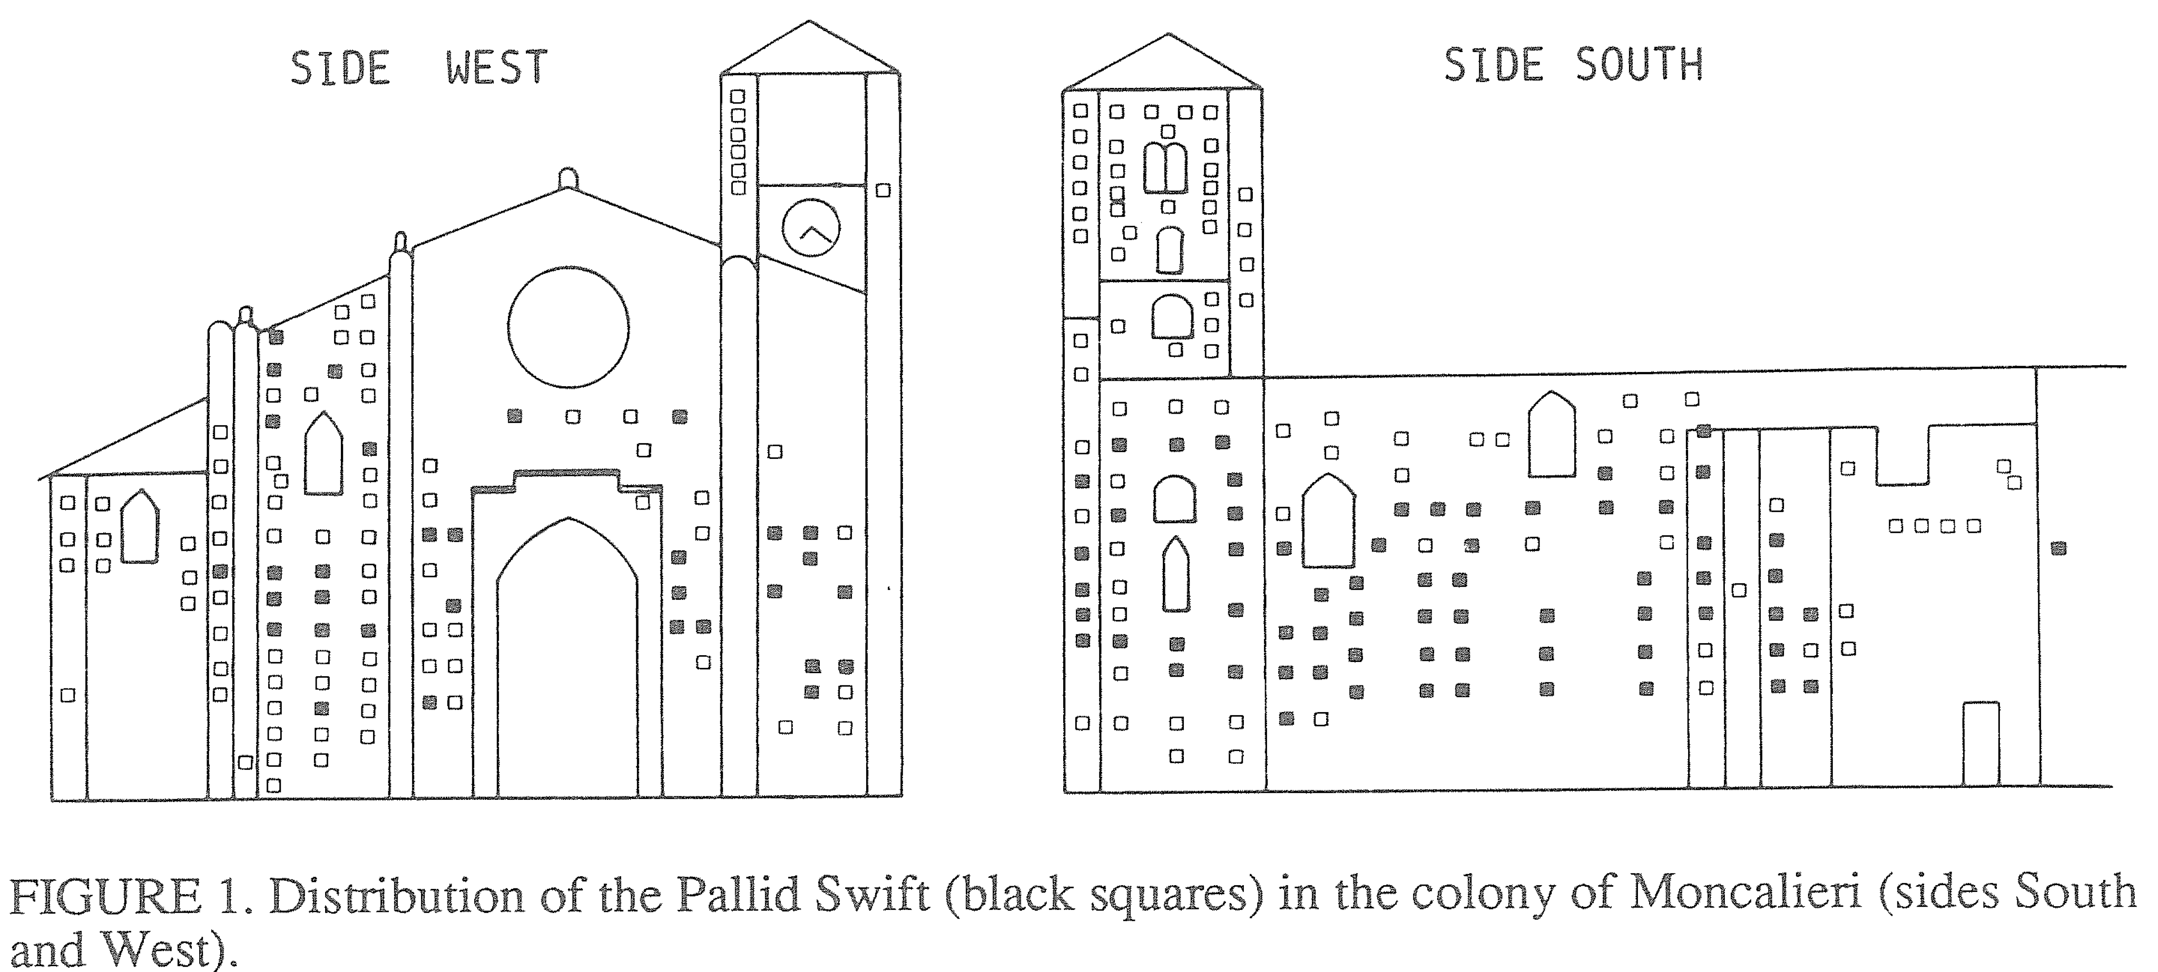
Main colonies
Moncalieri – Cathedral: distribution A. pallidus

Slide 30
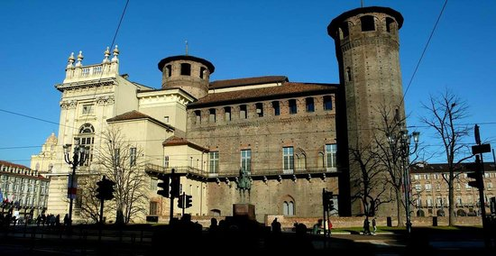

Main colonies
Torino – Piazza Castello
West side & tower 1
May 1949

Slide 31
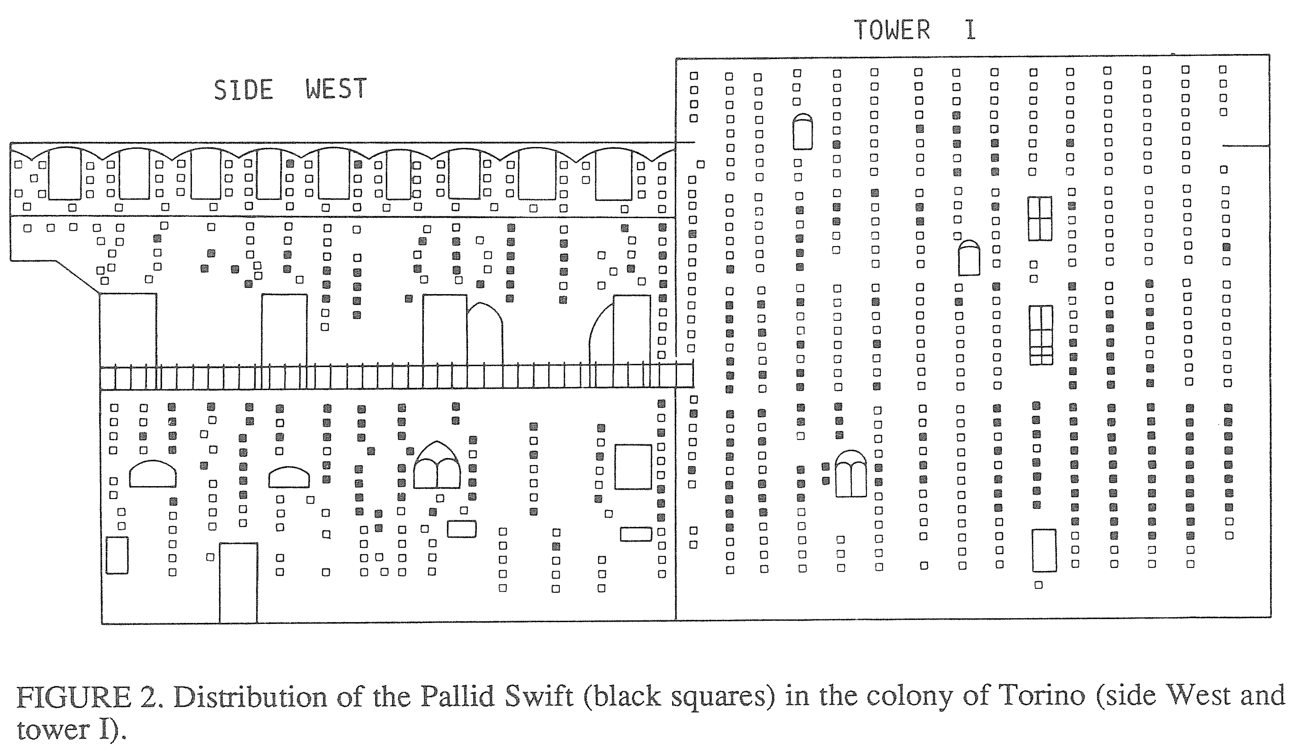
Main colonies

Slide 32
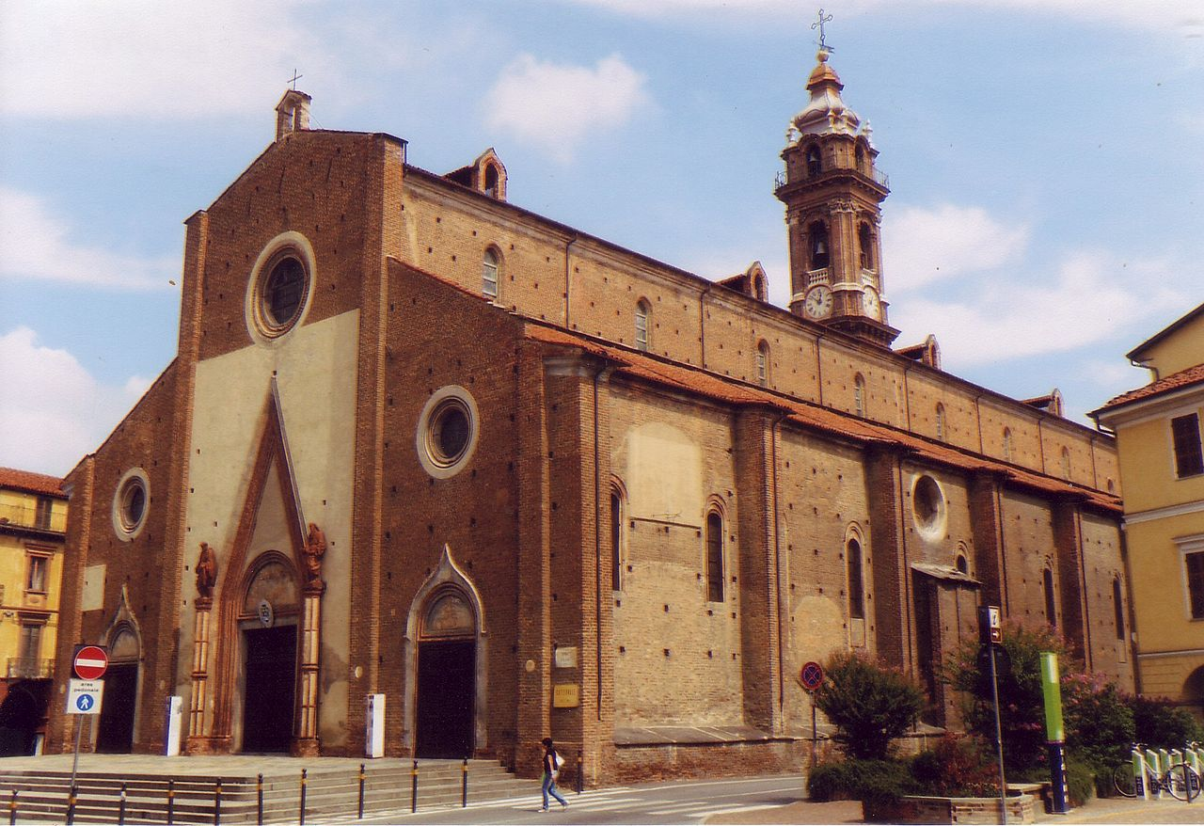
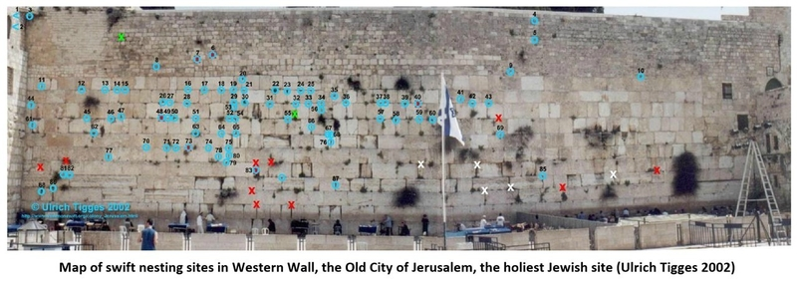
Main colonies
Saluzzo - Cathedral
Jerusalem – Western wall

Slide 33

Tel Aviv – 12 March 2018

