Slide 1
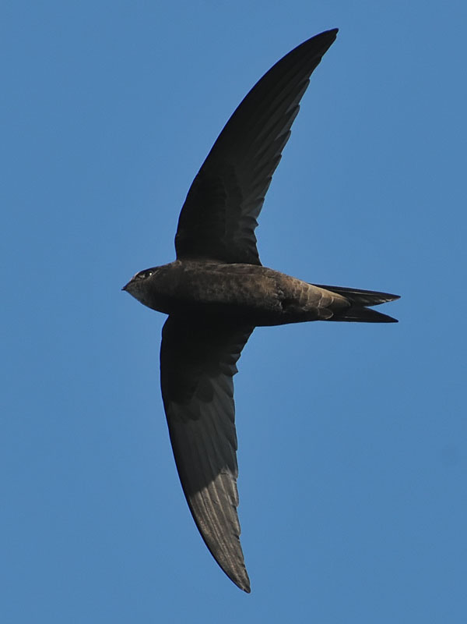
Swifts in Ireland
TED HUGHES
ARRIVAL
“They’ve made it again/
Which means the globe ‘s
Still working…”
Notes:
Talk will consider how the Swift adapts from spending 8 months of the year in Africa, most of that south of the equator, to 4 months of the year rearing up to 3 chicks in a wet, windy and cool Ireland.

Slide 2
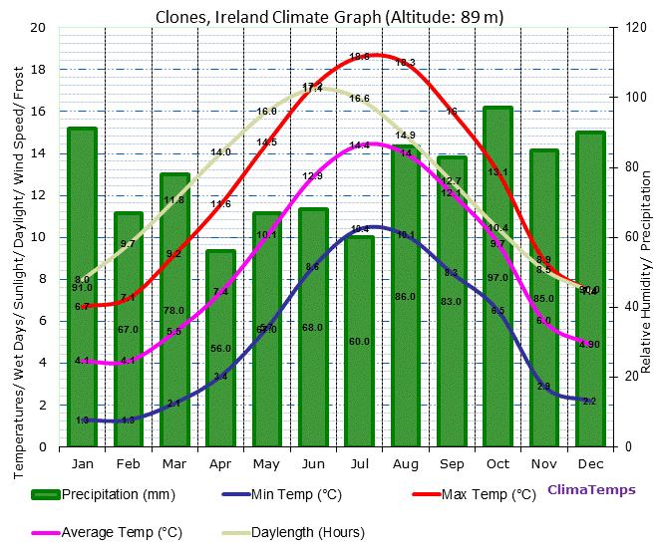
CLIMATE

Slide 3
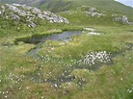
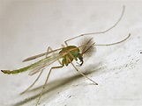
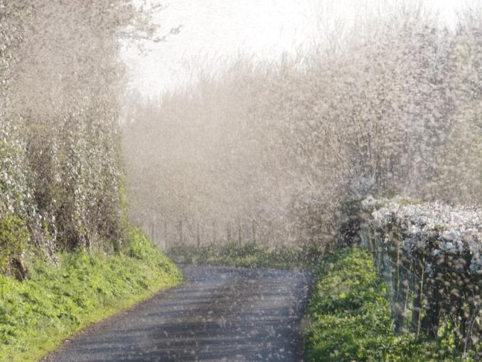
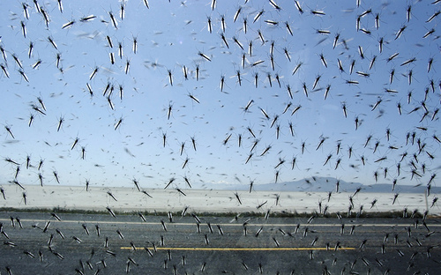
Ireland - A Watery, Insect Rich Landscape
AREA OF IRELAND
84421km
Anyone who visits the lough shore in May and early June cannot help but be affected by the Chironomid Midge, commonly known as the Lough Neagh fly. Those who live near the shore know never to open the windows and definitely never of an evening when the electric light is switched on. Despite their annoyance, they don’t bite, but boy oh boy, they swarm!
2
3% WATER AREA
2532km
2
MIDGES
BLANKET BOG
MIDGE
LOUGH NEAGH FLY
Notes:
Thousands of Lakes of varying sizes. An overview of the numbers (either in actual numbers, acres, kms – whatever works) of lakes, rivers, streams, raised and blanket bogs.
All rich in insect life. Lakes and bogs are a huge source of aquatic and other insects for swifts.
Take example of Lough Neagh, largest lake in Ireland, which seems to be where earliest sightings of Swifts are – arrive here around 16 April and in early May disperse to breeding colonies. Swifts at brianns colony when? Main numbers arrive – when? Swifts arrive at nest boxes at GMIT on 6 May each year almost to the day.

Slide 4
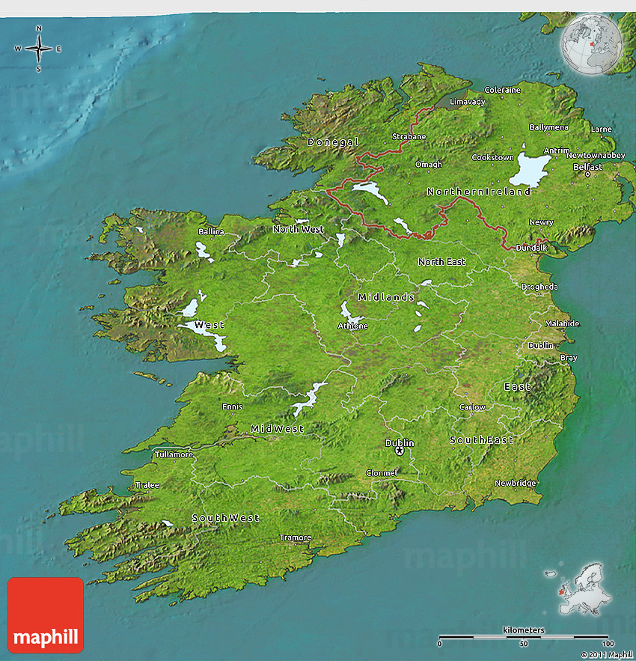
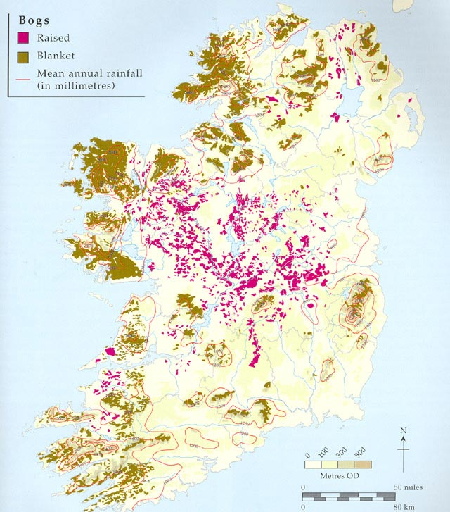
BLANKET BOG
RAISED BOG
LAKES
RIVERS
SWIFTS VIEW

Slide 5
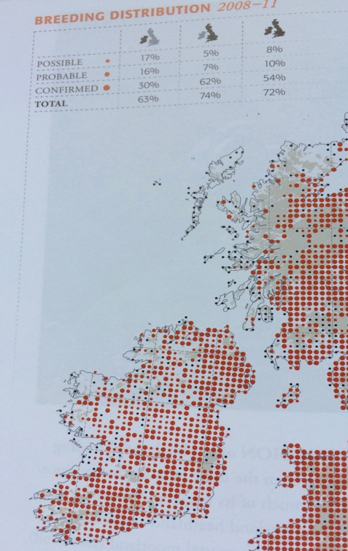
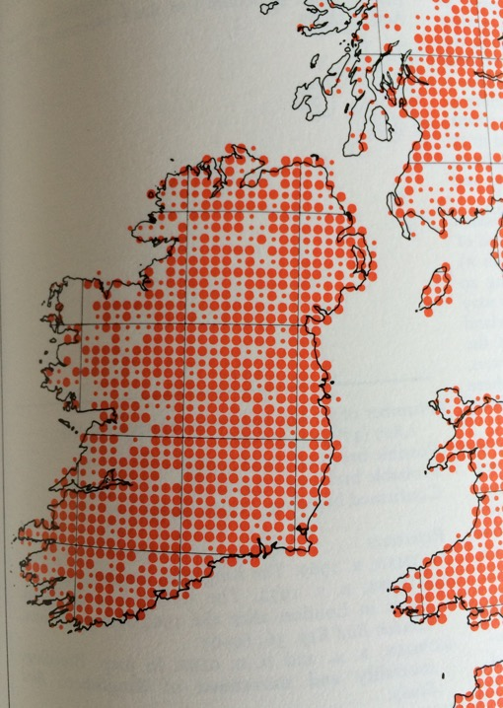
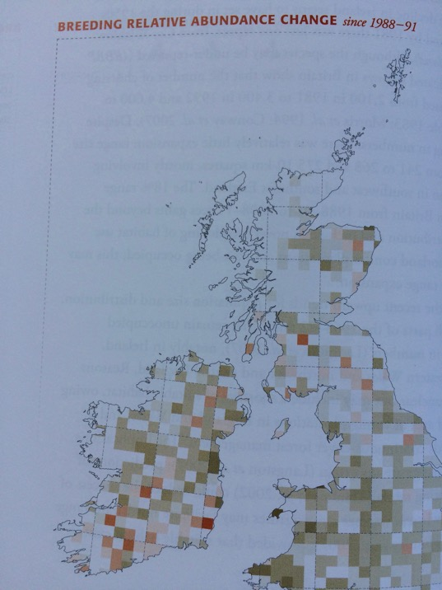
IRELAND SWIFT POPULATION DECLINE
Atlas of Breeding Birds in Britain and Ireland 1976
BTO & Irish Wildbird Conservancy
Bird Atlas 2007-2011
Ireland 38% to 46% Decline
Notes:
Despite the abundance of insect life found on lakes, rivers and bogs on the Western Sea Board there has been a 46% decline – Why?
The decline in Antrim has been much less – has it been? Muckamore Dungannon Lisburn etc. etc. Why?

Slide 6
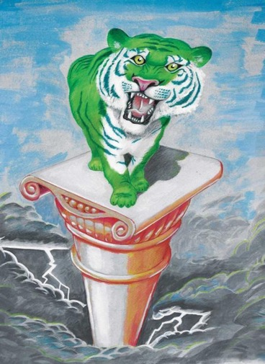
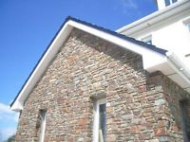
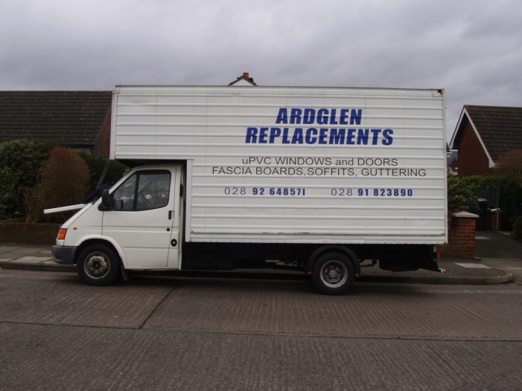
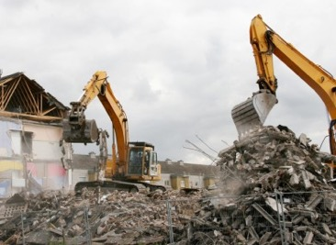
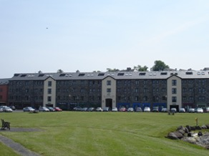
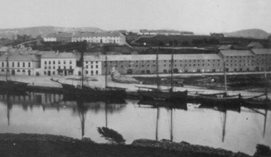
CAUSES OF THE DECLINE?
The Celtic Tiger
WESTPORT QUAY BUILT IN 1800 CENTURY
CONVERTED TO SHOPS,APARTMENTS IN 1999.
Notes:
West of Ireland relatively poor until the Celtic Tiger years and then experienced a building boom. One of the main culprits leading to nest site loss is the plastic facia and soffits that are now on 80%+ old buildings in Ireland’s towns.
The main negative impact on the swift breeding population in both jurisdictions in Ireland has been the political and financial administration of the economy and wildlife conservation. In particular, the impact of the “Celtic Tiger" years in Southern Ireland"

Slide 7

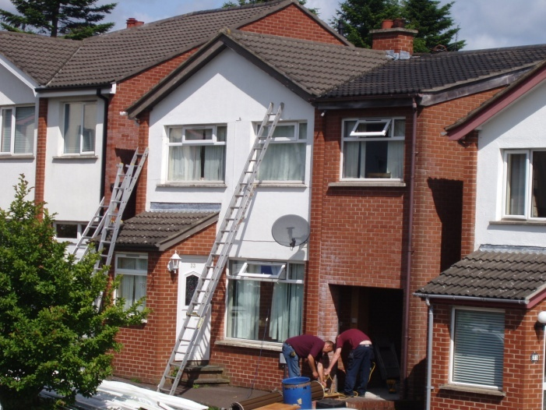
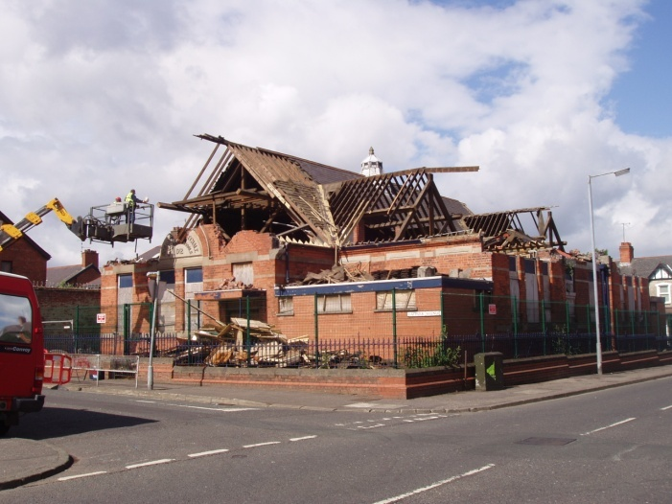
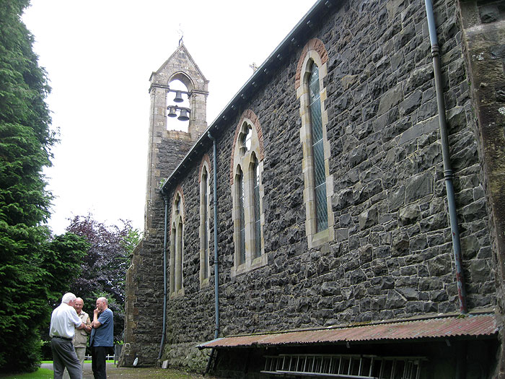
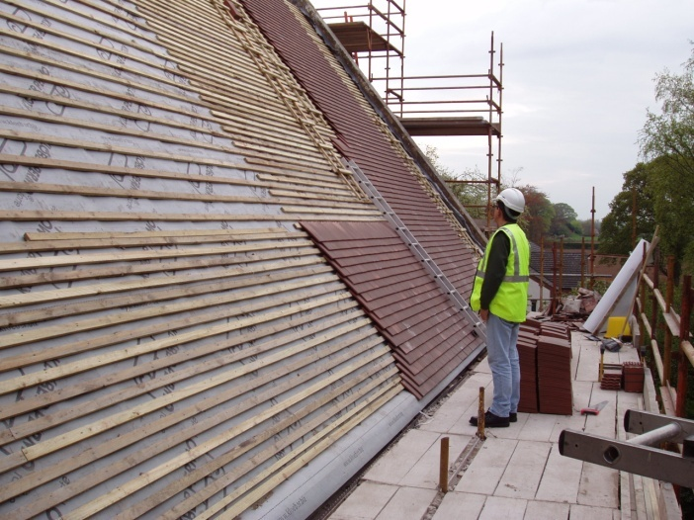
CAUSE OF THE DECLINE- 2?
Notes:
Loss of nest sites-demolition and redevelopment of old textile mills due to industrial decline. Reroofing schools, churches, houses, repairs, etc. Explosions/bombs during the ‘troubles’- example Newtownards – biggest ever bomb in ‘Troubles’ .

Slide 8

RECOVERING THE POPULATION
Counties with Nest box projects in 2013
Counties with Nest box projects in 2017
Notes:
The Northern Ireland Swift Group has been leading the way with Swift Conservation projects. In 2012, Brian Cahalane helped me set up a project in County Mayo which I think was just the second nest box project in Southern Ireland. Today, 5 years later, Swift Fever has hit Southern Ireland and there nest box projects in nearly every county with schools and community groups leading the way. We have the food for the birds and so need to provide them with the nest sites

Slide 9
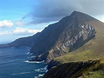

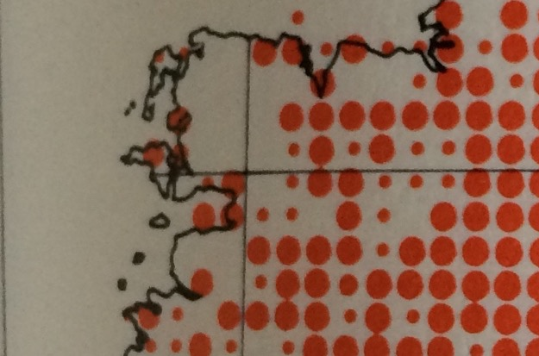
COUNTY MAYO – next stop America!
R.F. Ruttledge “Birds of Counties Galway and Mayo”1989
”An increase first noticeable about 1932 led to an extension of the breeding range to western seaboard towns …… Has bred in Achill and Belmullet . Recorded nesting numerously on cliffs on Rathlin Island 1900
Ussher and Warren.
Plan to attract back to these areas.
1976
Home to Great Western Lakes (Conn, Corrib, Mask) plus many other lakes, rivers and lots of bogs.
Rich in flying insects including The Midge
Agriculture
Impact of slurry on water quality and insect population
Notes:
County Mayo has seen Swifts disappear from the Western sea board but we believe this is not due to lack of food but the Celtic Tiger years. There are many lakes, rivers and bogs. Agriculture is mainly cattle and sheep with very little cereal crops due to weather. Slurry the main threat to water quality. Change in type of insects on lakes e.g. decline of Mayfly but increase in chironomids and no shortage of flying insects. Towns are small, especially on west coast so swift colonies could easily have been lost through building renovation/demolition in Celtic Tiger years.
habitat and suitable nest site availability combines to determine the numbers of breeding swifts found in Mayo.

Slide 10
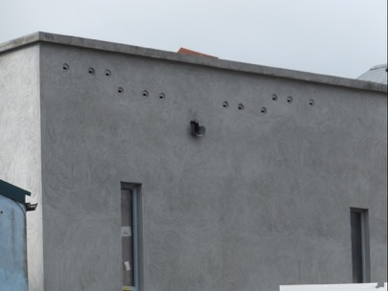
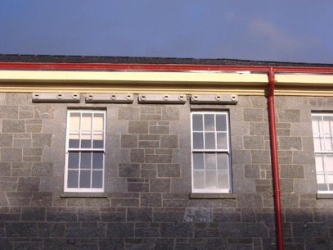
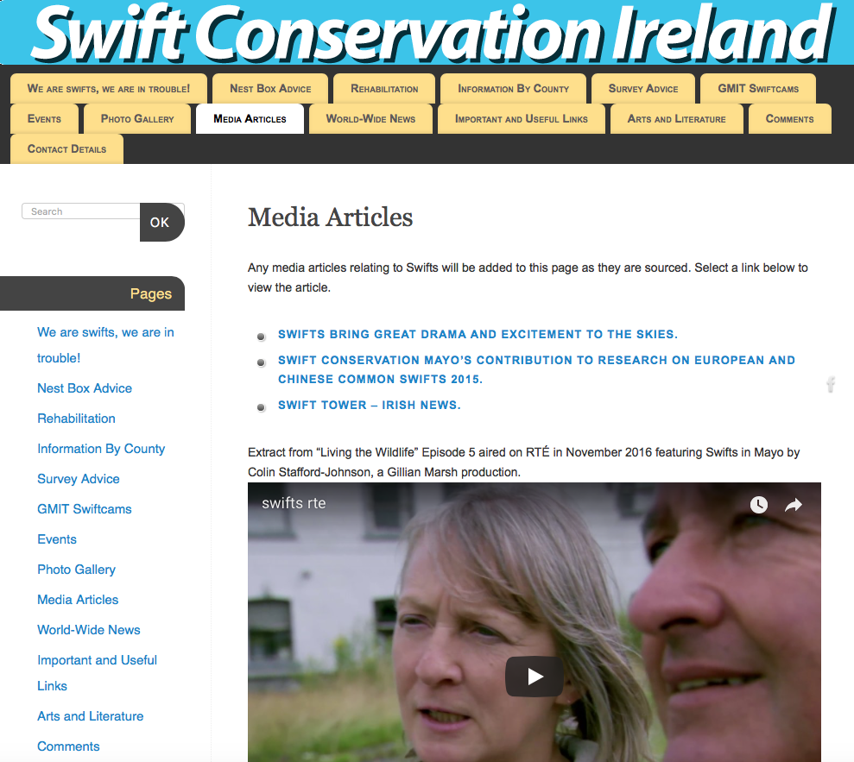
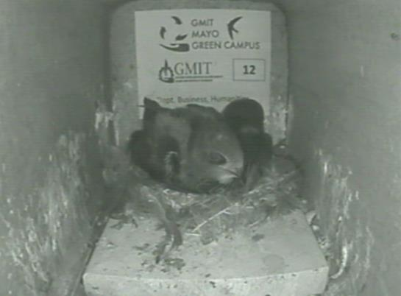
COUNTY MAYO
8% Increase in breeding population since 2013 through nest boxes (184). A positive example for the rest of the country
http://swiftconservation.ie/gmit-swiftcams/
Notes:
Nest box projects in Mayo have, in 5 years, increased the breeding population by 8%. Great live-stream from GMIT from 11 nest boxes and have used this for research to be presented by Chris.
There is not time enough here, but if you want to watch a 15 minute programme from the RTE (TV broadcaster) about Swift projects in County Mayo you can find it on the Swift Conservation Ireland website under Media Articles.

Slide 11
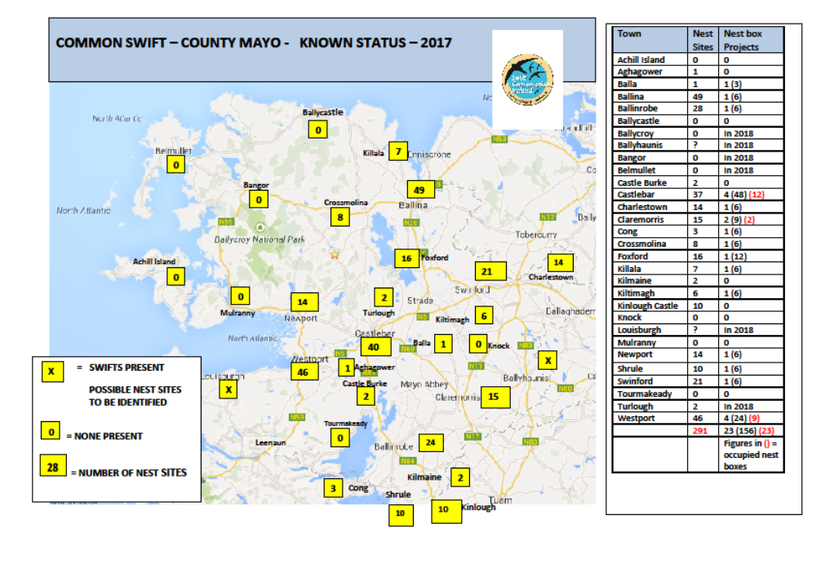

Slide 12
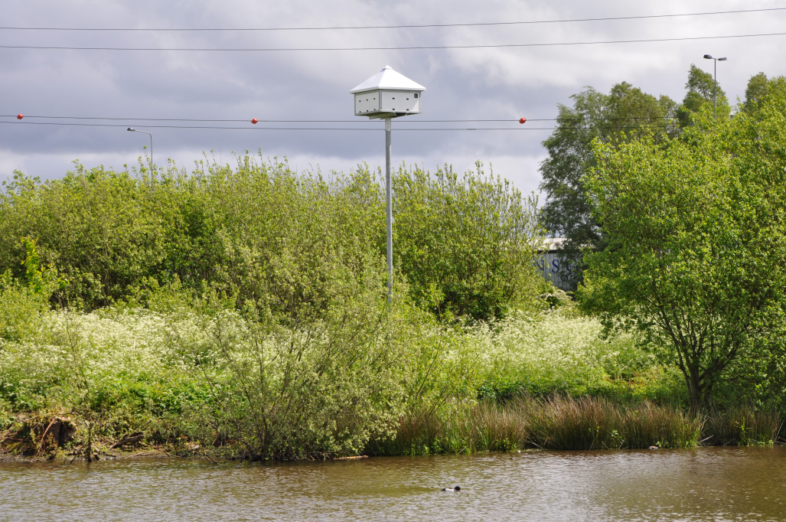
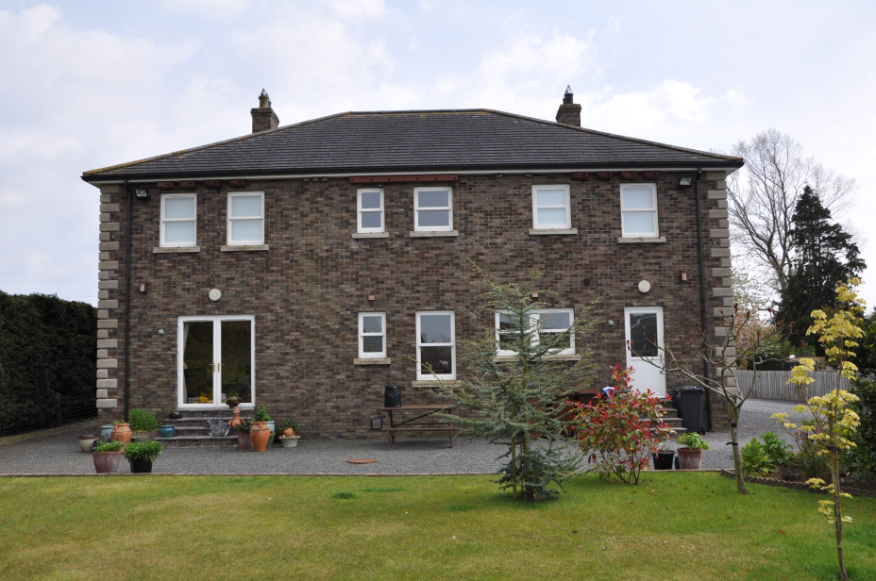
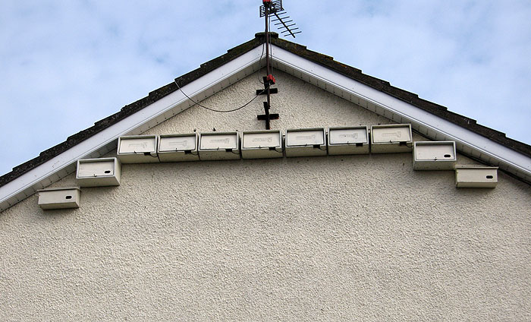
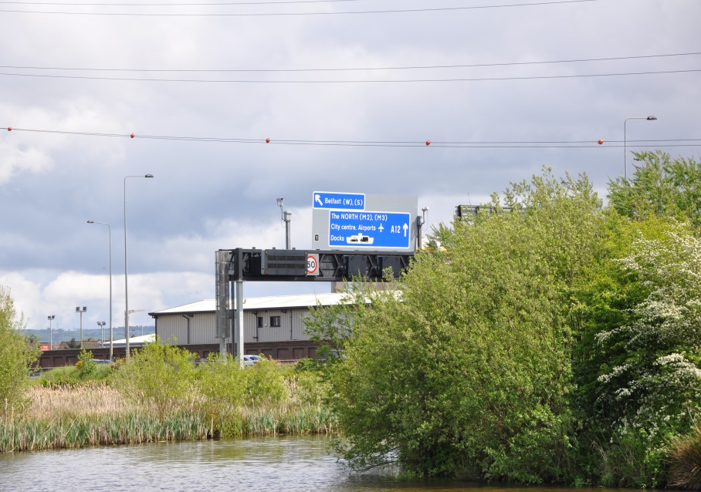
Co Antrim and Belfast
Notes:
Swift bricks in Antrim Library Top left Crescent Arts Centre Top right House in Antrim town bottom left and built in swift bricks in Skainos Building Belfast – Your own colony – Antrim Coast and Glens

Slide 13
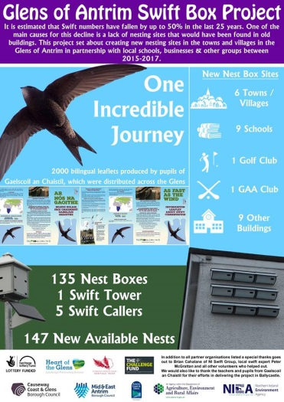

Slide 14
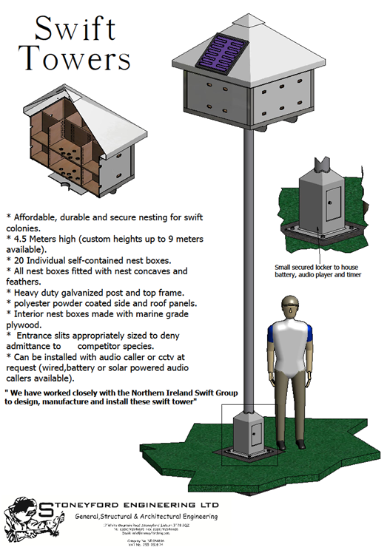
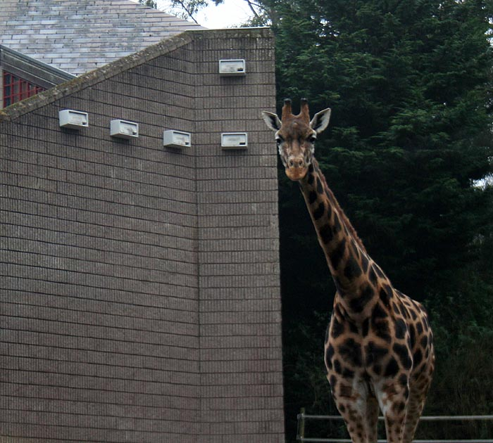

Slide 15

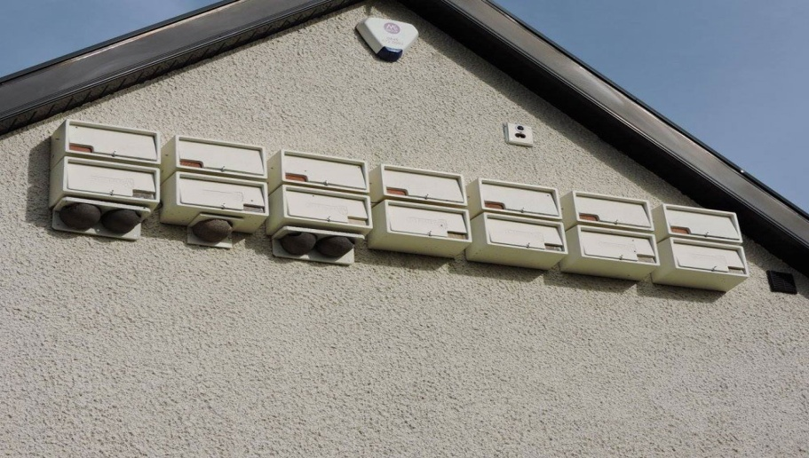
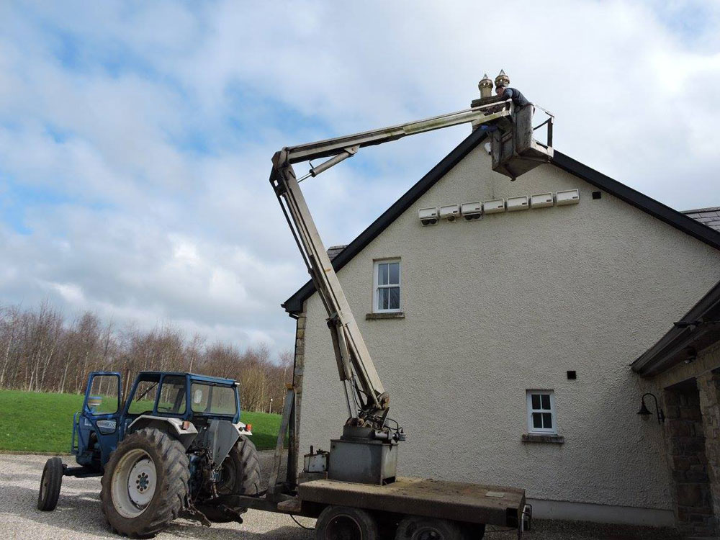
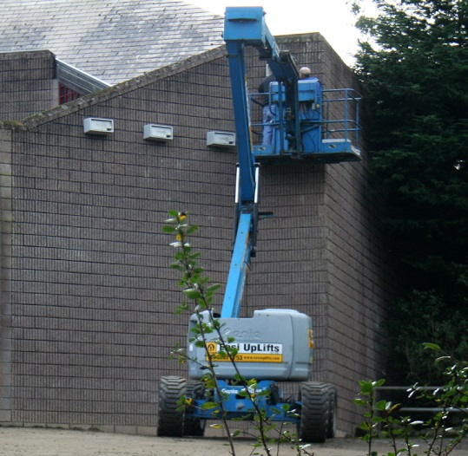
Health Warning! - It can become an addiction!
Notes:
This conference is an example of that

Slide 16
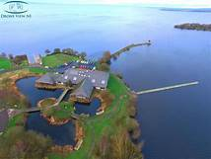
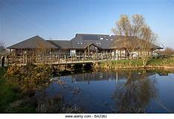
ARRIVAL TIMES
FIRST HATCH OF LOUGH NEAGH FLIES MID APRIL
SECOND HATCH JUNE
THIRD HATCH AUGUST
FIRST SWIFTS USUALLY AT LOUGH NEAGH
11TH APRIL ONWARDS
OXFORD
ISLAND

Slide 17
BOX BI 2014
ADULT ON NEST SECOND ADULT FIRST EGG FLEDGING LAST ADULT
16TH APRIL 24TH APRIL 9TH MAY 8TH JULY 18TH AUGUST 41 DAYS
BOX BI 2015
ADULT ON NEST SECOND ADULT FIRST EGG FLEDGING LAST ADULT
16TH APRIL 24TH APRIL 1ST MAY 5TH JULY 18TH AUGUST 44 DAYS
BOX B1 2017
ADULT ON NEST SECOND ADULT FIRST EGG FLEDGING LAST ADULT
18TH APRIL 23RD APRIL 3RD MAY 12TH JULY 11TH SEPTEMBER 61 DAYS

Slide 18
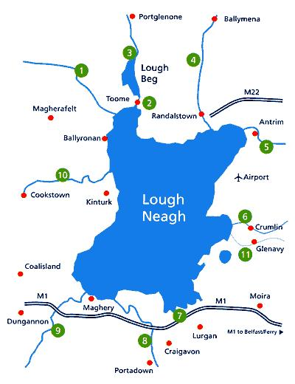
GPS TRACKERS
MARK’S HOUSE
BELFAST
13km
PORTMORE LOUGH
Golf club
River Lagan
3 Reservoirs
River
Portmore Lough
Lough Neagh
SITE NO 2

Slide 19
TOTAL NO OF VISITS JUNE 23rd 2011
33
NO
OF
VISITS.
WARM DRY DAY
HOURS.
4 5 6 7 8 9 10 11 12 1 2 3 4 SIESTA 7 8 9 10

Slide 20
TOTAL NO OF VISITS JUNE 24th 2011
31
VERY WET DAY
NO
OF
VISITS.
HOURS.
4
5
6
7
8
9
10
11
12
1
2
3
4
SIESTA
7
8
9
10

Slide 21
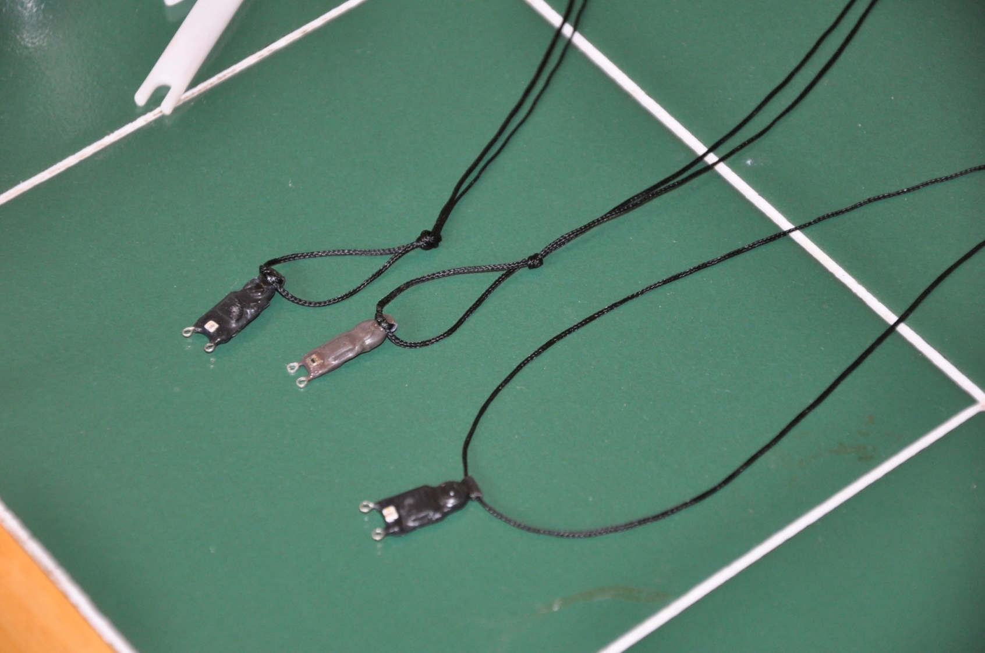

GPS LONG RANGE TRACKERS

Slide 22
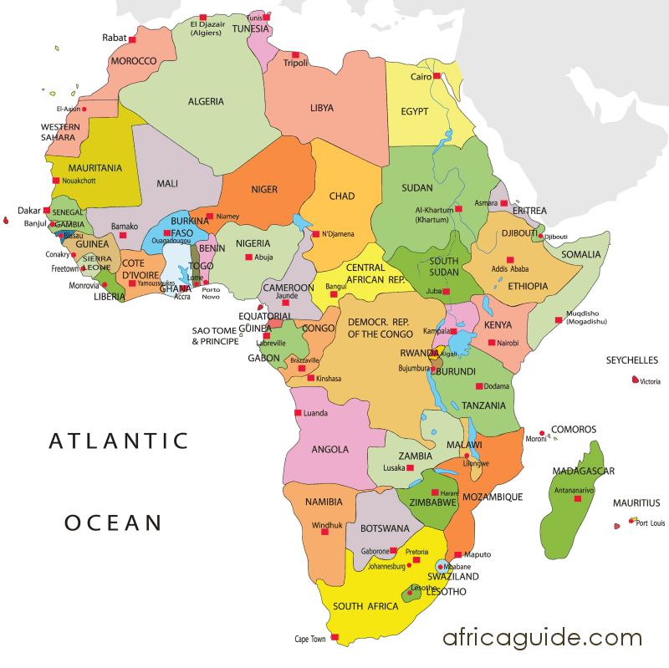

Slide 23
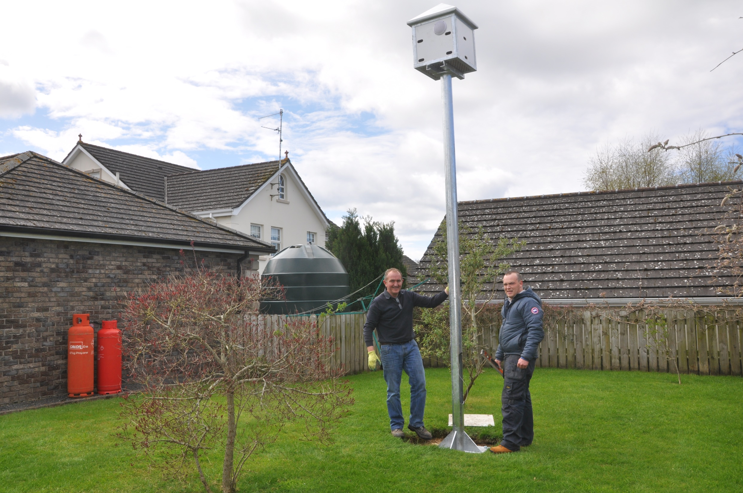

Slide 24
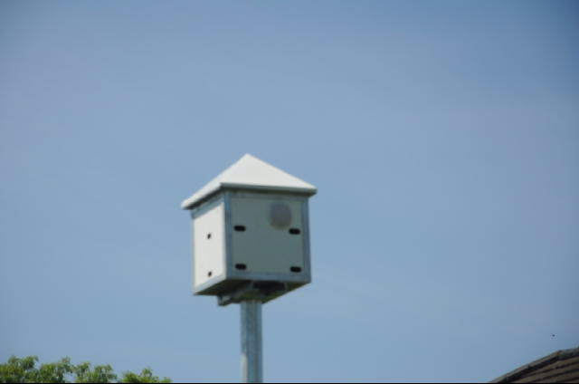

Slide 25
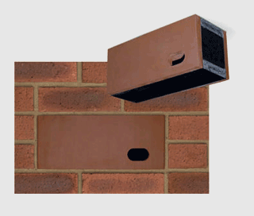
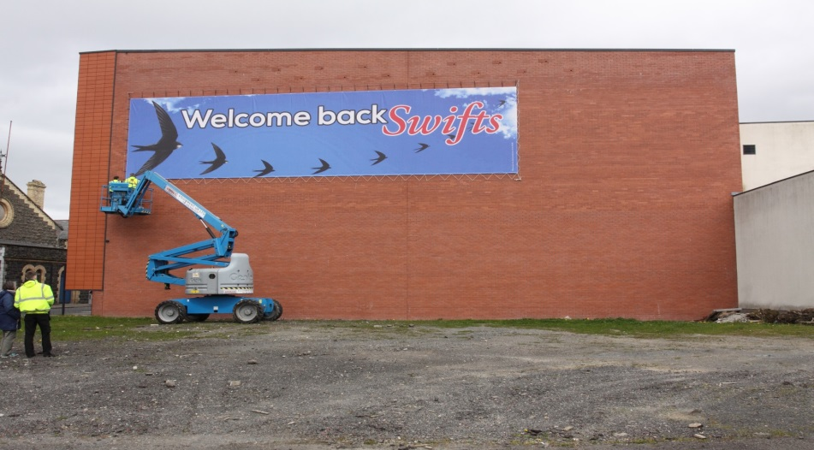
Welcome back swifts to Antrim

Slide 26
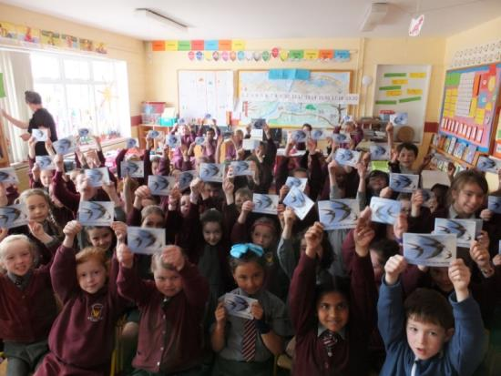
Working Together for the Swifts

Slide 27
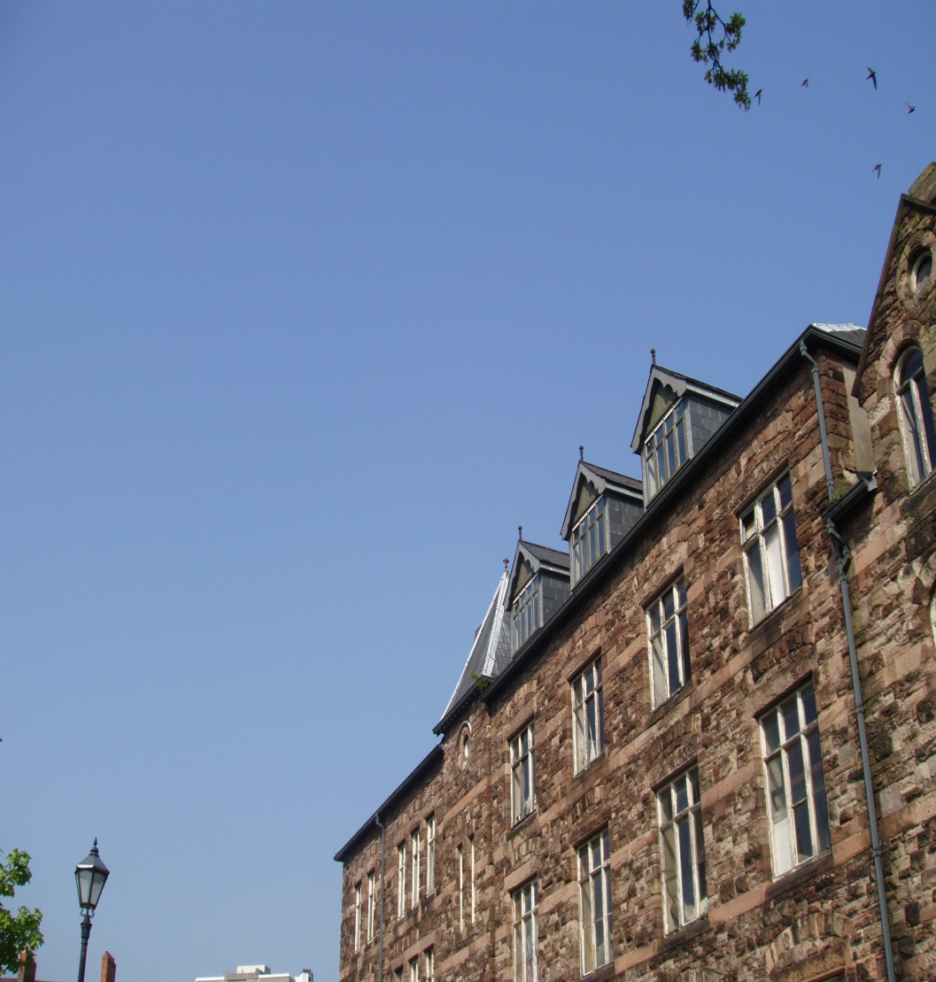
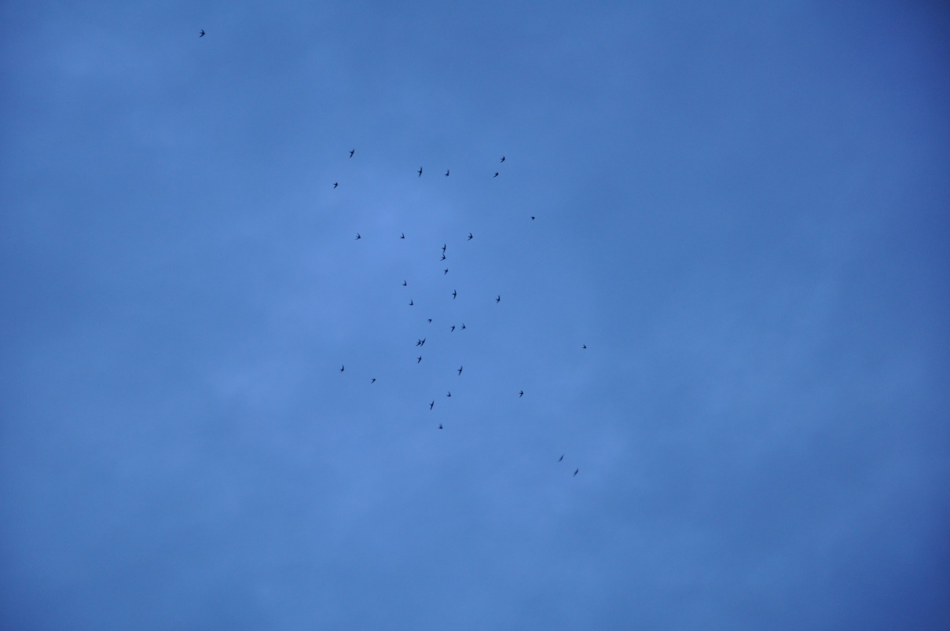
DEPARTURE
THOMAS GRAY
“AND LEAVES THE WORLD TO DARKNESS AND TO ME”
THANK YOU
Notes:
Lets hope they come back again for another 100 years and beyond. Thank you

