Slide 1
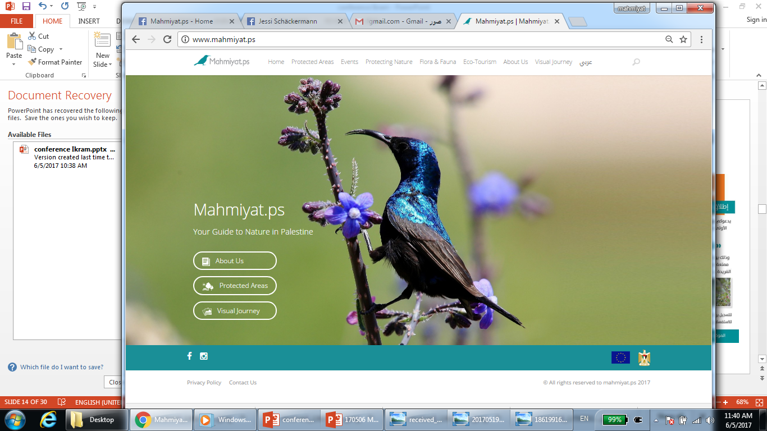

Environmental awareness
from the virtual world to the real world
Presenter: Ikram Quttaineh
Swift Conference – March 2018

Slide 2

Mahmiyat.ps
The first web presence for the Palestinian nature reserves.
It aims at encouraging the Palestinian Society to conserve the nature reserves and promotes ecotourism.

Slide 3
Situation in Palestine
373 recorded bird species , 13 IBA’s, 3 ringing stations
48 nature reserves, only 19 are handed over to the Palestinians (under Oslo Accords)
Undeveloped trails
Few flora and fauna specialists

Slide 4
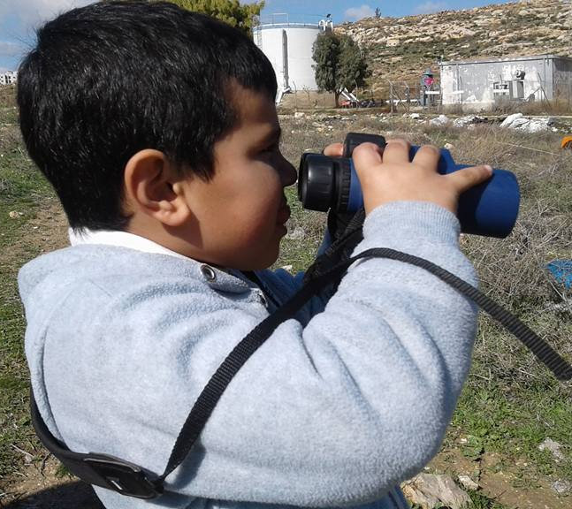
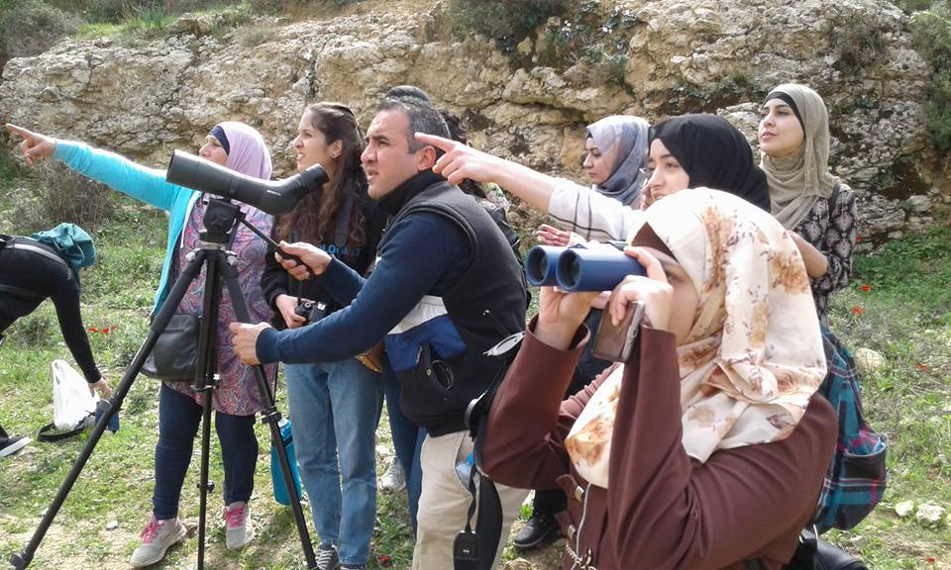
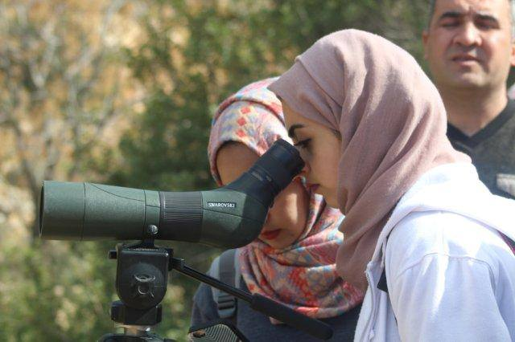
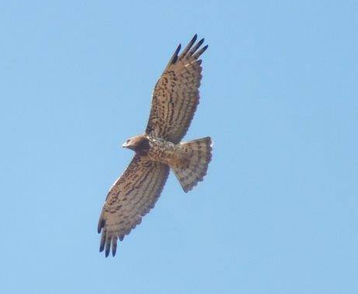
Ecotourism in Palestine
Ecotourism is a new form of free time activity in Palestine
Just a hand full of trained ecotourism tour guides ad birdwatchers exist in Palestine.
Saed uses birdwatching in schools and universities for environmental education
All pictures by Saed Shomali

Slide 5
Environmental awareness in the virtual world

Slide 6
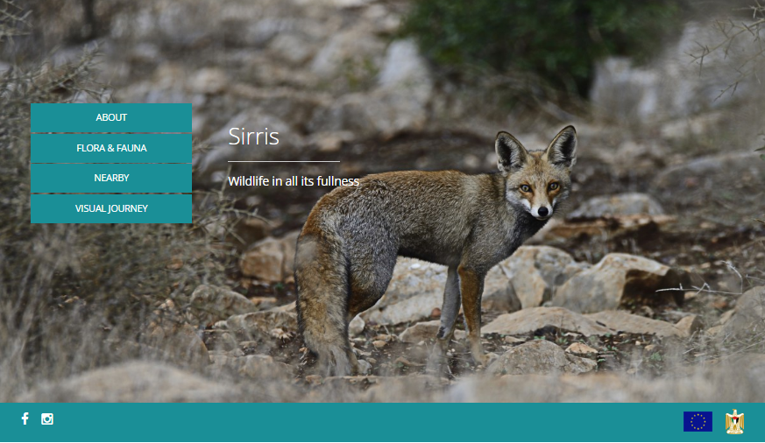
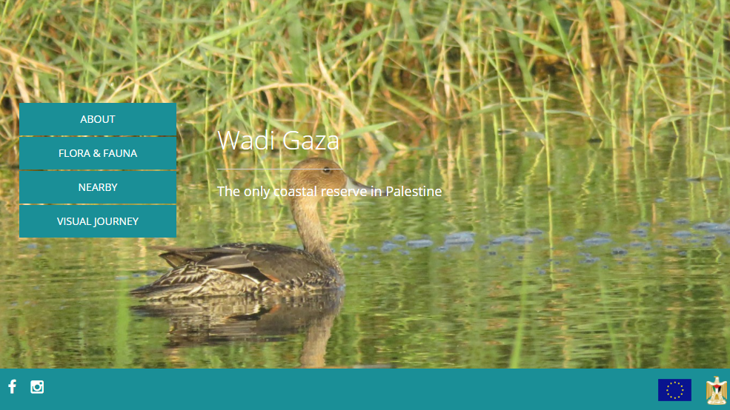
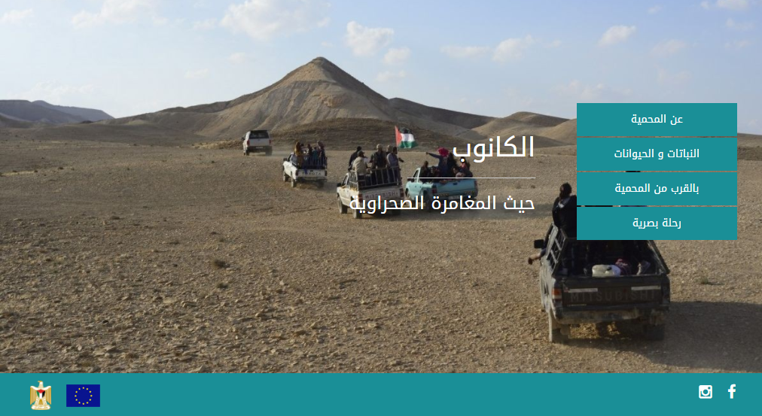
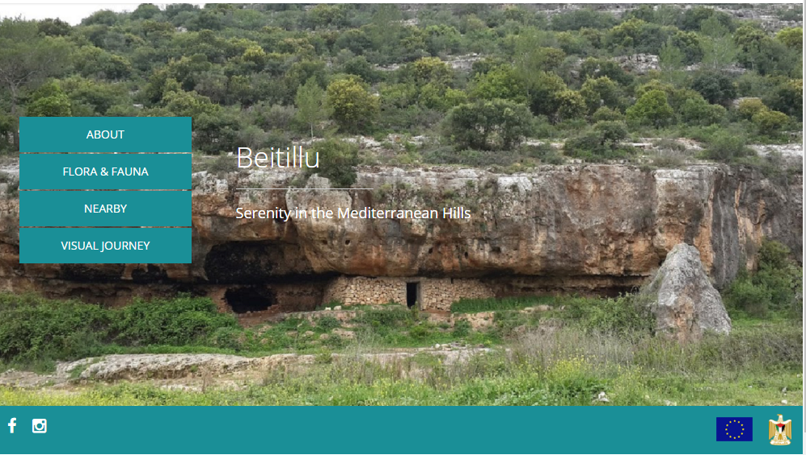

Slide 7
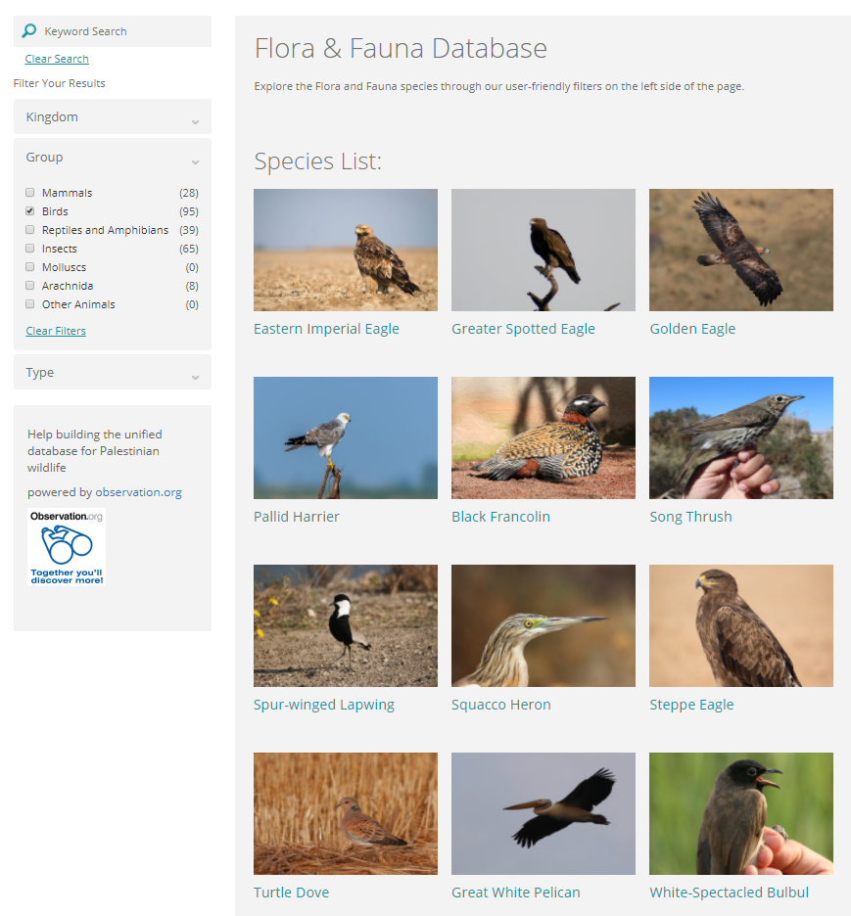
Flora & Fauna Database
Information on flora and fauna
Writers are all experts
Useful information, identification help, fun facts
For beginners and advanced nature lovers
Still growing database

Slide 8
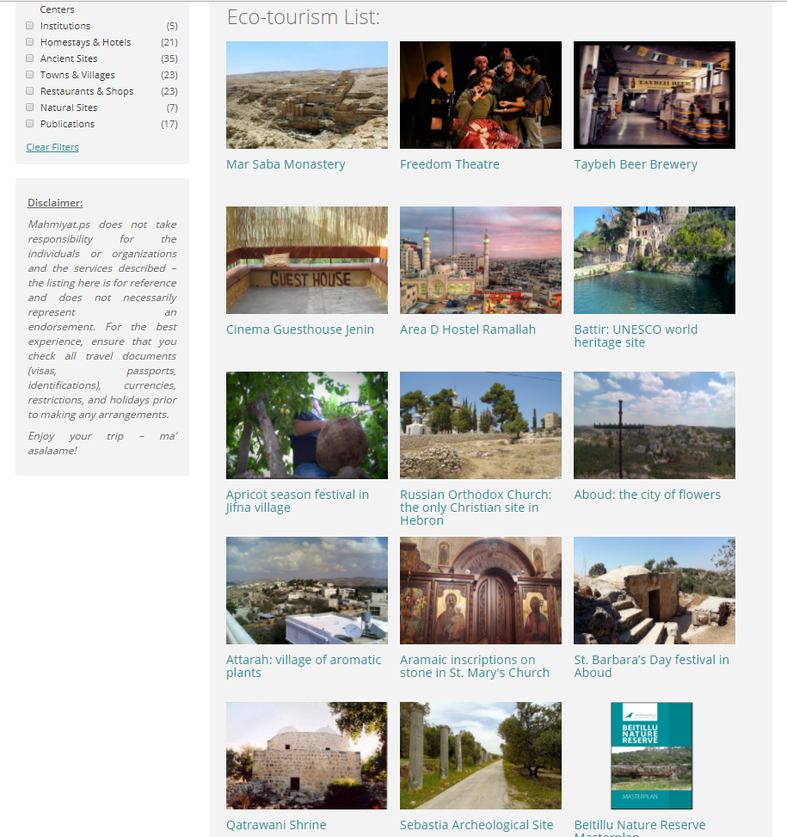
Ecotourism Database
Shop local products like soap, olive oil, fresh fruit, crafts, olive wood Christmas decoration, …
Visit a museum on Palestinian culture
Go cycling, rock climbing or cave climbing
Possibilities are endless

Slide 9
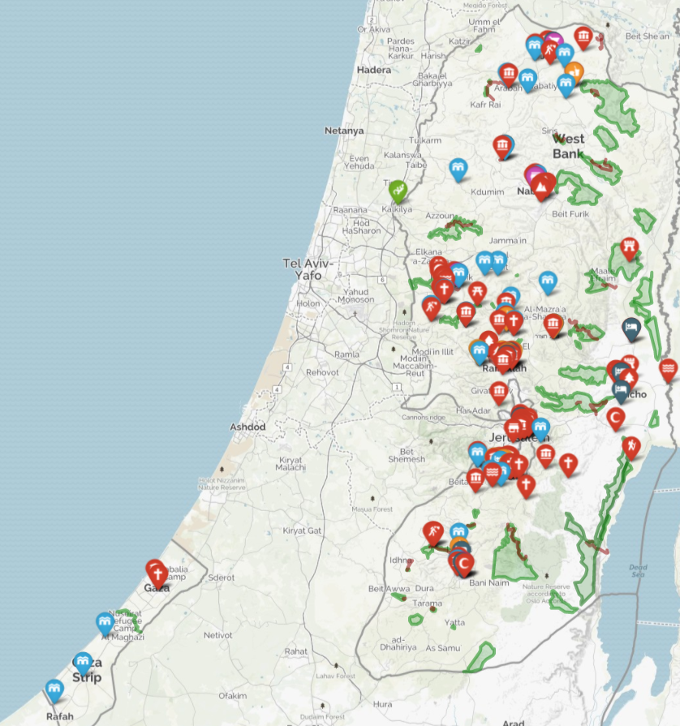
Find your way through Palestine's Nature
The interactive map on mahmiyat.ps shows you all the locations of interest concerning eco-tourism
Find your next travel destination, guesthouse, place to eat or information on the village you just passed!

Slide 10
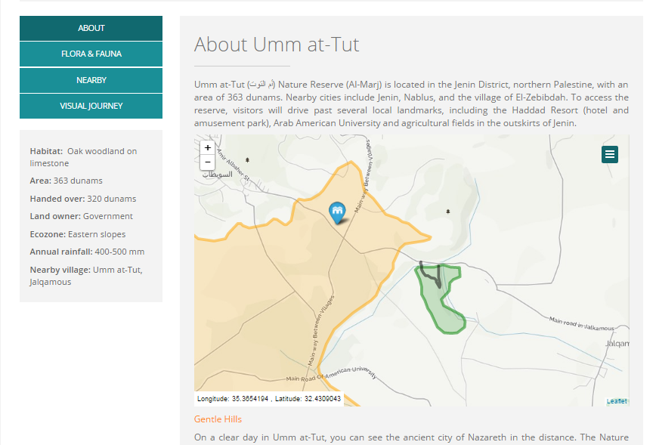

Slide 11
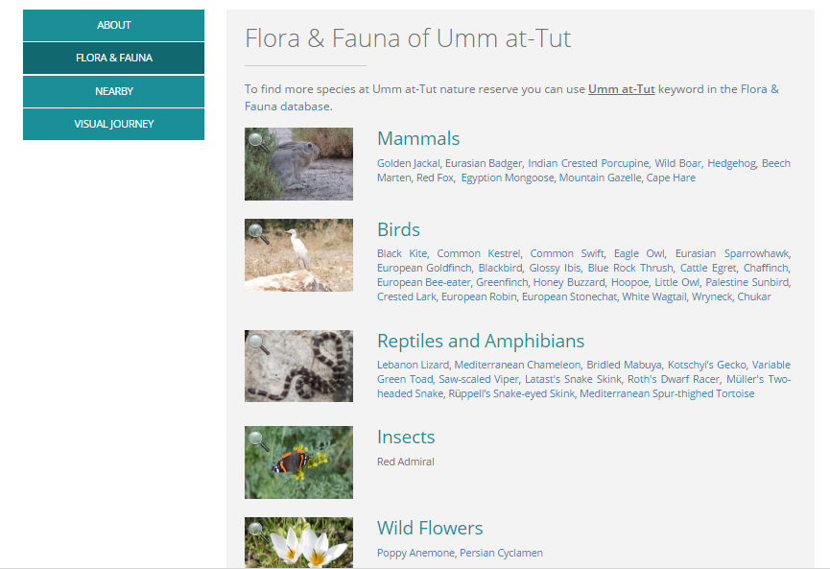

Slide 12
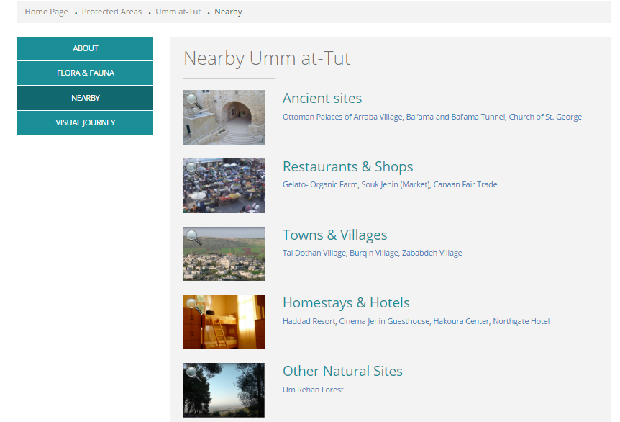

Slide 13
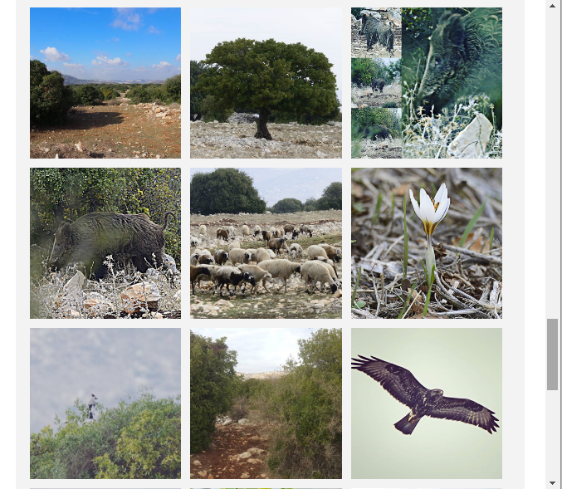
Visual Journey through the nature reserves

Slide 14
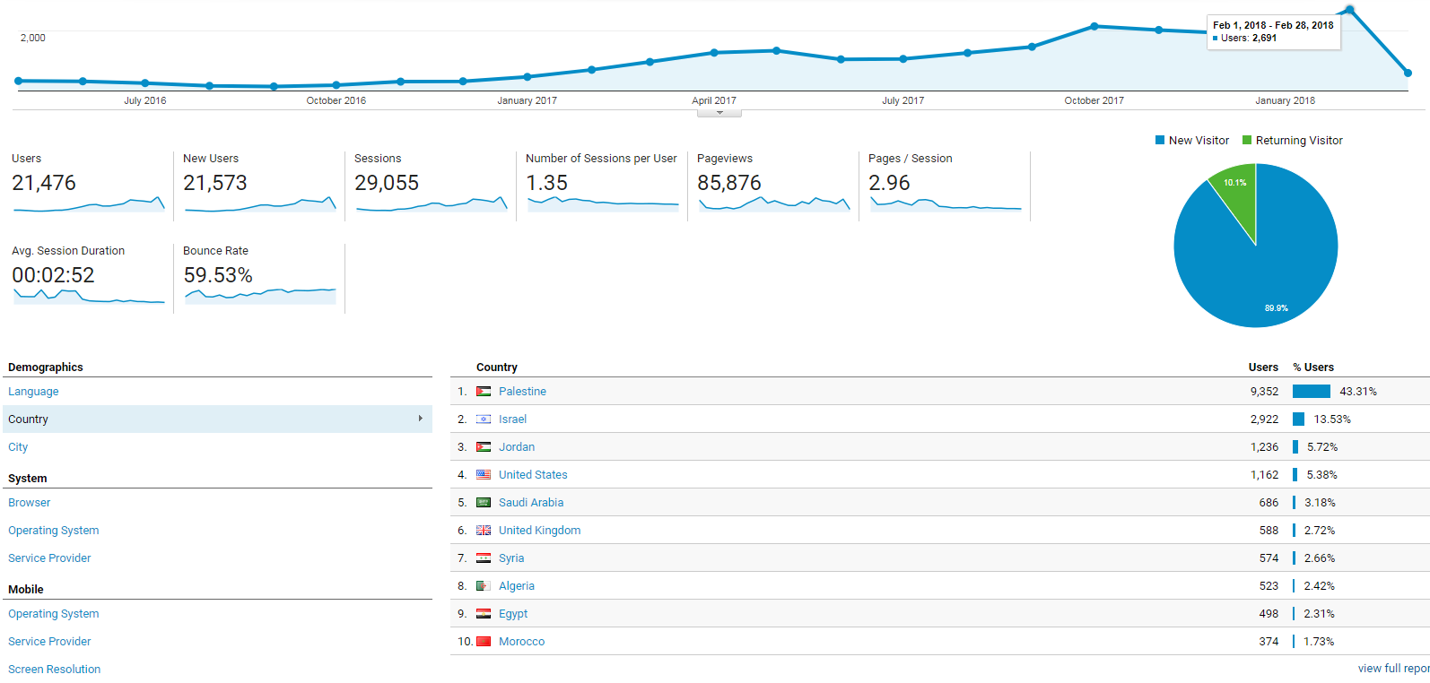

Slide 15
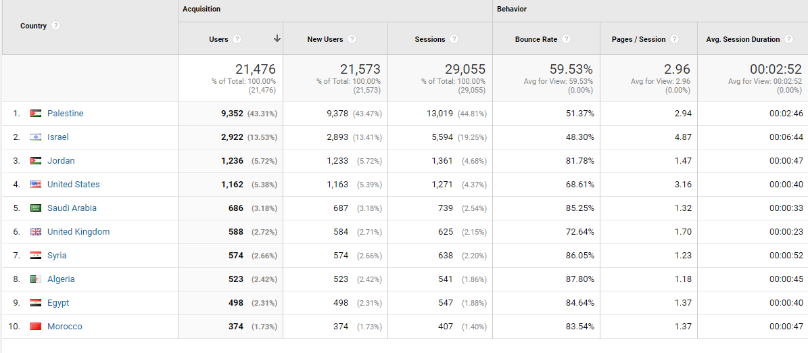

Slide 16
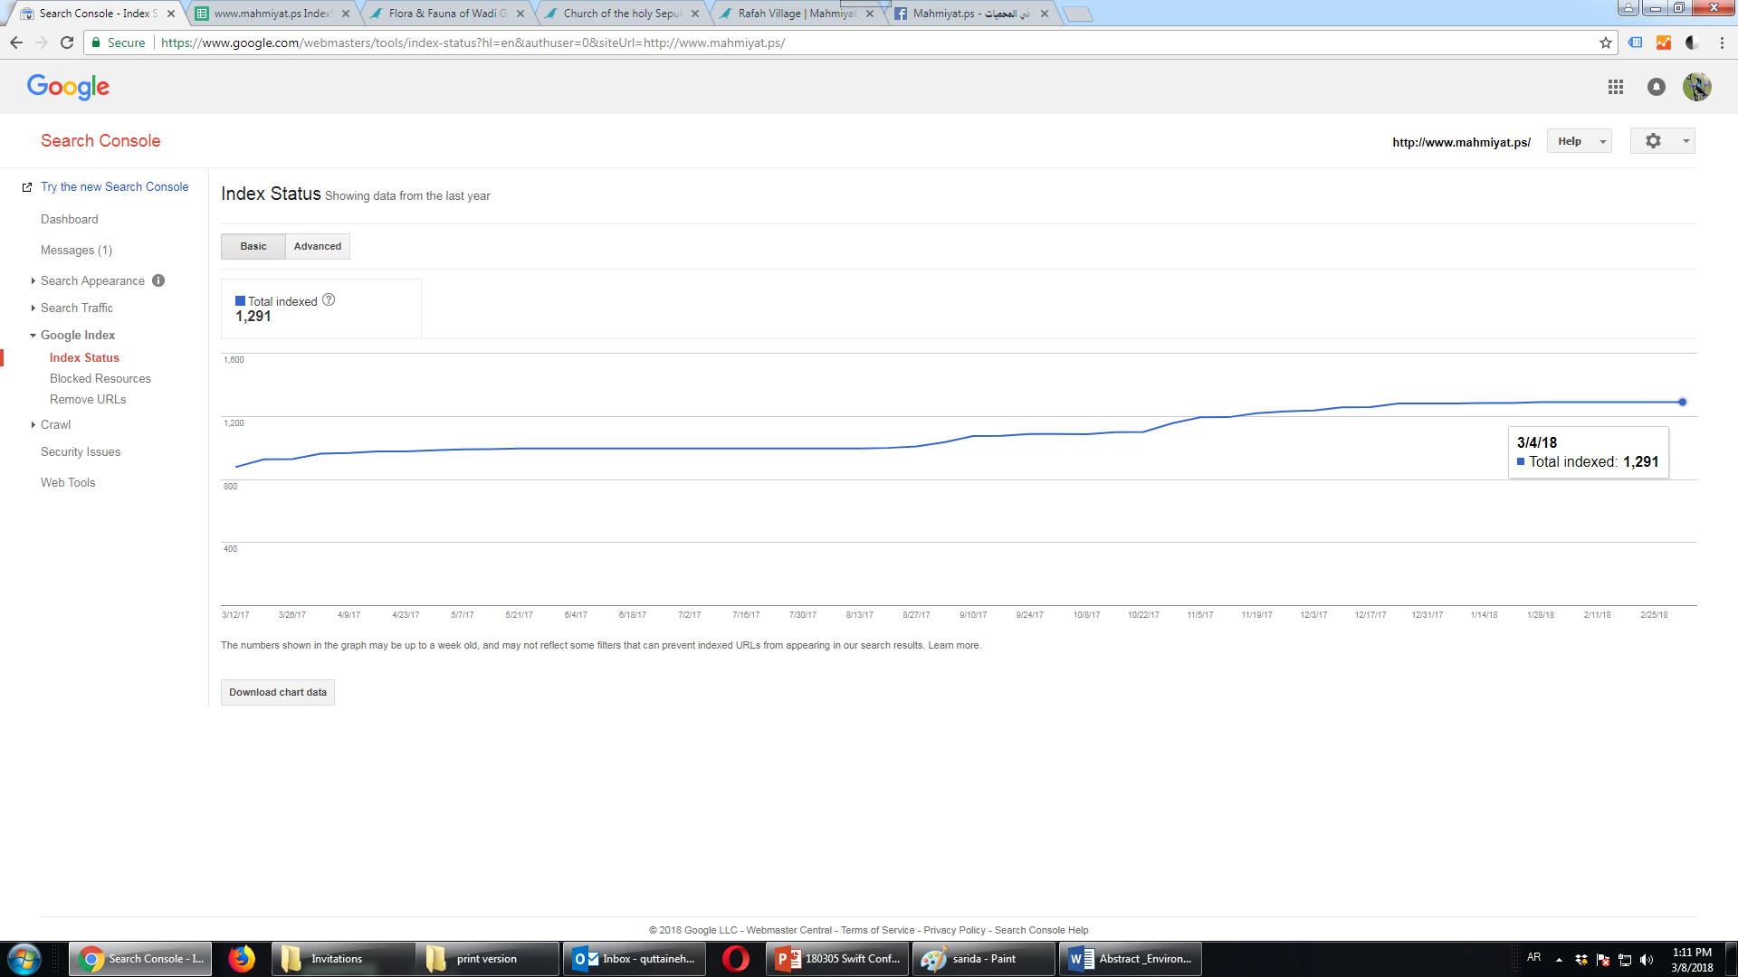

Slide 17
Environmental awareness in the real world

Slide 18
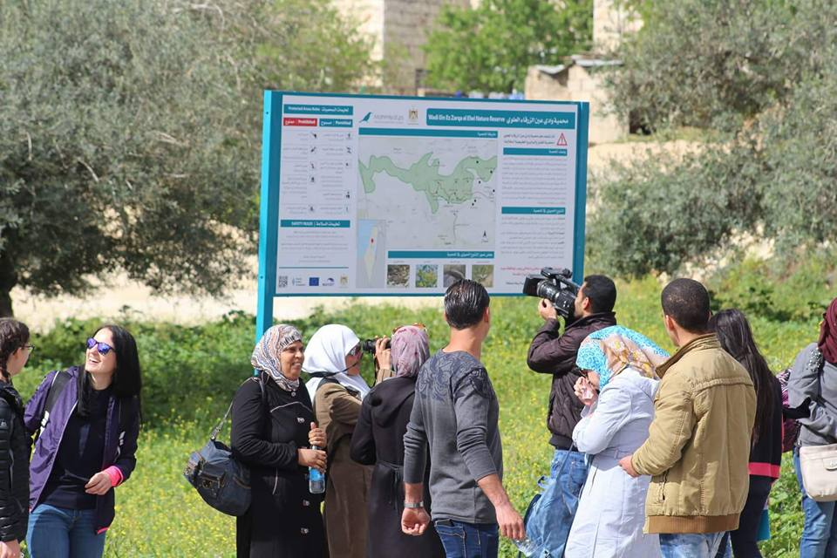
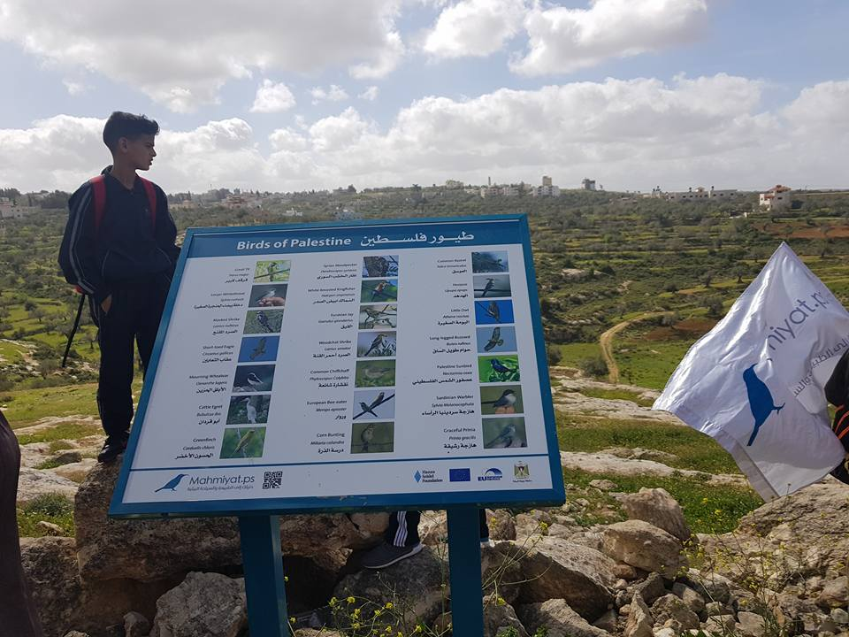
Installation of the first Palestinian guidance signs in the nature reserves

Slide 19
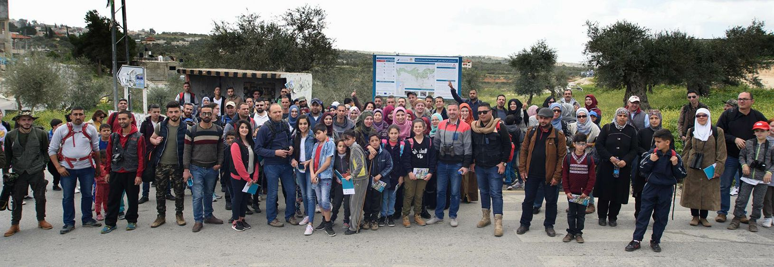
Community Events in the nature reserves

Slide 20
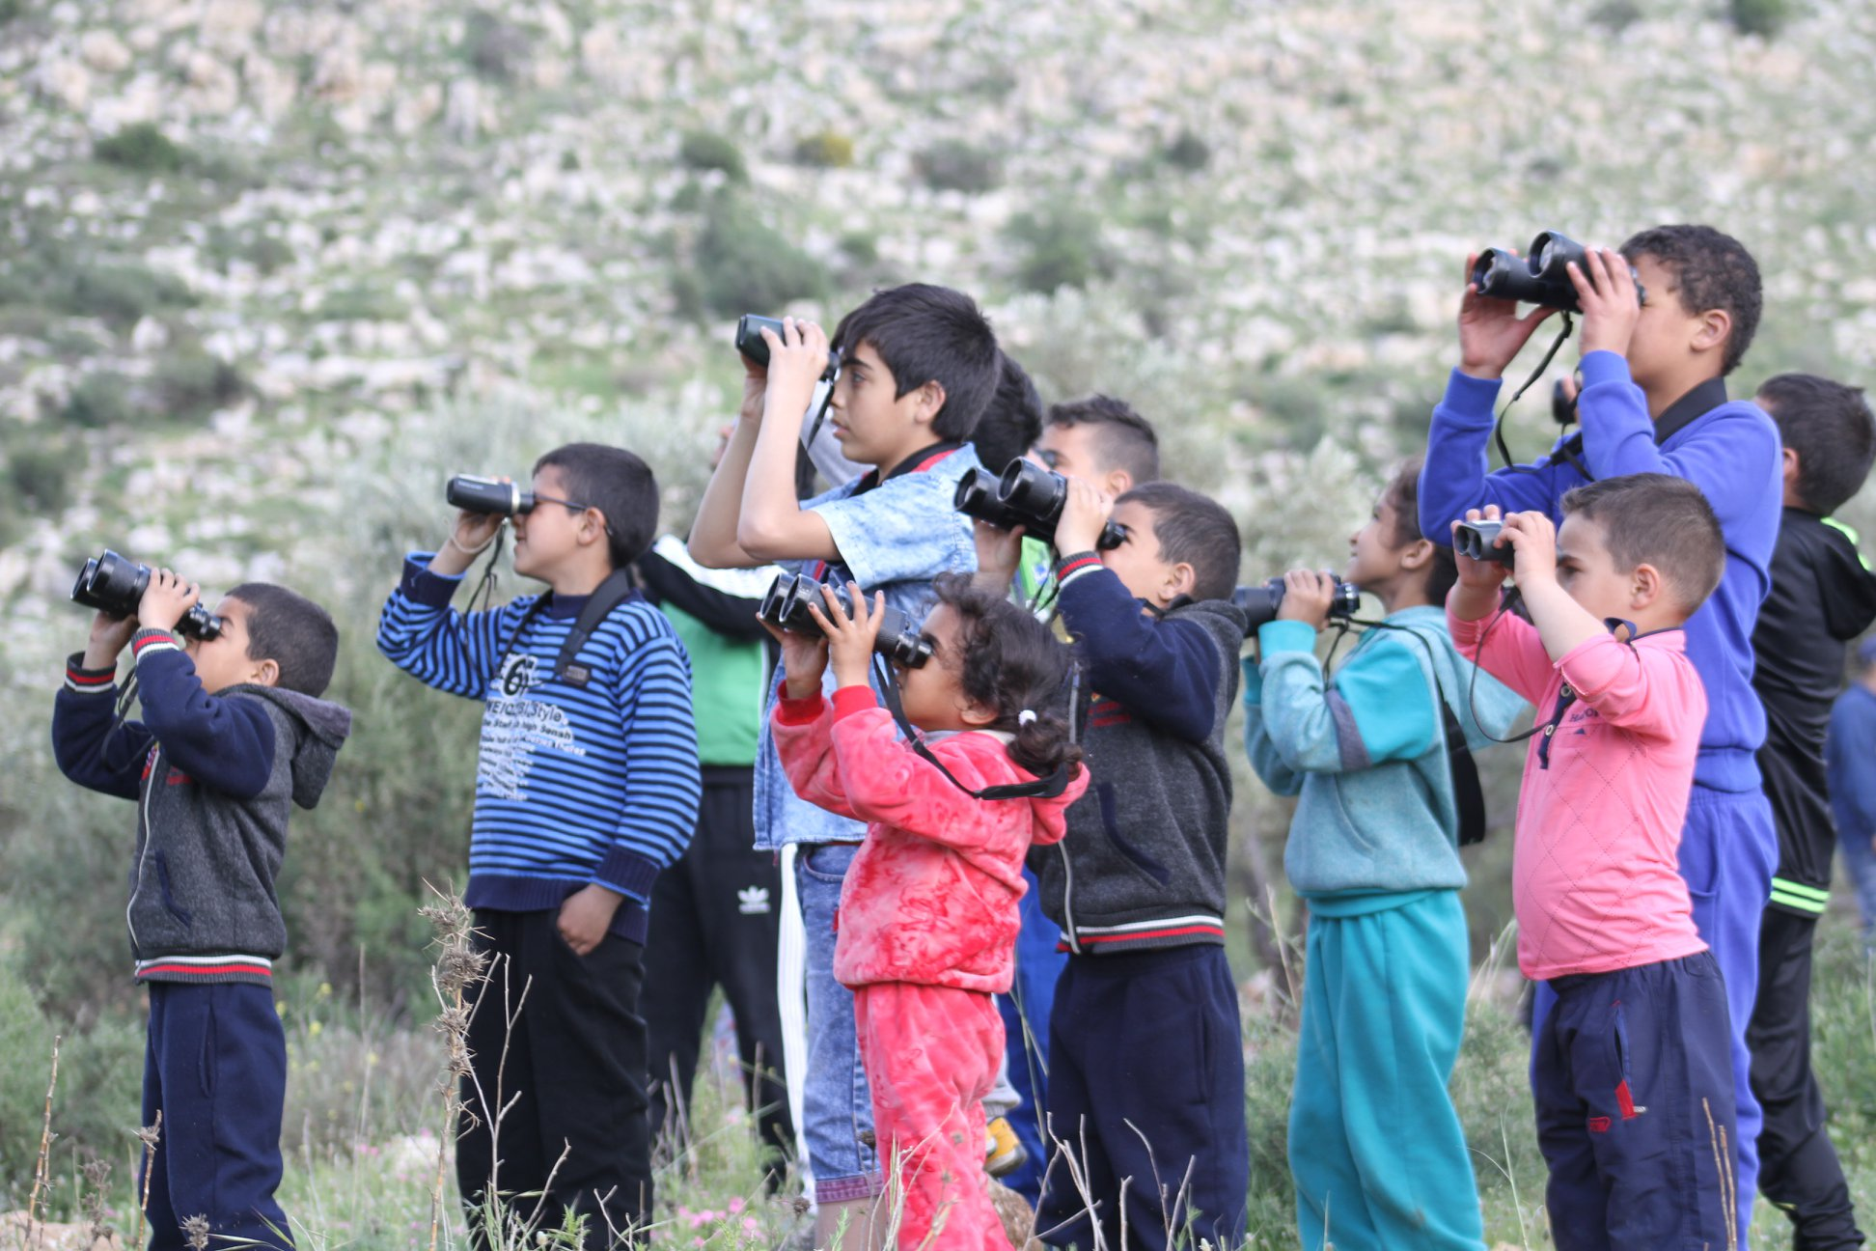
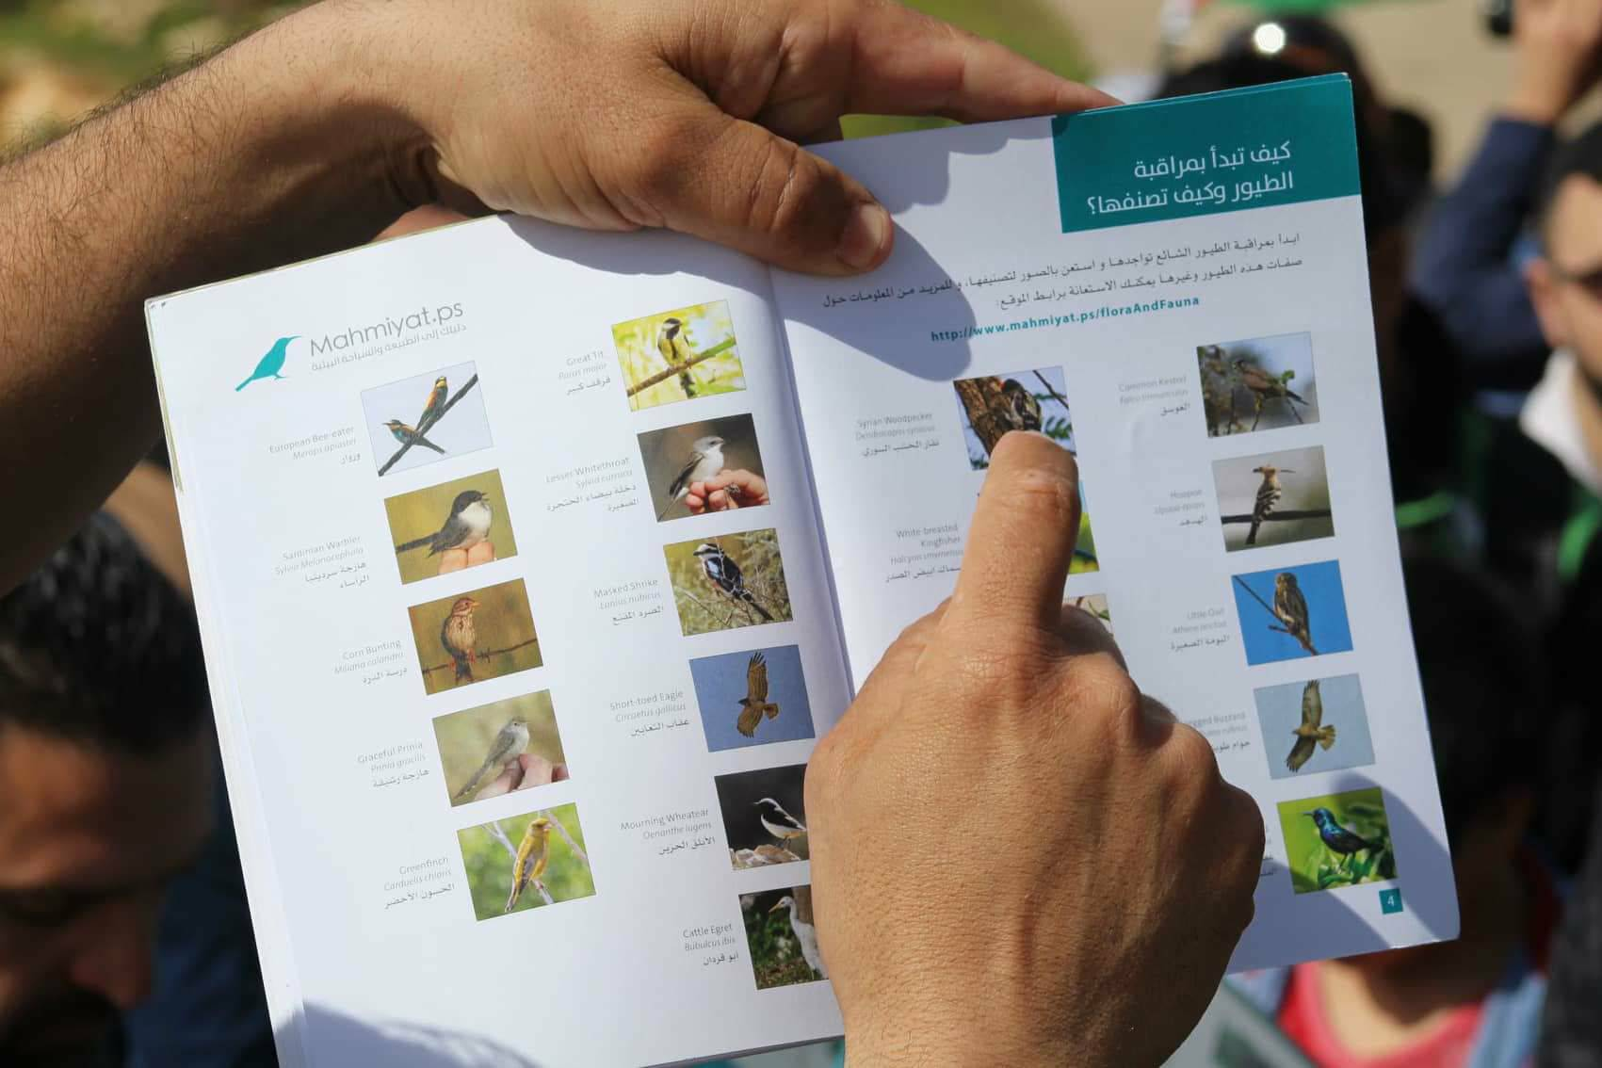
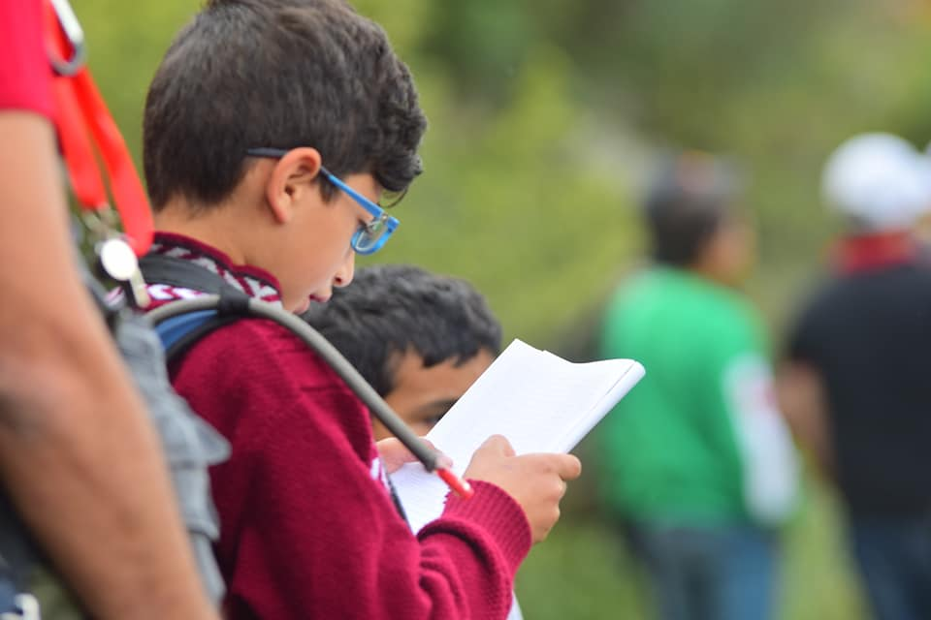
Bird Watching with families

Slide 21
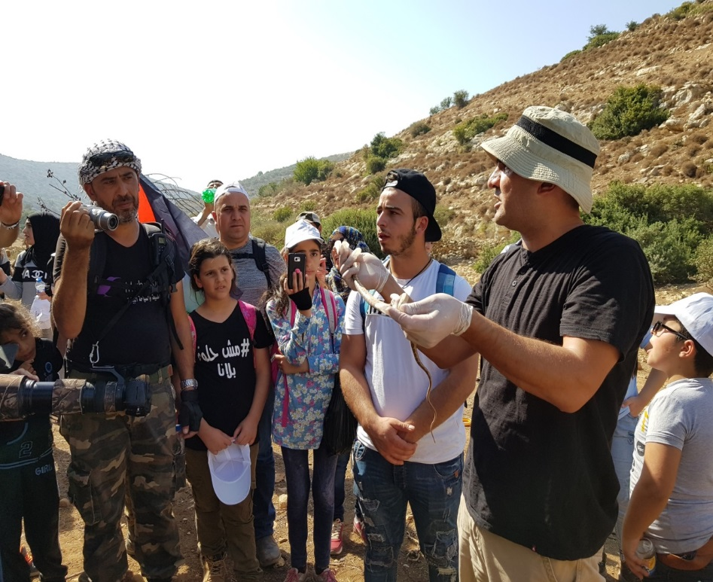
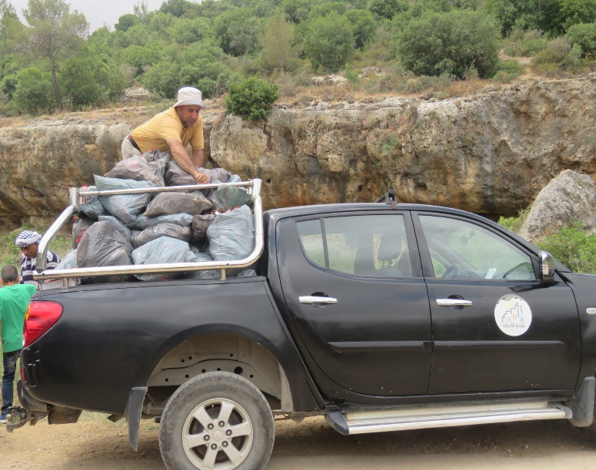
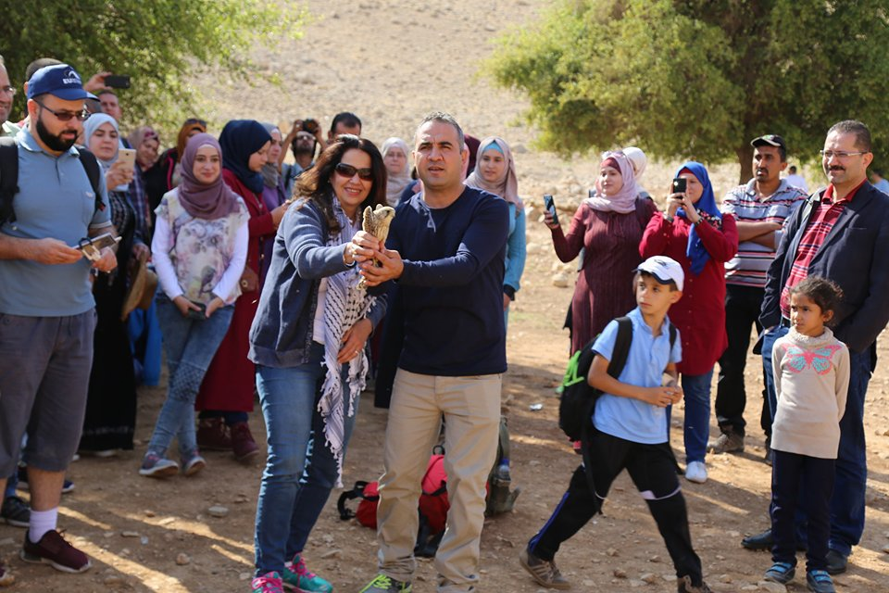
Release hunted birds and snakes to the nature
Cleaning campaigns in the nature reserves

Slide 22
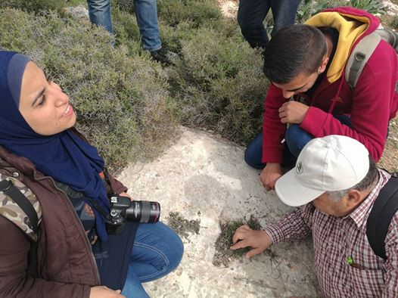
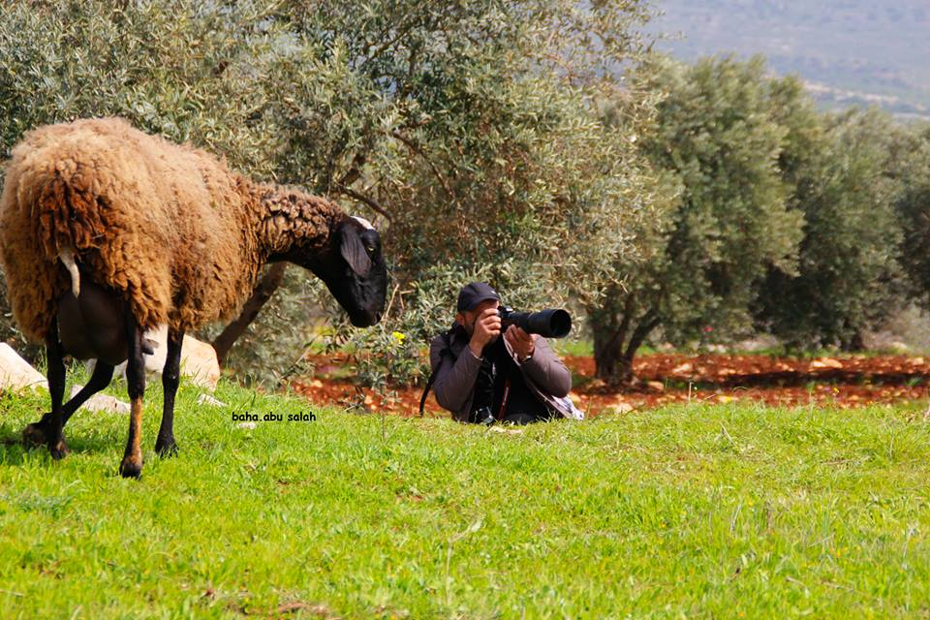
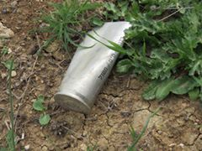
Learn about the flora and fauna
Learn about the threats (grazing, agriculture, Israeli settlements, littering etc. )

Slide 23
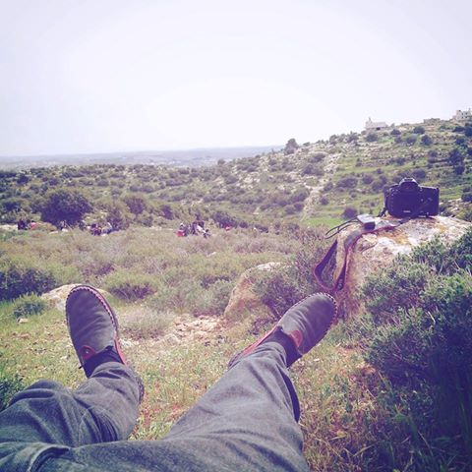
And enjoy !

Slide 24
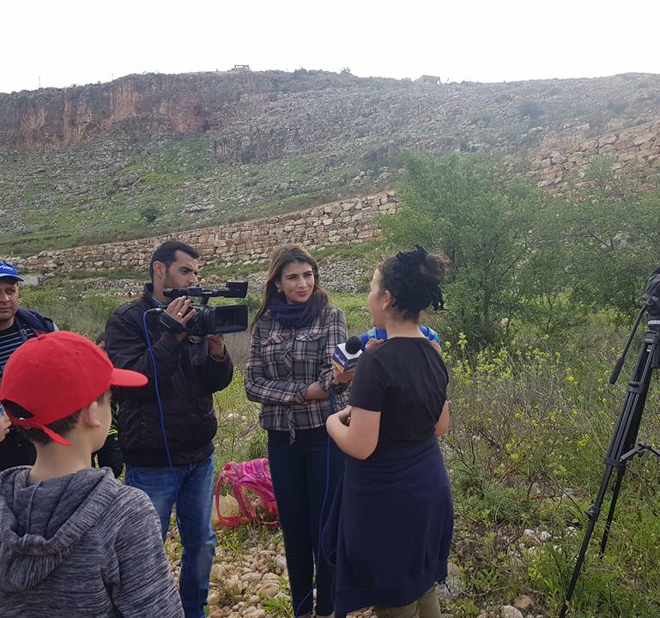
Media coverage for the events
(national TV. , newspapers, radio etc)

Slide 25
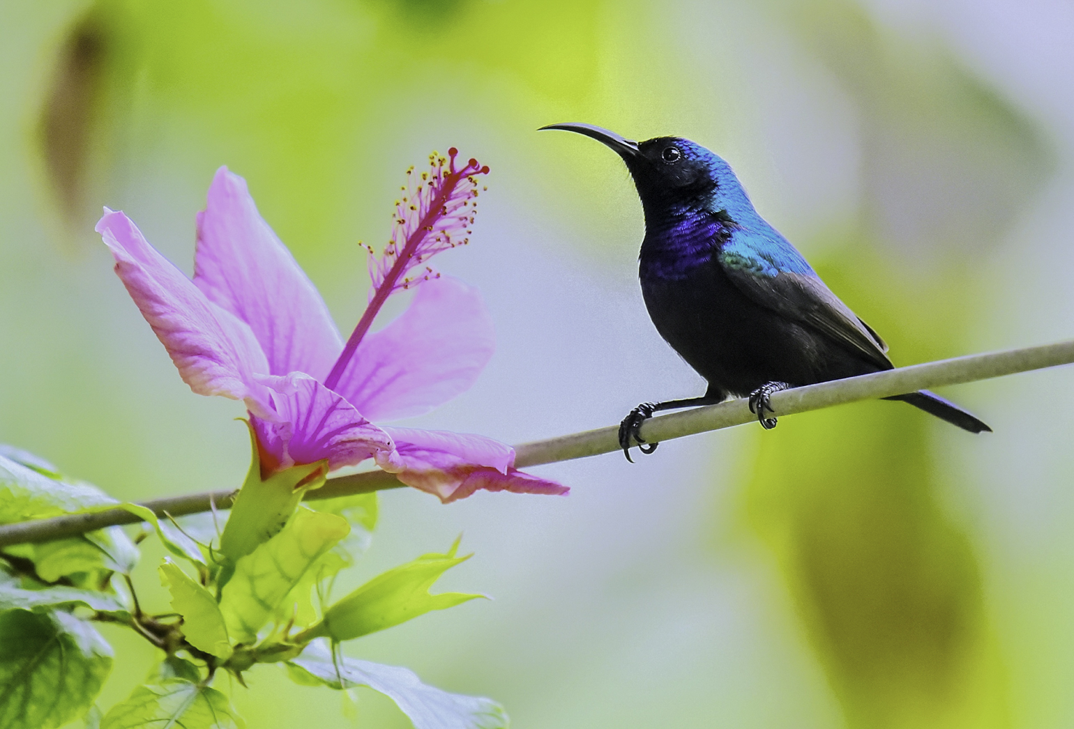
Implemented 15 community events
Visited 25 nature reserves in 2016 & 2017
Number of Participants : 3500

Slide 26
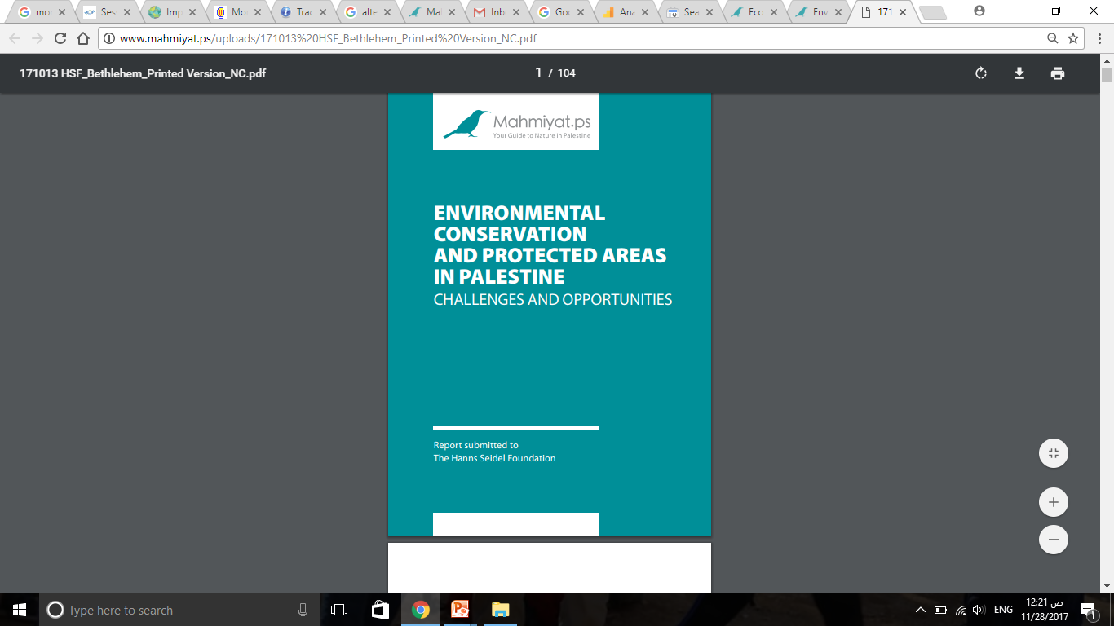
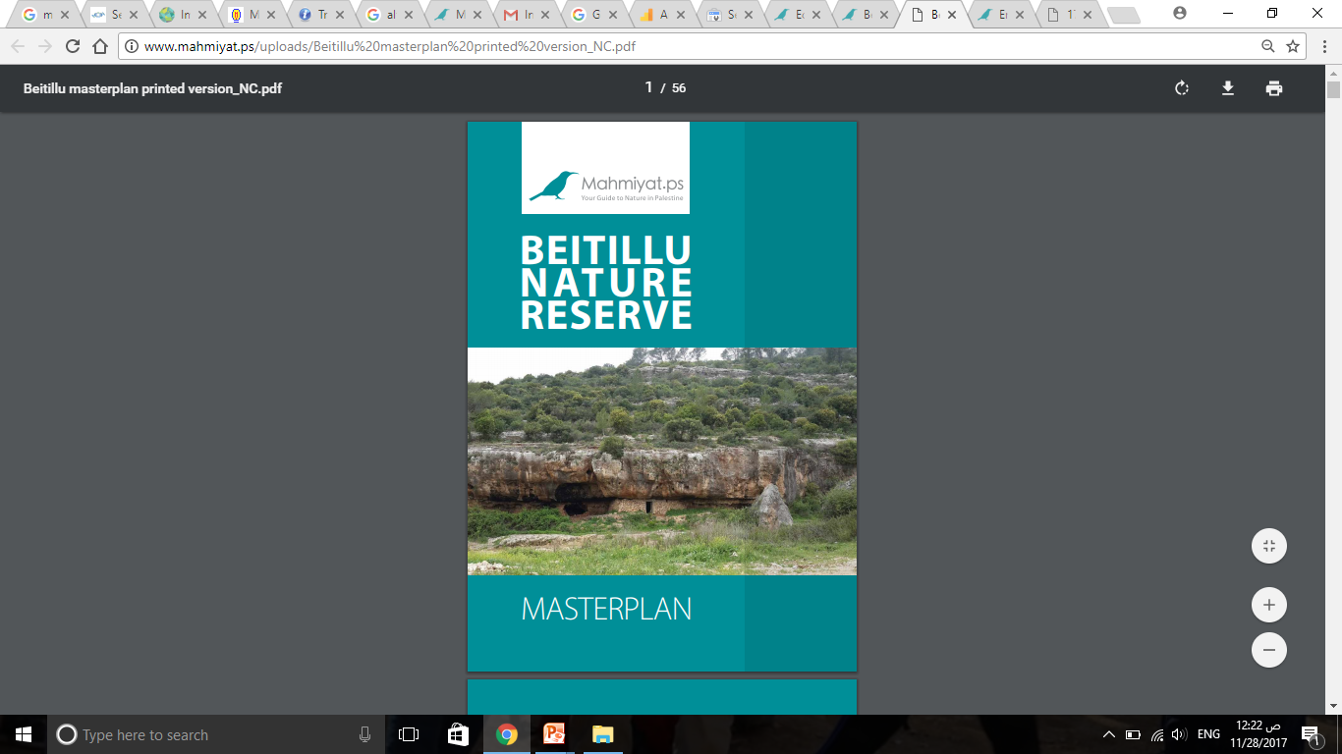
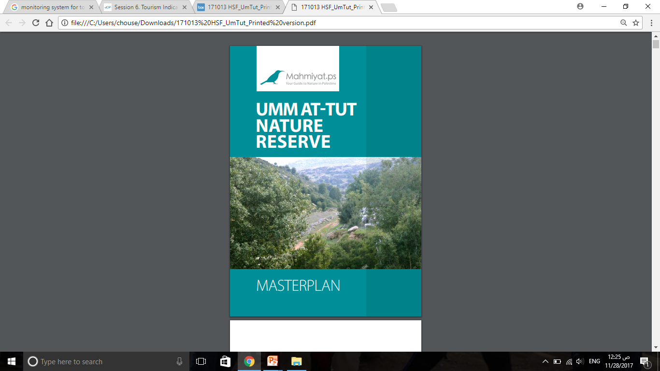
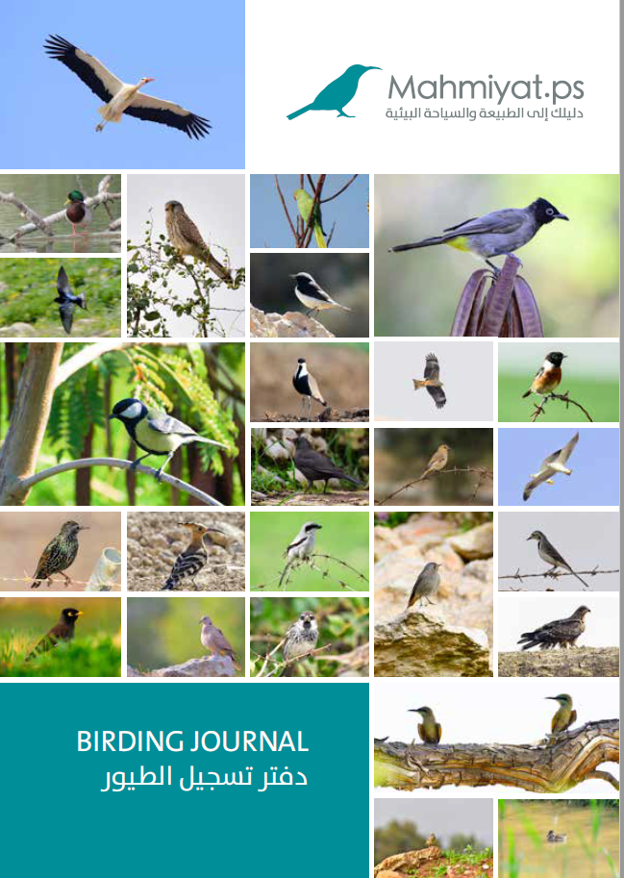
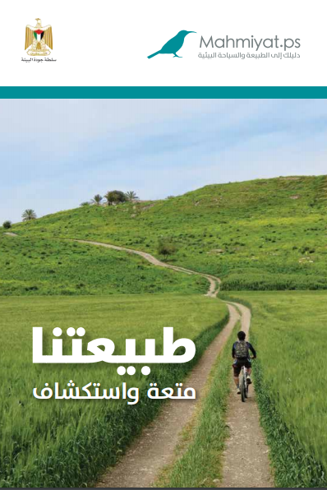
Publications
Planners Level
Community Level

Slide 27
Bottom-up Approach
Decision-makers Level
Planners Level
Local Community Level
Advocating the nature reserves
to the authorities
Empowerment of local community

Slide 28
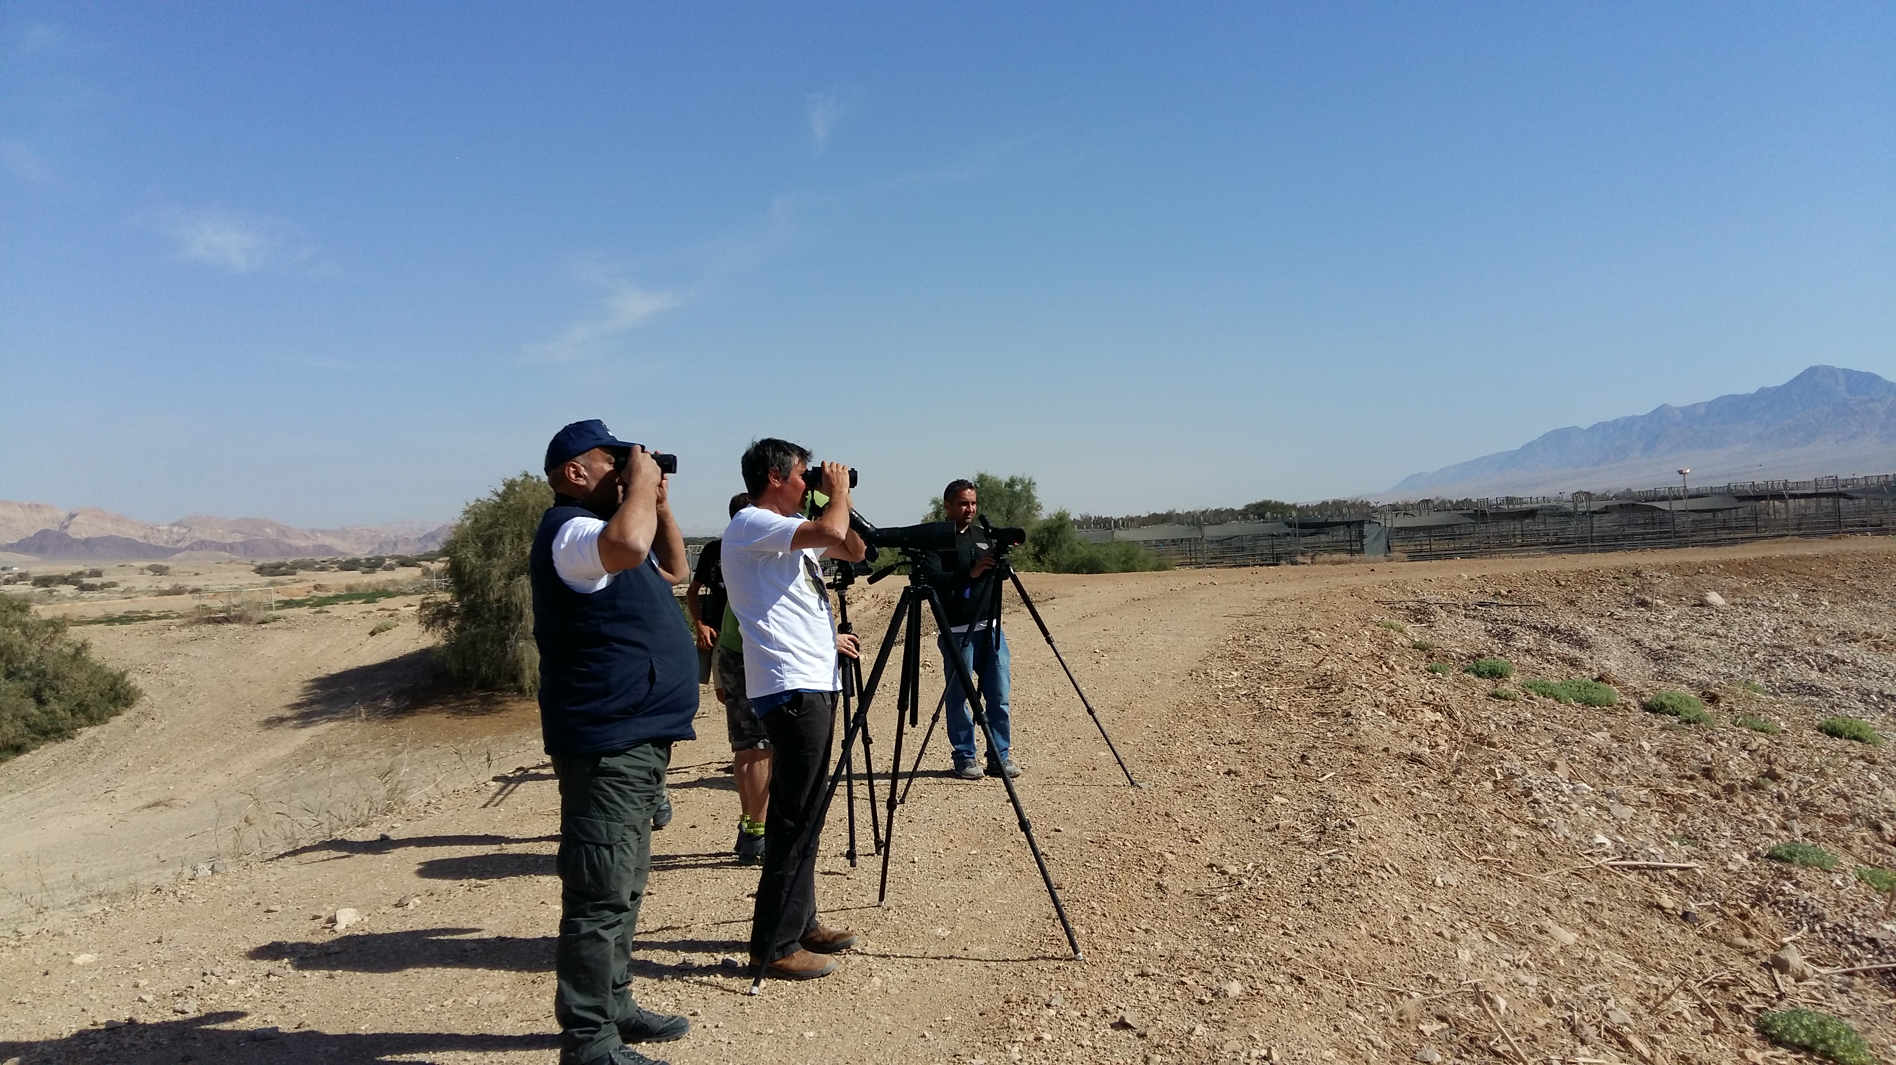
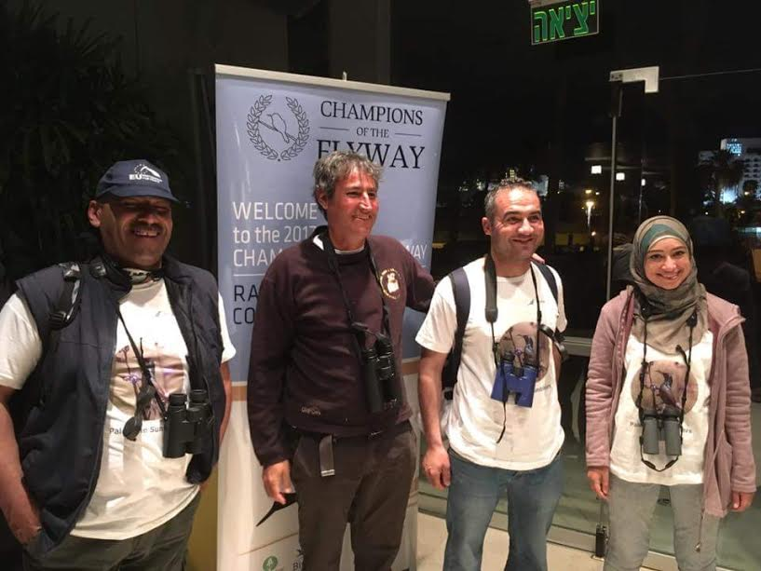
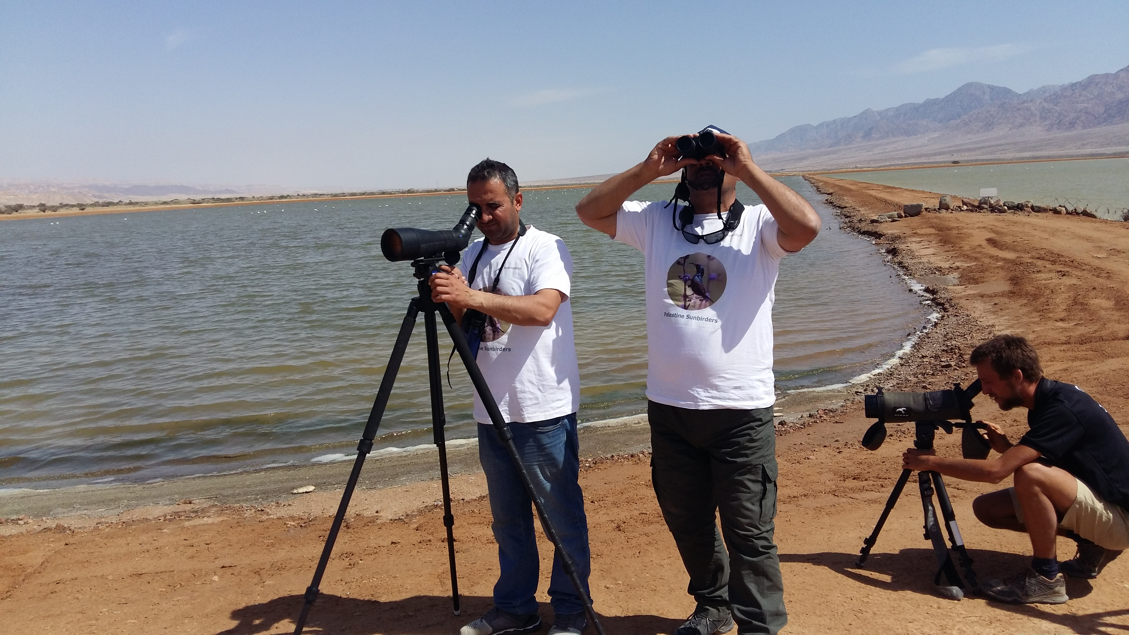
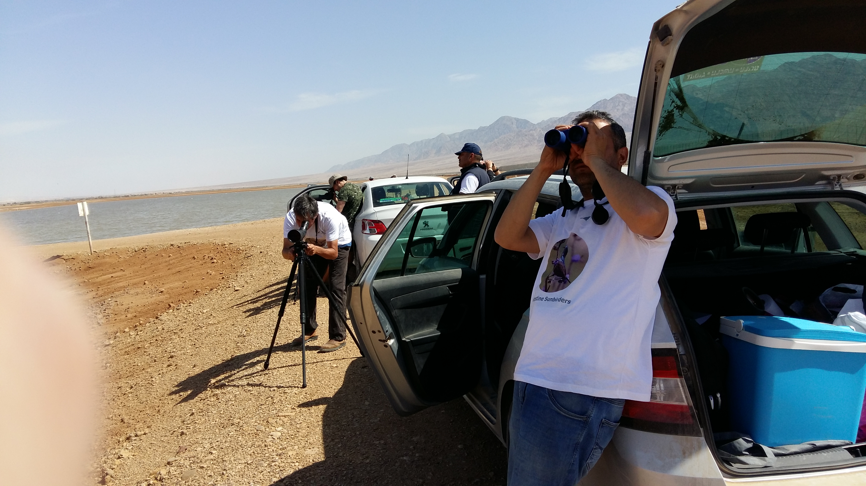
Sponsoring The Palestine Sunbirders Team
Champions of the flyway 2016, Eilat

Slide 29
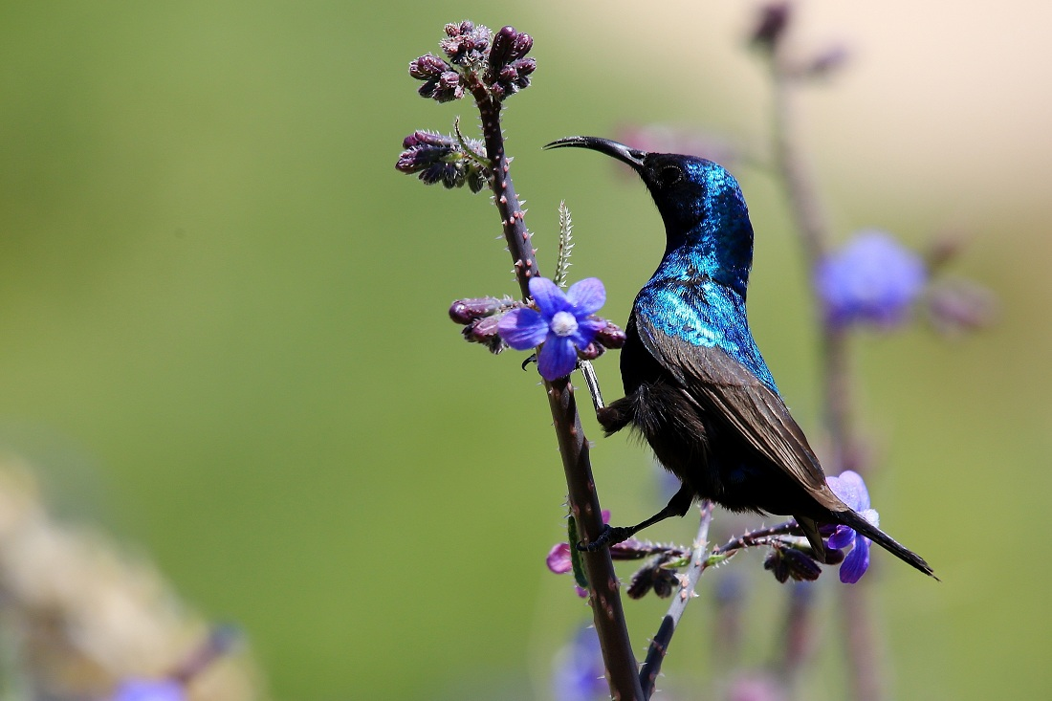
Thank you for your attention

