Slide 1
SWIFTS‘ SLEEPING BEHAVIOUR
(Apus apus)
A Day in Nestlings‘ Life
by Ninon Ballerstädt

Slide 2
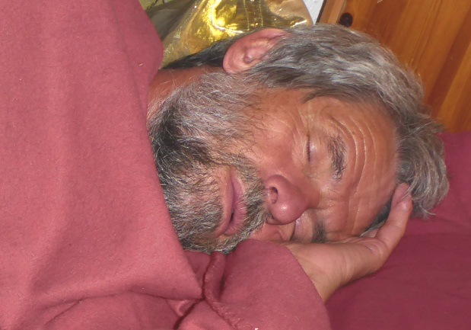
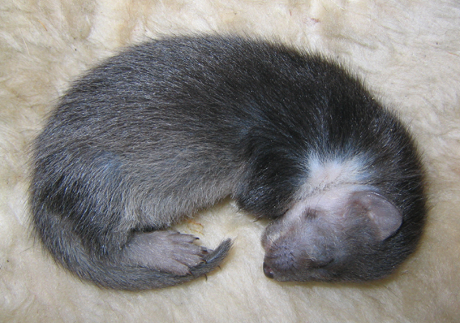
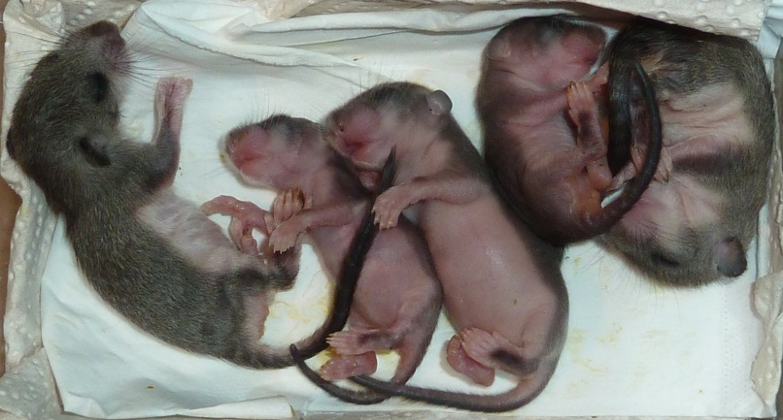
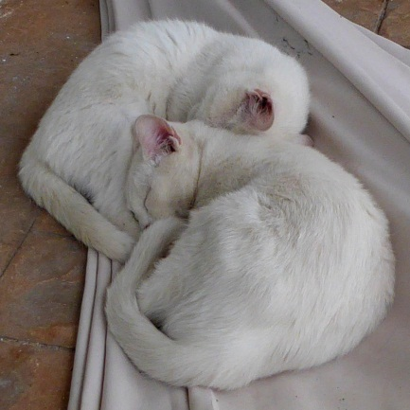
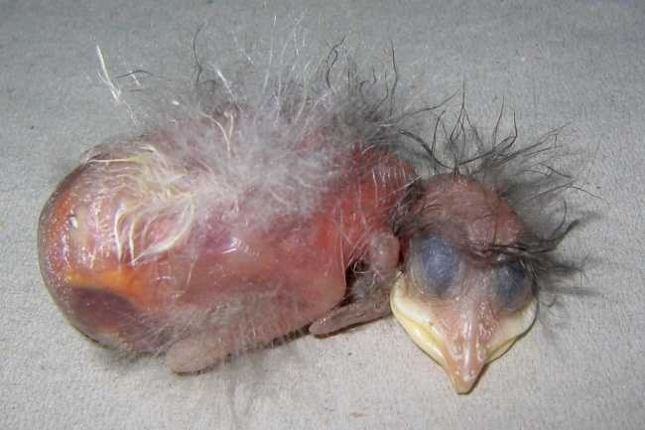
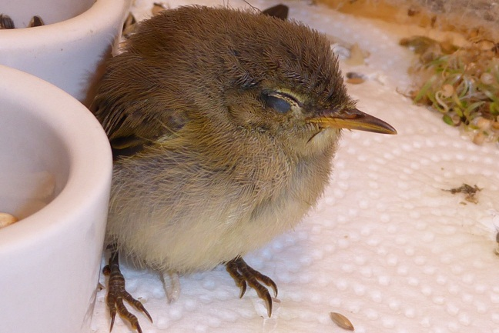
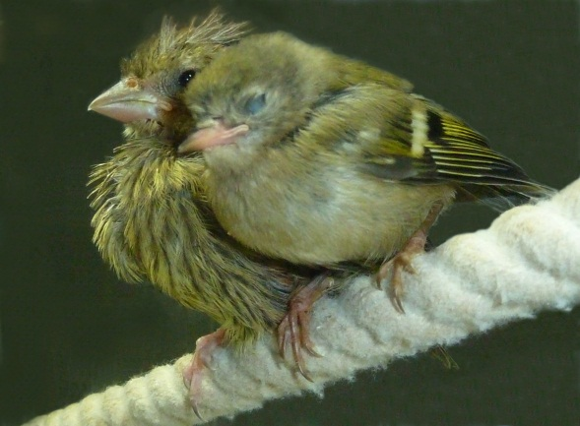
SLEEP – why do we sleep?
Sleep is essential, and as far as we know, needed by every creature.
A lack of sleep – sleep deprivation - leeds to sickness and in worst case to death, not only in humans (mammals) but in birds as well.

Slide 3
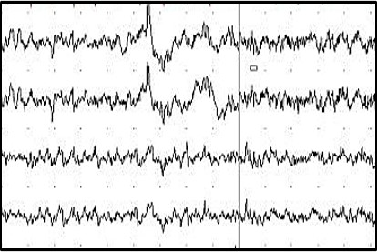
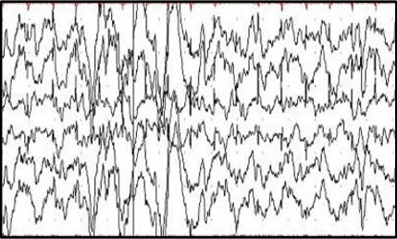
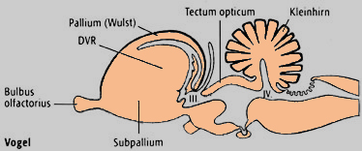
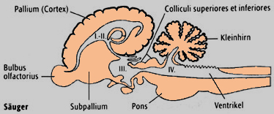
SLEEP – what is sleep?
The most important processes of sleep are generated in the brain.
REM – Sleep („Dreaming“)
NonREM – Sleep /SWS („Deep Sleep“)
BIRD
MAMMAL

Slide 4
SLEEP – special adaptations
How do birds manage their migration in spring and fall, when they have to fly day and night without any stop-over while crossing barriers like Sahara dessert or oceans?
It seems that birds in „migration-mode“ are able to practice something like uni-hemispheric sleep - very similar as it is know from marine mammals (e.g. dolphins).
In some birds this type of sleep seems to be regular, e.g. in common swifts.

Slide 5
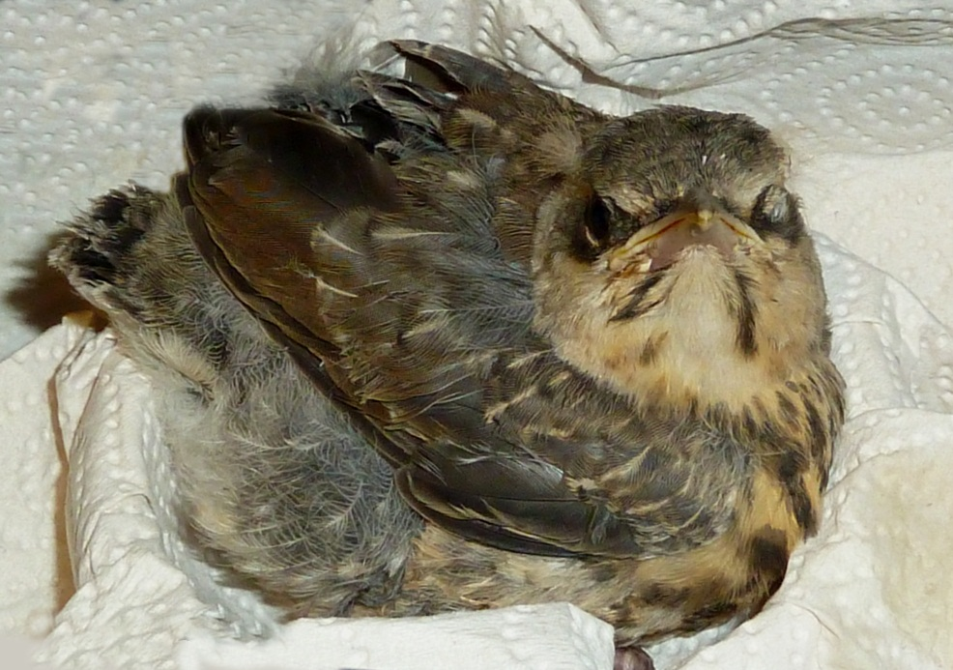
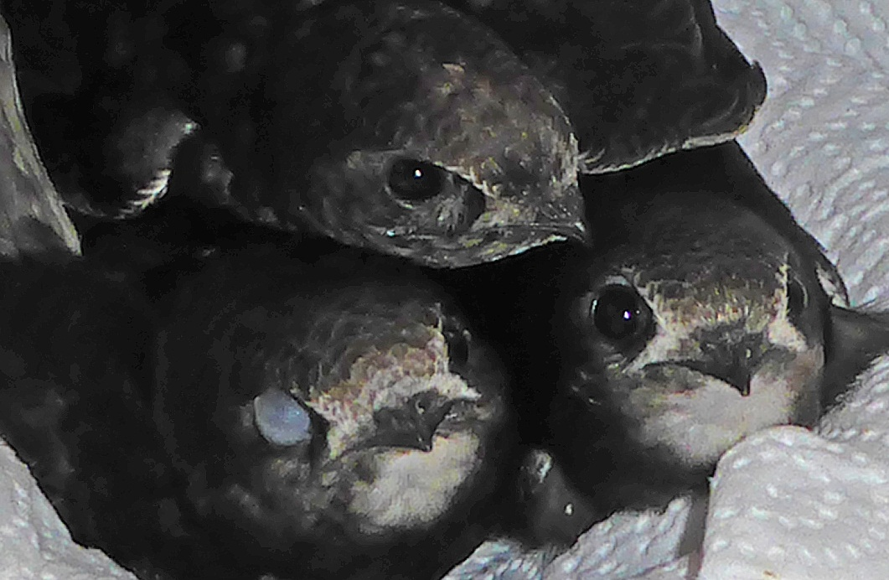
SLEEP – unihemisperic?
There is evidence to suggest uni-hemipheric sleep when animals keep one eye open while the other is closed.
The opposite brain region of the closed eye might be asleep:
If the right eye is closed the left hemisphere of the brain is resting.
An EEG would show proof of this assumption. But it is not easy to get.

Slide 6
Swifts are so special …
roosting in the air while flying
even swift nestlings don‘t behave like other birds during night-time
Because I am not able to messure the EEGs of swift nestlings (it would be invasive and you need a permit from the government) I decided to observe them with an IR-camera. Even a video recording can deliver an insight into the „sleeping behaviour“ of these amazing birds.

Slide 7
Equipment
1 IR-camera
video recorder (VHS)
180-min. video tape for 24 hours a day: fast motion with 8 pictures/second
in total 30 days of video recording
„nestbox“ with 3 (the first two weeks 5) nestlings

Slide 8
Procedure
analysis of a 180-min. video tape
at the beginning of every minute (hh:mm:00) the „behaviour“ of each swift was collected and documented in an excel data sheet
„behaviour“ was devided in 5 classes with increasing intensity of activity:
                calm/no movement
                head movement/looking around
                preening/scratching/stretching
                walking around
                push-ups/wing-flapping
additionally the status of the eyes (separated into the left and right eye) was recorded:
                opened
                half-opened
                closed

Slide 9
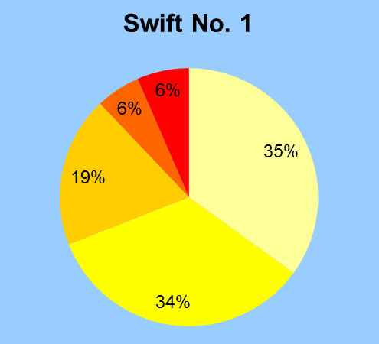
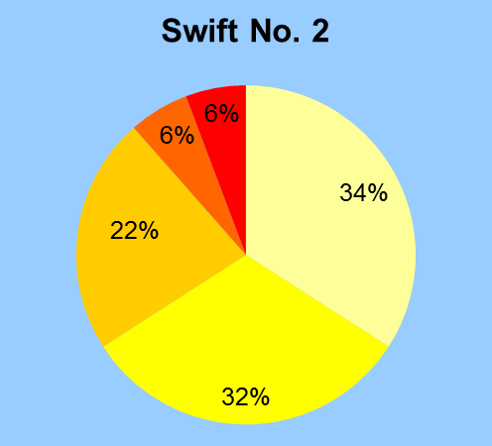
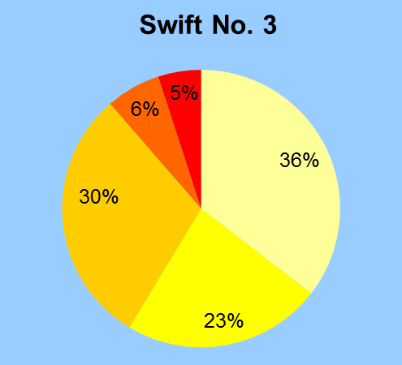
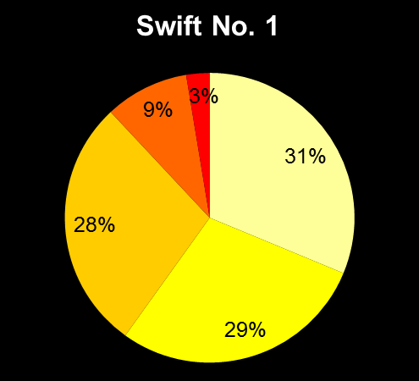
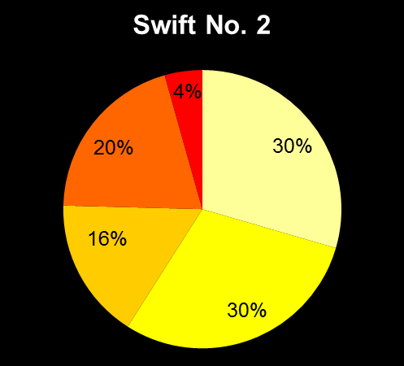
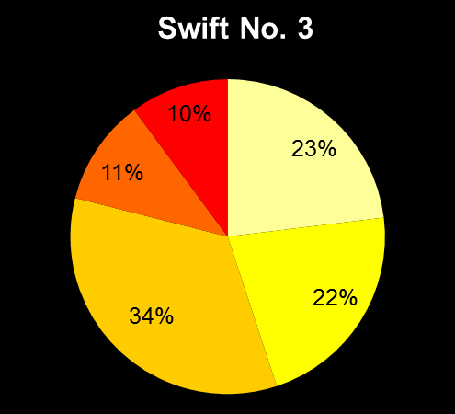
Results - Behaviour
DAY
NIGHT
CALM
MOVING HEAD
PREENING ETC.
WALKING AROUND
WING FLAPPING

Slide 10
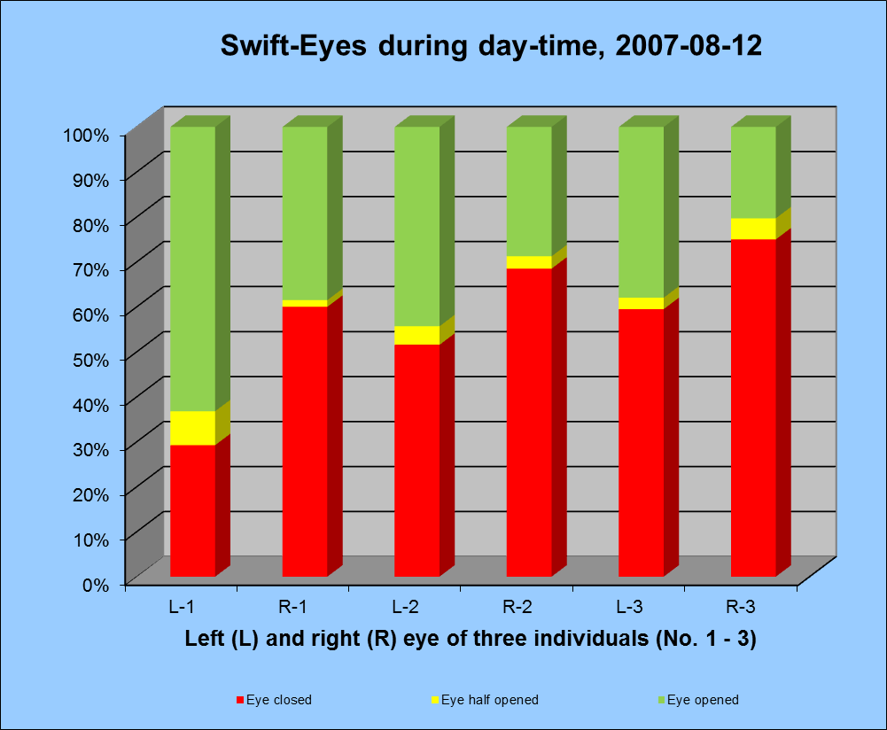
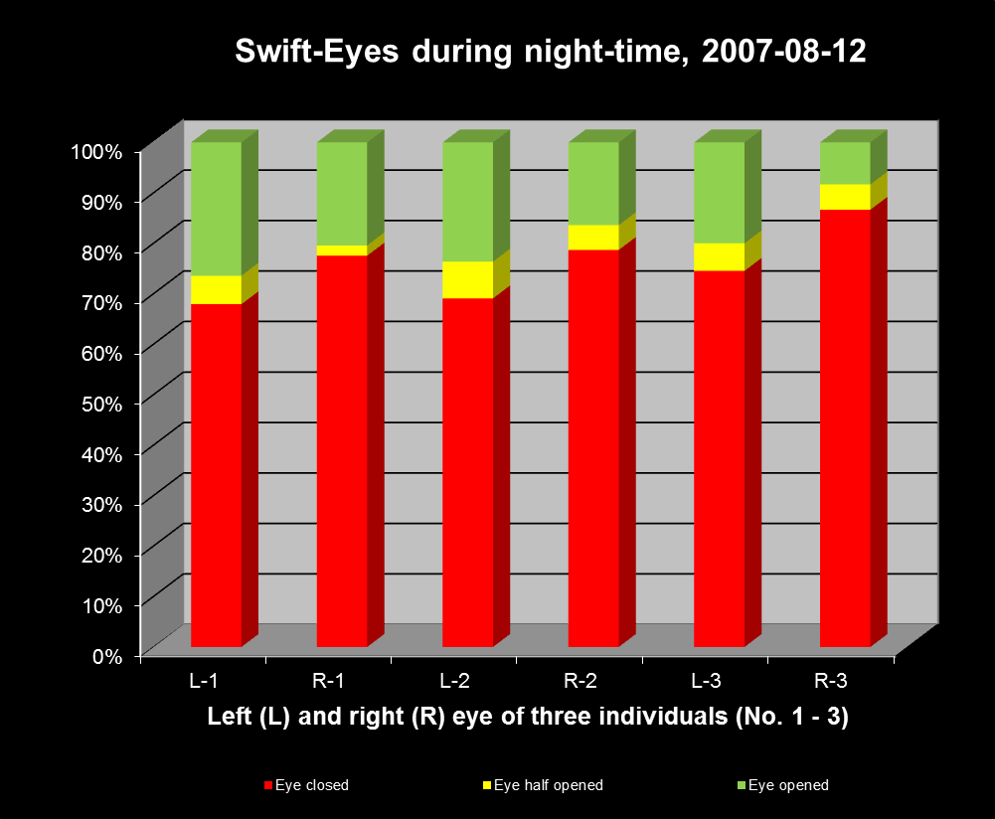
Results – Eye Status
EYE OPENED
EYE HALF-OPENED
EYE CLOSED

Slide 11
Bareisl-Film-Studios present:
The Night of the Swifts
with
Louis from Seeshaupt
Amadeus from Tutzing
Monika from Seeshaupt

Slide 12
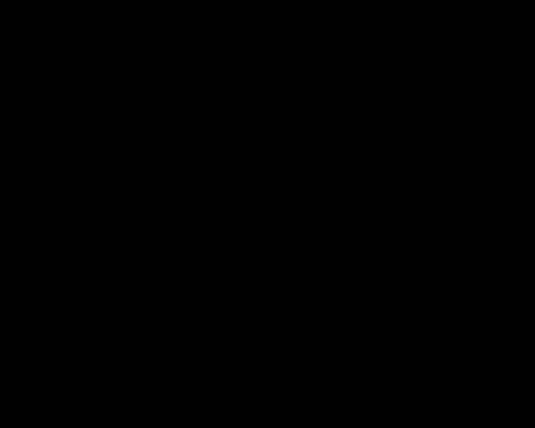

Slide 13
The End

Slide 14
The Night of the Swifts
Actors - Louis from Seeshaupt
- Amadeus from Tutzing
- Monika from Seeshaupt
Producer - Alois Seidl
Director - Ninon Ballerstädt
Assistant Director - Kruschel
Camera - Flori
Sounds - sorry, silent film

Slide 15

Thank you for your attention!
Any questions???

