Slide 1



Common Swift nesting sites conservation in Vienna
Thomas Starkmann

Slide 2
Team Members
Ferdinand Schmeller
MA 22 (Municipal Department Environmental Protection in Vienna)
ferdinand.schmeller@wien.gv.at
Harald W. Krenn
Department of Integrative Zoology – University of Vienna
harald.krenn@univie.ac.at
Thomas Starkmann
MSc Conservation Ecology and Biodiversity Management

Slide 3
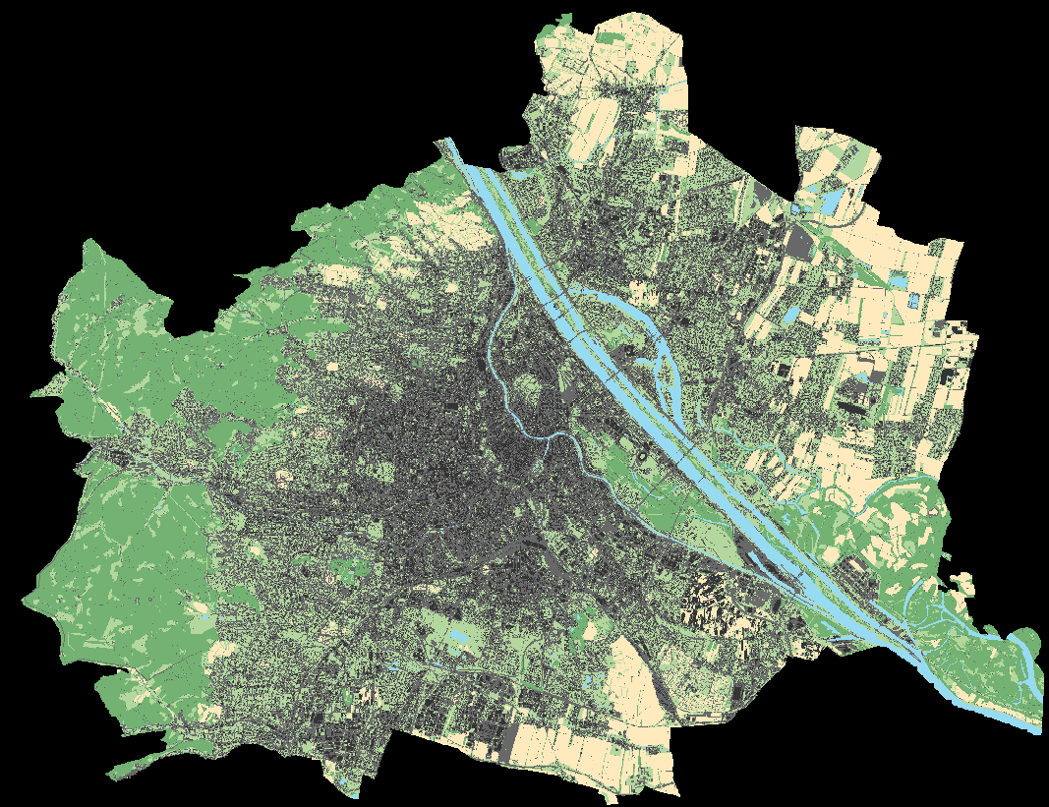
Common Swift in Vienna

Slide 4
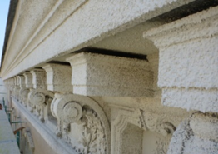
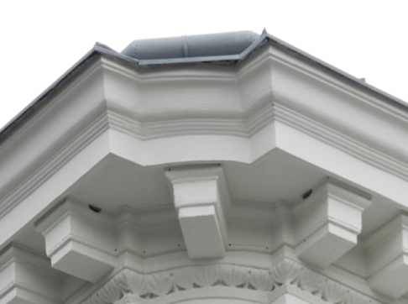
Common Swift in Vienna
©MA22
©MA22

Slide 5
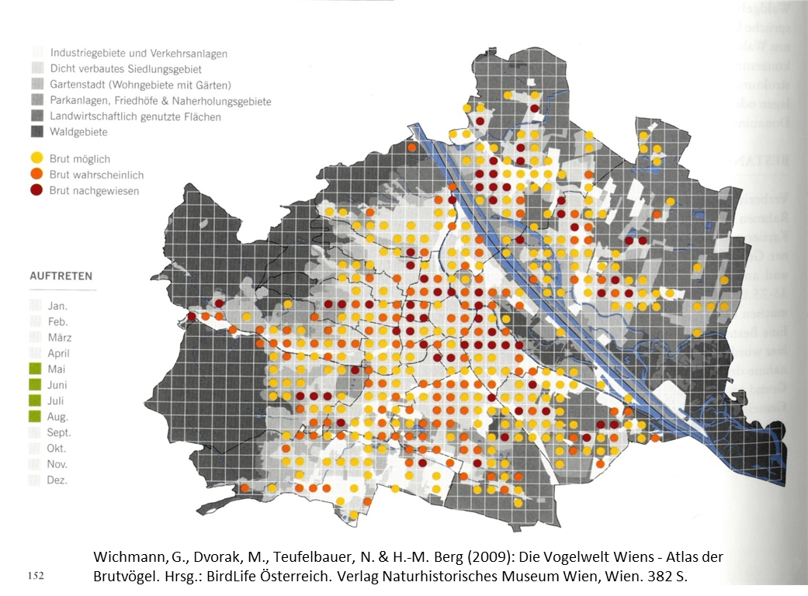
Available Data

Slide 6
Available Data
Mapping of breeding birds in a Viennese quarter (Zuna-Kratky 1993)
Low-key mapping and estimates for different breeding bird atlases
Reports of tree-breeding, occurence in villages,…
Call to report nesting sites in Vienna (2014)

Slide 7
Aims of the Project
Protection of nesting sites (loss mainly due to renovation of buildings)
Nesting sites have to be localized on correct address
Standardized mapping ensures credibility in legal proceedings

Slide 8
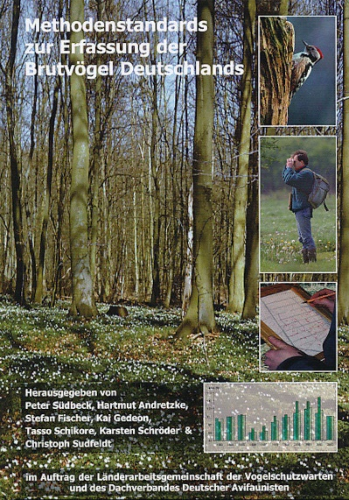
Survey 2017
No counting of flying individuals
Only mapping of known or supposed nesting sites
At least 30 minutes in the evening
at good weather conditions

Slide 9
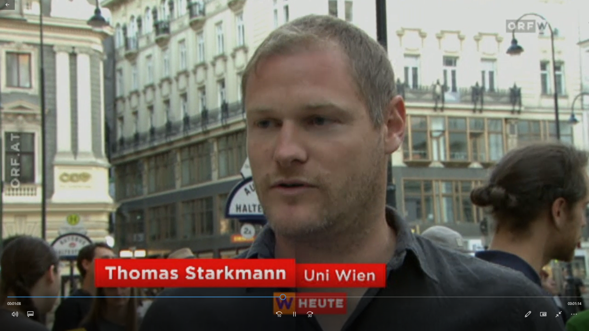
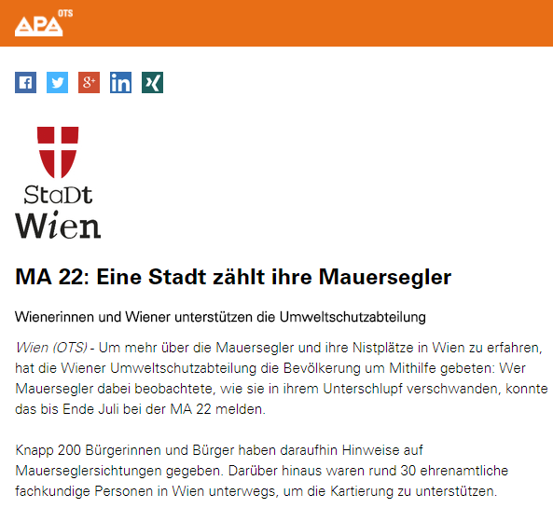
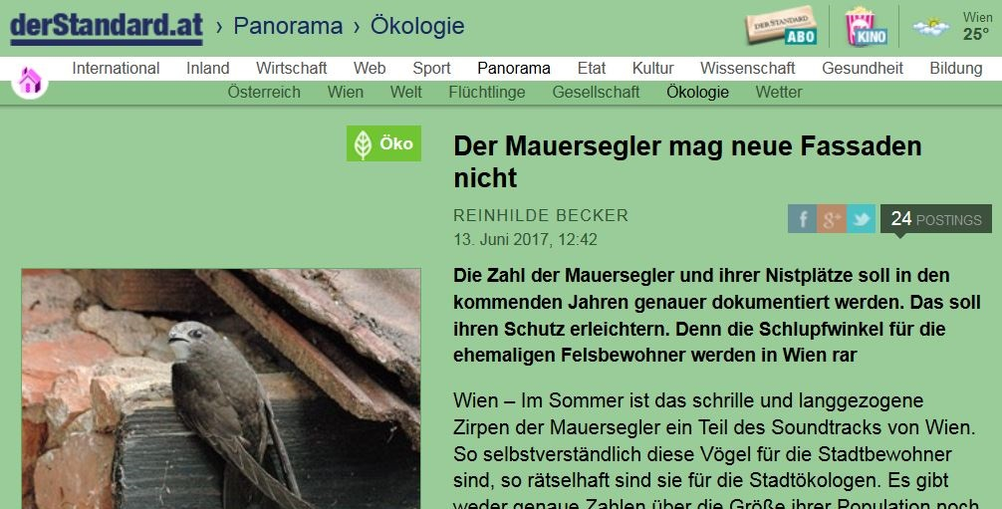
Survey 2017
Presenting the survey in media (newspaper, social media, TV)
Presentation in lectures at Universities

Slide 10
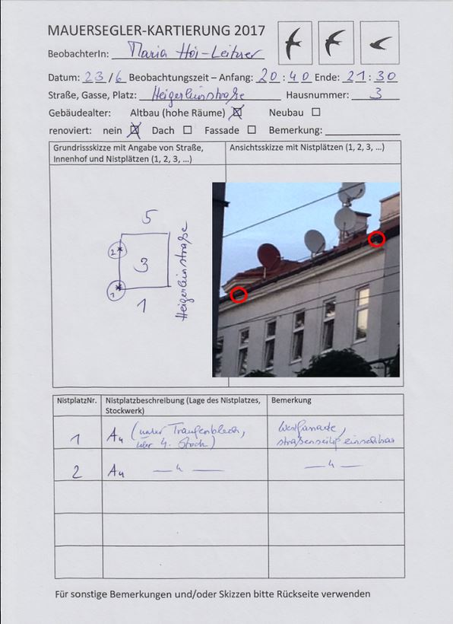
Survey 2017
Call to report nesting sites
Training of volunteers
Establishing survey form
E-Mail group for interacting and feedback

Slide 11
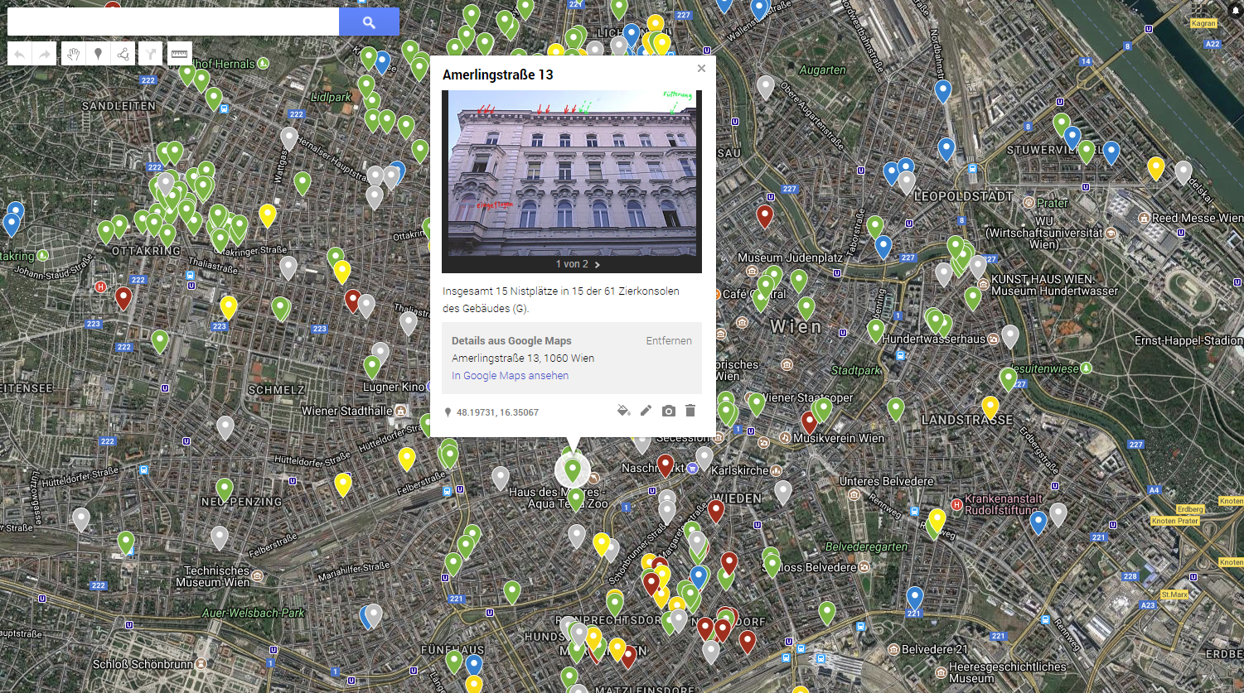
Survey 2017

Slide 12
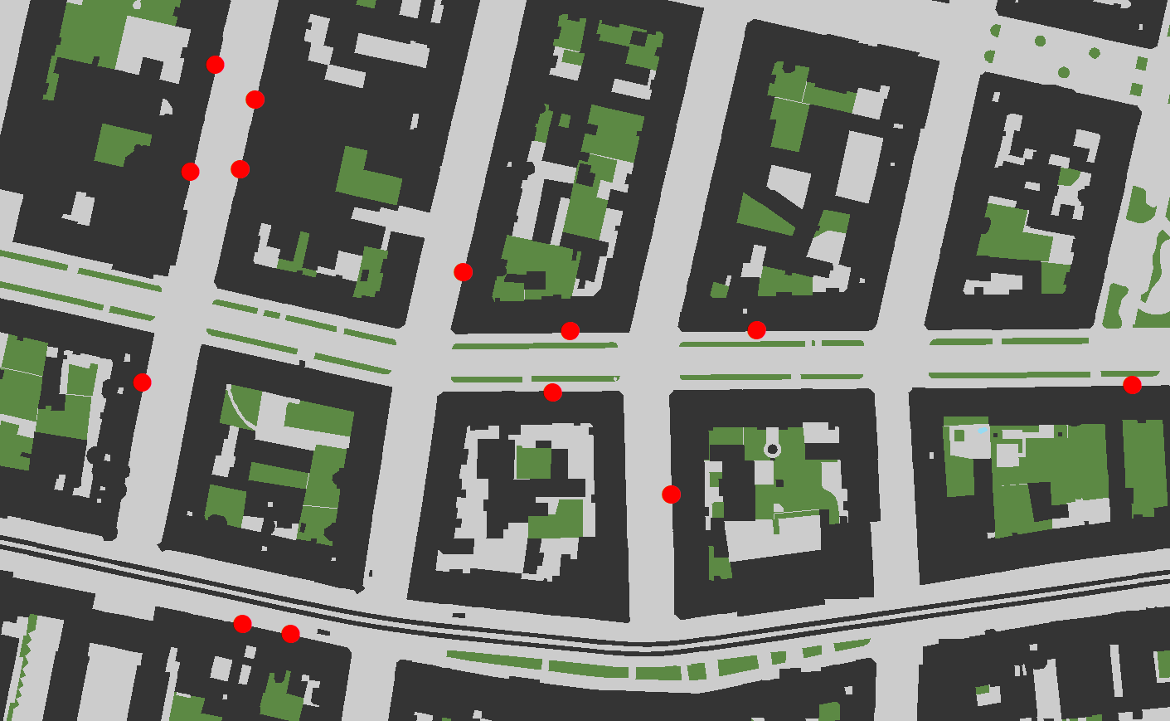
Results
236 buildings with nesting sites surveyed (+ 19 without)
832 nesting sites mapped

Slide 13
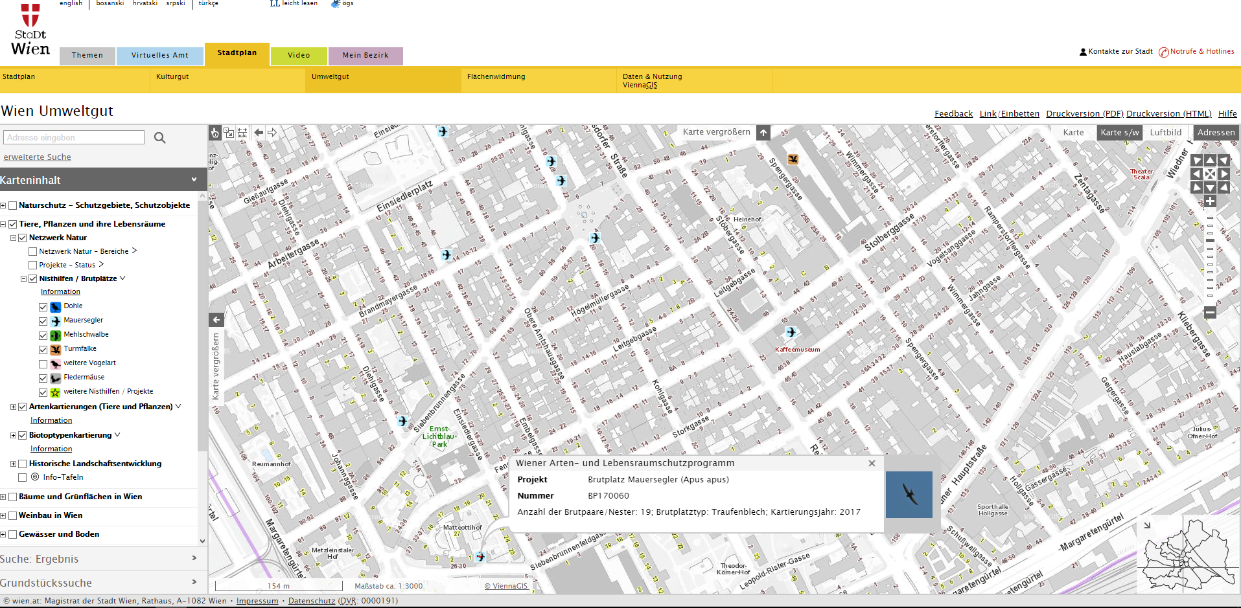
Results

Slide 14
Challenges for Survey 2018
Less media coverage
Intensify cooperations with NGOs (BirdLife,…)
Making „reporters“ to „mappers“
Better coverage of districts

Slide 15
Open Questions
Interface with Dpmt. of Building Inspection
Reliable estimate of population
Population dynamics, breeding success
Daily activity

Slide 16
Outlook
Ongoing survey of large colonies
GPS-tracking ?
Publishing in „Citizen Science: Theory and Practice“ and in an Ornithological Paper

Slide 17
Thank you for your attention!

