Slide 1
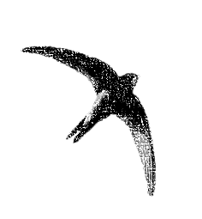
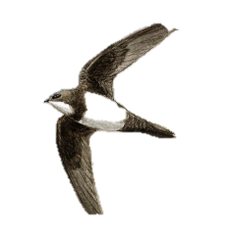
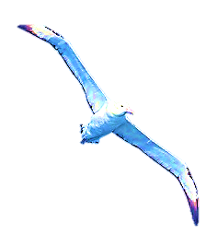



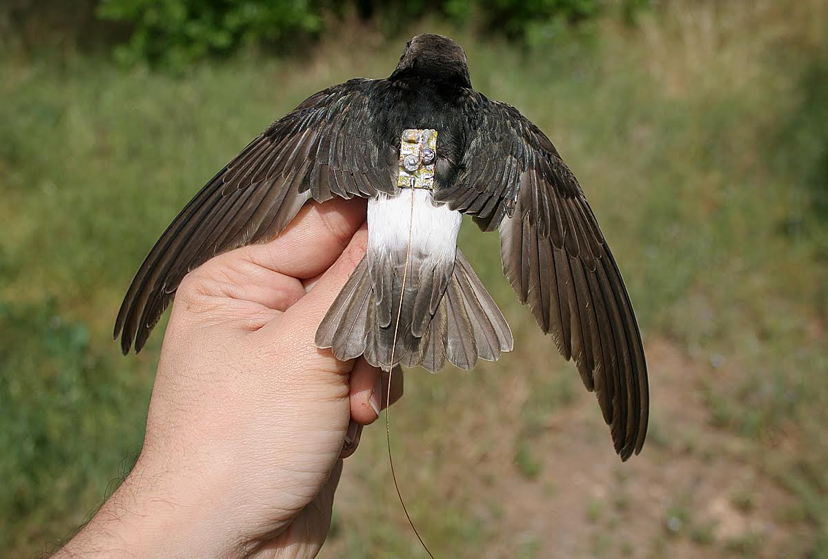
Using an advanced tracking system to understand the movement and breeding ecology of the Little Swift (Apus affinis)
Itai Bloch & Nir Sapir
Notes:
Hello everyone.
My name is Itai Bloch
I'm a master's degree studentat at the
Department of Evolutionary and Environmental Biology At the University of Haifa.
I would like to present to you my research:
Using an advanced tracking system for understanding the movement and breeding ecology of the Little Swift (Apus affinis)
My supervisor is Dr. Nir Sapir

Slide 2
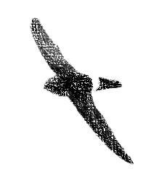
Index
  Introduction
  Research hypothesis
  Methods and materials
  Results
Notes:
in this talk I'm going to present:
The Introduction
Research Hypothesis
Methods and materials
And the Results
So, let's start the introduction

Slide 3
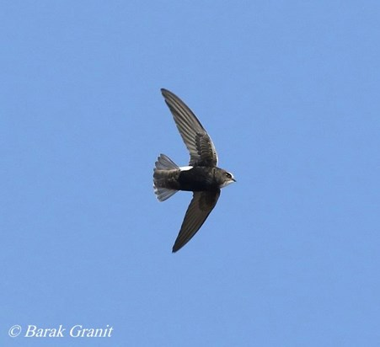
Introduction - study species: Little swift
Little swift - Apus affinis
  Apus affinis galilejensis
  Colonies of dozens to hundreds of couples
  Part of the flock sleeps in the colony
  Aerial Insectivores
Notes:
My study species is the Little swift
the little swift is the smallest swift in our region and is therefore he got the name little swift.
Its Latin name consists of APUS which is missing leg, Because his short legs
and AFFINIS It means belongs to ..
The subspecies in Israel called galilejensis. That Galilee is a region of Israel.
It got its name because the first record of this subspecies hunted near the Sea of Galilee by Tristram.
Colonies of the little swift have tens to hundreds of couples.
The little swift uses its nests even outside the breeding season.
During the nesting season, part of the flock sleeps in the colony and some of them sleeps outside the colony
And of course its a Aerial Insectivores

Slide 4
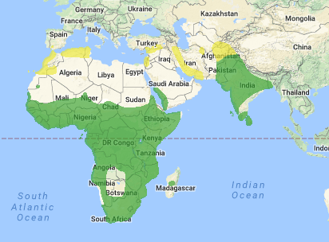
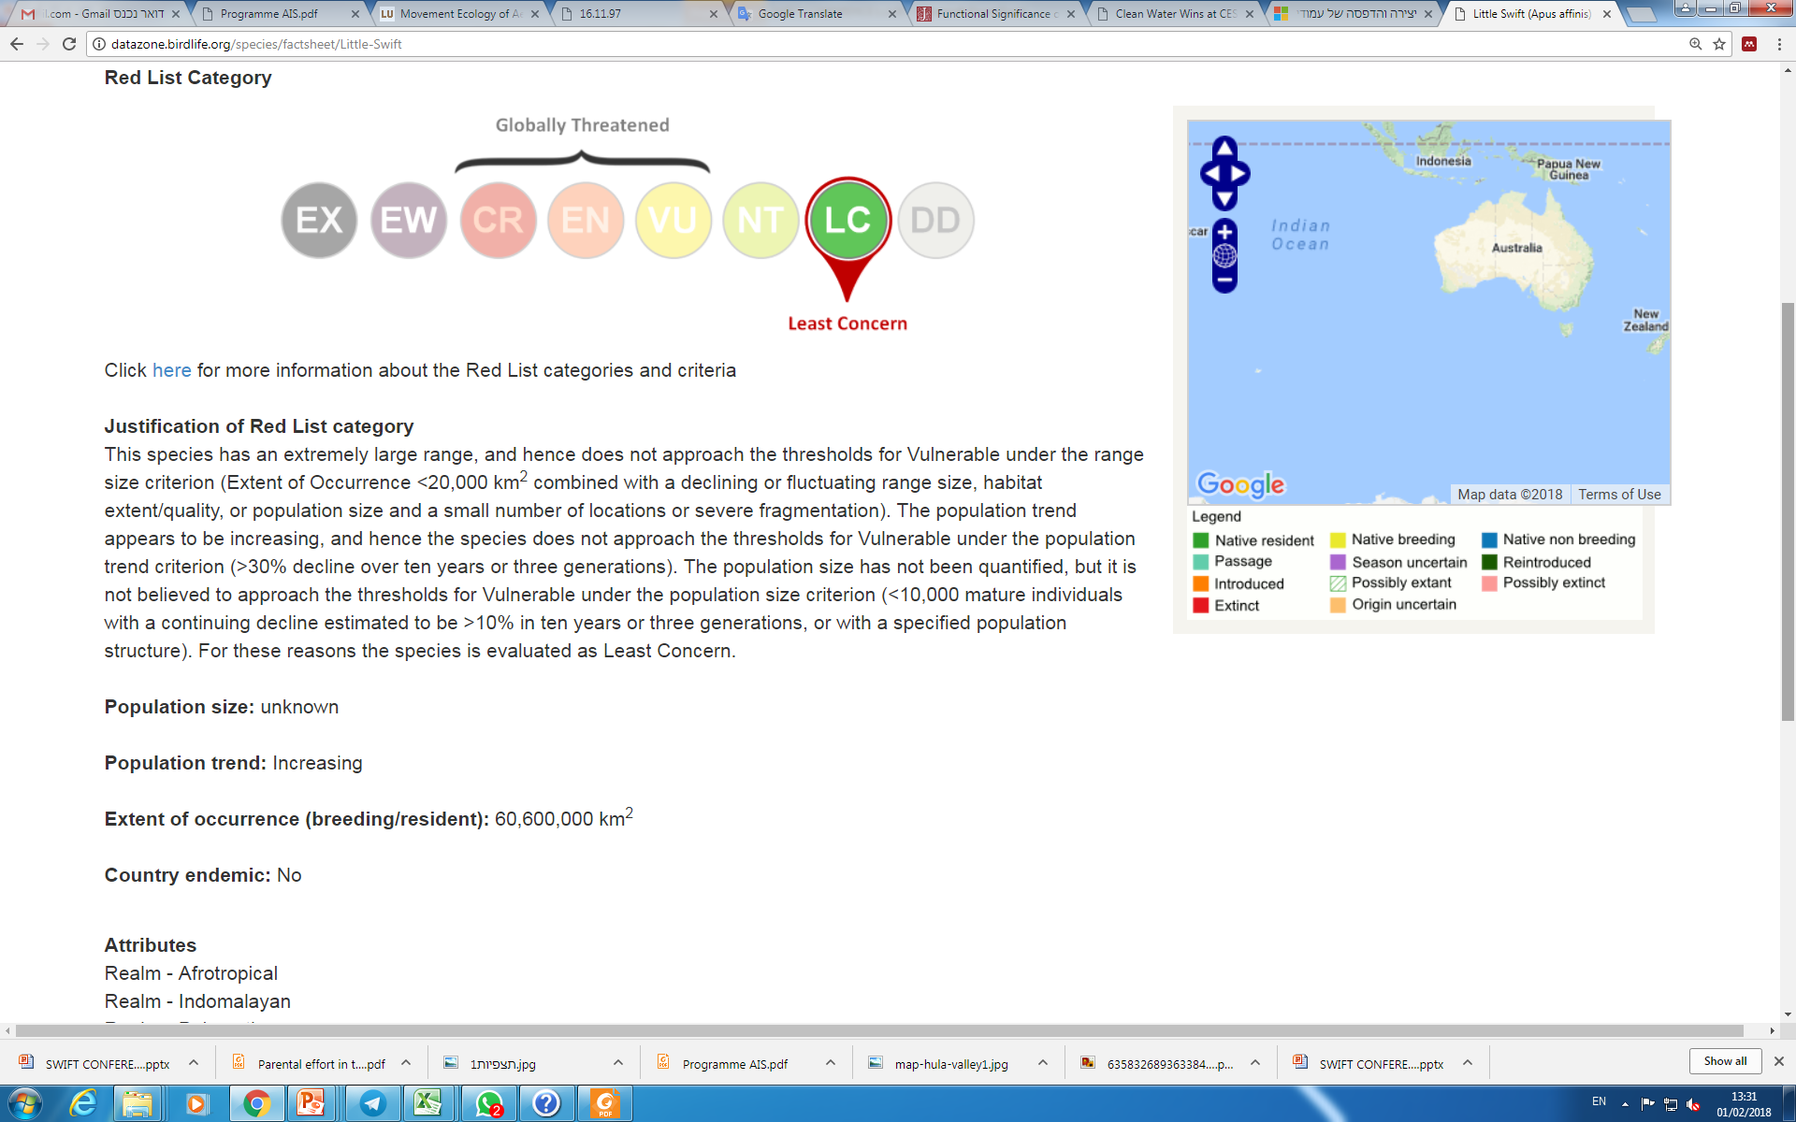
Introduction - study species: Distribution
BirdLife International (2004). Detailed species account from Birds in Europe: population estimates, trends and conservation status.
Notes:
The distribution of this species is in most parts of Africa, in Asia and also in Turkey and southern Spain.
it is a resident in most areas of its distribution, but the northern populations are migrate.
It is also found in Israel, where some of the populations are resident, but there are also migratory individuals.
It is not clear whether the individuals who migrate through Israel belong to the local population or belong to another population that just migrates through Israel

Slide 5
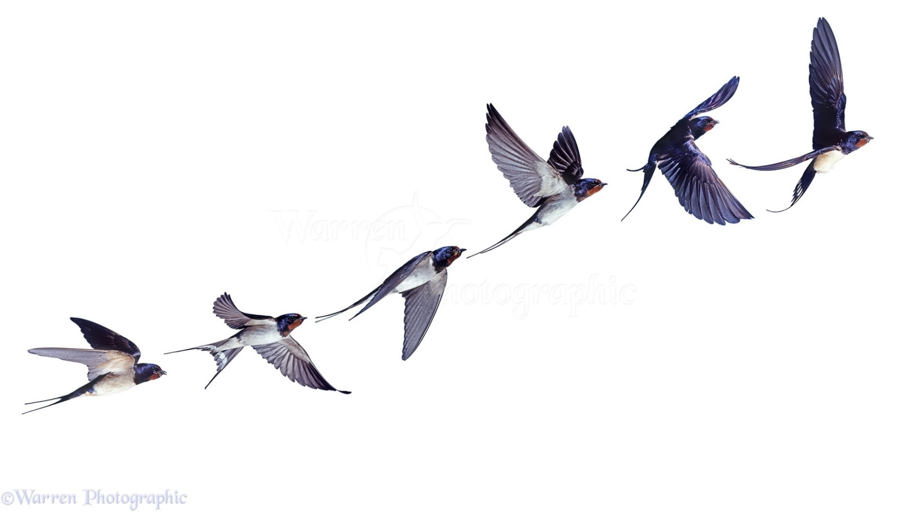
Introduction - Animal movement: Scale
Small scale - minutes / hours
Medium Scale - days / weeks
Large scale - months / years
Notes:
We can divide the movement of animals into several scales, where:
The Small scale will refer to Characteristics of the movement of birds in a short time - up to a few hours
The Medium Scale will refer to movements for several days to several weeks
And large Scale will refer to movement For months and even for several years

Slide 6
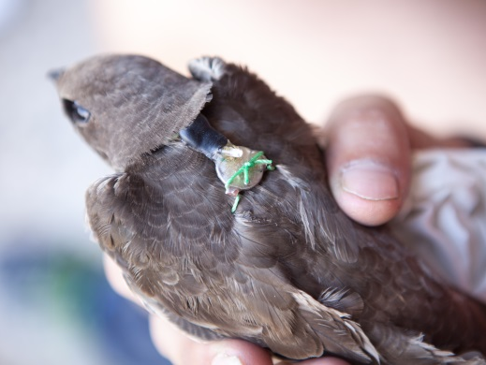
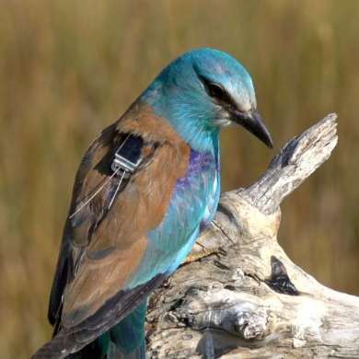
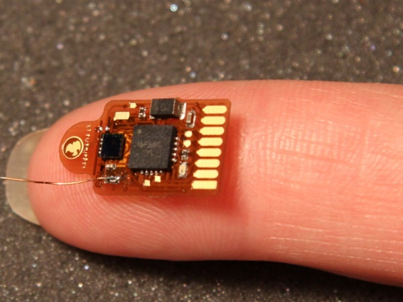
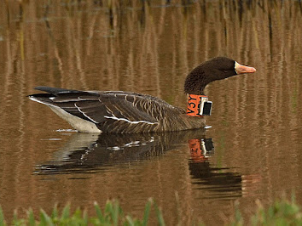
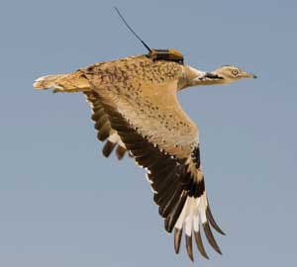
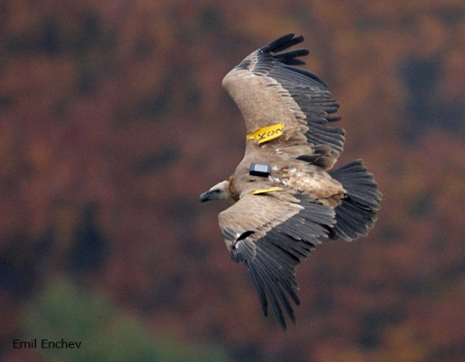
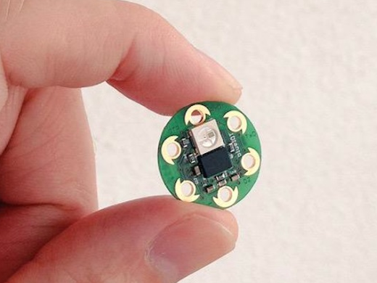
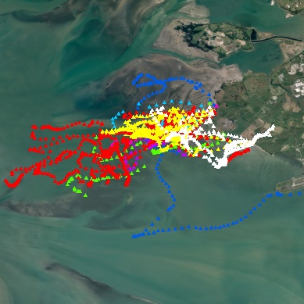
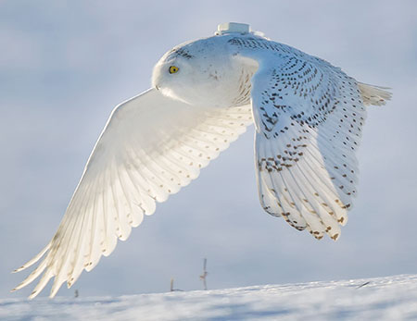
Introduction - Animal movement: Measurement
Notes:
There is a wide range of advanced technological Measurement that help to understand the characteristics of the movement of animals.
From small data loggers, through the use of radar to advanced cellular GPS devices

Slide 7
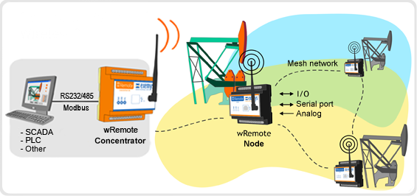
Introduction – The ATLAS system
ATLAS Advanced Tracking and Localization of
  Animals in real-life Systems
Reverse GPS – 1 g tags
Real-time / retrospective viewing
Notes:
The Atlas system tags transmit signals every 1-8 seconds,
The signals are received by antennas scattered throughout the area and stored in a database.
You can see the location of the tags in real time or download the data and analyze the results.

Slide 8
Index
  Introduction
  Research hypothesis
  Methods and materials
  Results
Notes:
So after we've finished the introduction we can move on to a research hypothesis

Slide 9
Hypothesis
The movement of Little Swifts and their nest visits will vary during the breeding season.
These changes will be reflected in:
Frequency of nest visits
Duration of stay in the nest during the night
Foraging range
Notes:
The Research Hypothesis is:
The movement of Little Swifts and their visits to the nest will vary during the breeding season. These changes will be reflected in:3 aspects:
Frequency of nest visits
Duration of stay in the nest during the night
Foraging range

Slide 10
Hypothesis
The movement of Little Swifts and their nest visits will vary during the breeding season.
These changes will be reflected in:
Frequency of nest visits
Duration of stay in the nest during the night
Foraging range
  Location transmitters (ATLAS tags)
  Comparing the number of visits during the breeding season
Notes:
In the first aspect: Frequency of nest visits
We used the ATLAS tags (an Location transmitters) to Look at the frequency of the nest visits
and then to the look whether the number of visits to the colony varies during the season

Slide 11
Hypothesis
The movement of Little Swifts and their nest visits will vary during the breeding season.
These changes will be reflected in:
Frequency of nest visits
Duration of stay in the nest during the night
Foraging range
Notes:
The second aspect is the Duration of stay in the nest during the night

Slide 12
Hypothesis
The movement of Little Swifts and their nest visits will vary during the breeding season.
These changes will be reflected in:
Frequency of nest visits
Duration of stay in the nest during the night
Foraging range
  Location transmitters (ATLAS)
  Location at night during the breeding season
Notes:
In this aspect:
We will also use the ATLAS tags (Location transmitters)
And we checked how long the SWIFTS nighttime was spent in the nest
And whether there is a difference in that time during the nesting season

Slide 13
Hypothesis
The movement of Little Swifts and their nest visits will vary during the breeding season.
These changes will be reflected in:
Frequency of nest visits
Duration of stay in the nest during the night
Foraging range
Notes:
The third aspect is the Foraging range

Slide 14
Hypothesis
The movement of Little Swifts and their nest visits will vary during the breeding season.
These changes will be reflected in:
Frequency of nest visits
Duration of stay in the nest during the night
Foraging range
  Location transmitters (ATLAS tags)
  Foraging range during the breeding season
Notes:
In this aspect We used again the ATLAS TAGS
And we checked whether the foraging range varies during the nesting season

Slide 15
Hypothesis - Predictions
The movement of Little Swifts and their nests visits will vary during the breeding season.
These changes will be reflected in:
Frequency of nest visits –
Duration of stay in the nest during the night –
Foraging range -
Notes:
So What we expect to find:

Slide 16
Hypothesis - Predictions
The movement of Little Swifts and their nests visits will vary during the breeding season.
These changes will be reflected in:
Frequency of nest visits - will increase
Duration of stay in the nest during the night –
Foraging range -
Notes:
In the first aspect
- Our hypothesis is that the frequency will increase because the chicks are growing and they need more food

Slide 17
Hypothesis - Predictions
The movement of Little Swifts and their nests visits will vary during the breeding season.
These changes will be reflected in:
Frequency of nest visits - will increase
Duration of stay in the nest during the night - will decrease
Foraging range -
Notes:
In the second aspect we assume that as the season progresses, SWIFTS will spend less time in the colony and spend more time in foraging
Again, because the chicks need more food

Slide 18
Hypothesis - Predictions
The movement of Little Swifts and their nests visits will vary during the breeding season.
These changes will be reflected in:
Frequency of nest visits - will increase
Duration of stay in the nest during the night - will decrease
Foraging range - will remain unchanged
Notes:
In the third aspect, we assume the SWIFTS have fixed areas For collecting food
And these areas are not expected to change Relative to the age of the chicks
and therefore the foraging range will remain essentially unchanged.

Slide 19
Index
  Introduction
  Research hypothesis
  Methods and materials
  Results
Notes:
Now for the Methods and materials

Slide 20
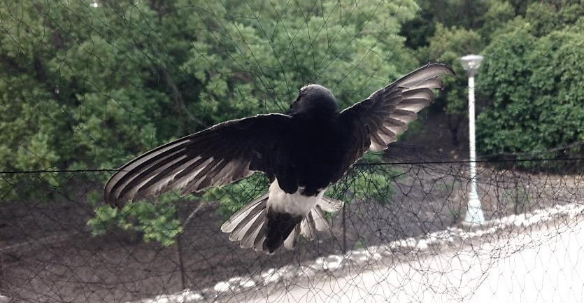
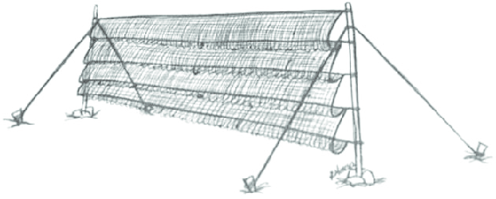
Methods - Swift capture
Mist nets
Net location
Capture time
Notes:
Swift capture
So, as you know, the SWIFTS are in the air almost all the time,
Therefore the best way to capture the SWIFTS is when they leave the colony.
And The best time is before the first light, when SWIFTS which sleep in the colony go out to foraging.
We used mist nets outside the colony, located in a building in the Hula Valley, in northern Israel.

Slide 21
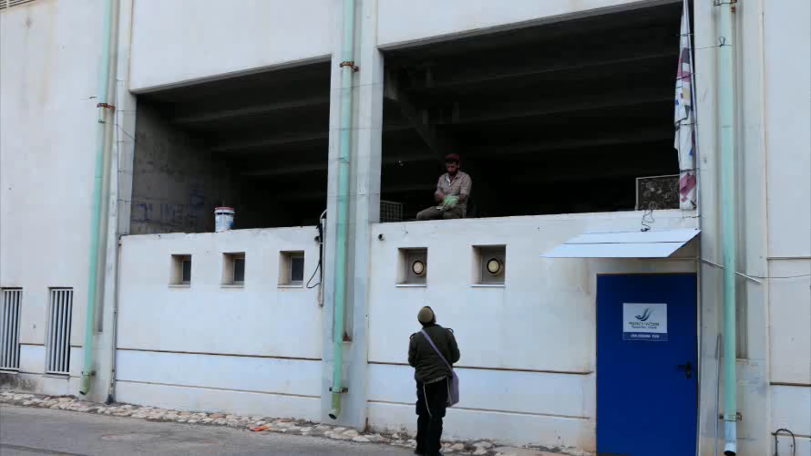
Methods - Swift capture
Notes:
In this video you will see right away, you will see the swifts capture
We spread a mist net from side to side. It covers all the exit openings from the colony.
The colony is in this corner
And if you look well, you will see the birds that have been caught in the mist net

Slide 22
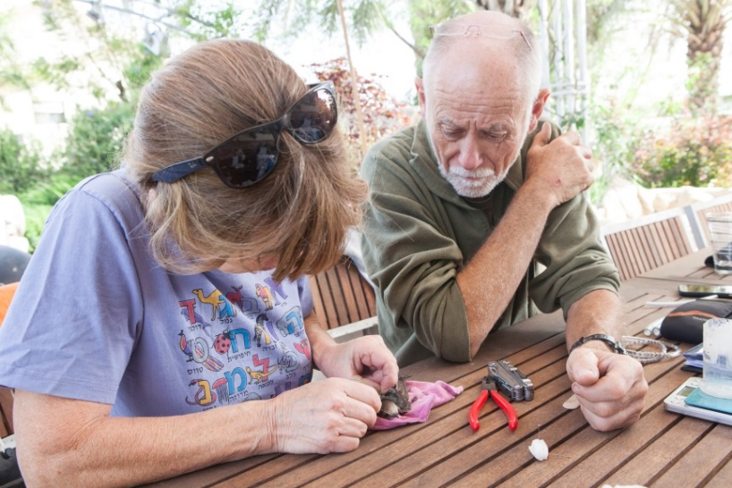
Methods – Tags & data collection
Ringing and data logging
  Identification ring
  Size (wing and tail length)
  Body mass
Tagging with ATLAS tags
Notes:
After catching the SWIFT, we put an identification ring
We took some data, such as Body mass, and wing and tail length
And then we put the Atlas tags to SWIFTS
That's how the atlas tags look like

Slide 23
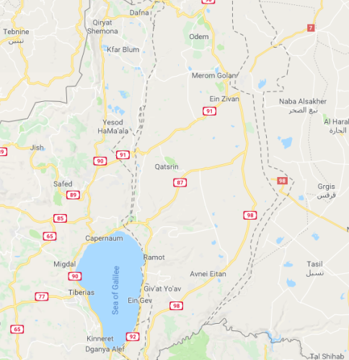
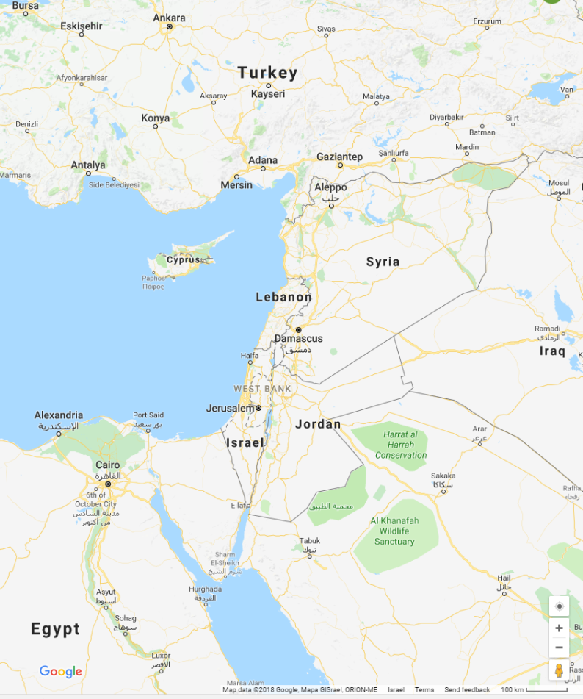
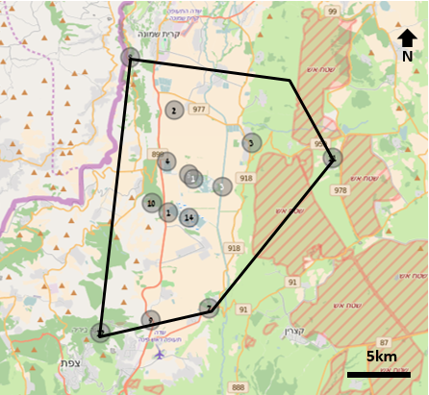
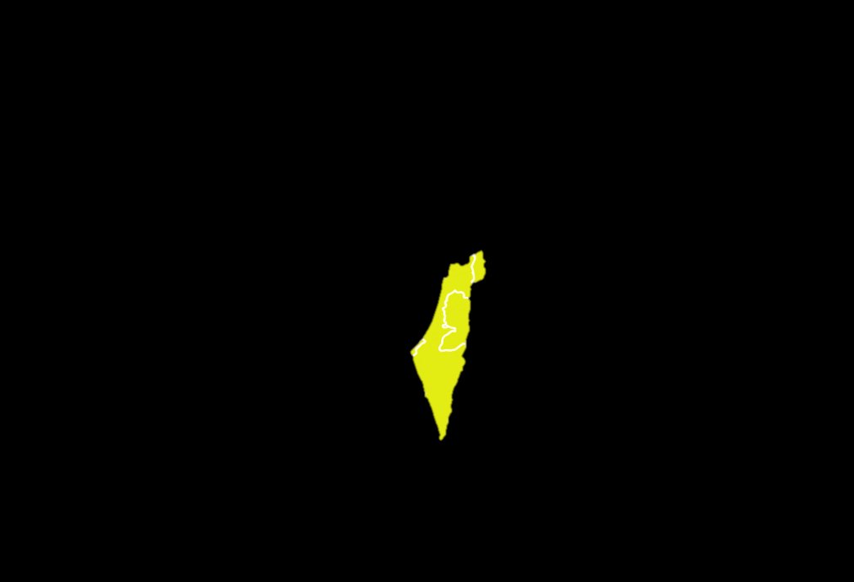
Introduction - Research area
Notes:
Our research is located in the Hula Valley, in northeastern Israel.
Just north of Sea of Galilee
In the middle of the Hula Valley, there is a small settlement called Yesod HaMa'ala.
Our SWIFTS colony is located in Yesod Hama'ala
The circles are the antennas that receive the signals from the transmitters

Slide 24
Index
  Introduction
  Research hypothesis
  Methods and materials
  Results
Notes:
And now to the results

Slide 25
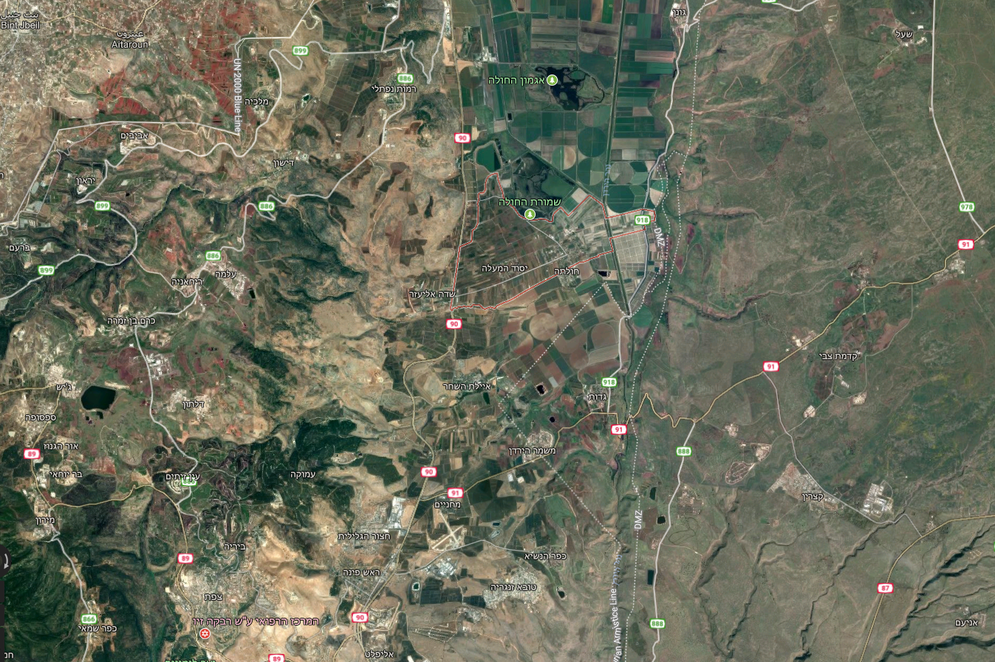
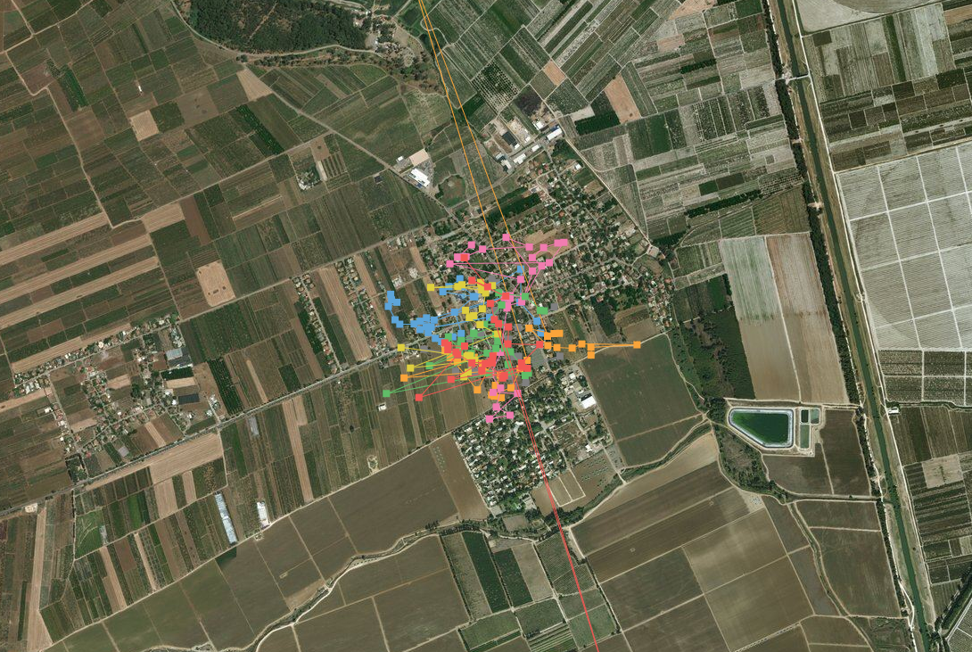
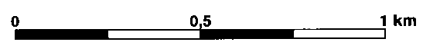
Results
The Swifts colony area
The Hula Valley
Meron Mountains
The Golan Heights
The Swifts colony
Notes:
So, again. The Hula Valley is here.
It is located between the Golan Heights and the Meron Mountains.
The nest colony is located in Yesod HaMa'ala
This is how the data that are obtained using the Atlas system.
Each color represents a different individual

Slide 26
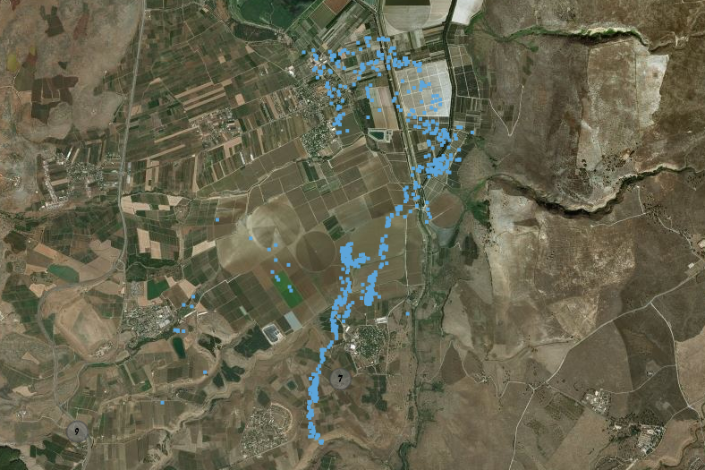
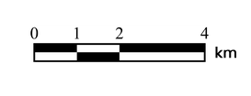
Results
Movement of a single individual for 3 hours
Notes:
And here we can see the Movement of a single individual for 3 hours
From the colony, south and back

Slide 27
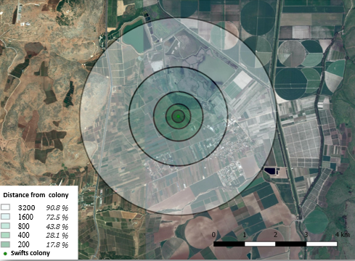
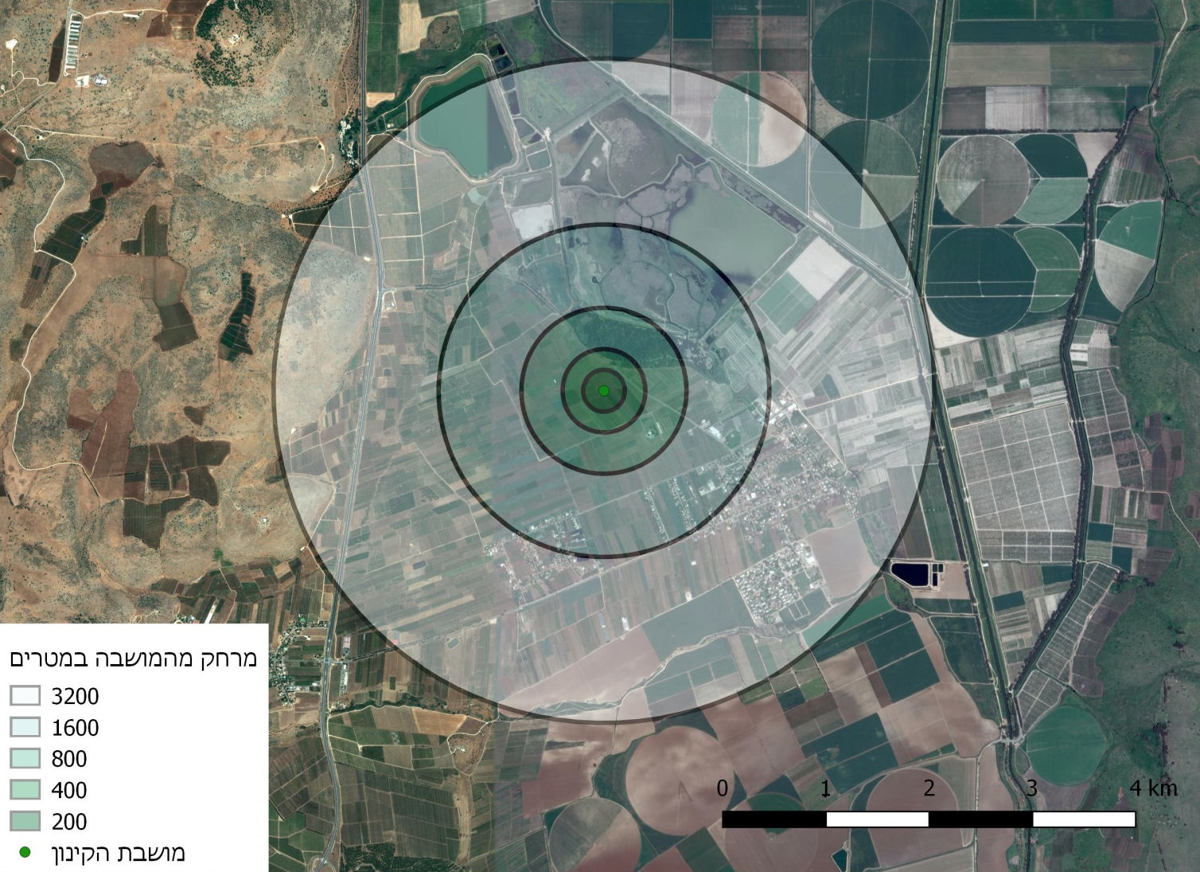
Results – Foraging range
Distance from colony
3200
1600
800
400
200
90.8 %
72.5 %
43.8 %
28.1 %
17.8 %
3200
1600
800
400
200
Swifts colony
Swifts colony
Notes:
When looking at the foraging range,
We saw that almost half the time the SWIFTS remain within a range of up to eight hundred meters,
And More than 90 percent of the time SWIFTS searched for food within a range of 3.2 kilometers

Slide 28
Results - Entrance to the colony
Notes:
Entrance to the colony for overnight stays
The red line represents the times of sunset and the blue line represents the time in which the last individual enters into the colony.
You can see that as the season progresses, the SWIFTS stay longer outside the colony

Slide 29
Results - Departure from the colony
Notes:
A similar situation can be seen in relation to the departure time from COLONY in the morning.
The red line represents the sunrise and the blue line represents the exit time of the first individual from the colony
You can see that as the season progresses, the SWIFTS come out earlier from the colony

Slide 30
Results - Visit frequency and foraging range
Notes:
When looking at the red line that represents the average range in which SWIFTS searched for food during the day,
You can see that during the day, the foraging range is increasing.
In contrast, the blue columns represent the average number of visits.
You can see that the number of visits to the nest decreases during the day

Slide 31
Results - Visit frequency and foraging range
Notes:
Now we will look at a distance in medium scale of several days -
When we look at the red line indicating the average foraging range
We can see that during the season, the foraging range is on the rise.
In contrast, observing the blue line indicates the frequency of visits to the nest
Will show us that the frequency of visiting the nest is decreasing during the season.

Slide 32
Hypothesis - Summary
The movement of Little Swifts and their nest visits will vary during the breeding season.
These changes will be reflected in:
Frequency of nest visits – Decline observed
Duration of stay in the nest during the night – Decline observed
Foraging range – Increase observed
Notes:
In conclusion:
What we saw in the results was this:
Frequency of nest visits was Decline
Both on a small scale and on a medium scale
We saw a decrease in the duration of the nest during the night
And in the Foraging range we saw an increase in both the small scale and the medium scale

Slide 33
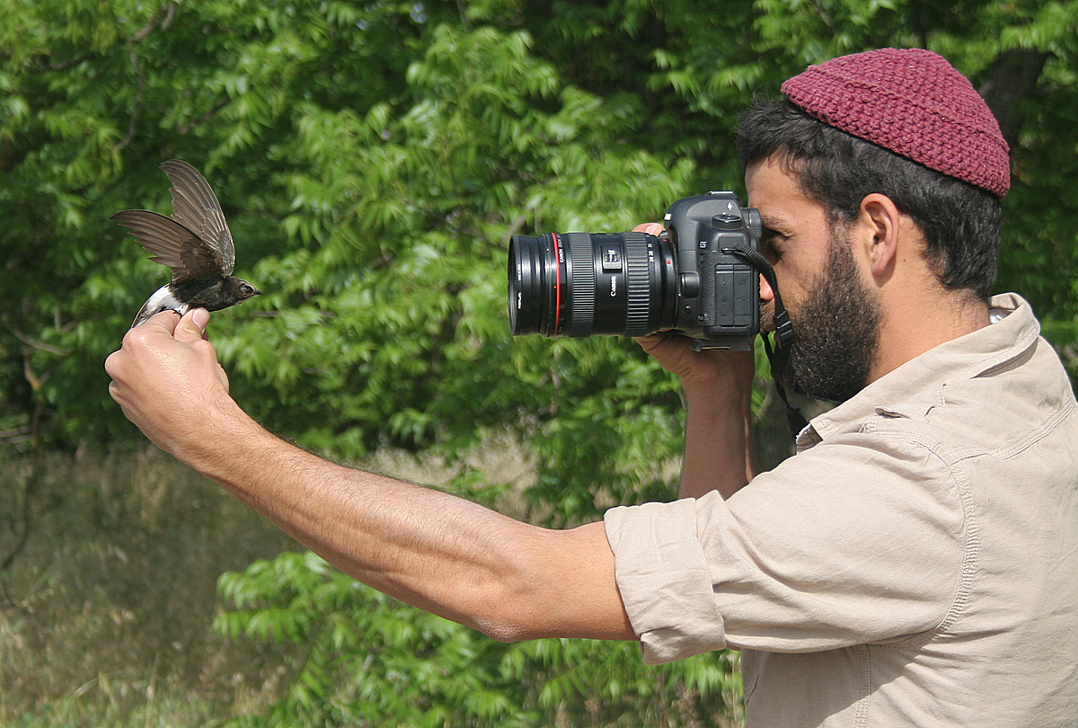
Questions ?!?
Notes:
Questions

