Slide 1

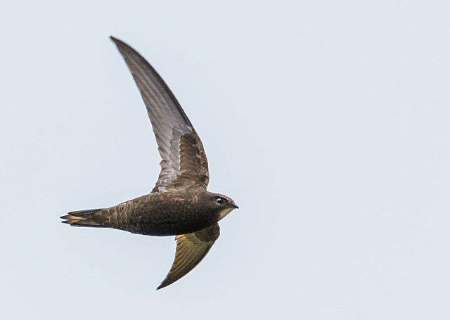
An overview of Apus apus-and Apus apus pekinensis
Notes:
The talk will be in the form of an overview of what we know about the species in 2018 compared with 2010 - 26mins and 4 mins questions

Slide 2
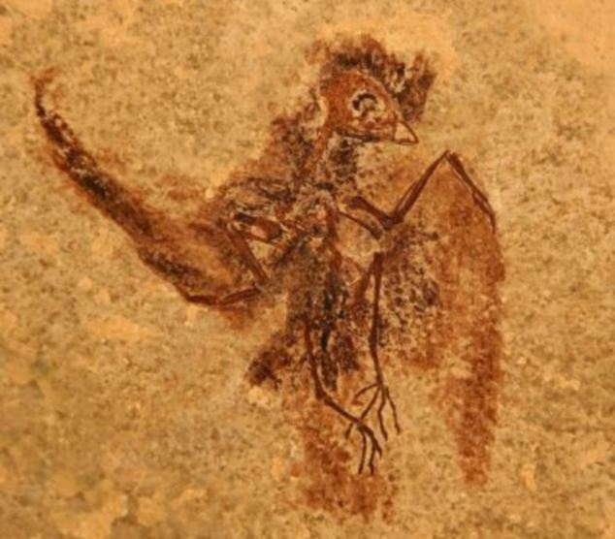
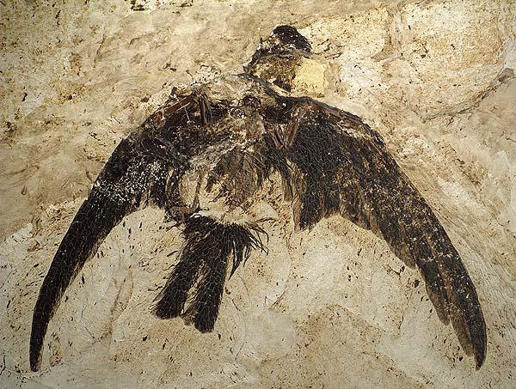
Swifts have been around for about
50 million years!
Eocypselus rowei.
Found in Wyoming.
12 centimetres from head to tail.
Around 50 million years old
Evolutionary precursor to swifts and hummingbirds.
Scaniacypselus fossil in Senckenberg Museum Frankfurt - Scanish Swift – 49 million years old. Photo Ulrich Tigges.
The story here is more about avian classification rather than details of swift evolution.
Reptiles to birds to modern birds!
Around 100 species of swift.

Slide 3
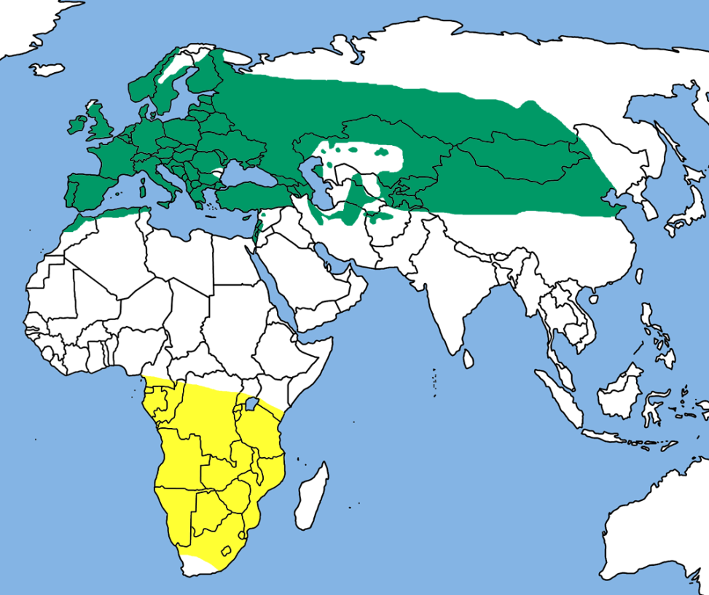
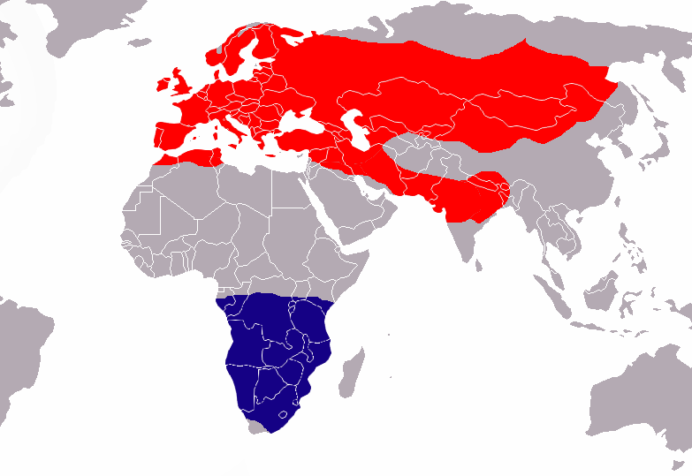
Apus apus and Apus apus pekinensis Very widespread distribution
Notes:
A Guide to the Swifts and tree Swifts of the world - Chantler and Driessens 1995. Pekinensis is found from Iran eastwards.
The Wikipedia map on the right shows the species in Iran, Afghanistan, Pakistan, Northern India and Nepal while not extending to Beijing??
Perhaps we could discuss over the coming days.

Slide 4
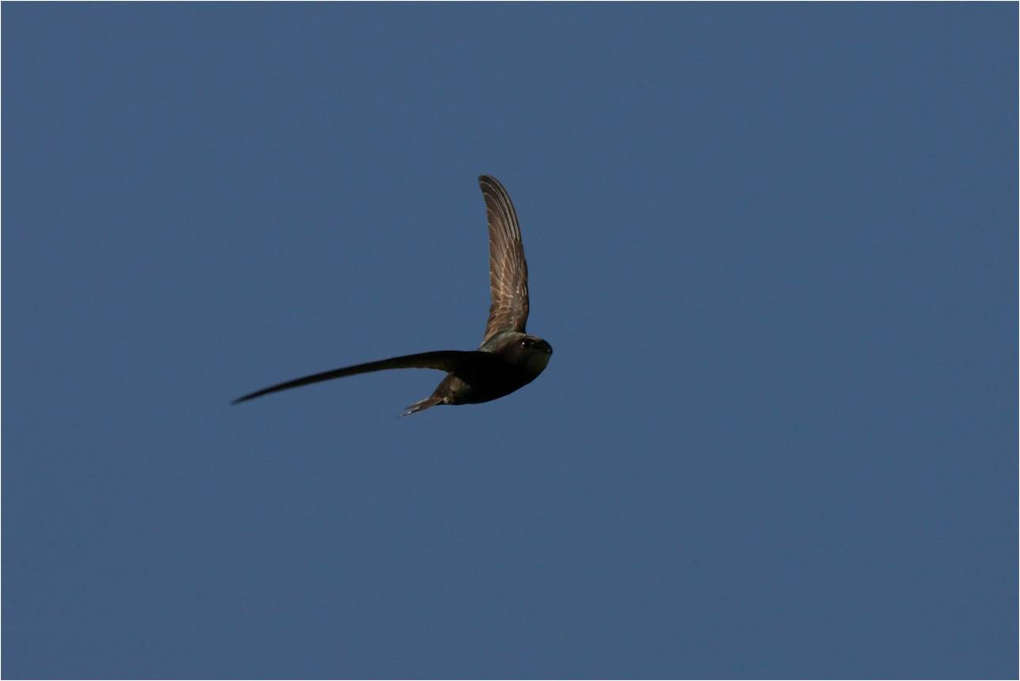
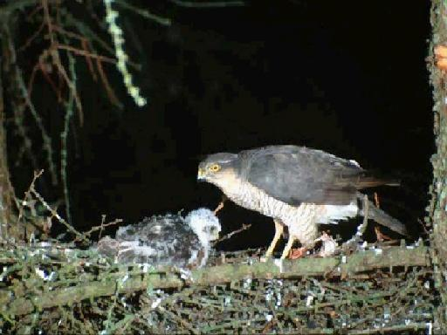
Apus apus ‘HABITAT’ IS “AIR”
IT’S ALL ABOUT FLIGHT!
Look at the length of the wings-
Unlike most birds - e.g. sparrowhawk in woodland -
IT’S NOT LIMITED BY SPECIFIC HABITAT REQUIREMENTS!
aerial plankton feeder
A bird of the air!
The Non Stop bird!

Slide 5
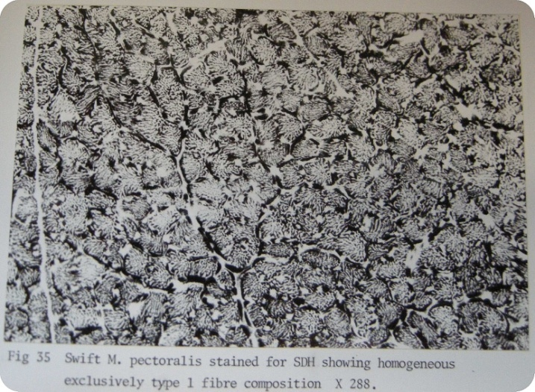
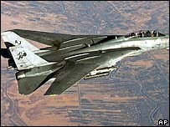
Adapted at a molecular level. A powerful and finely tuned engine
100% Type 1 muscle fibres – packed with mitochondria
Energy source is fat – more efficient than high octane fuel!
Same as Humming birds which are also Type 1
Swifts like Jets refuel in mid air!
Notes:
As well as its many adaptions to life in the air- eyes, wing morphing, sleep, drinking, bathing, torpor and so on swifts like all birds are adapted at the molecular
Level.

Slide 6
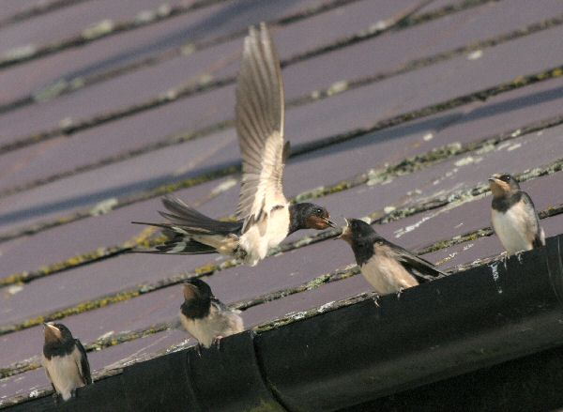
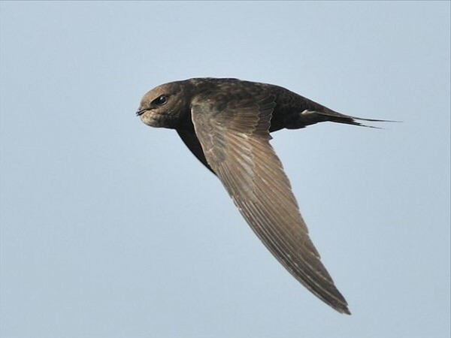
Non Stop life in the air brings some unavoidable consequences!
Swallow can perch-passerine.
Feeds its fledged young – swift does not.
Builds its nest with mud. Swifts in cavity
Swallow preens when perched.
Can get Calcium and minerals from the ground.
Swallow roosts. Swift sleeps on wing.
Convergent evolution – species are not related.
Swift Torpor. Swallow not.
Totally different ball game.
Very different life strategies!
Researches need to be aware of this!
Many of the characteristics of the swift are the inevitable result of its evolutionary path.

Slide 7
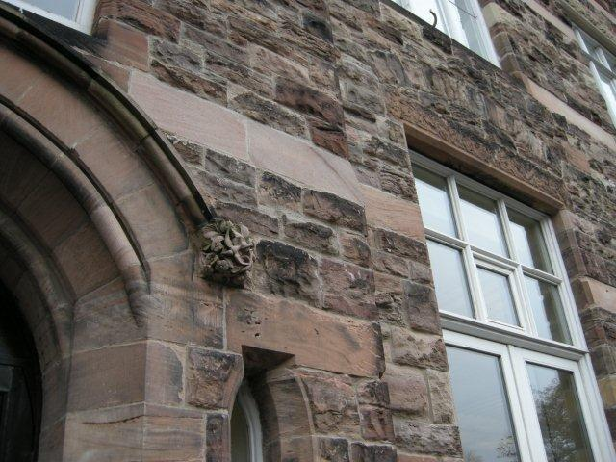
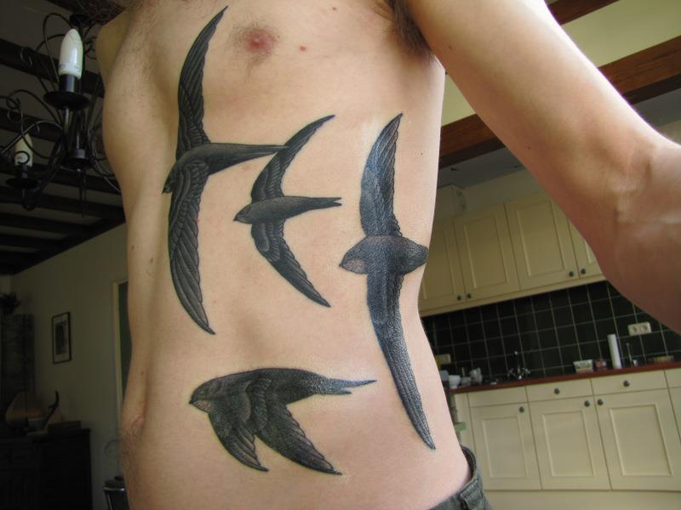
Swifts inspire!- they get under your skin and sometimes on it!
The stone masons tribute!
-and the poets- Ted Hughes --“a bolas of three or four wire screams jockeying across each other on their switchback wheel of death.” --

Slide 8

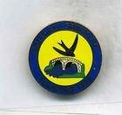

Swifts capture the imagination.
Notes:
Taxis, cars, trains, matches, football teams – the list is endless. You could write books on this!

Slide 9

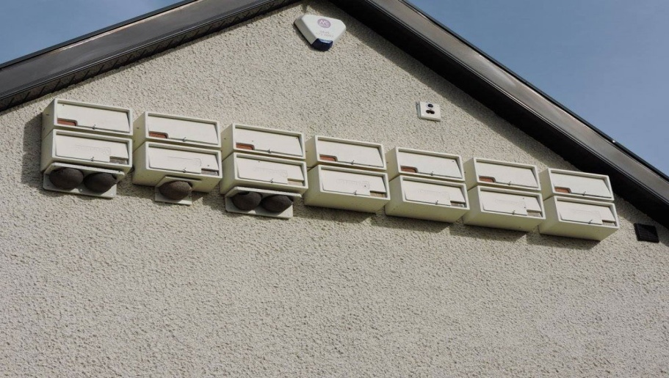
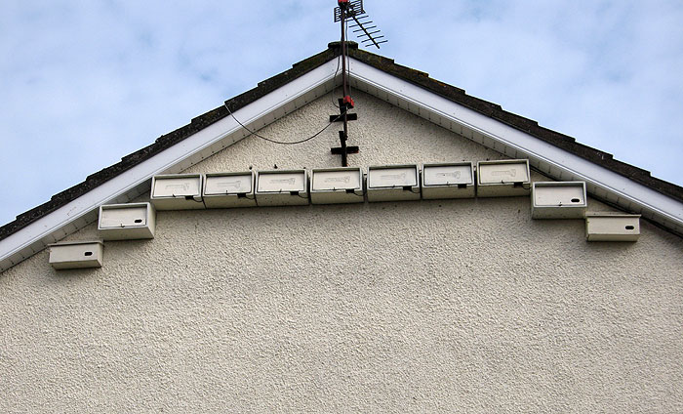
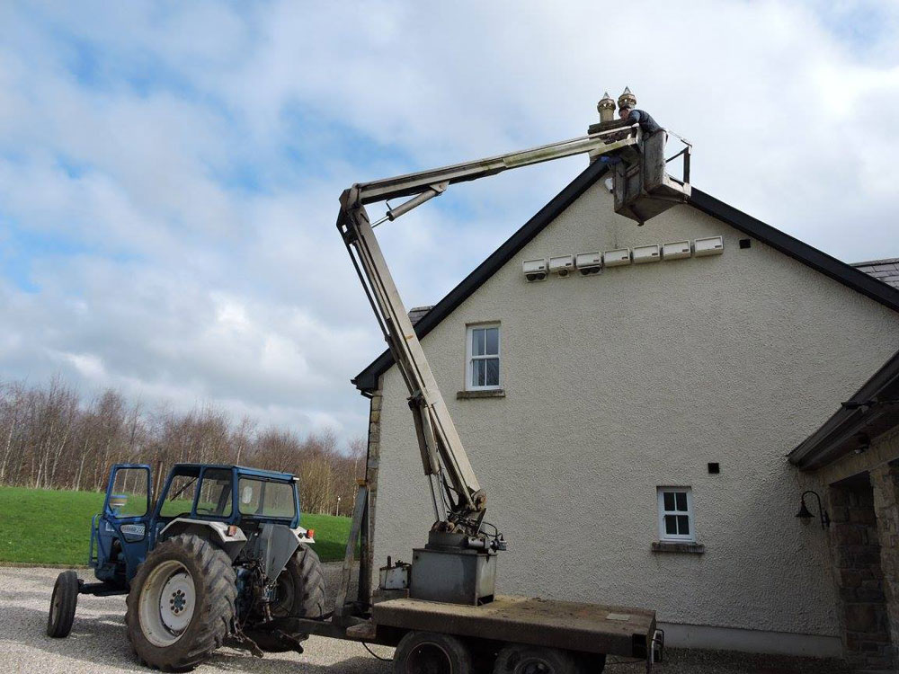
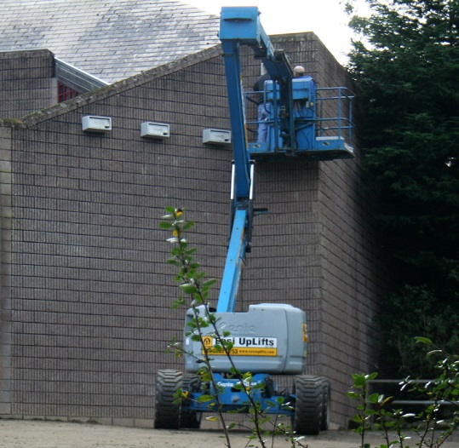
Health Warning! - It can become an addiction!
Notes:
This conference is an example of that. You can spend a lot of time thinking about swifts? What, why, how, etc. “Jerusalem Syndrome” –
more likely we’ll suffer from a much more deadly disorder – “Jerusalem swift syndrome”!
What other bird could sustain 5 International Bird Conferences in 10 years?

Slide 10
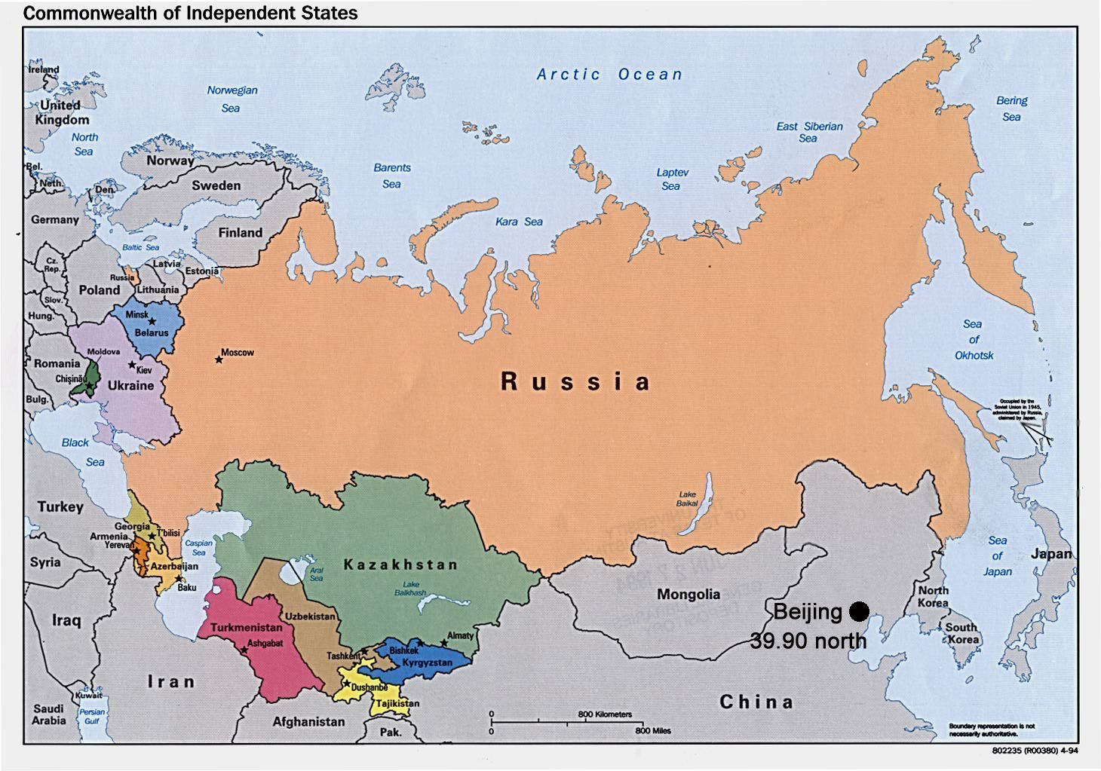
Apus apus pekinensis distribution
Notes:
Lets go back to distribution again. Pekinensis occurs from Iran (possibly eastern Iraq) eastwards through the West Himalayas to Mongolia and Northern China.
Ulrich Tigges is working on reviewing the literature with a view to detailing more precisely the line of distribution between the two subspecies.- around
the Caspian Sea area. It would also be interesting to get observations from this huge swathe of Mongolia, Russia and China. Maybe they already exist?

Slide 11
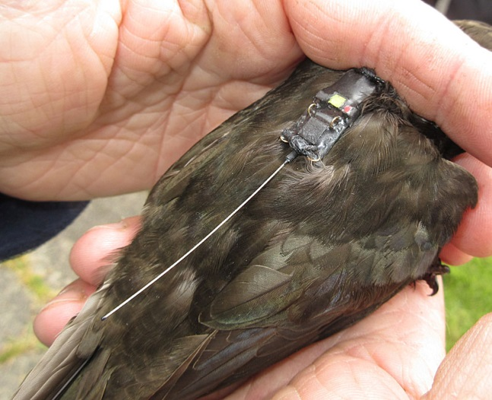
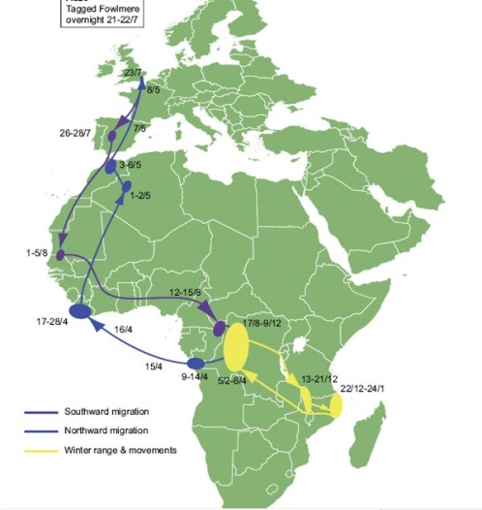
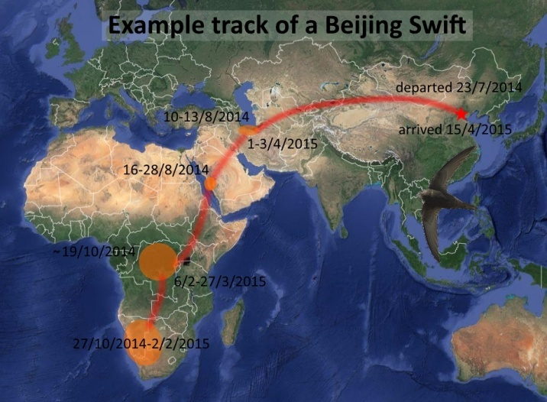
Apus apus and Apus apus pekinensis wintering areas 2010 to 18.
Same species- 2 races
One went North East
One went North West
Wintering areas overlap
A320
Notes:
In 2018 we know a lot more than previously - On the right Dick Newel and Lyndon Kearsley’s work in Beijing China with a group of British, Swedish,
Chinese and Belgian scientists in 2014 in the Summer Palace of China’s former rulers. The migration routes here are fascinating with European and Asian birds mixing together in central Africa and ending up in Namibia and South Africa. The map on the left is from a BTO report on a 2012 study supported by Action for Swifts where Chris Hewson and Phil Atkinson attached a Geolocator to a swift known as A320.

Slide 12
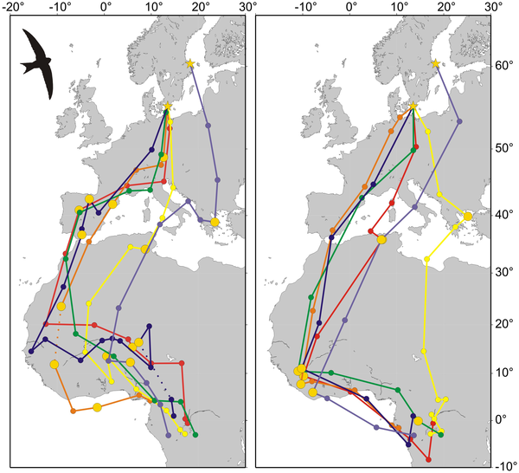

Figure 1. Migration tracks of swifts.
Åkesson S, Klaassen R, Holmgren J, Fox JW, Hedenström A (2012) Migration Routes and Strategies in a Highly Aerial Migrant, the Common Swift Apus apus, Revealed by Light-Level Geolocators. PLOS ONE 7(7): e41195. https://doi.org/10.1371/journal.pone.0041195
http://journals.plos.org/plosone/article?id=10.1371/journal.pone.0041195
Notes:
We didn’t know this in 2010 in Berlin . Now we do! This is an open-access article from Suzanne Akesson 2012 study on 6 birds in Sweden. Its now fairly well established
that within the European swift population the various sub populations have their own migration routes and favoured wintering areas as with here in Sweden.
The common swift adopts a mixed fly-and-forage strategy during migration. Further tracking work in other countries has continued to show how various subgroups of the
population have different breeding and wintering areas.

Slide 13
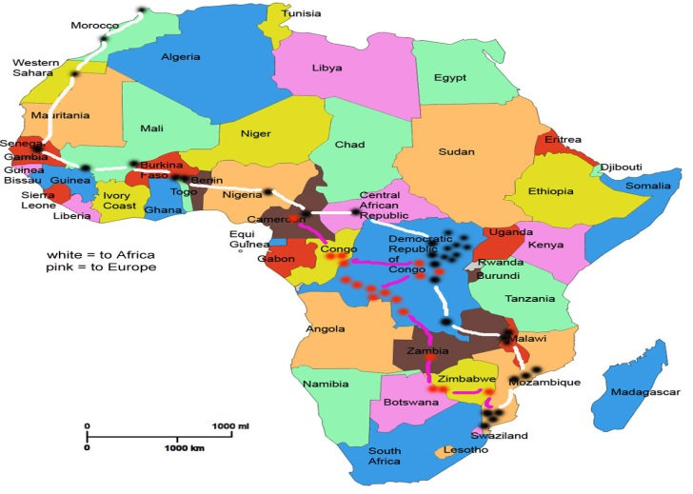
Example of RSPB GPS 2016 and BTO 2012 Geologger migration routes
Notes:
What we saw in the Cambridge BTO work has now been replicated in Ireland in 2016 (Chris Hewson- Mark Smyth) and in 2017 by RSPB. Could be predicted! This is a GPS tagged bird from Mark Smyth’s colony in Antrim. An important point here is to emphasise that unlike most birds e.g. geese which have to land to refuel swifts can feed in the air so maps will have a natural variation from year to year according to feeding opportunities local weather conditions etc.

Slide 14
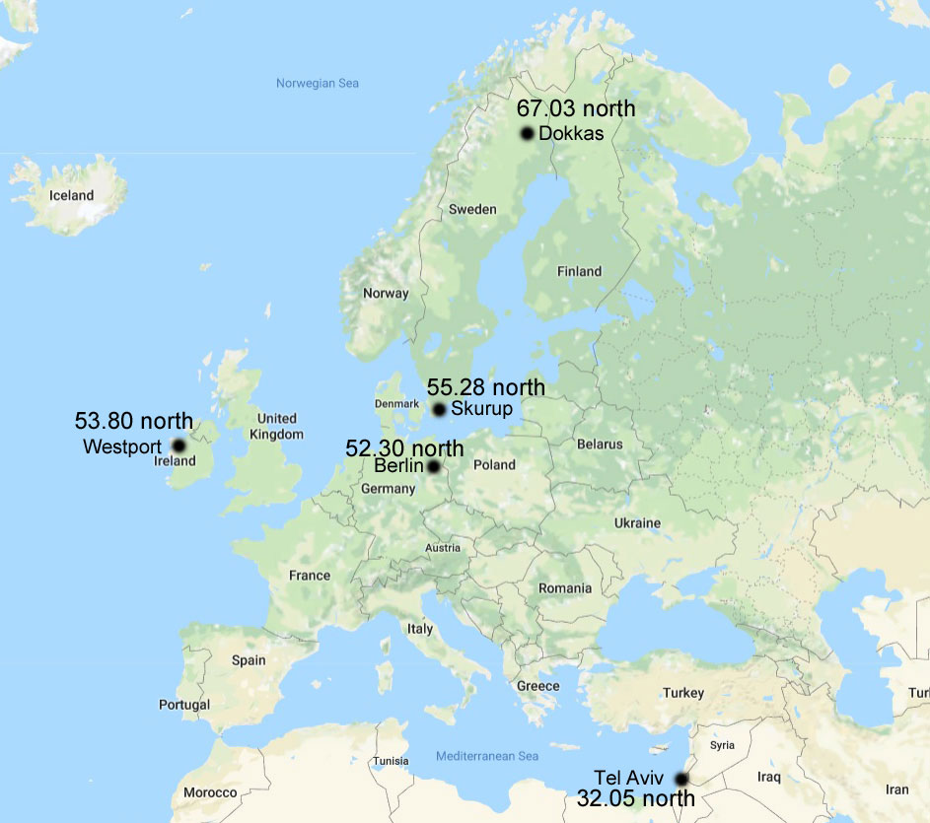
Spring migrant in Israel. Ulrich Tigges http://www.commonswift.org/
Notes:
The different populations in different places have different arrival and departure dates relating to the different climates and daylight length the birds will encounter. Tel Aviv at 32.05 North has 28 Feb as its main group arrival. In Berlin at 52.30n it’s the 11th May. In Skurup at 55.28 N its May 23rd and at Dokkas Swedish Lapland at 67.03 N its 10th of June. Mayo is 53.80 North (very similar to Berlin) . Meanwhile pekinensis the Beijing swifts nest 39.90 North- at the same latitude as the heel of Italy. It would be interesting to compare exact arrival times of the varying waves of pekinensis across their range.

Slide 15
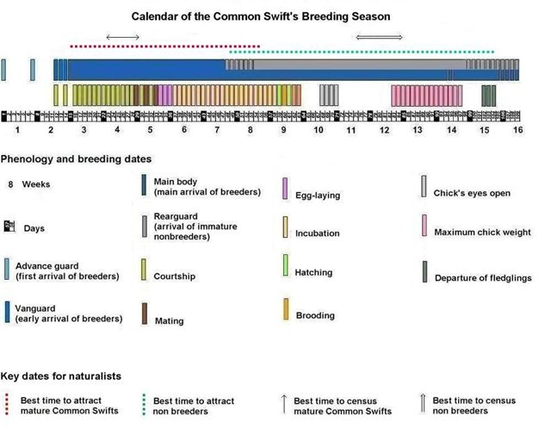
Swift Calendar -Ulrich Tigges

Slide 16
Nest Site Selection in the context of social interactions within a colony.
As well as the established breeders lots of other things are going on in and around a colony -
In any colony however small - non-breeders arrive.
These can be 1st 2nd or 3rd year returners
These birds are prospecting colonies and or nest sites
Immature birds exhibit banging behaviours – bangers.
Screaming parties occur from arrival of breeders but become more frequent again, after the relative quiet during incubation and brooding of chicks.
Always more swifts than there are actual breeders in any colony
All part of a highly ritualised social conduct for species!
Notes:
WHAT HAPPENS TO ALL THIS ACTIVITY and the immature birds if colony is lost? And whole colony loss is not uncommon.

Slide 17
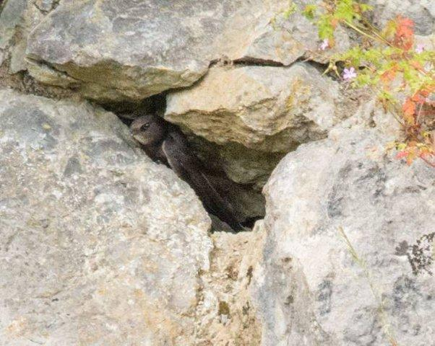
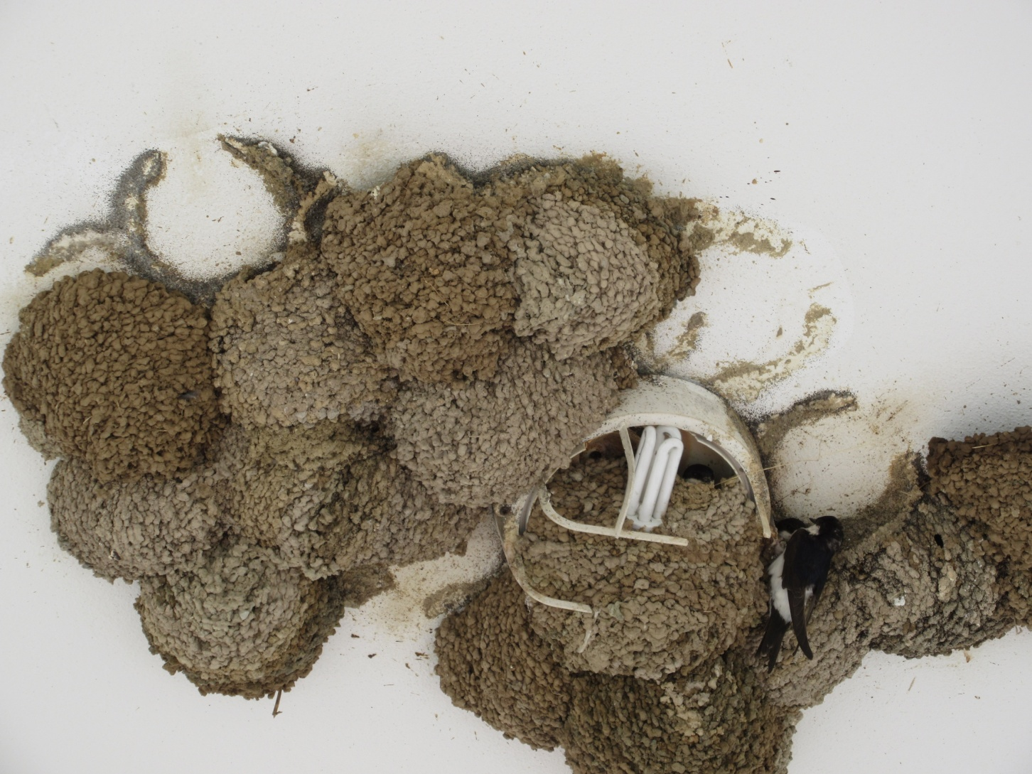
Its all about finding, occupying and defending a nest site!
"The discovery of a suitable nesting site is, undoubtedly, the most important event in the life of a Swift" - Ulrich Tigges
Limited availability
Swifts Achilles heel!
Compare with House Marten
Notes:
Top photograph James O'Neil

Slide 18

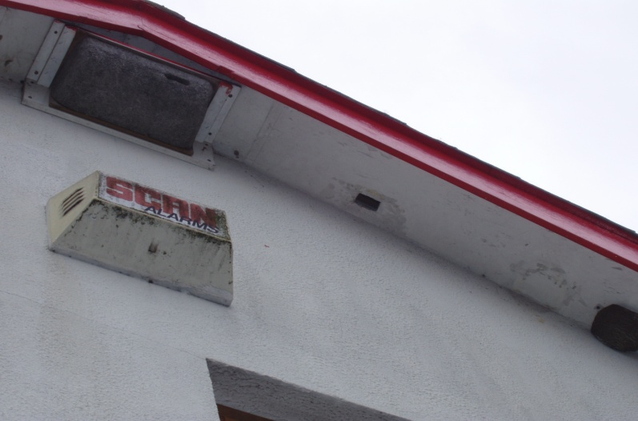
Once swifts disappear from an area it can be slow process to get them back.
A vital part of conserving the species is to have anchor tenants to attract other swifts!
Are any swifts breeding nearby? Swifts like swifts!
Swift Calls are the nearest thing to a silver bullet!
But not guaranteed!
No swifts then more calls needed!
Notes:
If you are lucky you may have anchor tenants left to build a colony up again provided there is also nest site availability.

Slide 19
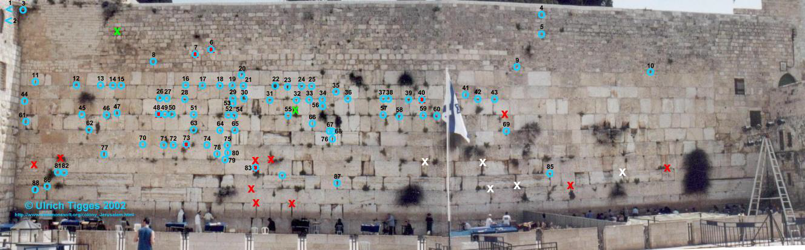
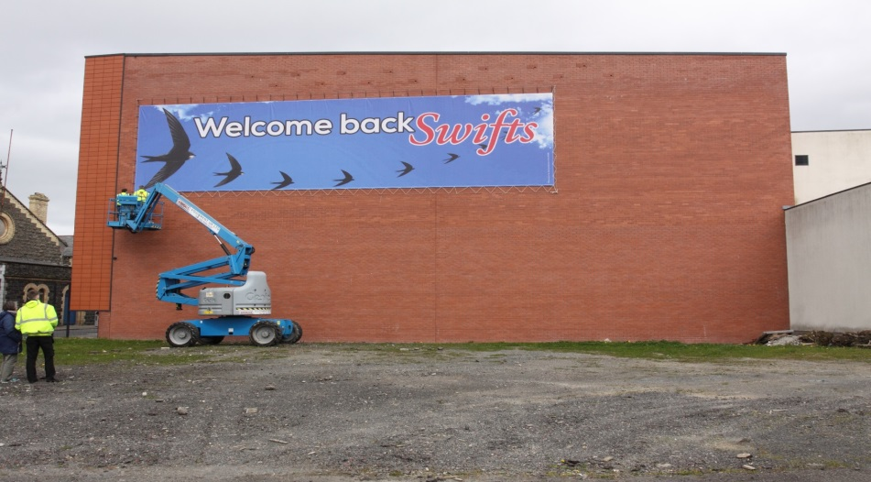
Arrival is a very special time of the year! - Ted Hughes again -
“They’ve made it again/ Which means the globe’s still working . . .”
---“Fifteenth of May. Cherry blossom. The swifts
Materialize at the tip of a long scream
Of needle. ‘Look! They’re back! Look!’ And they’re gone
On a steep Controlled scream of skid” ------
Notes:
From Israel to Lapland! A joyous time.

Slide 20
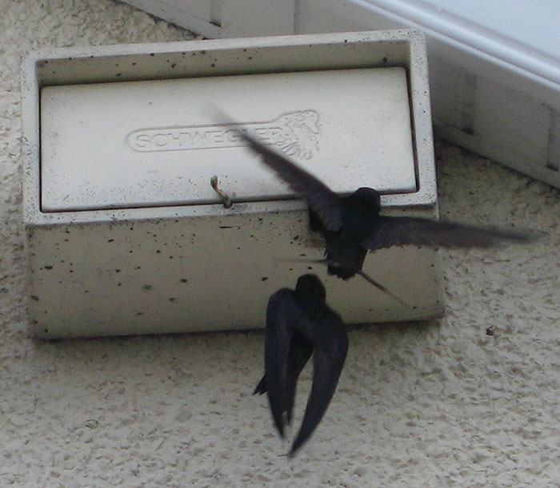
Main locations for swift population change from “anywhere” to the nest.
Goes from complete freedom to roam the skies to being tied to the nest site
Now needs to stay local
The food supply for the chicks is dependent on weather and nearby habitats to supply insects to the air.
Notes:
To researches. Be careful not to put pressure on adult birds during early stages of incubation! Think carefully about why you are doing it.

Slide 21
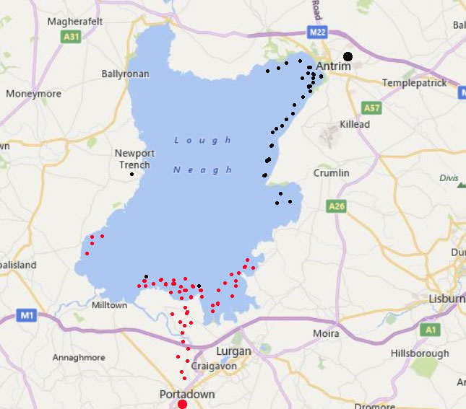
Feeding and breeding- example track Lough Neagh - 2017
Needs to find food as near the nest as possible.
Takes advantage of peak Aphids and Chironomids 1st peak in mid summer.
Feeding behaviour necessitated by weather and growing chicks.
Once chicks are fledged pressure is off. They can forage more widely.
Notes:
Researches should be aware of which sub section of the population they are looking at.

Slide 22
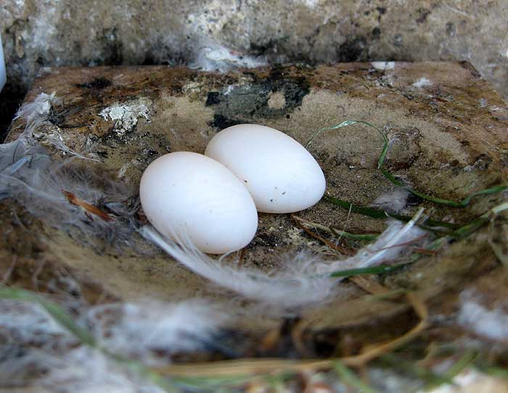
They are with us to nest, lay their eggs,

Slide 23
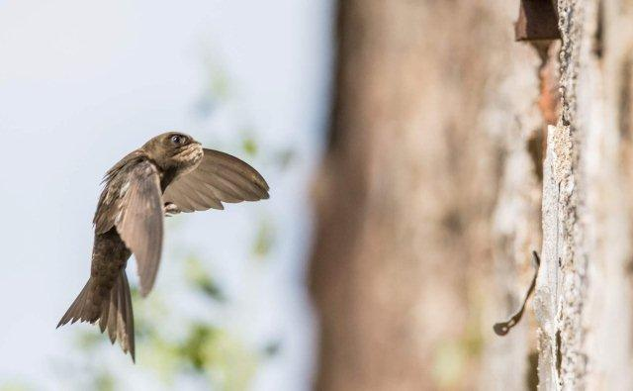
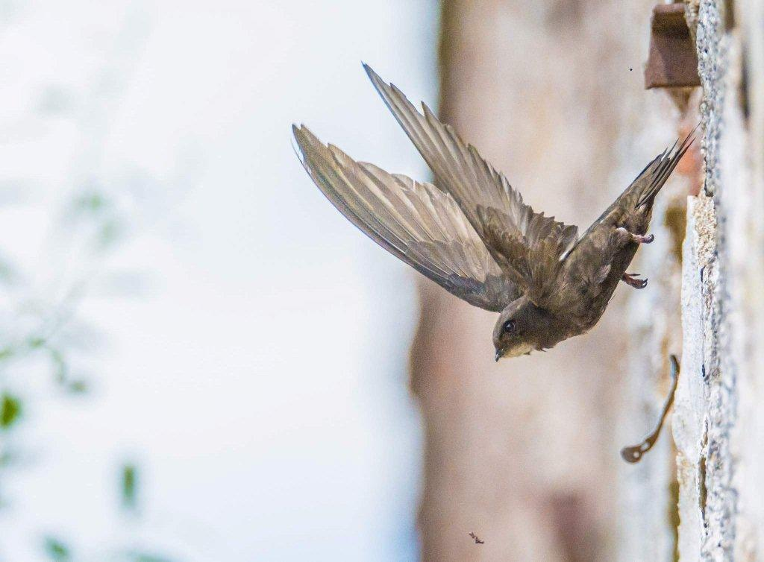
And feed their chicks.

Slide 24
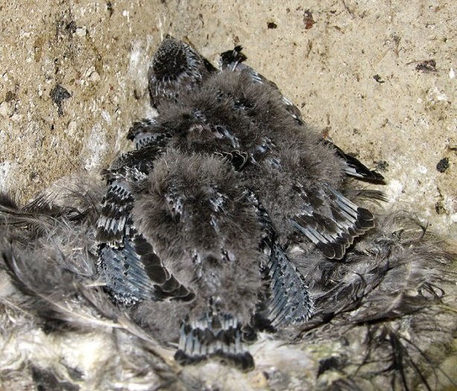
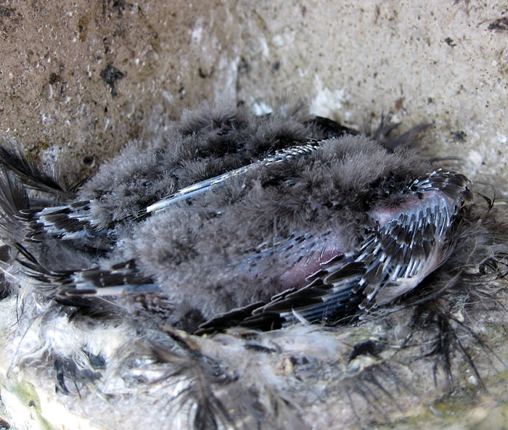
Chicks grow rapidly
By second week after hatching both parents hunt
Food every hour
Sometimes within minutes – Lough Neagh – bolus in 2 minutes.

Slide 25
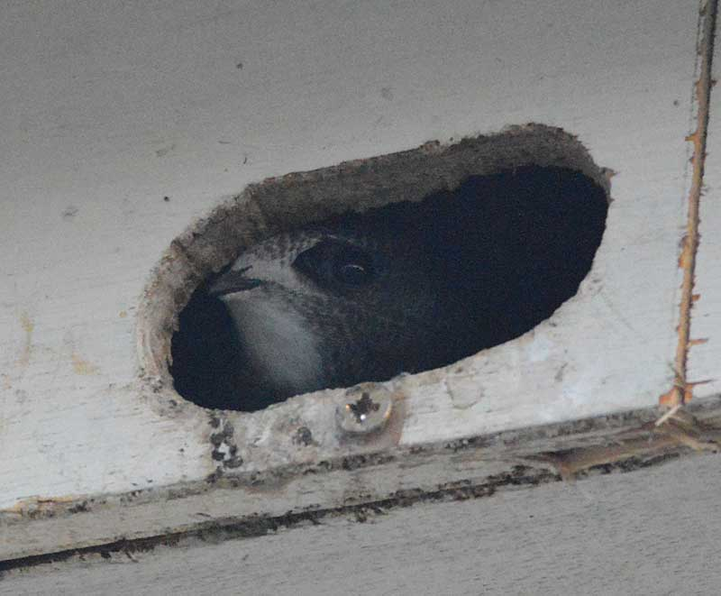
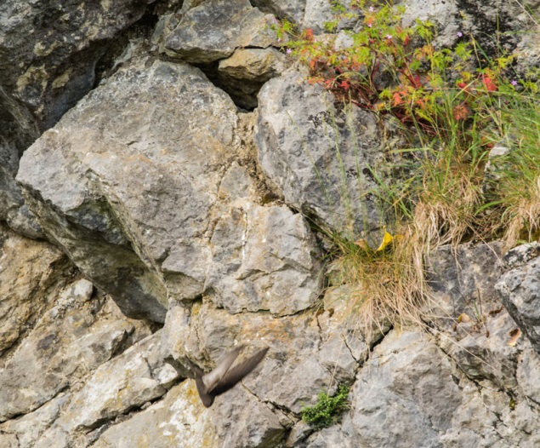
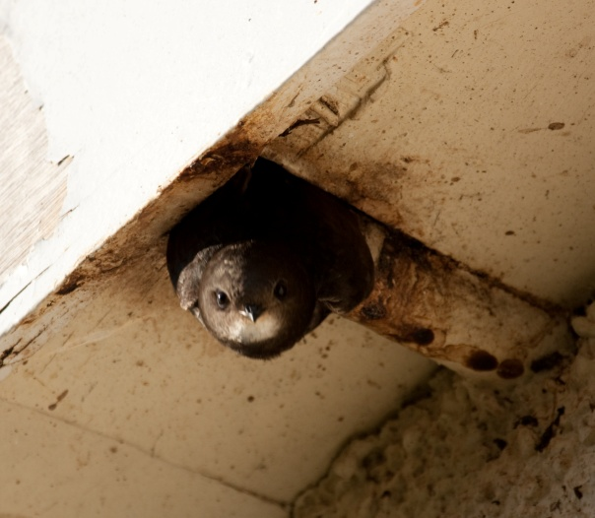
And then the first flight!
That magic moment each summer – 40 days or so at 40 to 45 grams. Wings 16 cm long.
“Maybe even more important than finding a nest site?”
Fly or die!
The class of 2018 will be airborne!
Notes:
Anyone lucky enough to witness this can only be filled with wonder! Also a sad time. Its almost over for another year!

Slide 26
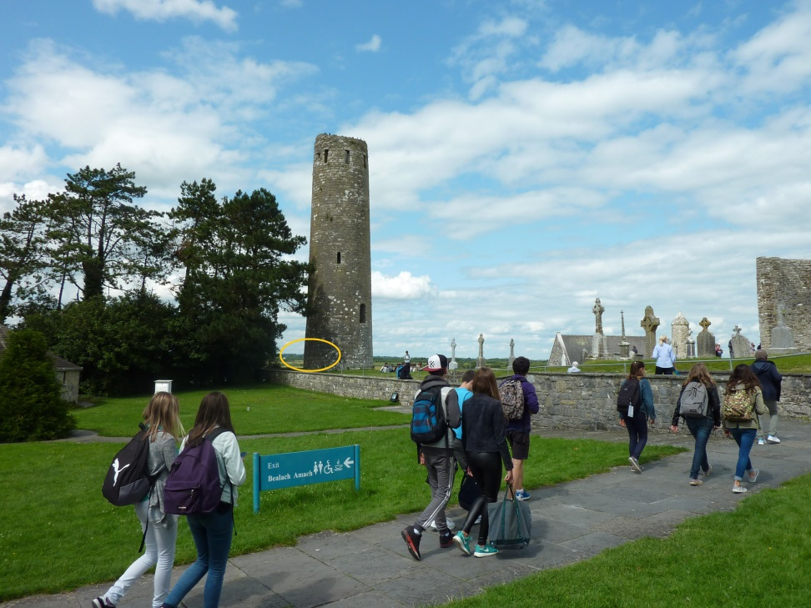
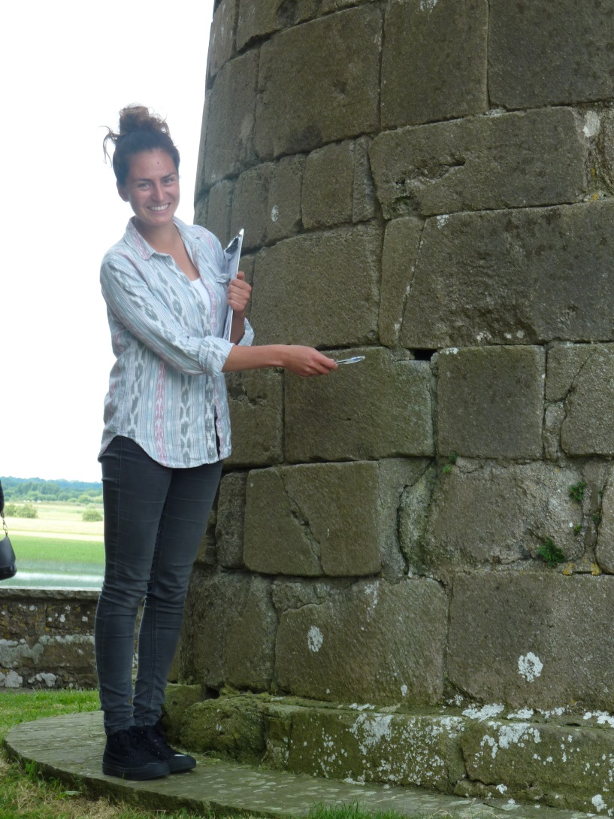
Clonmacnoise Co. Offaly – a low nest site. - Difficult first flight?
Notes:
An area of research worth looking into is mortality and its causes at this vital stage of fledging.

Slide 27
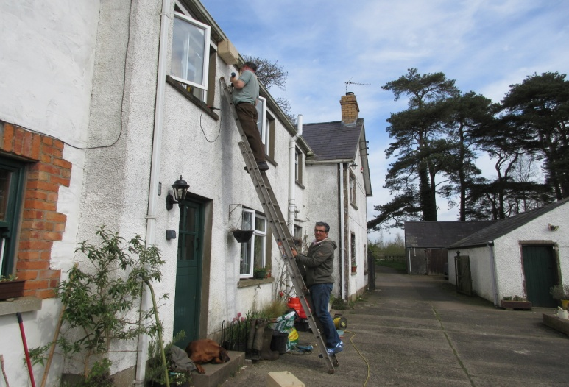
Swift Conservation – What should we do? Is it nest sites, or insects, or what?
Notes:
Lets bring things back to a practical level

Slide 28
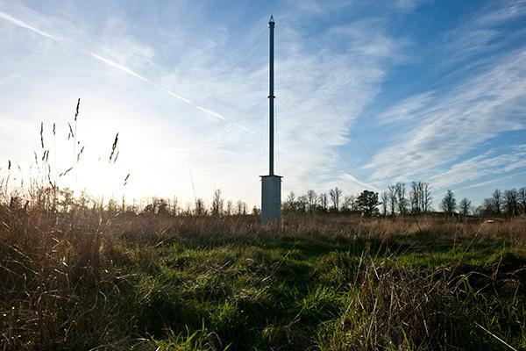
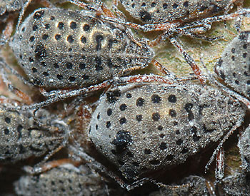
Lets look at Insects - Rothamsted Research
Since 1968 12.2 meter-long suction tubes deployed to monitor agricultural pests.
Rothamsted Insect Survey. Daily records April to November
16 traps -12 in England- 4 in Scotland
400 of the 600 aphid species in UK recorded

Slide 29
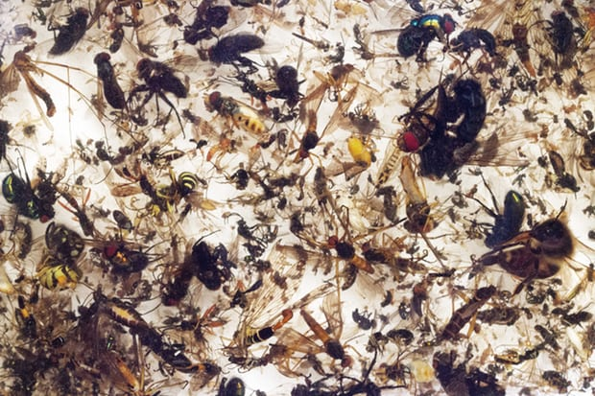
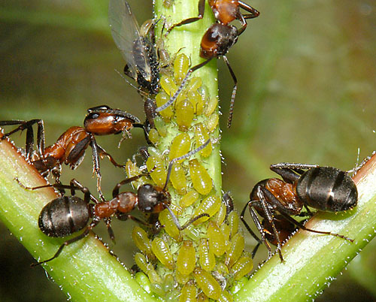
Total Biomass declines.
“Between 1970 and 2002 no significant decline in biomass in England .”
“Catches in southern Scotland, however, declined by more than two-thirds during the same period” WHY?
Notes:
Dr James Bell – head of research

Slide 30
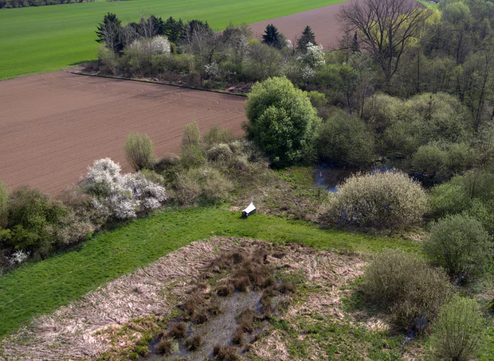
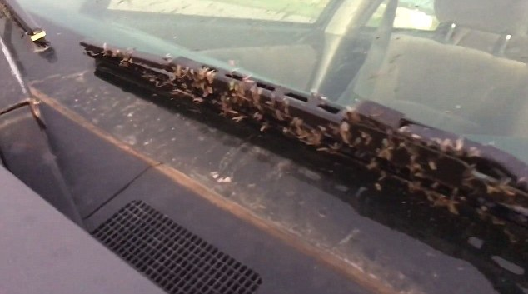
Ecological Armageddon?
PLOS One journal – In German NR’s flying insect populations have declined by more than 75% over the duration of the 27-year study using Malaise Traps.
Dramatic plunge in insect numbers and that’s nature reserves!
Notes:
Bogs in west of Ireland.

Slide 31


Are declines in Swift primarily linked to loss of Nest Sites, or lack of insects?
Swift is dependant on insects in the air!-but-
not concerned if their origin is woodland, grassland, bog, urban, aquatic etc.
As long as there are flying insects there will be feeding swifts!
Notes:
They are found in virtually any temperate or tropical area where prey can be found. Swift habitat includes desert, oasis, Mediterranean scrub, steppe, farm or grassland, urban areas, forest and canyons. Anywhere that there are insects. Some people in Ireland talk about “creating swift habitat”. Best way might be to create another Lough Neagh!

Slide 32


Swift - A Key Indicator species of change?
Maybe, but not of early changes in insect population! - because –
How do you separate out loss of nest sites effect from any effects due to falls in insect numbers? We need more accurate information.
The swift in UK probably eats more species of animals (small insects and spiders) than any other bird.
African diet?
Likely it will be the last insectivorous species to go!! – if it goes all is lost!
Good indicator of urban air quality!
In Ireland are lakes masking insect declines in other habitats?
Is it a similar story elsewhere?

Slide 33




Loss of nest sites-mills, schools, churches, houses, repairs, etc.
Notes:
Meanwhile if we look at nestsites we can see clear evidence of wholesale and widespread losses. The key to conserving swifts in Ireland is keeping
existing colonies and creating new ones! Move from pieces of paper to -ACTION!!! - We can’t hang up bags of aphids!

Slide 34




Keep existing colonies and provide new cavities!
Notes:
At present as far as we in Ireland are concerned this is where our main activity lies. Insects in the air are big politics! And we can’t hang up bags of them!

Slide 35



Cliffs, Nest Boxes, Towers, Walls, Bricks. CAVITIES!
Notes:
We are interested in all of these.

Slide 36


It’s the cavity!
Notes:
It’s the economy stupid!

Slide 37


Overall Global message is “Conserve existing sites and create new ones”!
Is the swift safe?
As long as there are insects and cliffs.
How many do you want?
Do you want the spectacle?
The greater the numbers the greater the spectacle!
Notes:
In 2010 in Berlin I came to the conference with a real concern that the swift was in big trouble. Now in 2018 I'm a lot more hopeful.
I'm convinced that the swift will not disappear from our skies anytime soon . – There is a huge adaptability and elasticity in the species. Its highly opportunistic and has a built in resilience!!

Slide 38

And here is the spectacle! – The boys are back in town!
Notes:
Swifts will not disappear but do we want big colonies especially in Urban areas where people can marvel at their behaviours and connect with nature again?
What a way to see and appreciate NATURE! Screaming parties epitomise summer. Photo James O’Neil

Slide 39

Swifts as a unifying force for conservation and nations.
“They’ve made it again/ Which means the globe’s still working . . .”
“They swat past hard fletched, veer on the hard air, toss up over the roof and are gone again”
Notes:
We have seen how this species is found over a vast range of countries in Europe, the Middle East, Asia and Africa. “the globe still working” What a lovely way to explain natural systems and sustainability! This conference is a great example of this. We have here in this venue many nationalities. But I want to say
something about Israel and Ireland in particular. Israelis and Palestinians both have a long and difficult history. But YOU can and do unite when it comes to
conservation. Ireland and Britain have also a troubled past going back over many hundreds of years. Irish and British people from both Northern Ireland and the Irish Republic have their own historic differences. As you may know N. Ireland has been in the news lately for our politicians not being able to reach a political
agreement. Despite this I can speak for all the Irish contingent north and south Irish and British when I saw that we are well ahead of our politicians! We are
all totally united in doing what we can to conserve the swift. This conference is a shining example to the world that people may be divided politically but in every nation where the swift Apus apus and Apus apus Peckinensis occurs we are UNITED in our determination to conserve not only the Swift but all the biodiversity that sustains this Planet. Long may we be able to say They've made it again. The Globe – our world is still working. AND- They’ve left again to roam across the African continent

Slide 40

Back to roam across the African continent!

Slide 41
END – 3 Fantastic Websites!
www.swift-conservation.org/
http://actionforswifts.blogsp
http://www.commonswift.org/

