Slide 1

From War To Peace
5th International Swift Conference
March 2018
Ret Gen Mansour Abu Rashid

Slide 2
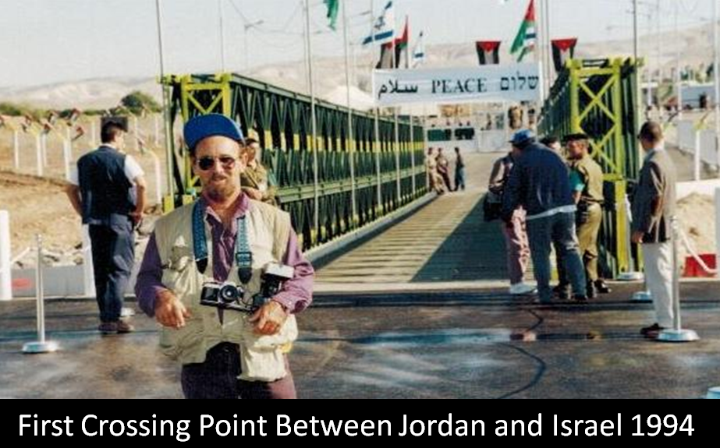
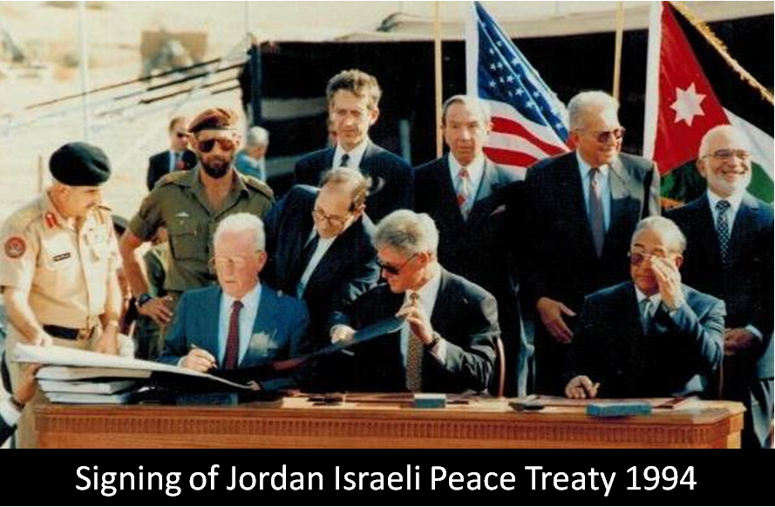
Jordan Israeli Peace Treaty

Slide 3
A success story
Since our establishment in 2000, ACPD center worked passionately to overcome regional divides & to seek collaborative solutions of common problems.
We have a unique fingerprint on facilitating dialogue between the peoples of the Middle East and improving understanding and tolerance.
Through implementing tens of cross border projects, workshops and seminars, we encouraged Jordanians, Arabs and Israelis to engage in a meaningful dialogue based on mutual respect.

Slide 4
Sphere of Work
Women Empowerment
Environmental/ Agriculture
Academic
Sport

Slide 5
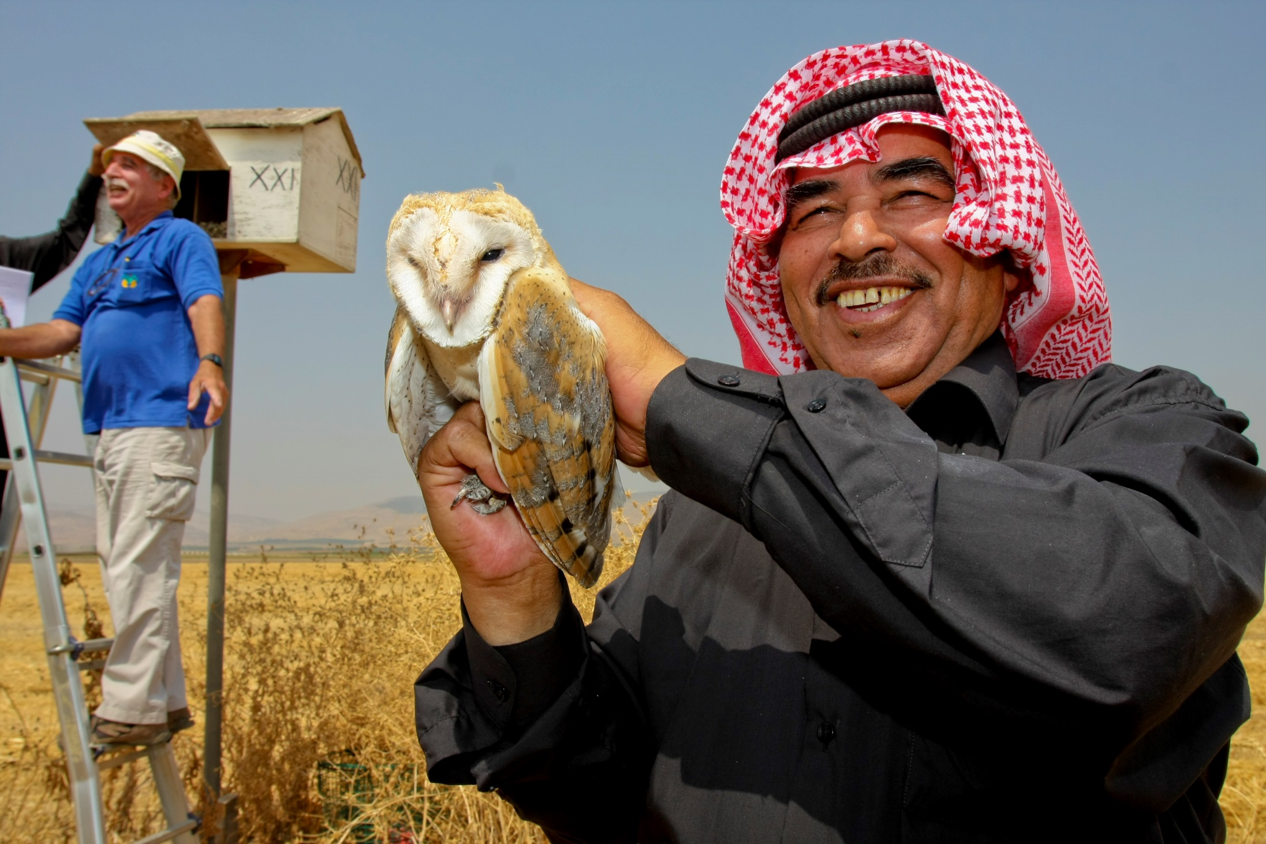
Using Barn Owls & Kestrels as Biological Pest Control Agents in Agriculture
2002 - Present
Environmental
Initially, the project gathered from the Jordanian side (ACPD) & from the Israel side, Society of the Protection of Nature in Israel, Tel Aviv University & The international center for the study of birds’ migration LATRUN.
However, in the years later the project was enlarged and included from Palestine The Palestine Wildlife Society & Al Quds University.

Slide 6
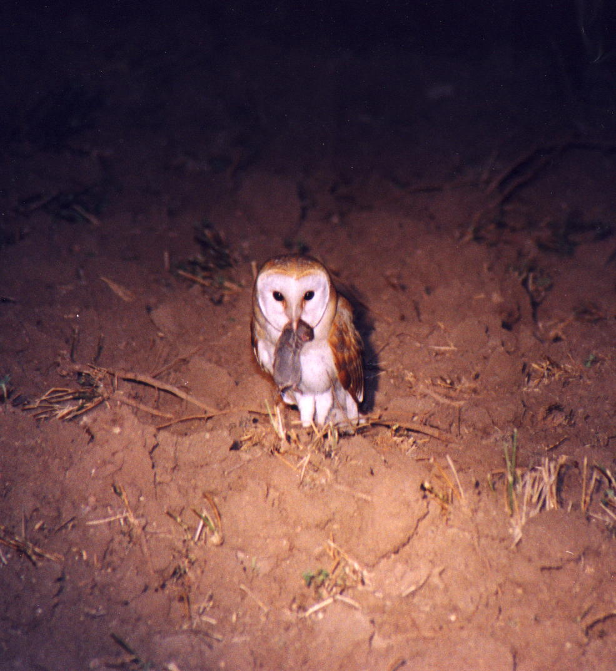
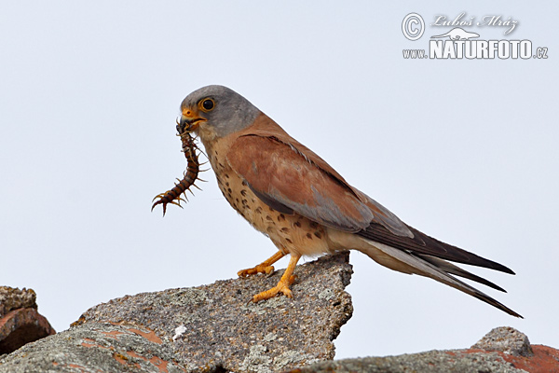

Slide 7
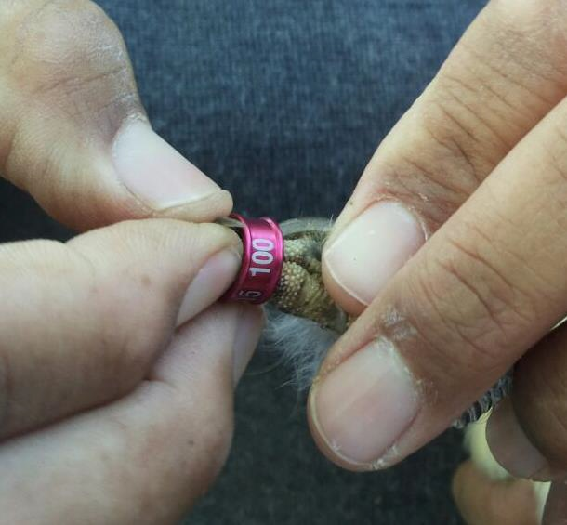
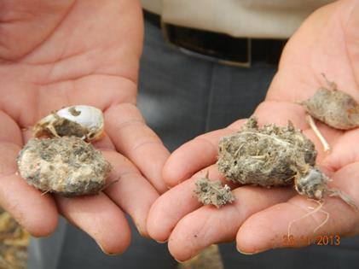

Slide 8

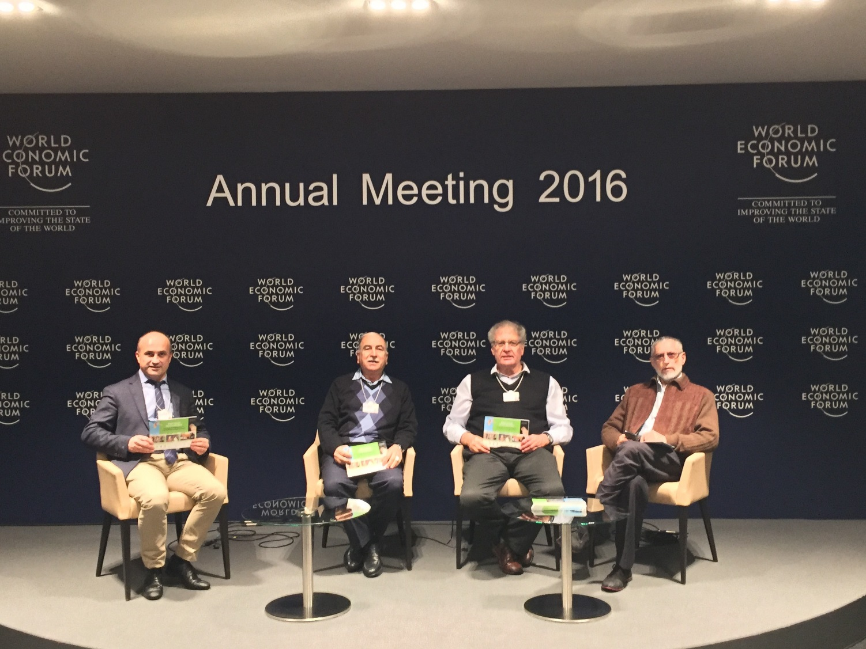
Davos – First impressions
WORLD ECONOMIC FORUM
JANUARY 2016

Slide 9
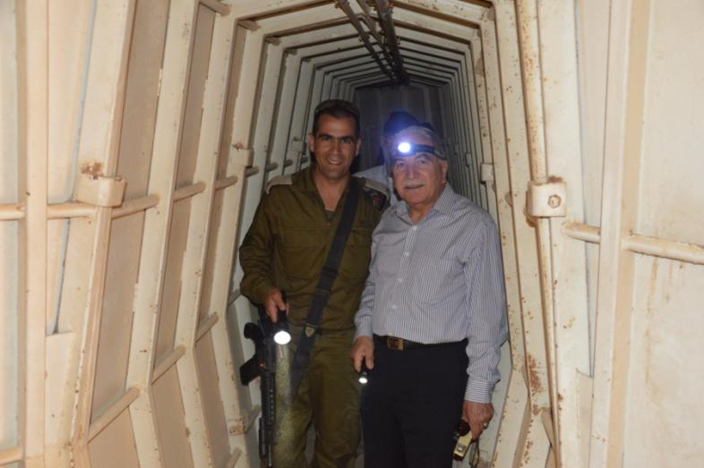
Bat Project
Environmental

Slide 10
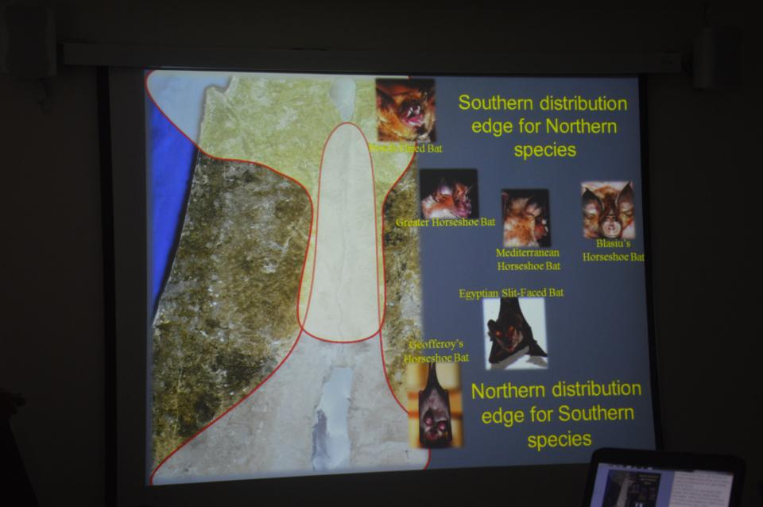


Slide 11
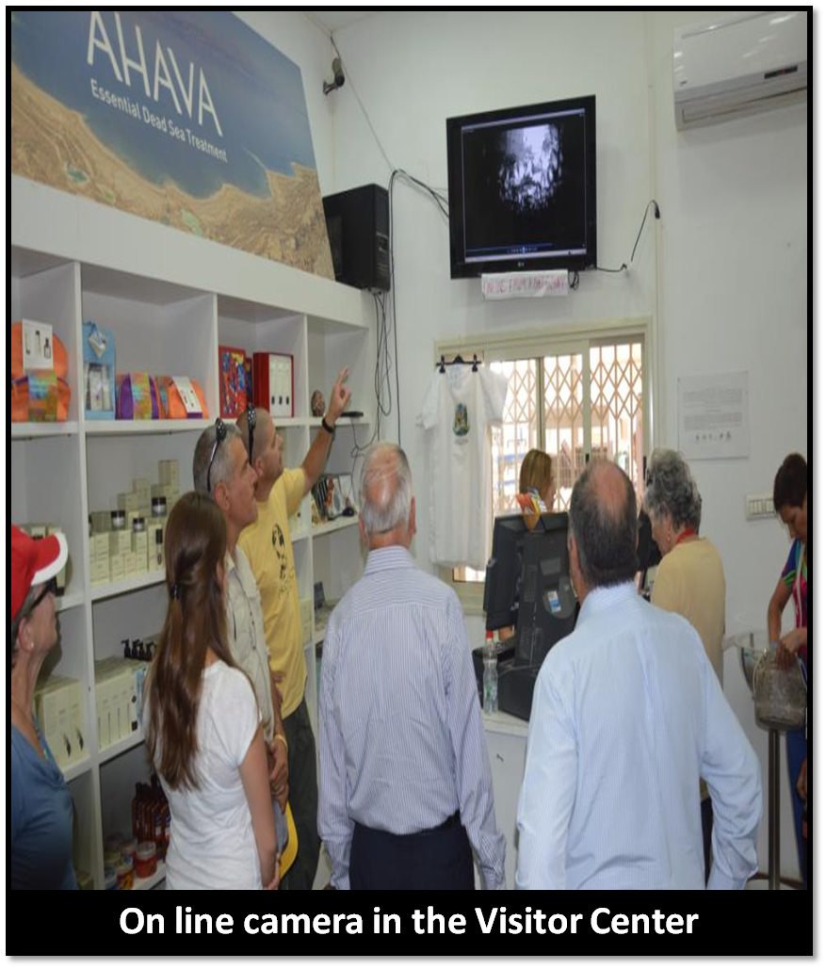
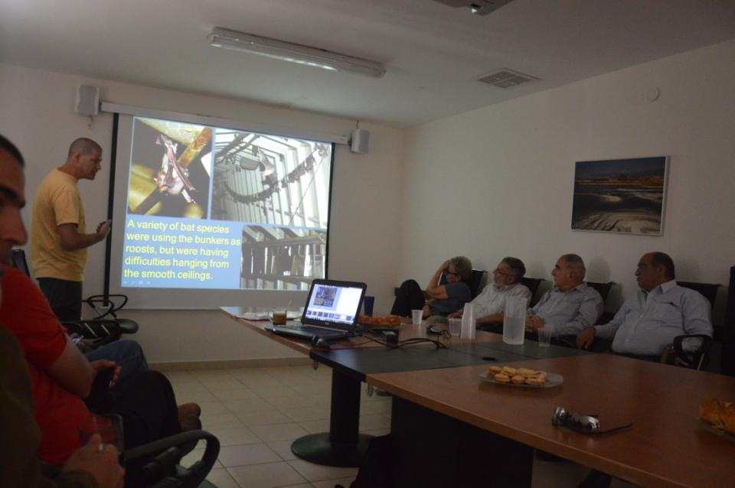

Slide 12
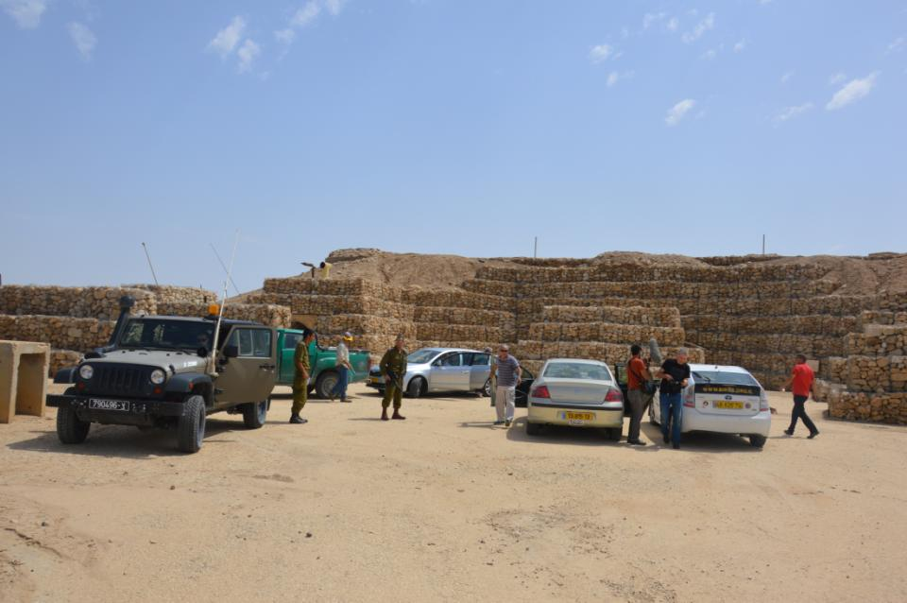
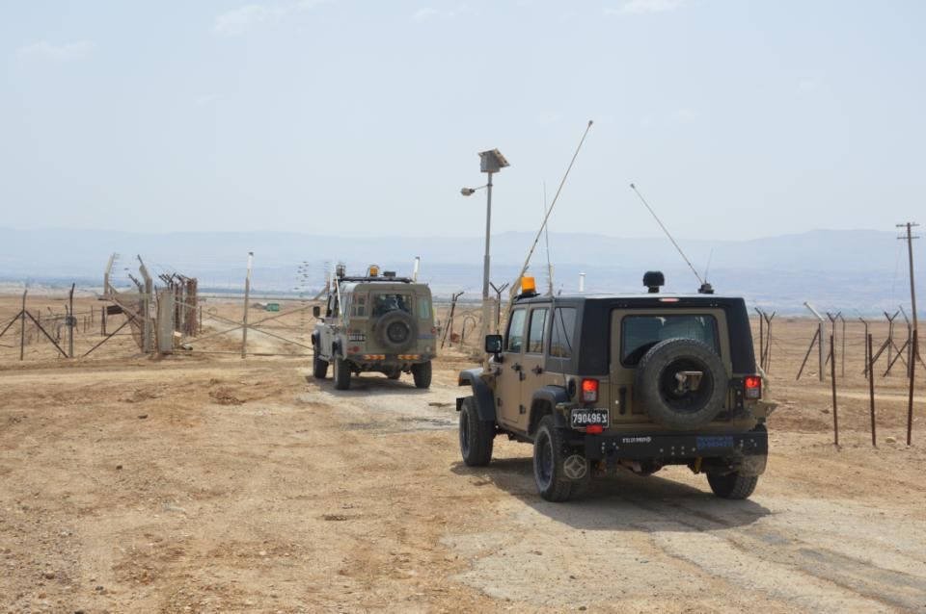

Slide 13
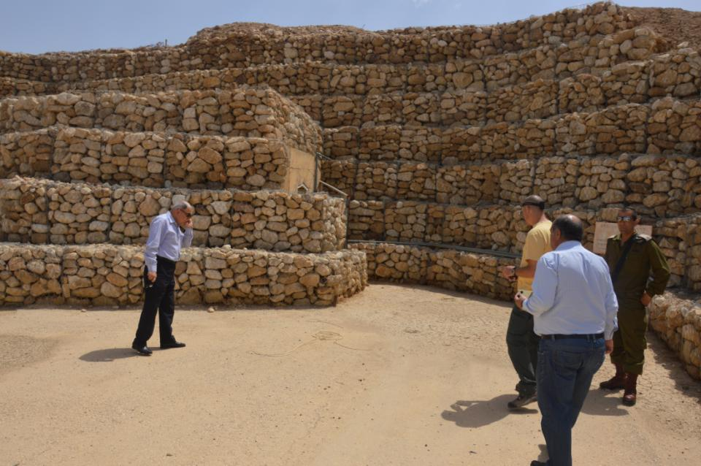

Slide 14
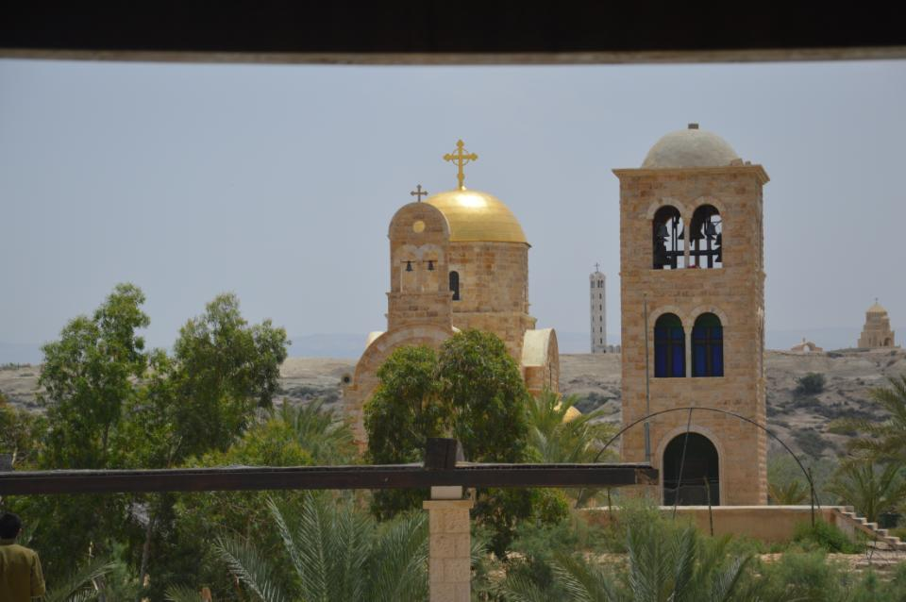
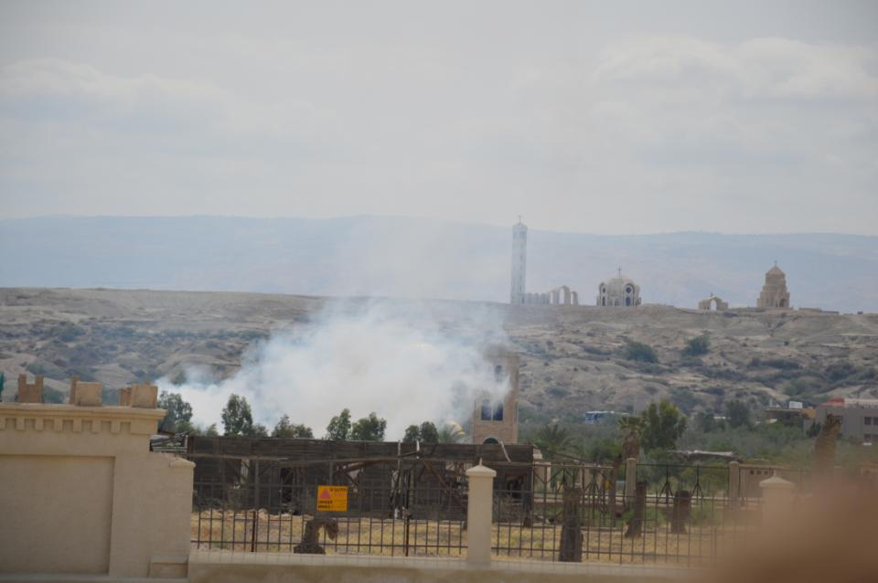
19th May, 2014: Spraying pesticides against mosquitoes in the Jordanian side before the Pope visit. (This is the job of the bats!)

Slide 15
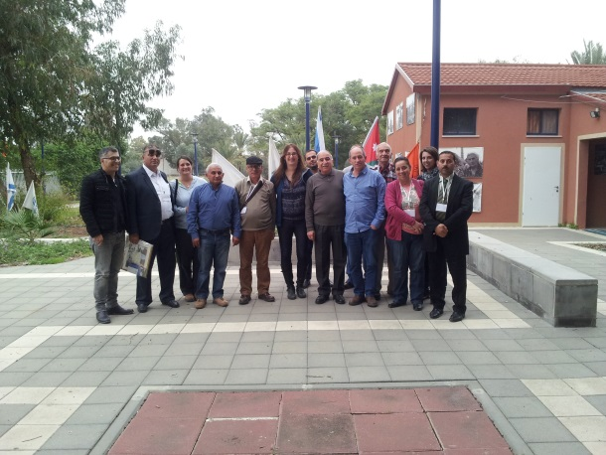
Jordanian Israeli & Palestinian Agriculture Experts Cooperation
Agriculture
The project was implemented in order to promote mutual cooperation in the field of “Pest Control” along other related technologies. As our region is still faced with a number of challenges, the need for genuine and authentic implementation of such projects has become a priority.

Slide 16
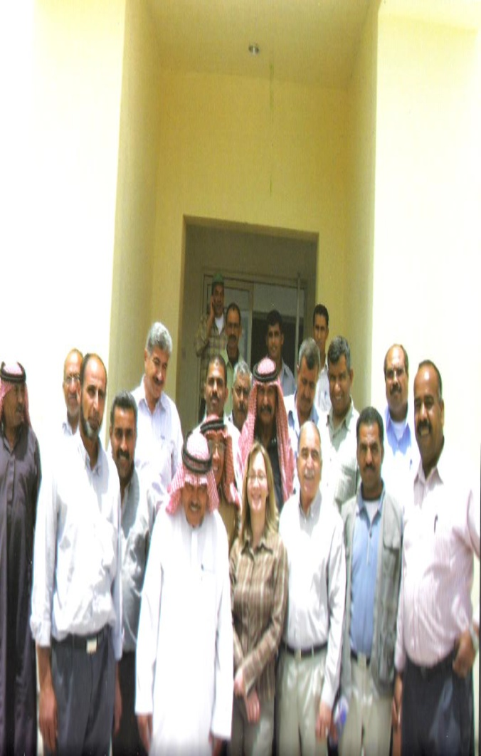

Slide 17
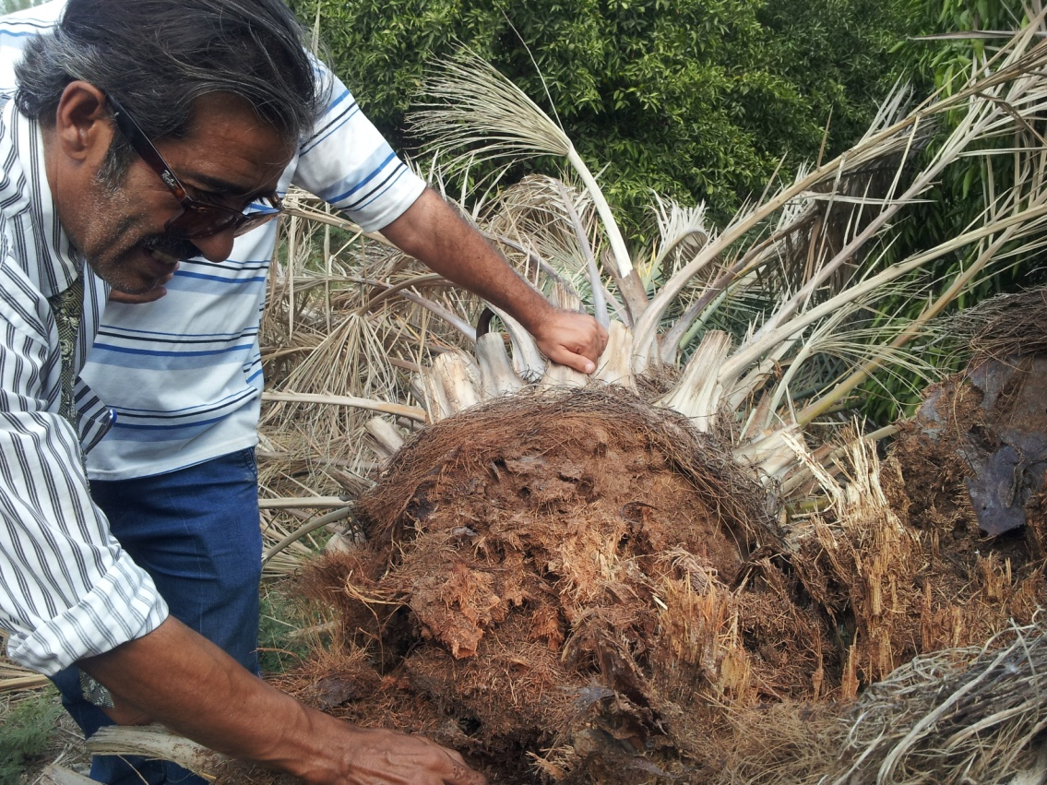
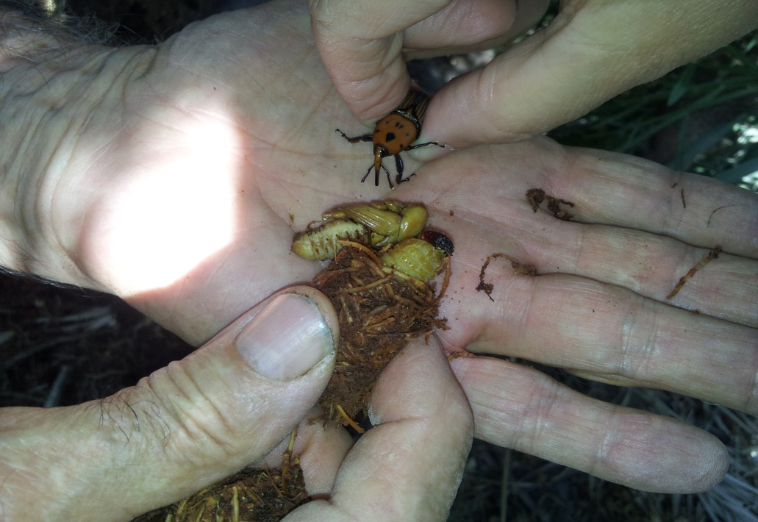

Slide 18
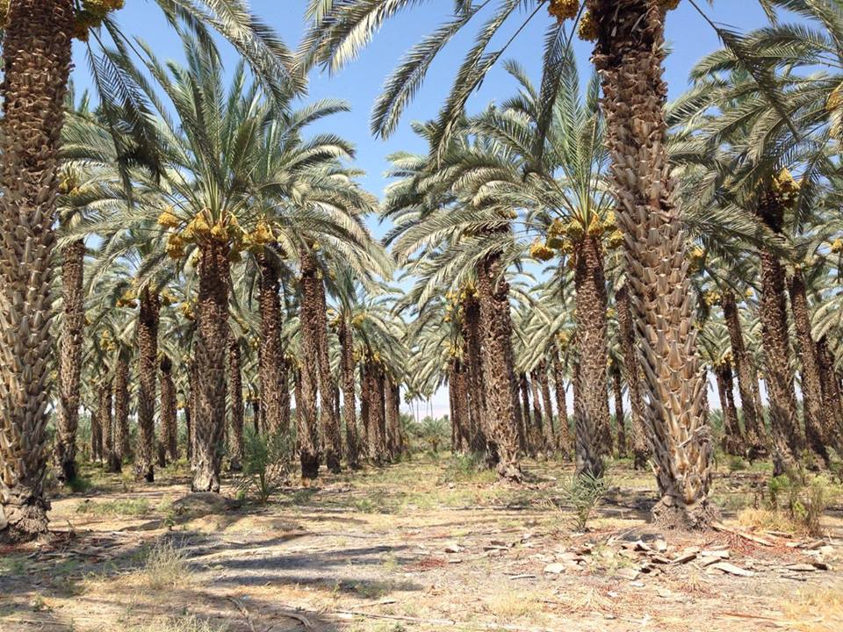
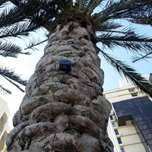
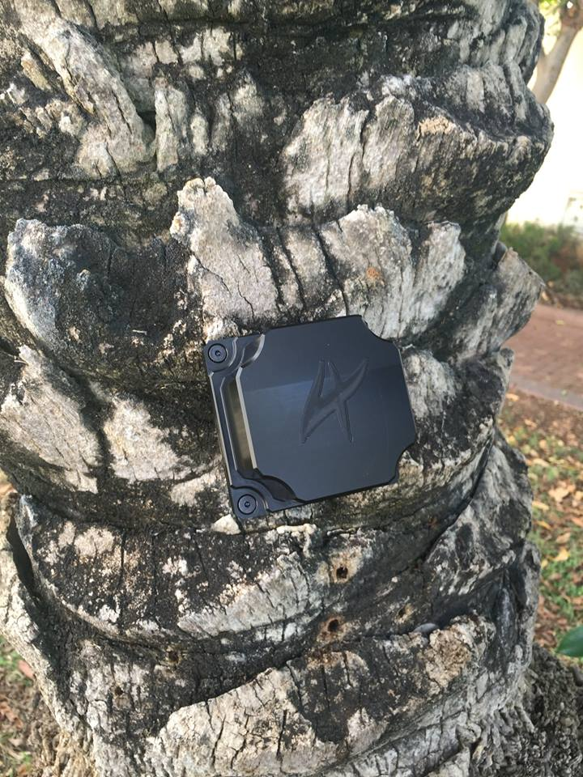
Notes:
http://news.stanford.edu/news/2009/august24/gulf-aqaba-project-082509.html
http://en.people.cn/90001/90777/90854/7181253.html
http://www.israelnationalnews.com/News/Flash.aspx/343261#.V1wgmY9OJjo

Slide 19
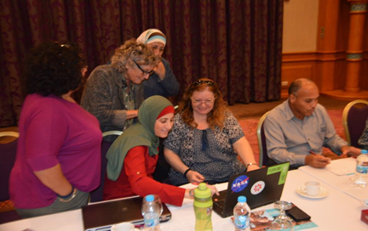
Women Empowering Women
2016-Present
Women Emp
Jordanian & Israeli women from diverse backgrounds gathered to share personal experiences

Slide 20
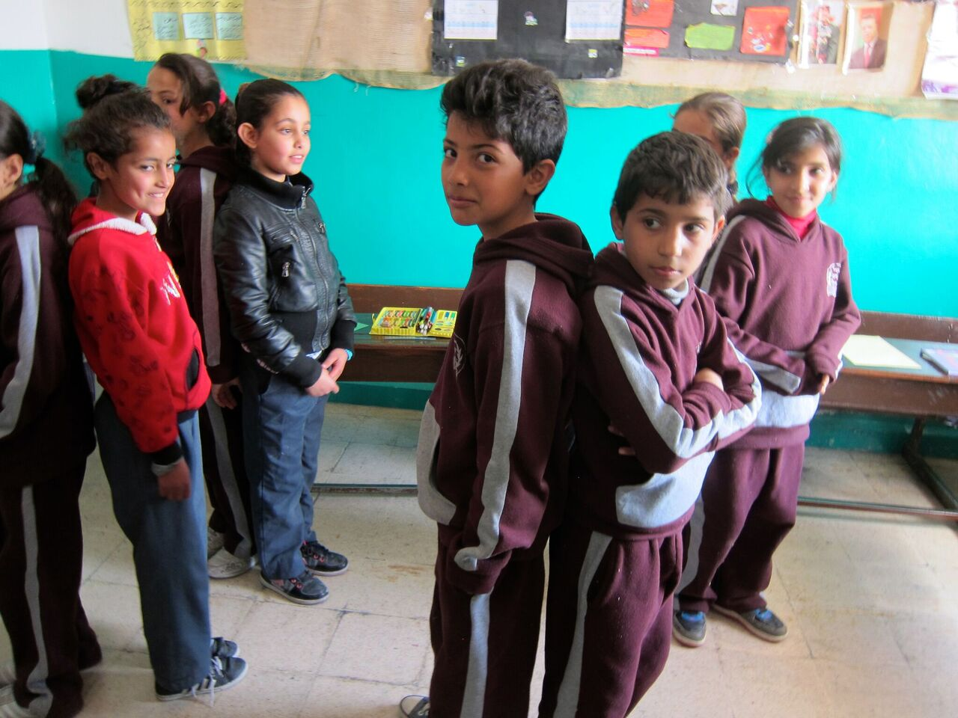
Capacity Training on Non-Violent Communication for School Educators & Students
2006-2015
Academic
ACPD in partnership with The House for Professional Solutions in Palestine & Beresheet La Shalom in Israel conducted a year long program for educators & students from Jordan, Palestine & Israel.

Slide 21
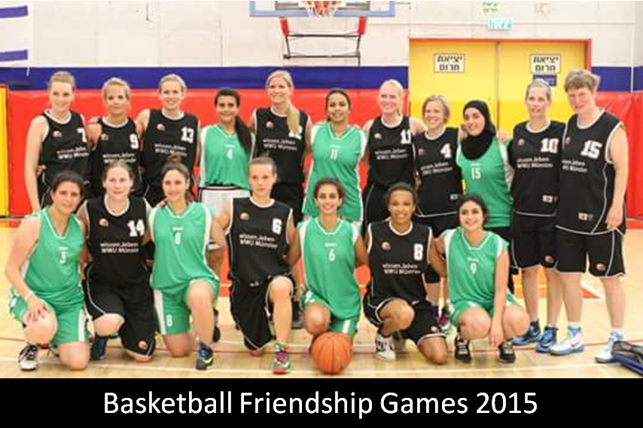
Sport
Regional Cooperation in the Sphere of Sport
2006-Present
Jordanian & Israeli athletes gather in Israel to use sport as a vehicle to promote peace between the two neighbors.

Slide 22
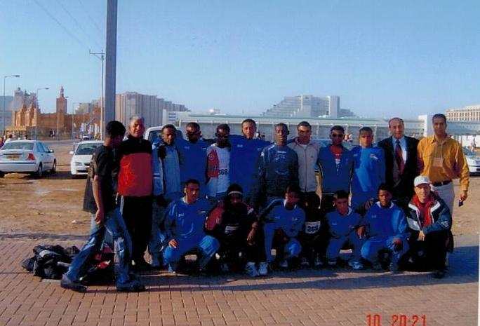
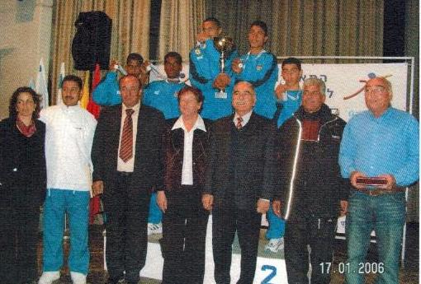
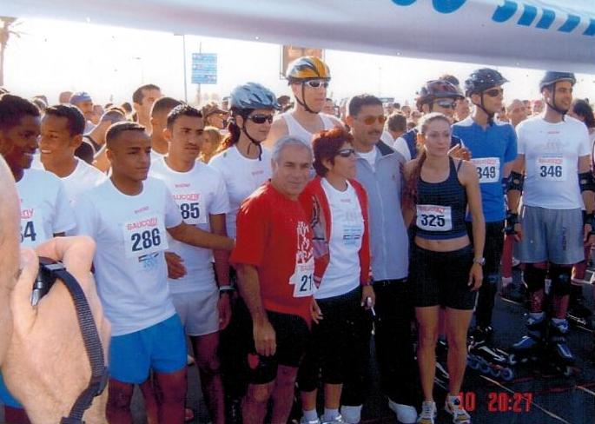
Regional Cooperation in the Sphere of Sport
2006-Present
Three Borders Race 2006

Slide 23
For 17 years ACPD, has endured bravely regional challenges which forced others to quit.
Currently the challenges are tougher and the tides are higher yet, our commitment to peace still as strong
We still believe in the power of joint projects in paving the way for positive peace in the region

