Slide 1

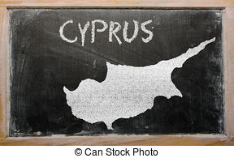
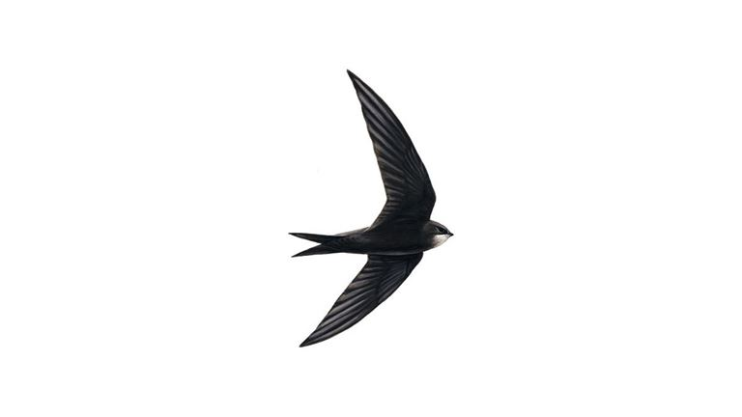


Helping swifts in

Slide 2
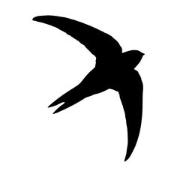
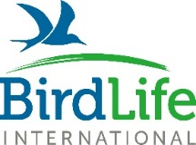
About BirdLife Cyprus
Non-profit, non-governmental organisation
Formed in 2003 through the merger of 2 ornithological societies
10 staff
Approximately 500 active members and 5000 supporters
BirdLife International partner in Cyprus

Slide 3
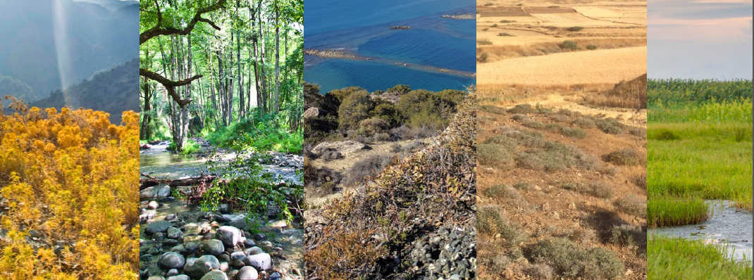
Our mission
Protecting the wild birds of Cyprus, their habitats,
and wider biodiversity, through monitoring,
conservation and education actions,
and by developing people’s appreciation of nature.

Slide 4
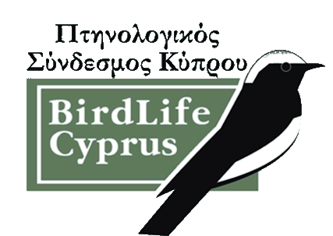
Some of BirdLife Cyprus’ projects
Campaign against illegal bird trapping
LIFE Oroklini – wetland restoration
Akrotiri Marsh (Darwin Plus) – wetland restoration
Management plans for all SPAs in Cyprus
Barn Owl Project
Swift Project

Slide 5
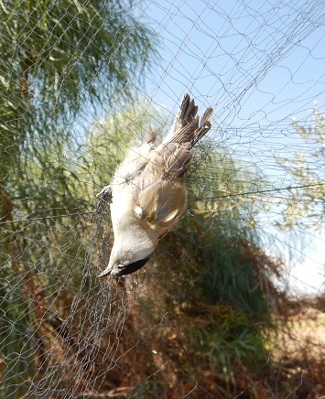
Campaign against illegal
Bird Trappping
Industrial scale
155 different species of birds found trapped on mistnets and limesticks
Over 2 million birds could have been killed in Cyprus in autumn 2015 based on our latest report
BirdLife Cyprus is working for a ‘zero tolerance’ approach
© BirdLife Cyprus,
Trapped Blackcap
Notes:
And although enforcement action took place to a certain extent on the trapping fields by the competent authorities, enforcement against restaurants serving ambelopoulia has been very limited and much reduced in the last few years. BirdLife Cyprus was not informed of any restaurant prosecution taking place in 2015 (and only one restaurant was prosecuted in 2014). This inaction is indefensible as restaurants are the key economic driver of this illegal activity. We believe that this much reduced enforcement action against them is influenced by the lack of political will by the Cyprus Government for tackling effectively illegal bird trapping and trade and by the very bad development regarding the proposed ‘alternative plan’ (read relevant e-news article).

Slide 6
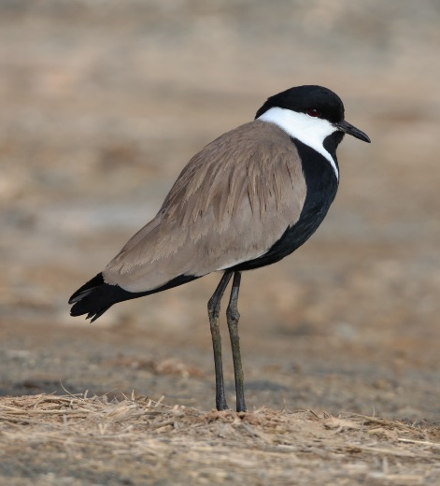
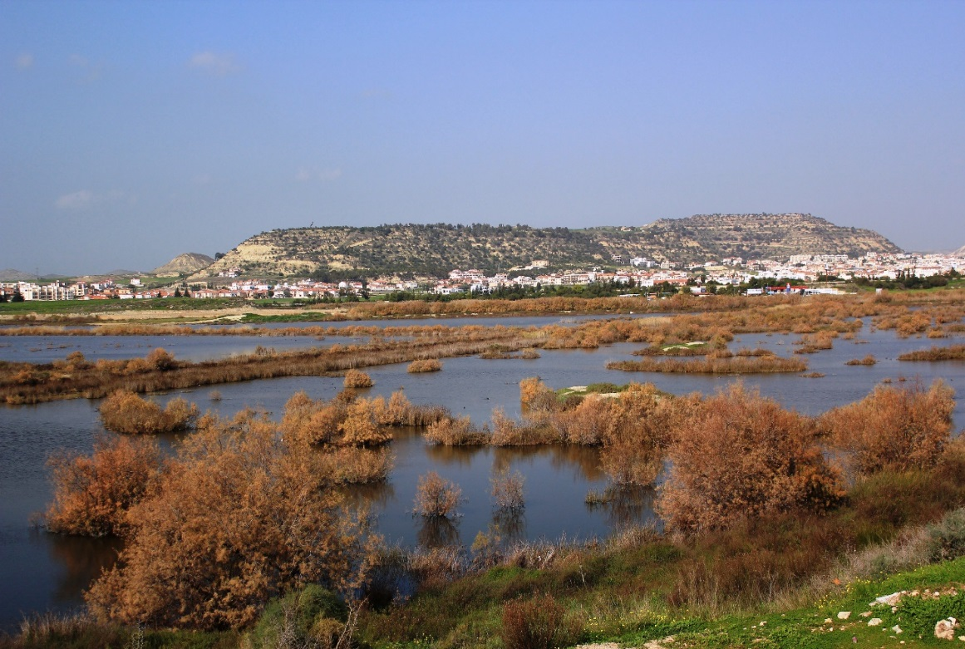
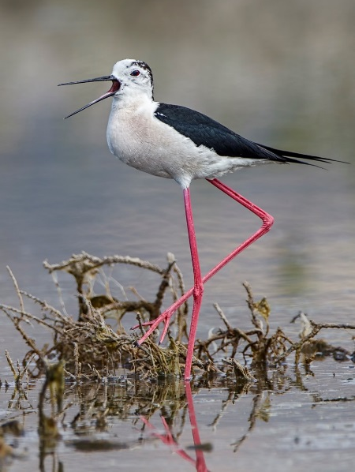
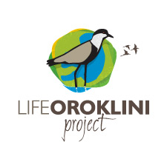
Wetland Restoration
Oroklini Lake (LIFE+)
© S. Christodoulides,
Spur-winged Lapwing
© M. Apostolidou, Oroklini Lake
© A. Stoecker,
Black-winged Stilt

Slide 7
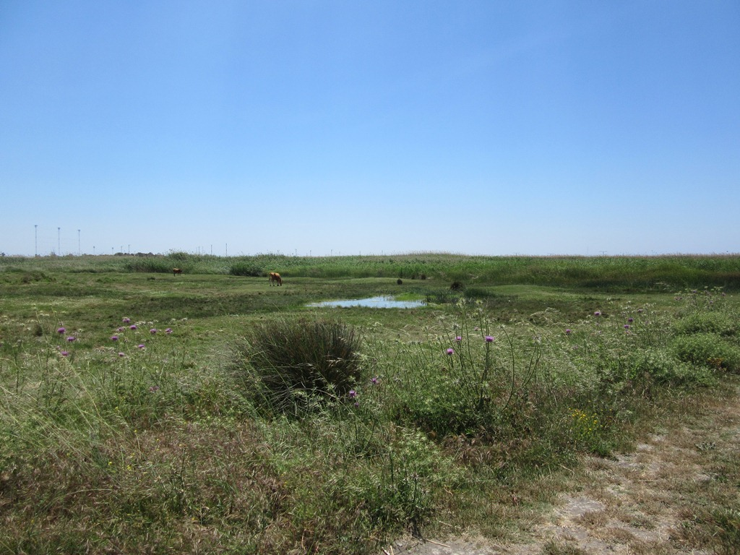
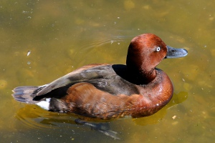
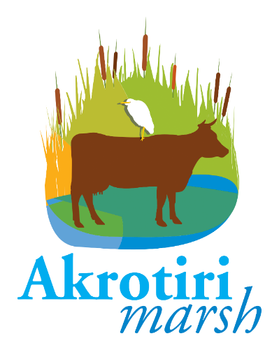
Wetland Restoration
Akrotiri Marsh (Darwin+)
© Martin Pettitt, Ferruginous Duck
© Melpo Apostolidou, Akrotiri Marsh

Slide 8
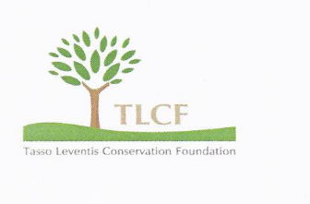
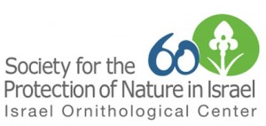
Barn owl projects
The main objective of the project in Cyprus, is to use Barn Owls as pest controllers of rodents by placing nest boxes in certain sites in order to minimise rodenticide use. (2015-16 & 2018-19)
© D. Nye

Slide 9
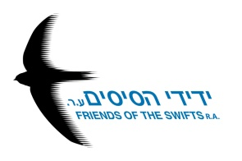
The Swift Project in Cyprus

Slide 10
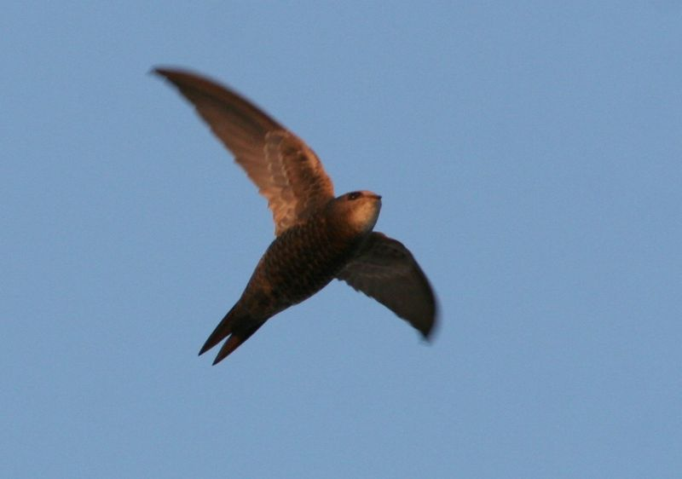
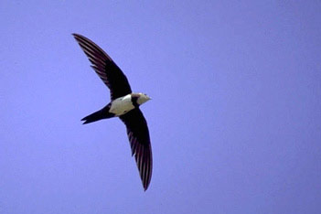
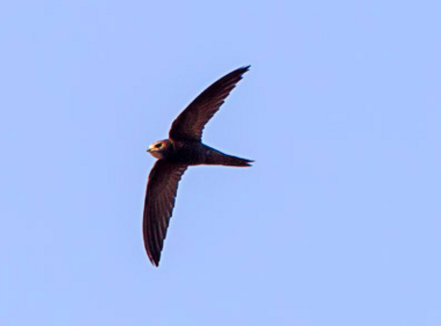
3 species of Swifts in Cyprus
Pallid Swift
Alpine Swift
Common Swift

Slide 11
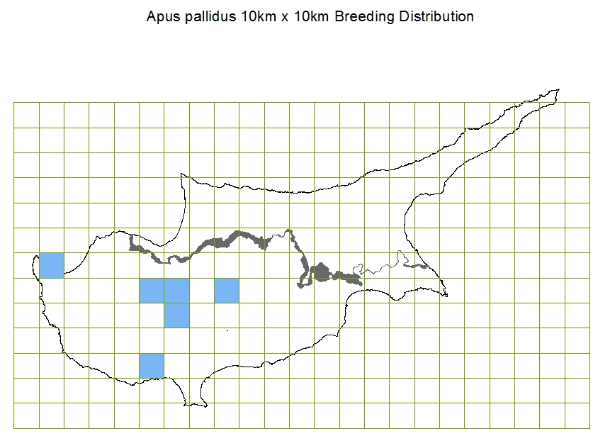
Pallid Swift
Pallid Swift © Bogpumper / Commons Wikimedia
Notes:
Distribution maps based on 10x10km squares in government-controlled Cyprus
Pallid swifts are locally fairly common migrant breeders – small colonies oft with common swift – about 10 sites are known, but there are probably more

Slide 12
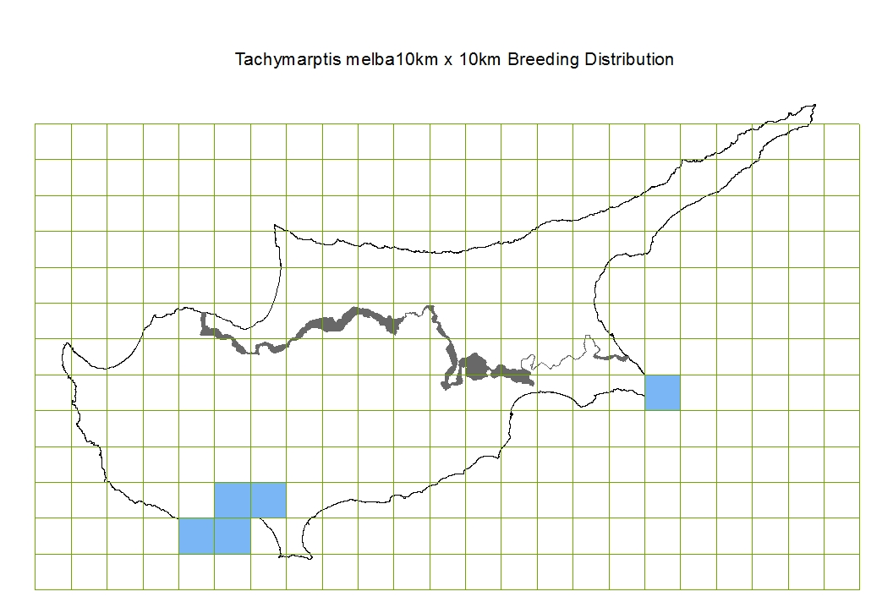
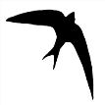


Alpine Swift
Alpine Swift © Jonathan Hornung / Commons Wikimedia

Slide 13
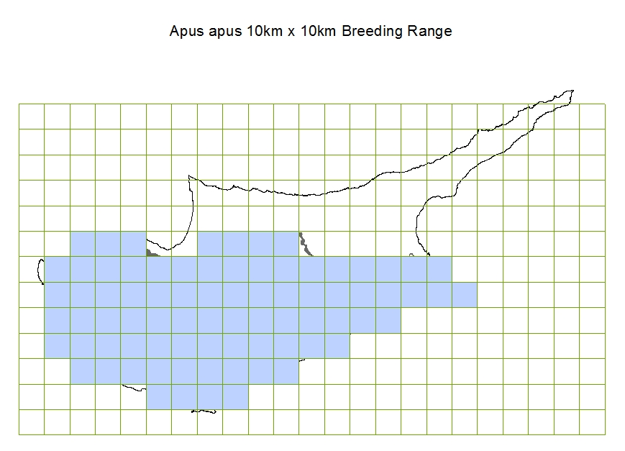
Common Swift
Common Swift © Albert Stoecker

Slide 14
- Arrive in March (usually with some first records in February)
Leave by late July
Passage birds until September (even October)

Slide 15
The most up-to-date population estimates (Article 12 reporting in 2012) for Cyprus are:
Common Swift 15,000-60,000 pairs (uncertain trend)
Alpine Swift 200-500 pairs (trend unknown)
Pallid Swift 200-1,000 pairs (trend unknown)
Notes:
It is hard to know trends for rare breeding birds as the common birds monitoring scheme does not ‘capture’ such species, though it works well for common and widespread species such as the common swift

Slide 16
Common Swift
Trend Evaluation 2006 - 2016: Uncertain trend (data from 103 sites)
Notes:
note this is an index, not actual population numbers, it starts at 100 and then goes up or down depending on what population counts show. It is done with the standard TRIM analysis used for common birds survey data

Slide 17
Common Swift
Trend Evaluation 2006 - 2016: Uncertain trend (data from 85 farmland sites)
Notes:
note this is an index, not actual population numbers, it starts at 100 and then goes up or down depending on what population counts show. It is done with the standard TRIM analysis used for common birds survey data

Slide 18


A joint project for SPNI, the Friends Of The Swifts association and BirdLife Cyprus, using Swift nest boxes as an awareness raising tool

Slide 19
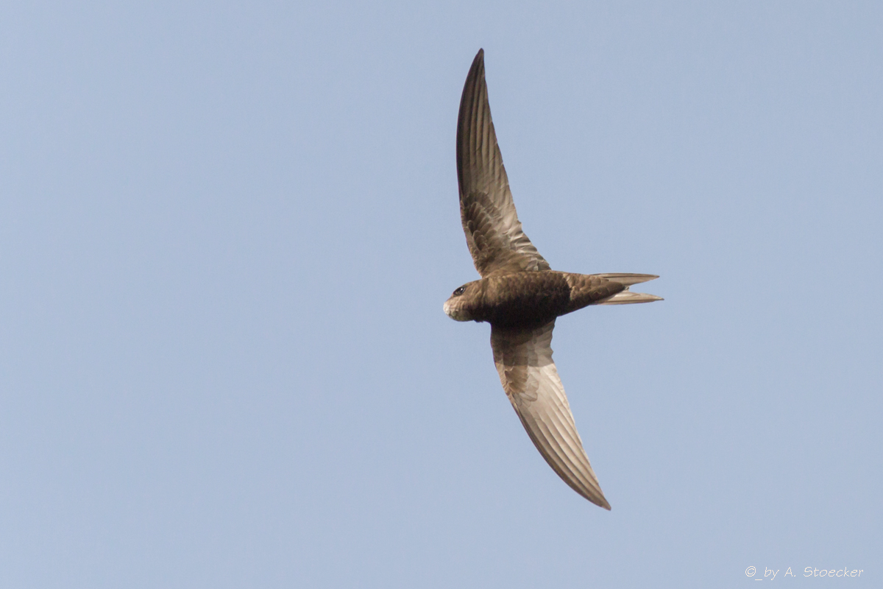
Aim of the project:
Establish foundations for am awareness raising program
Help Common Swift by installing nest boxes

Slide 20
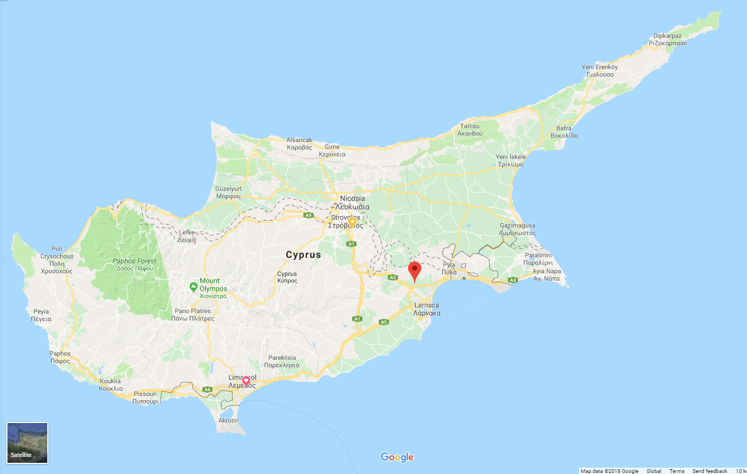
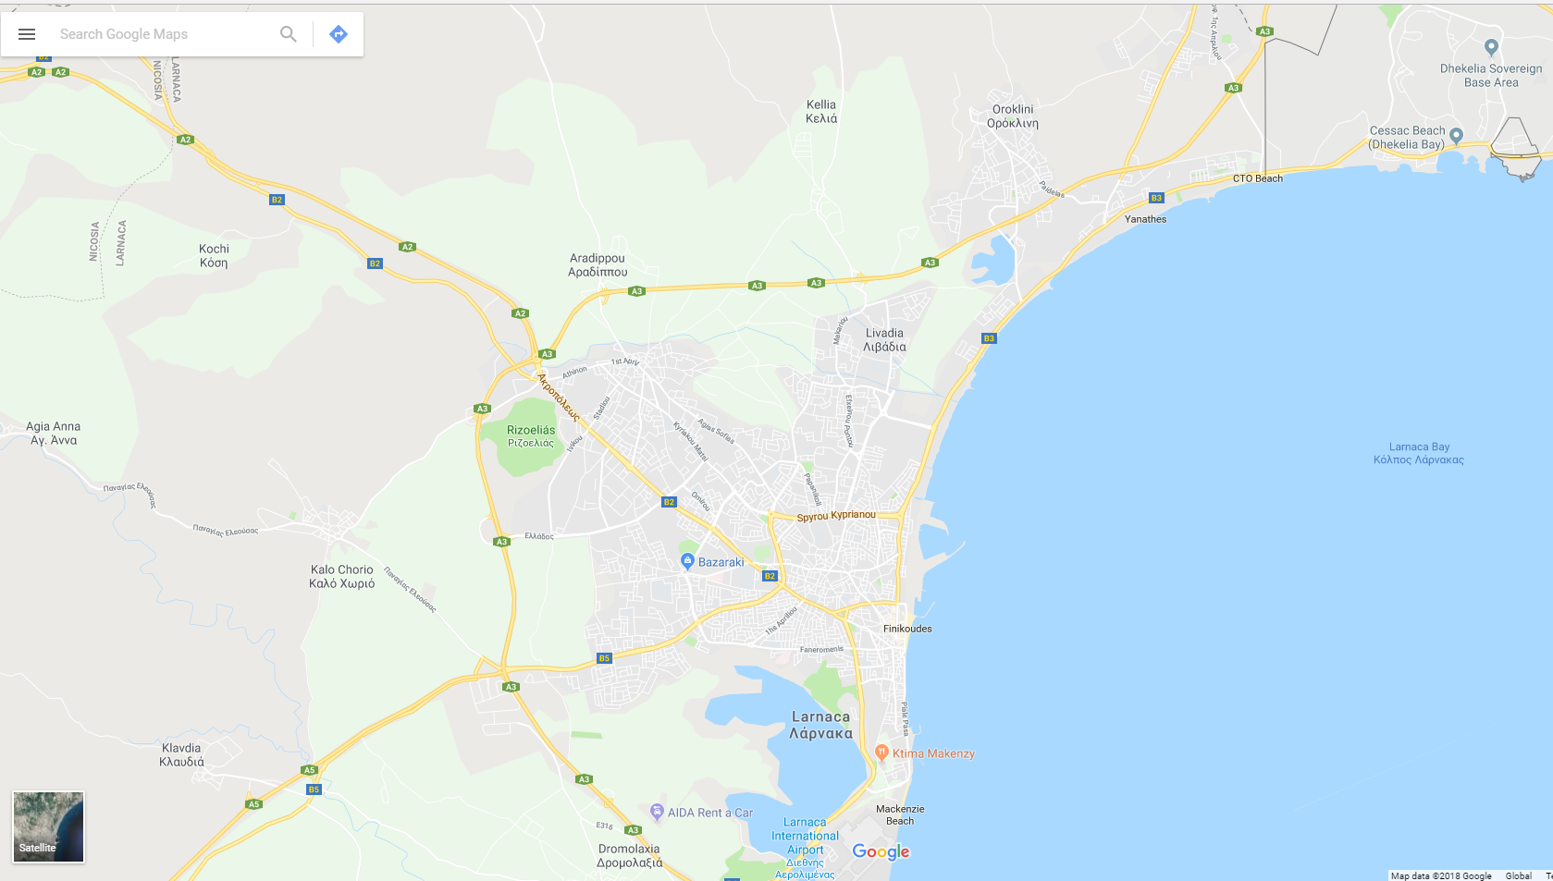
Activities in Cyprus:
Engaged two communities:
Aradippou & Voroklini (9km apart)

Slide 21
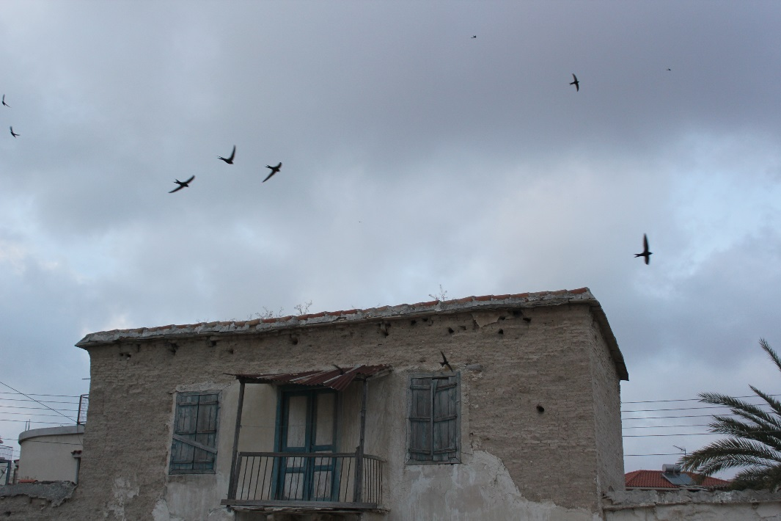
Both communities have old town centers with old buildings and recent developed areas with no space for swift nesting.

Slide 22
The project included:

Slide 23
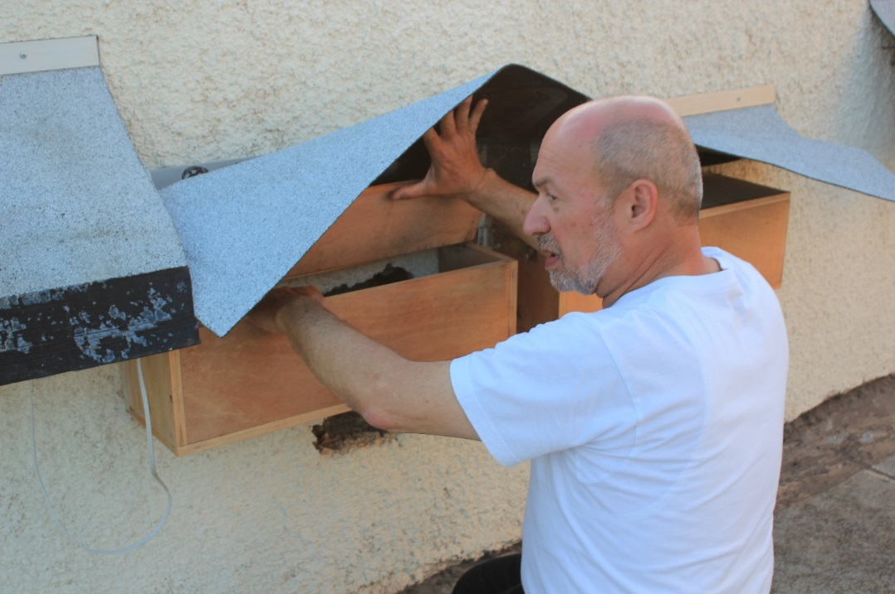
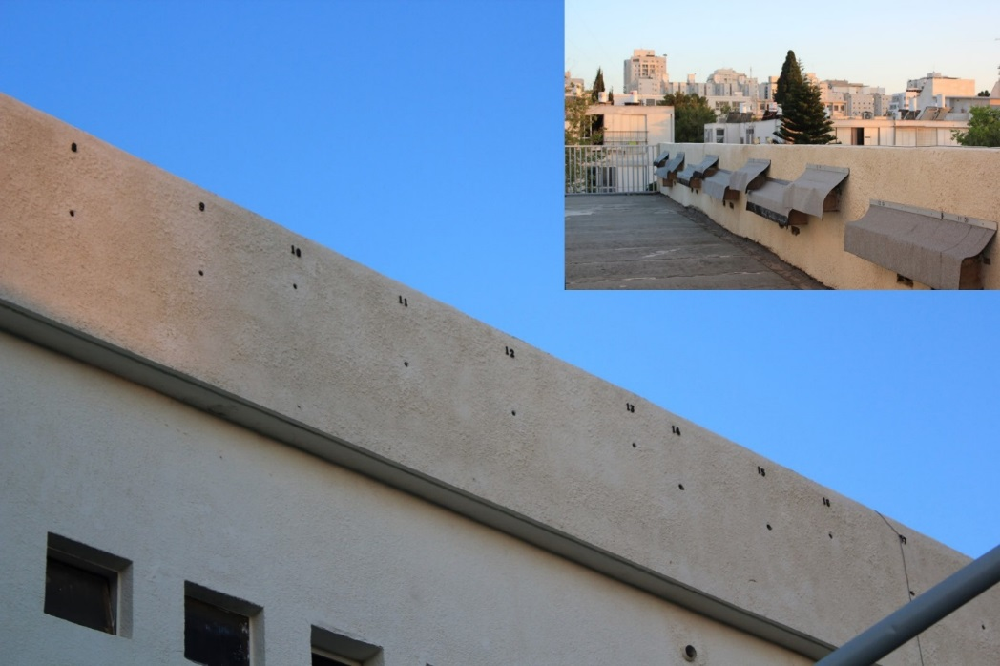
Exchange visits to Israel and Cyprus

Slide 24
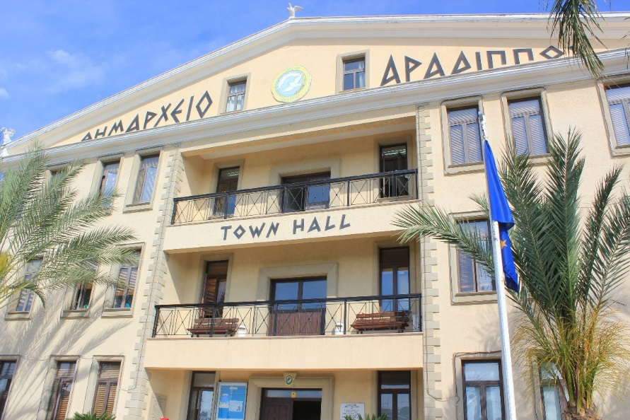
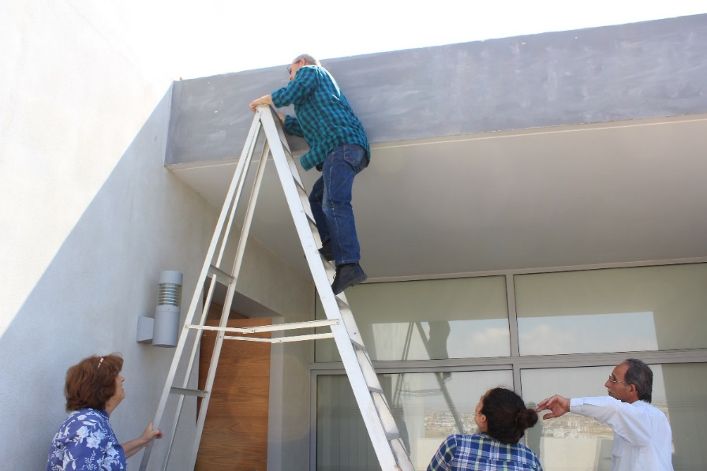
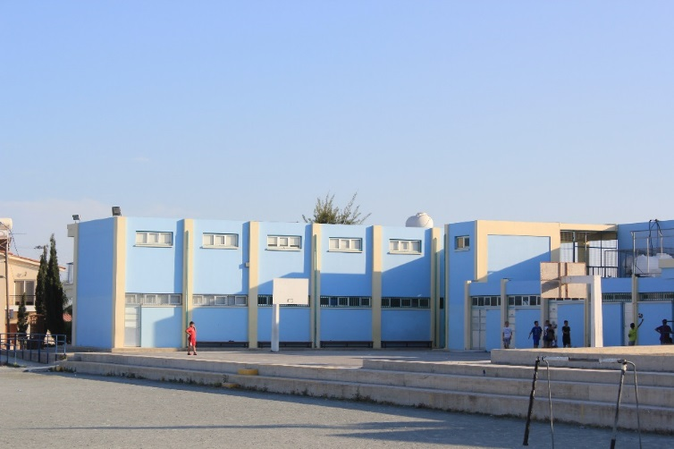
Exchange visits to Israel and Cyprus

Slide 25
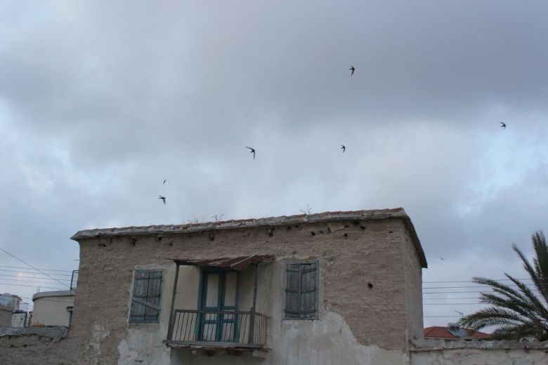
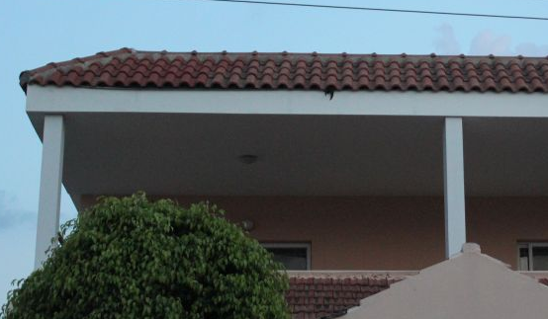
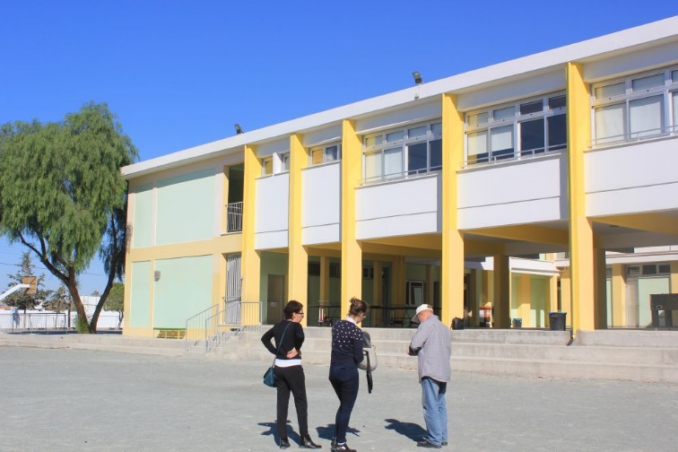
Observation studies to identify sites for nest box installation

Slide 26
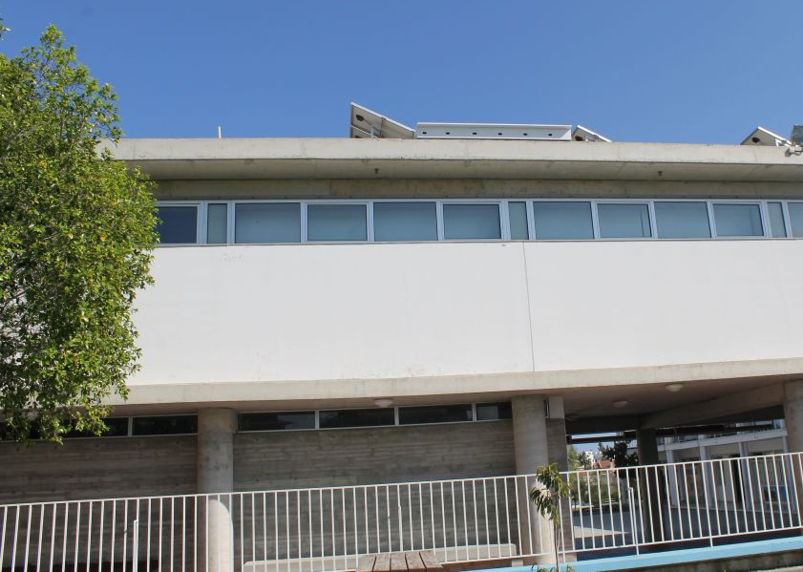
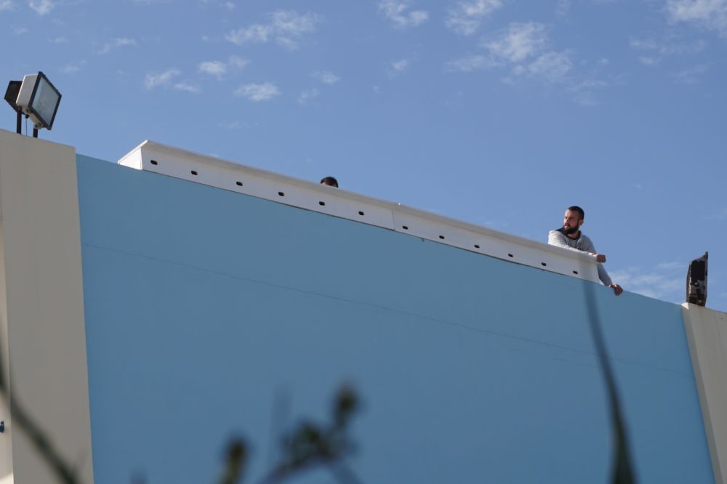
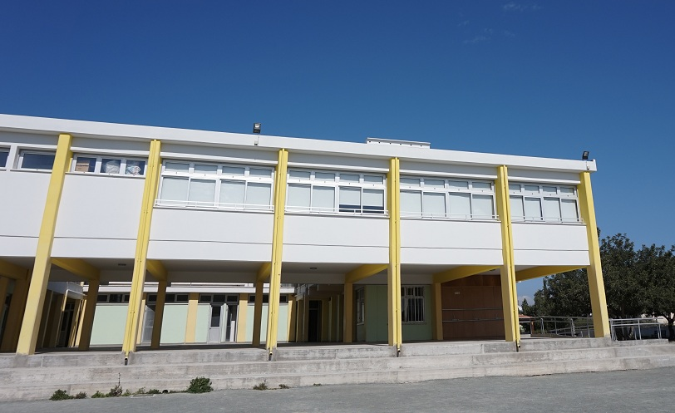
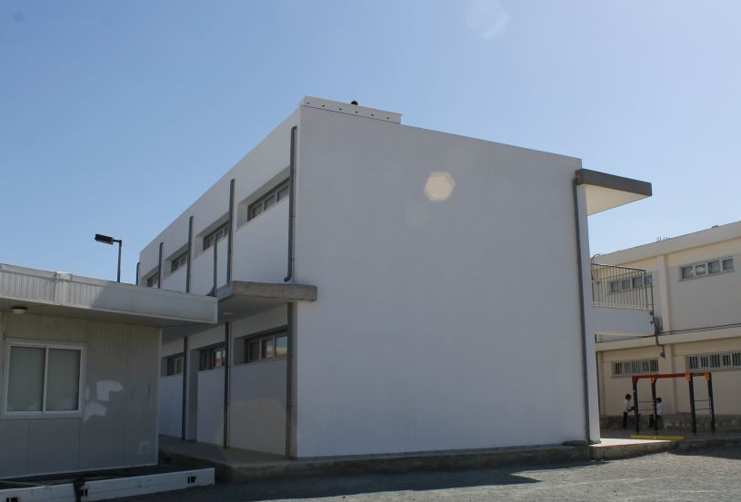

Slide 27
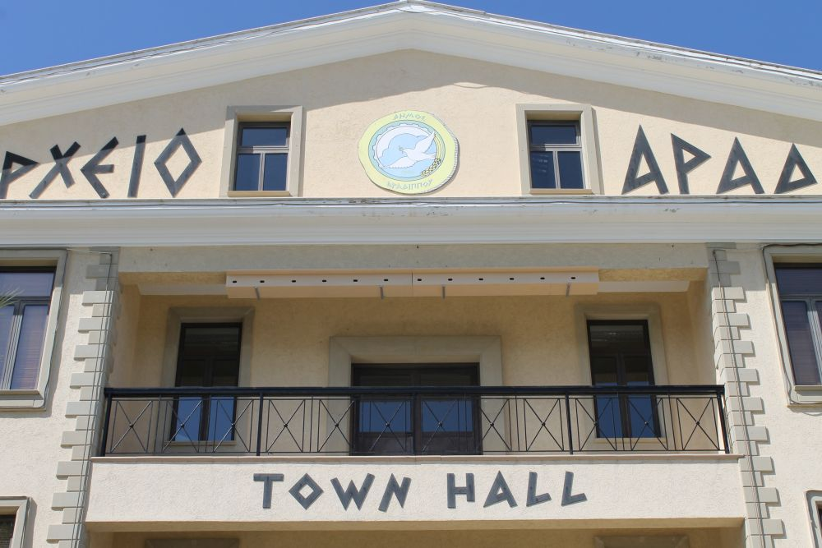

Slide 28
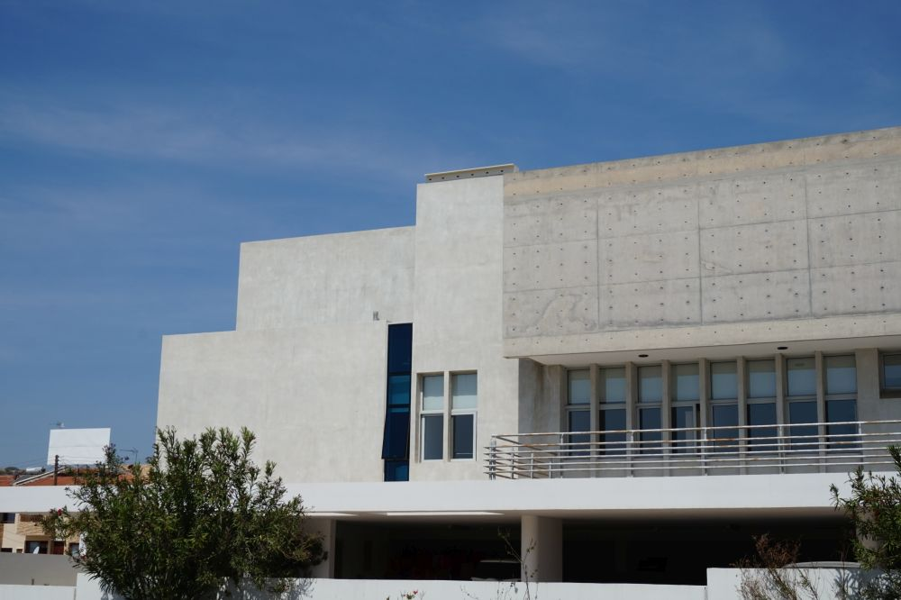

Slide 29
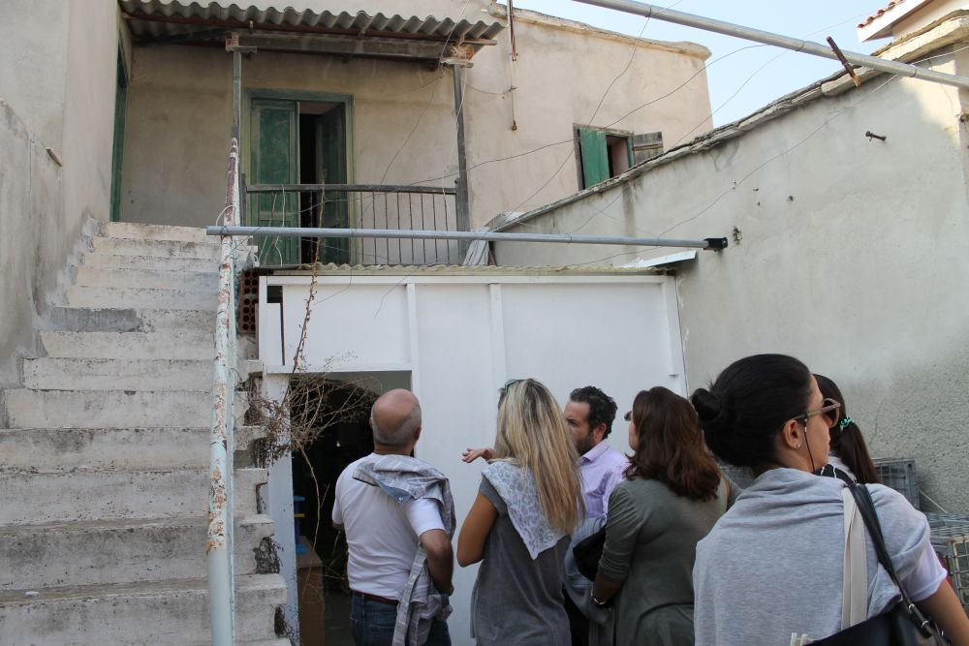
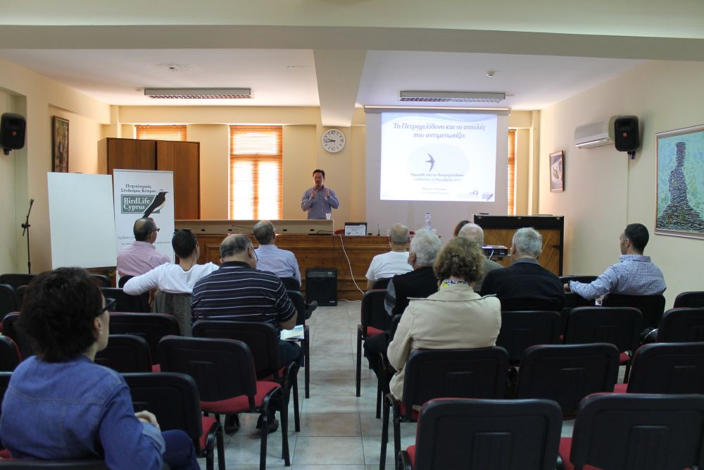
Workshops

Slide 30
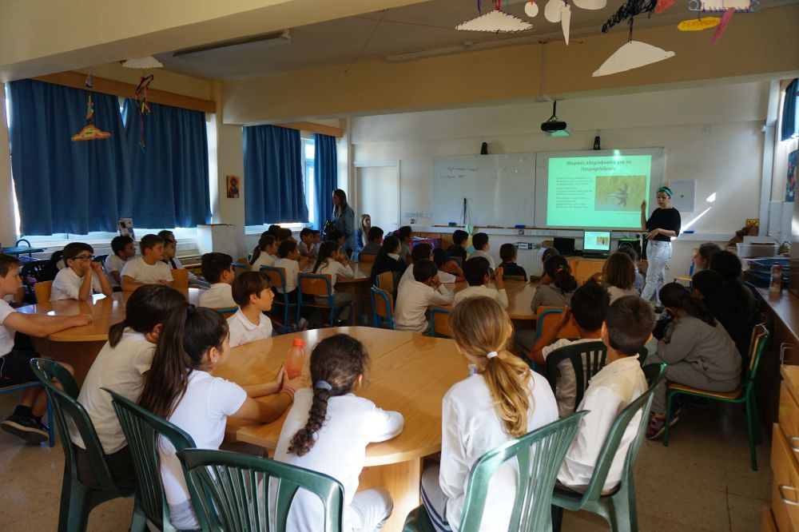
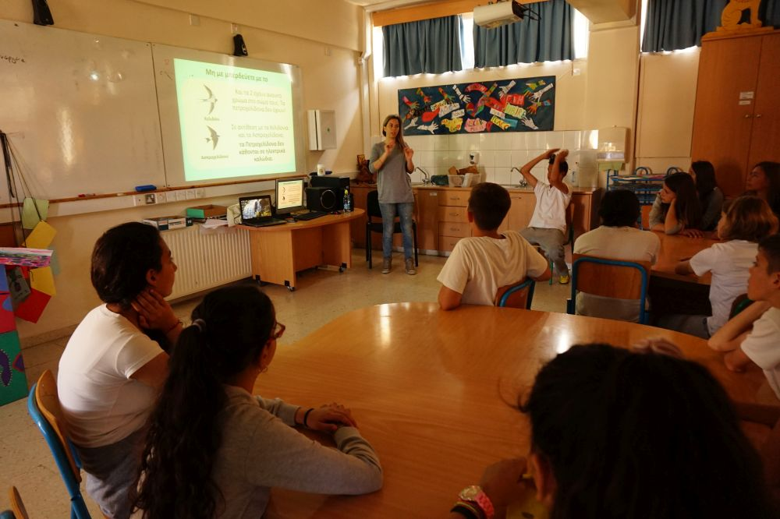
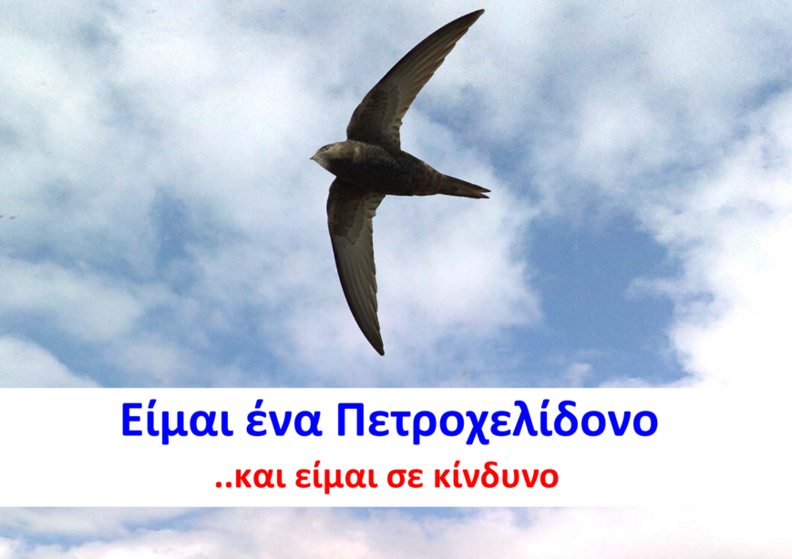
Education work with schools
“I am a Swift
I am in trouble”

Slide 31
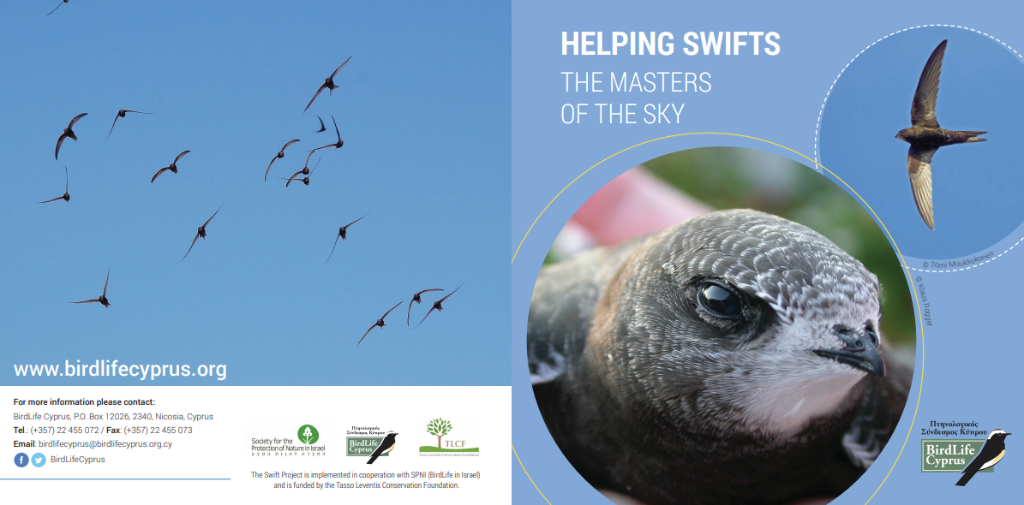
Leaflet for the general public

Slide 32
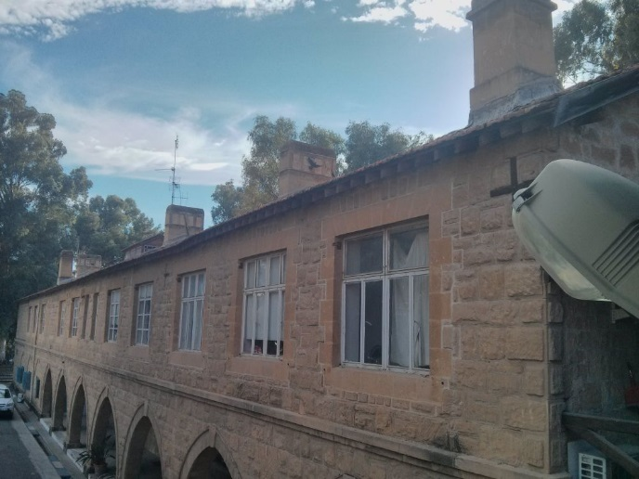
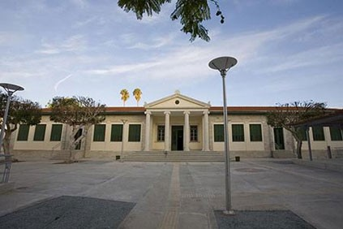
The project opened the doors to other collaborations:
Exploring the possibility to install nest boxes at the Ministry of Interior and the Cyprus University of Technology

Slide 33

Currently working with Cyprus Telecommunication Authority to install 5 nest boxes on their buildings

Slide 34
Our next steps…
Establish a good collaboration with CYTA and expand the program as part of the Authority’s corporate Social Responsibility
Liaise with corporate companies
…and any other inspiring ideas that may come out of this seminar!

Slide 35
Thank you for your attention!

