Slide 1
SCULPTING the Wild

Slide 2
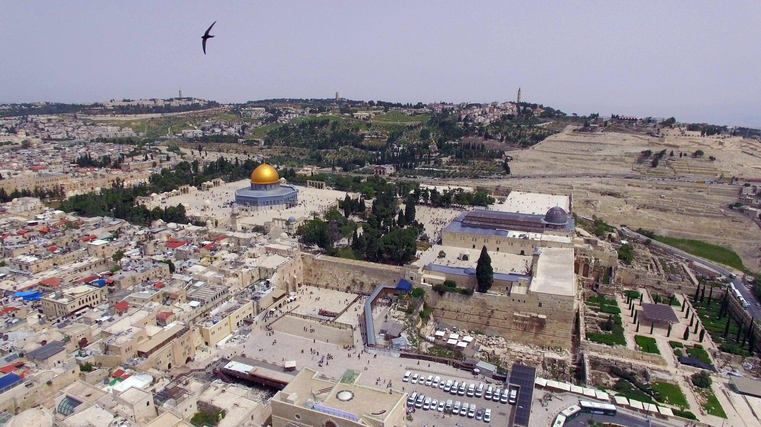
The Old City Of Jerusalem

Slide 3
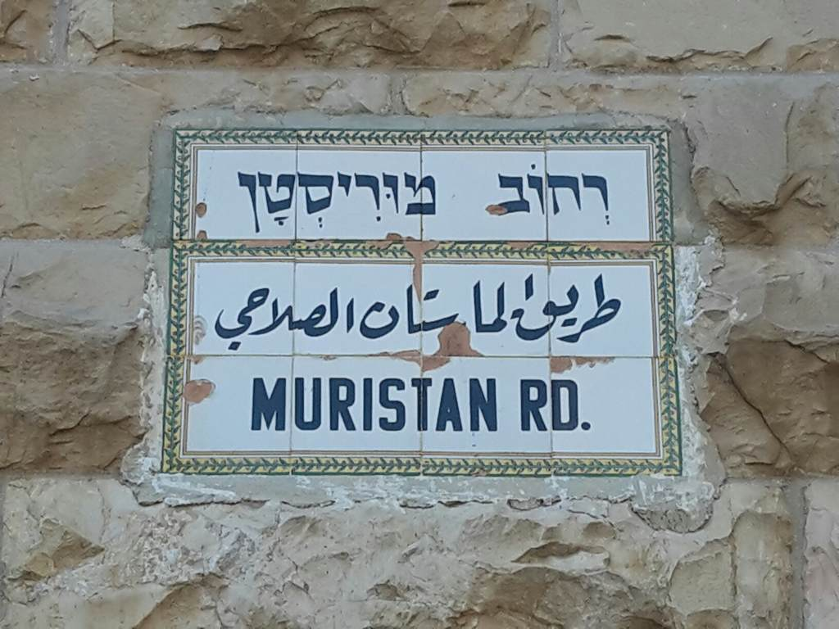

Slide 4
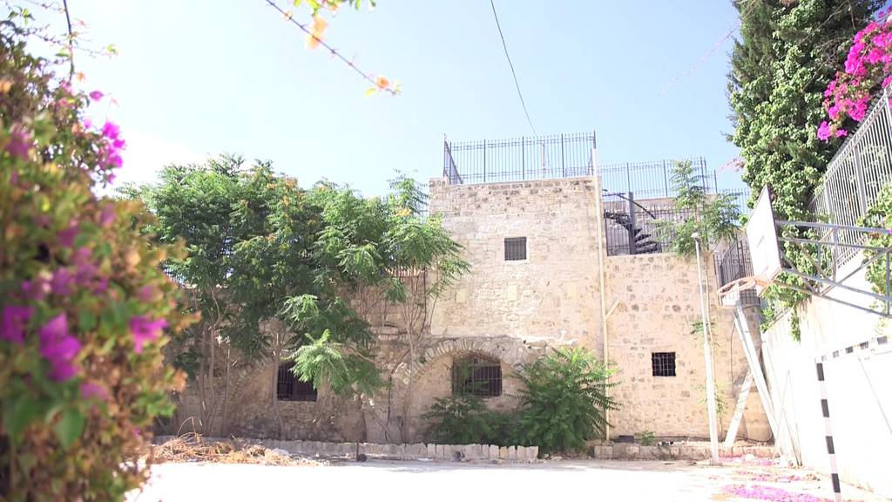
The Muristan Garden

Slide 5
One minute Muristan

Slide 6
TREE of HOPE – the Swifts’ project

Slide 7
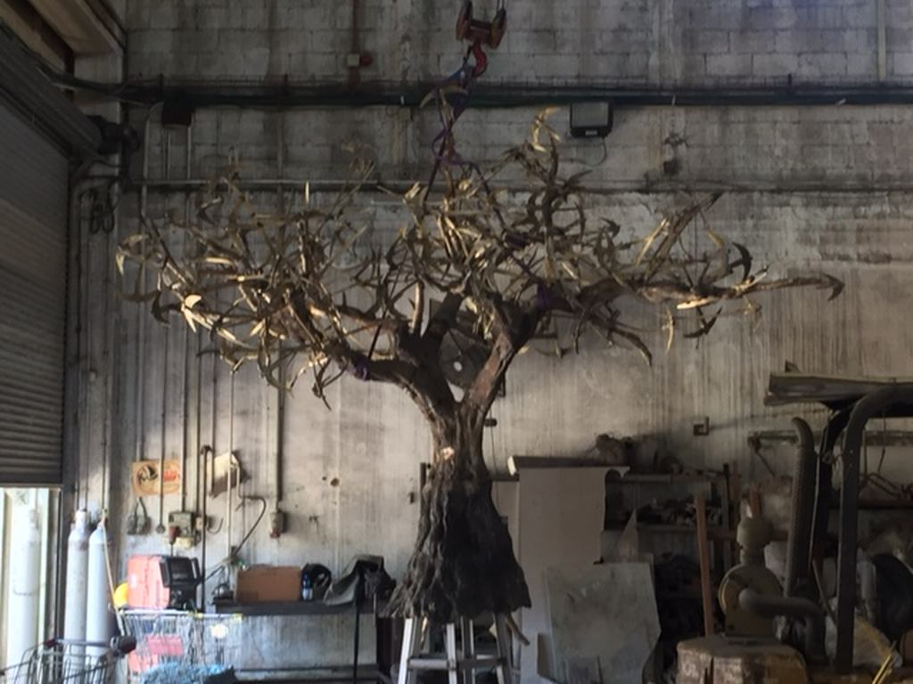
TREE of HOPE
18.08.2016

Slide 8




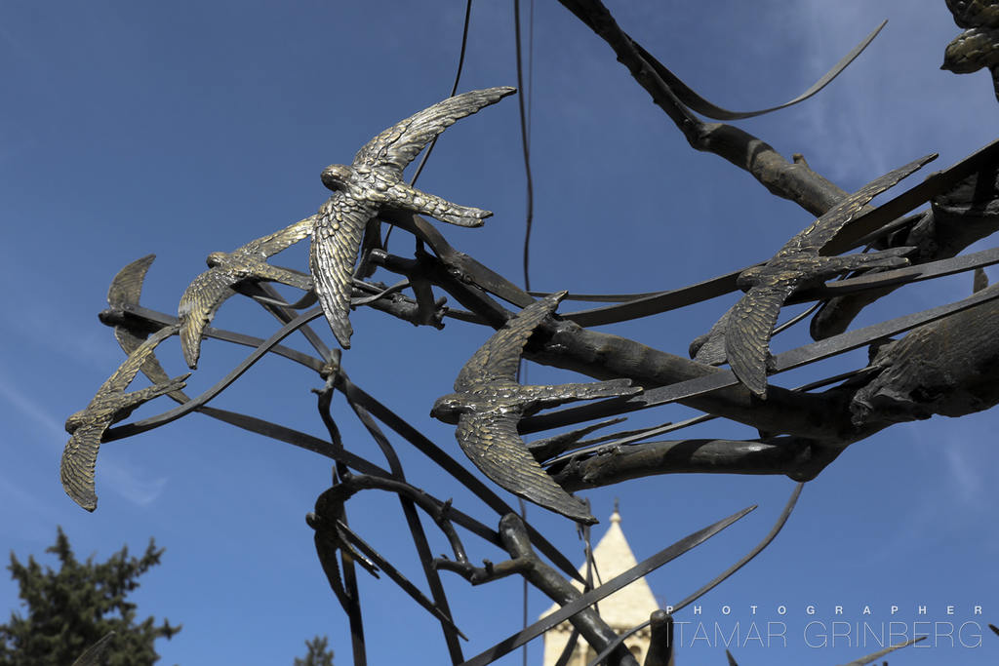
TREE of HOPE – the Swifts’ project

Slide 9
The Muristan Garden
2014

Slide 10
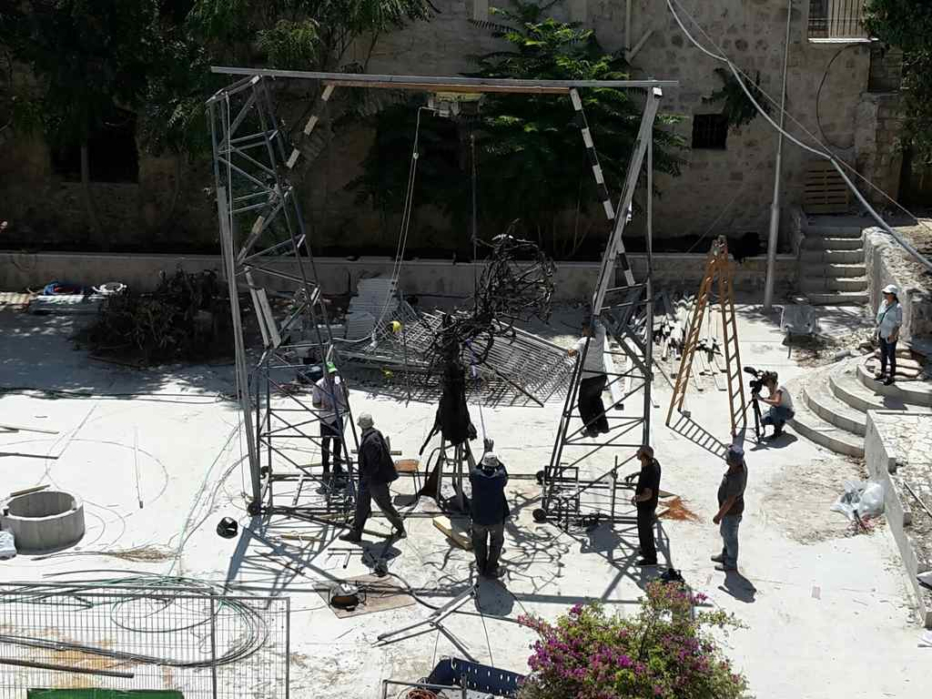
05.09.2016
Arriving

Slide 11
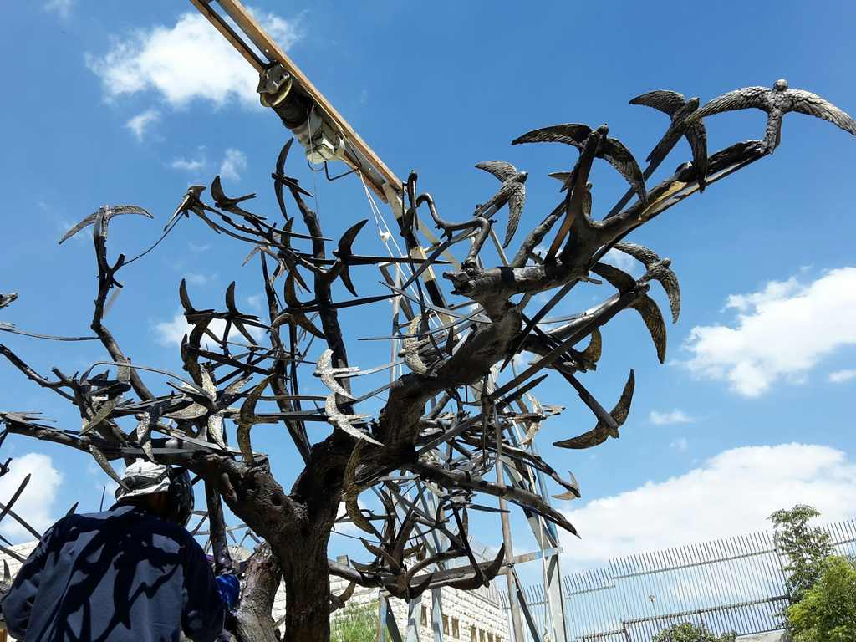

Slide 12
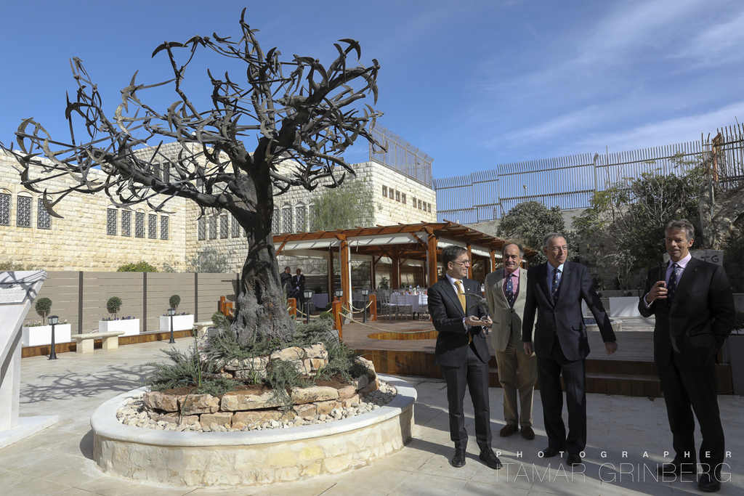
The opening of The Muristan Garden
24.11.2016

Slide 13
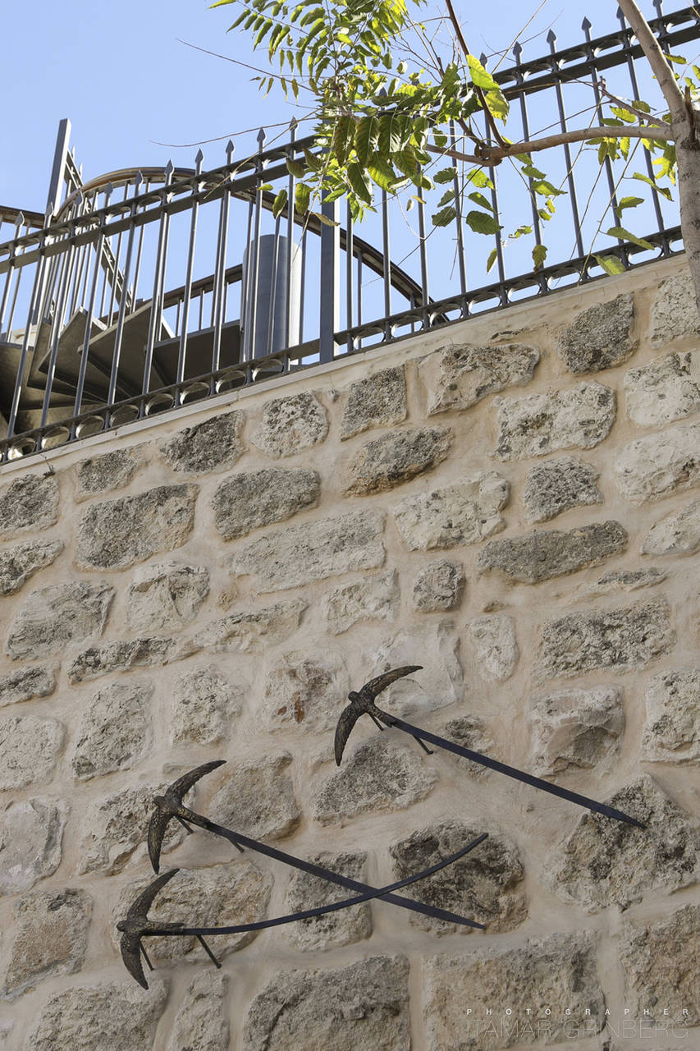

Slide 14
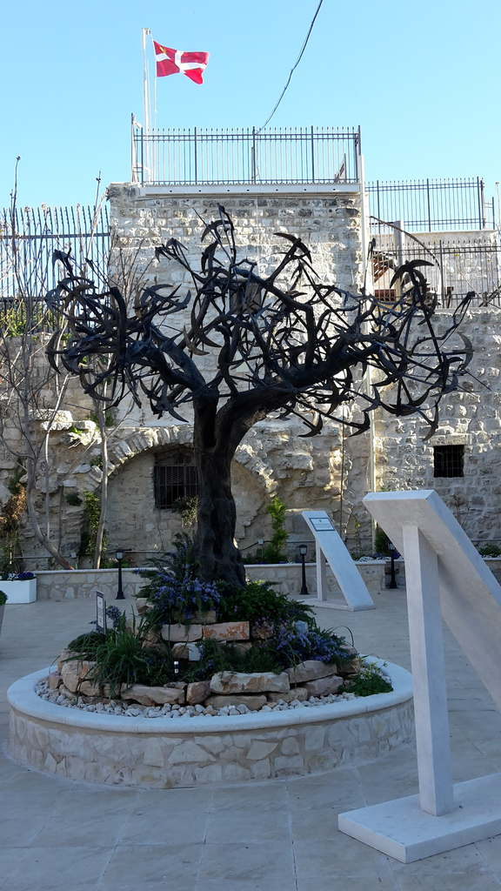

Slide 15
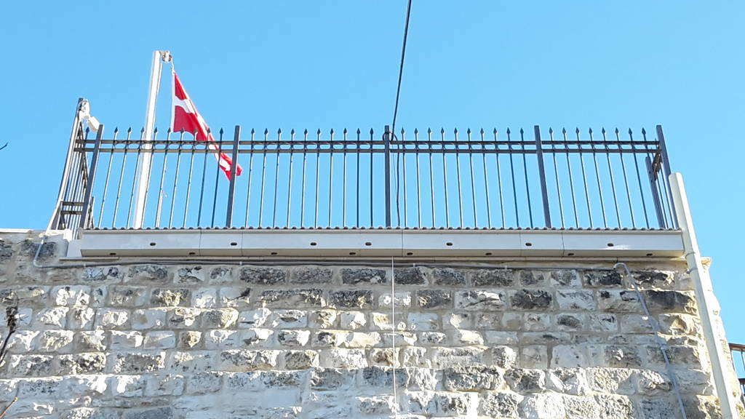
Done and ready

Slide 16
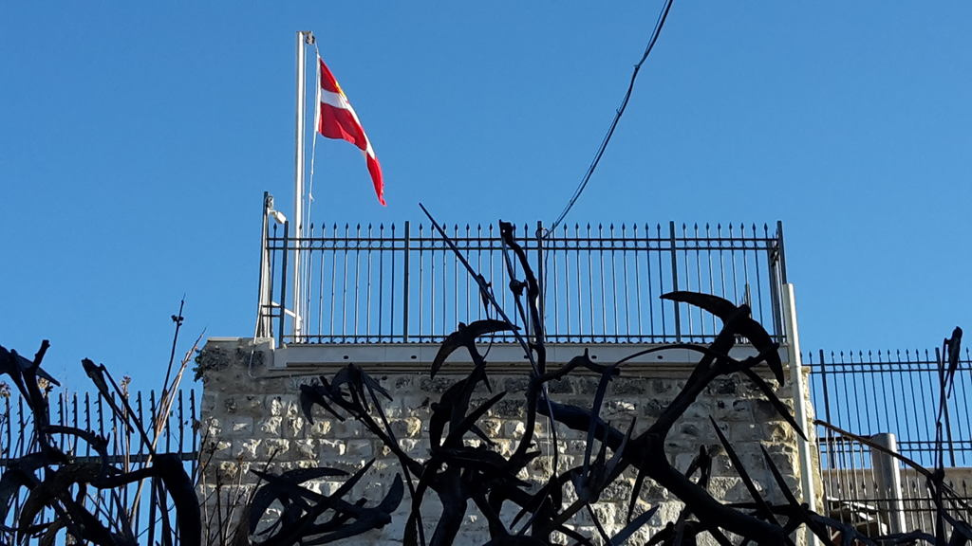
TREE of HOPE – the Swifts’ project

