Slide 1
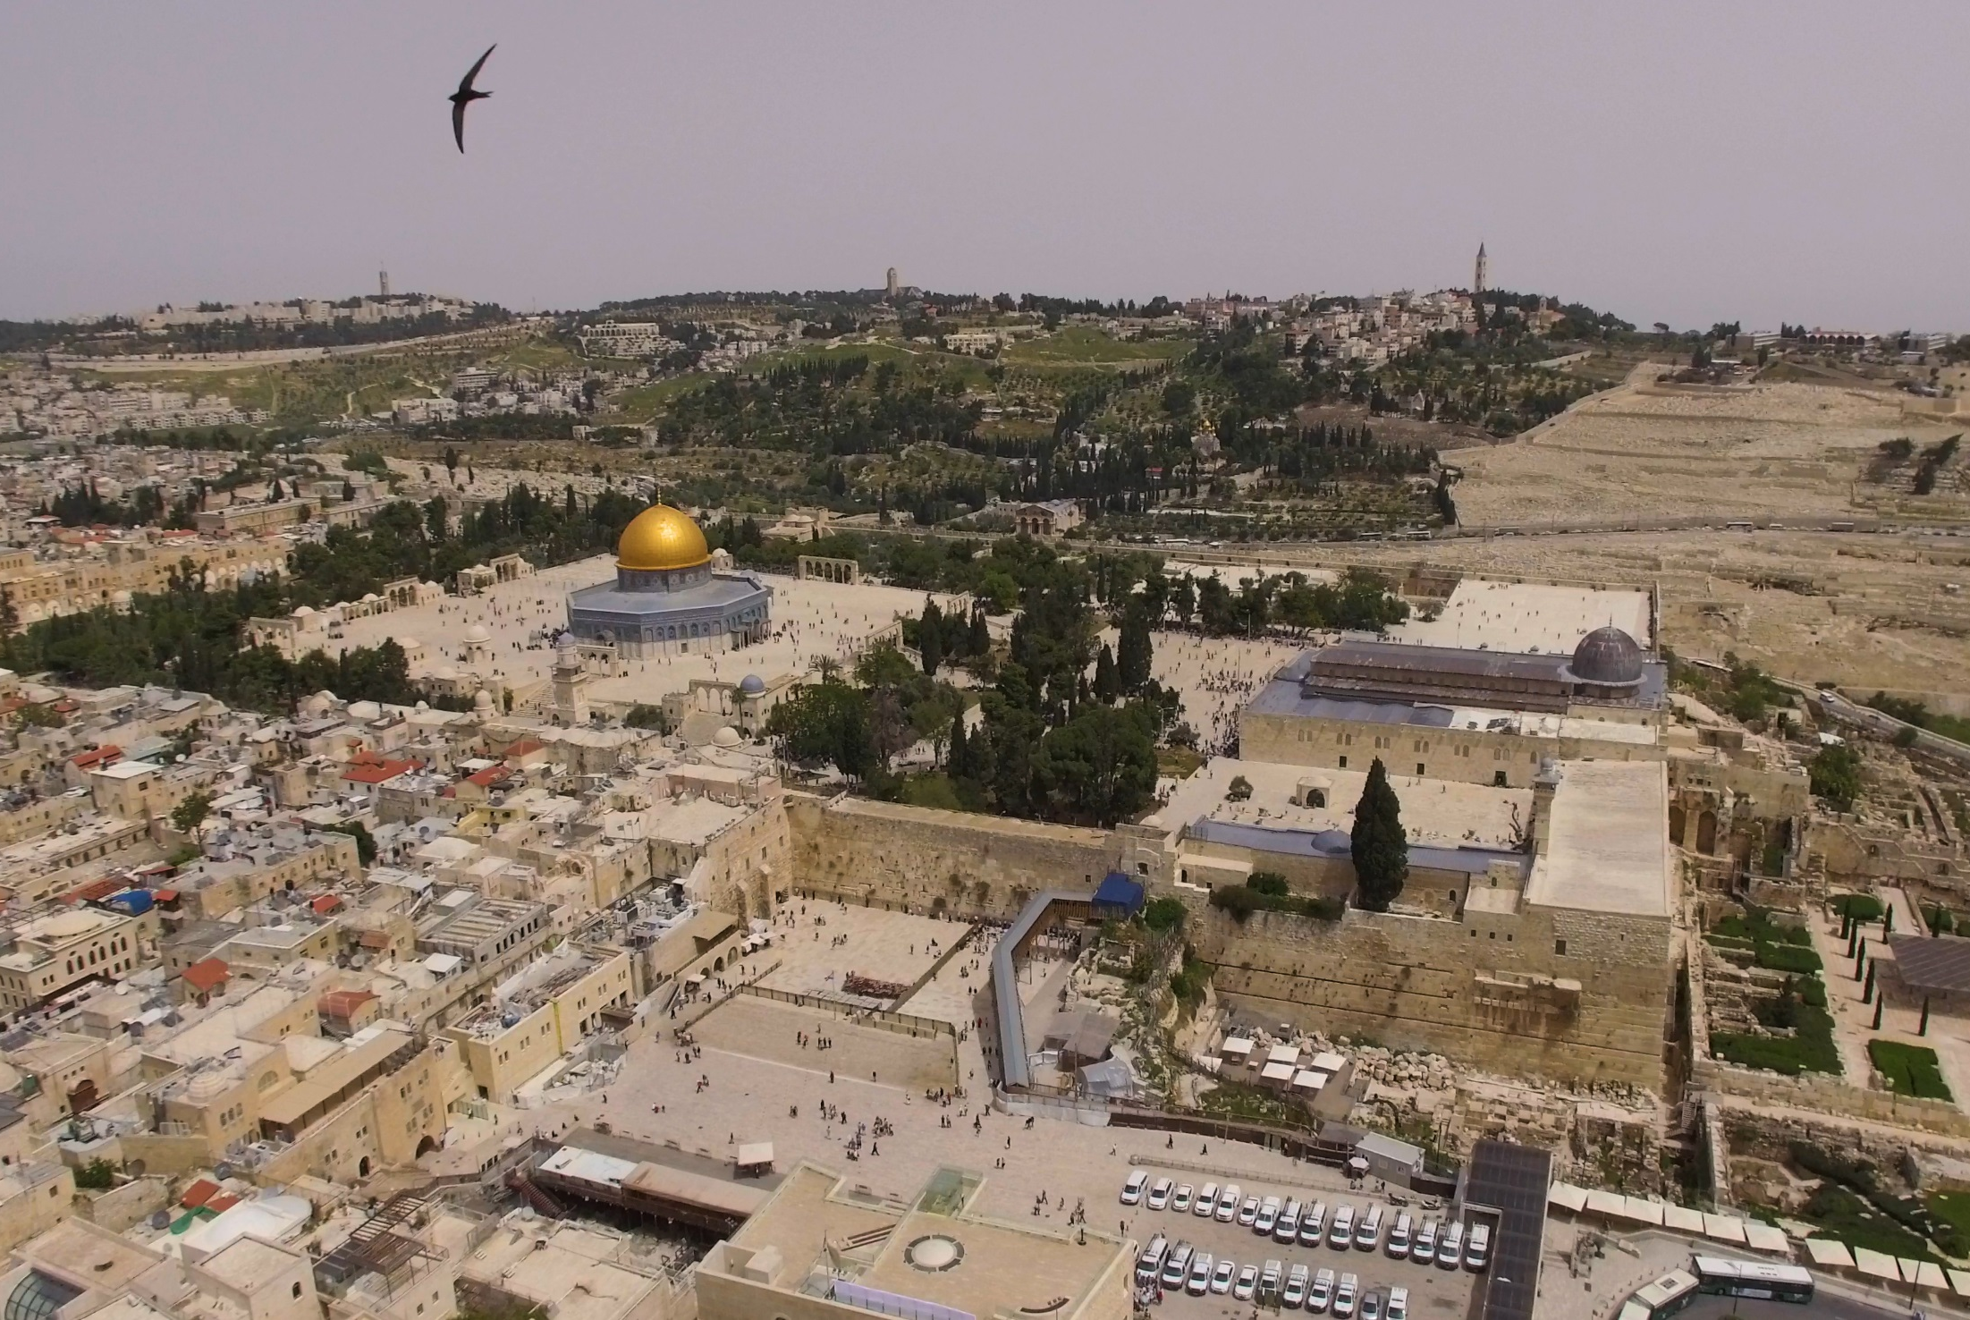







A Swift Way to Peace
6 study cases for Swift lovers
Yossi Leshem & Amnonn Hahn, Israel
Photo: Yuval Dax

Slide 2
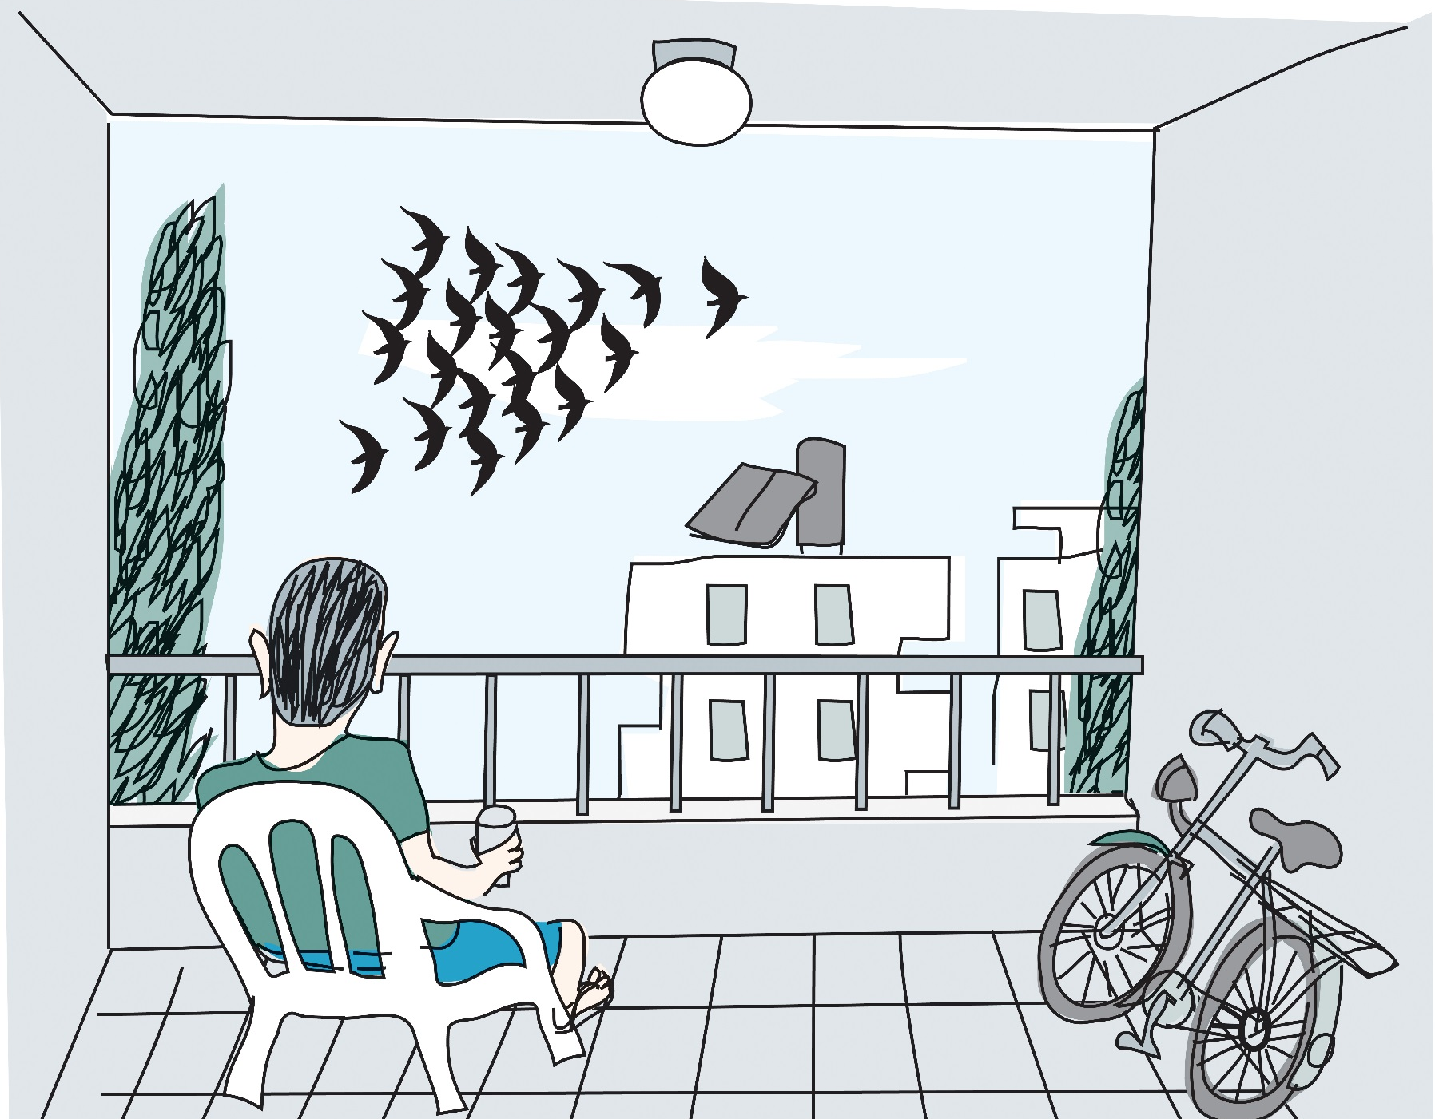
“A person knows a bird for years…and is still surprised by it”
Quote: Eli Mohar Illustration: Amos Biderman

Slide 3
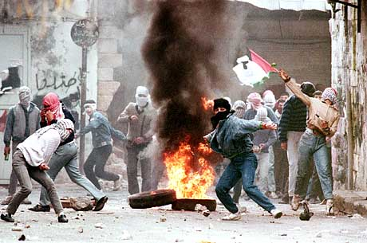
Which way do we choose?!

Slide 4
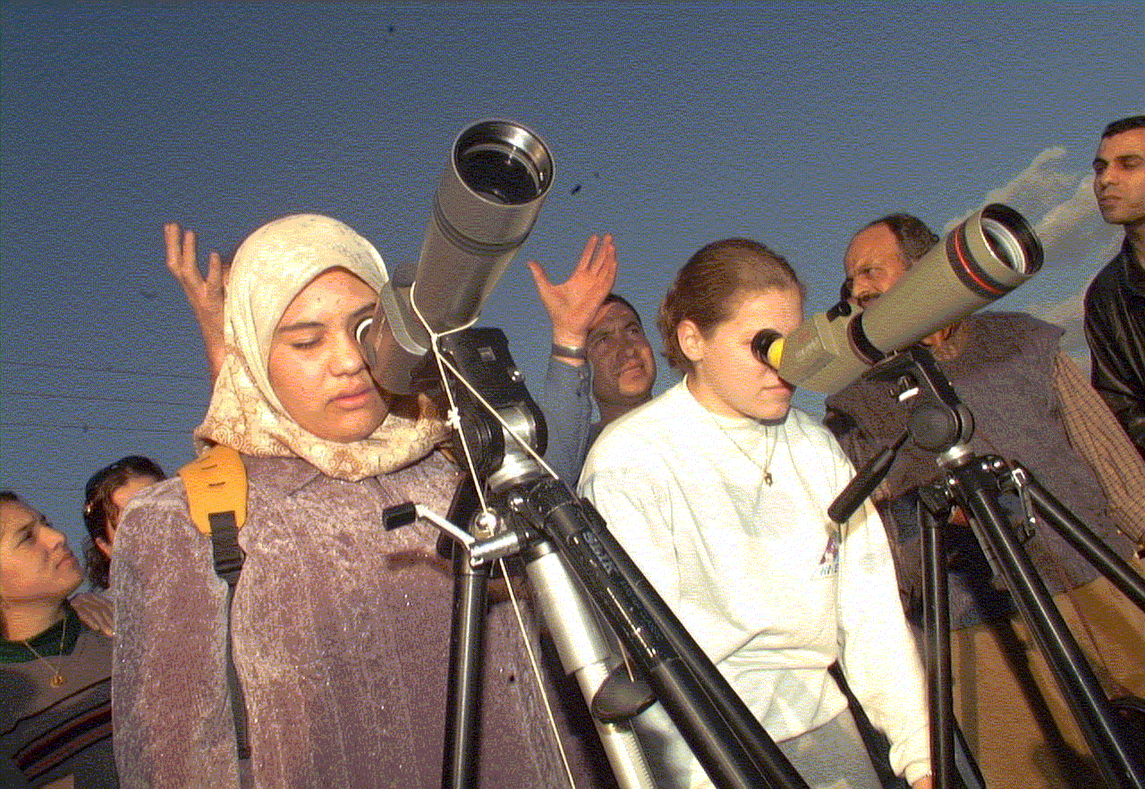
Notes:
4

Slide 5
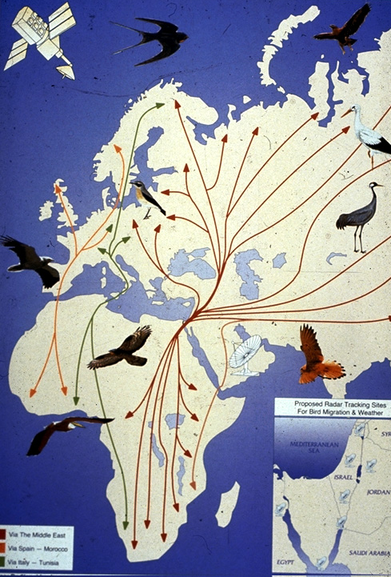
500 million
birds migrate
over Israel
twice a year
Notes:
5

Slide 6
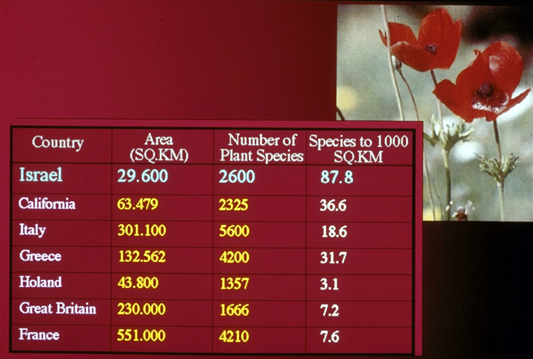
23,500
90.4

Slide 7
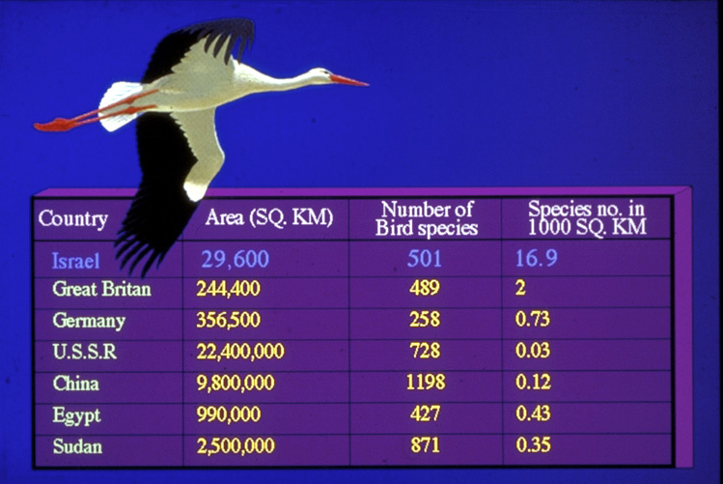
23,500
540
43.5
630
38.7
460
7.75

Slide 8
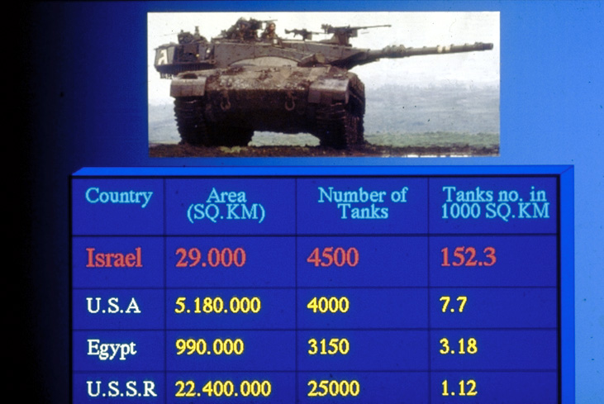

Slide 9
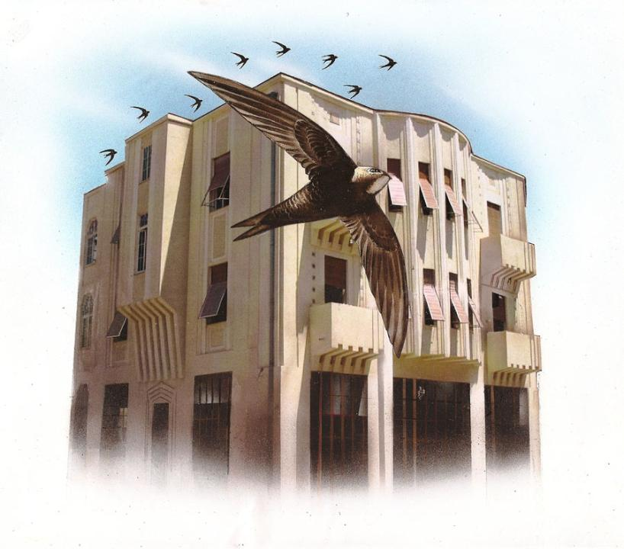
The “Schiff House”, one of “The White City Tel Aviv” UNESCO World Heritage Sites
Illustration: Tuvia Kurtz

Slide 10
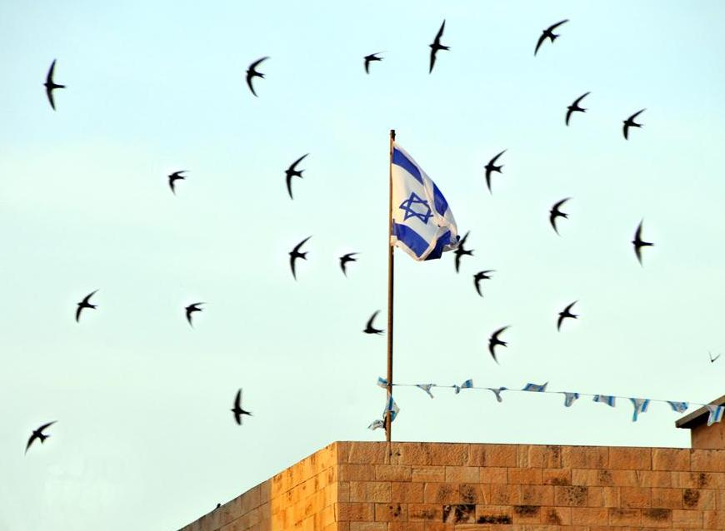
Swift populations in urban areas have declined by over 50%
Swifts over the walls of Jerusalem’s Old City
Photo: Amir Ezer

Slide 11
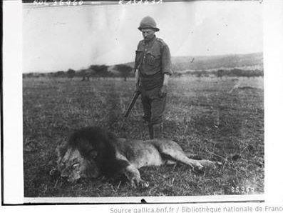
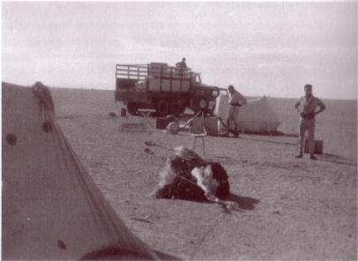
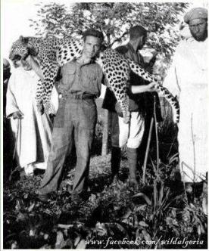
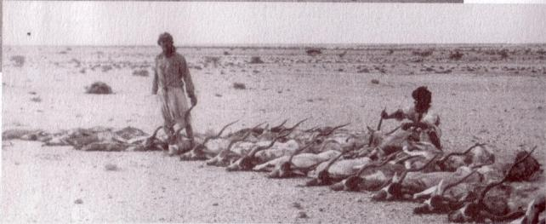
In Algeria and Morocco, when they were French colonies,
ostriches, leopards, lions and addaxes were pushed into extinction

Slide 12
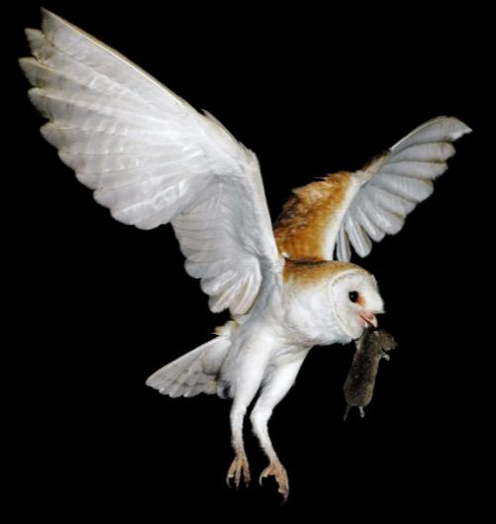
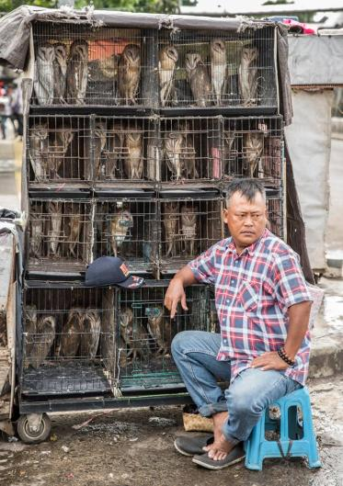
Do we want to relate to Barn Owls as in the right-hand photo from Indonesia,
or as biological pest control agents in agriculture as in the left-hand photo
Barn Owl in flight with vole (Photo: Amir Ezer)
Selling Barn Owls in an Indonesian market (Photo from the Internet)

Slide 13
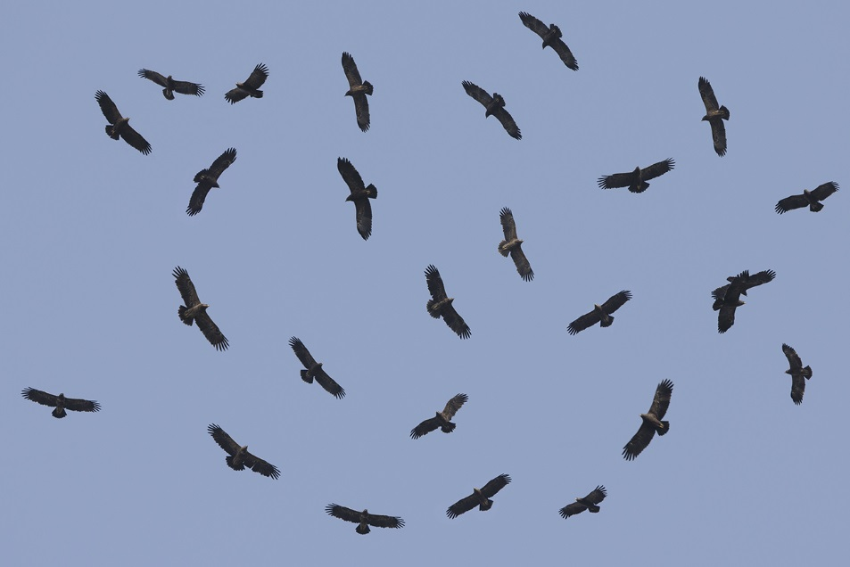
The entire world population - 120,000 (!)
Lesser Spotted Eagles
Photo: Amir Ben Dov

Slide 14
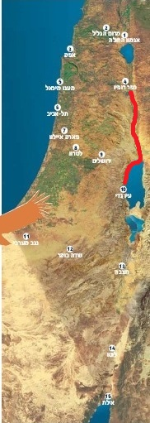
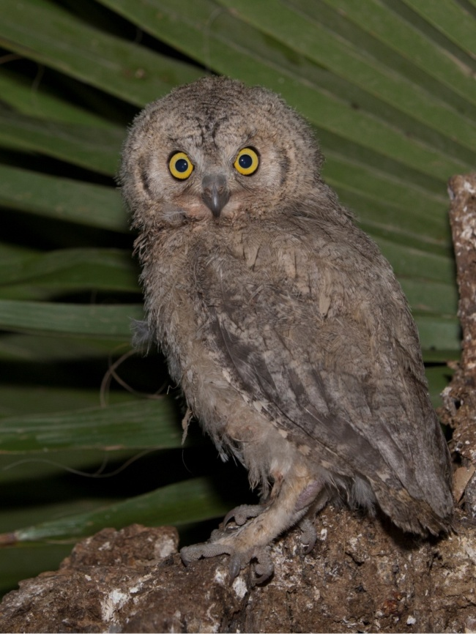
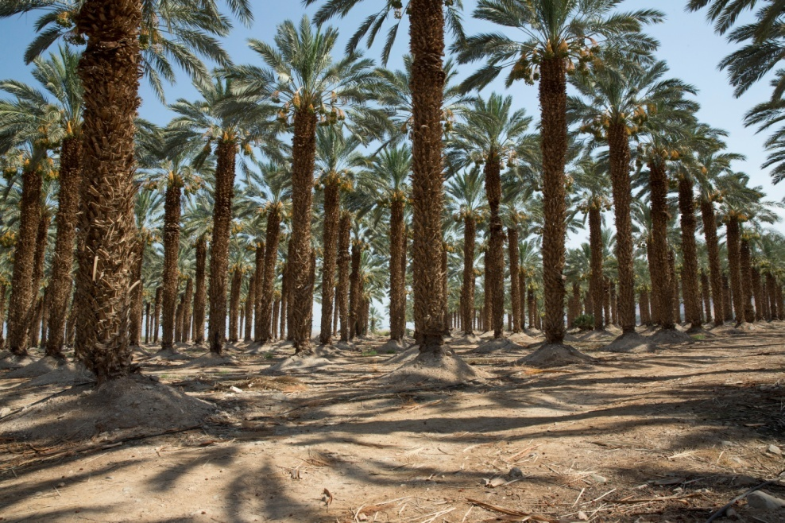
2015: Striped Scops Owl (Otus brucei) - about 100 pairs were found along the Dead Sea and Jordan Valley
Photo: Amir Ben Dov

Slide 15
About 100 pairs of the Desert Owl (Strix hadorami)
breed in the desert in Israel
Photo: Amir Ben Dov & NPA

Slide 16
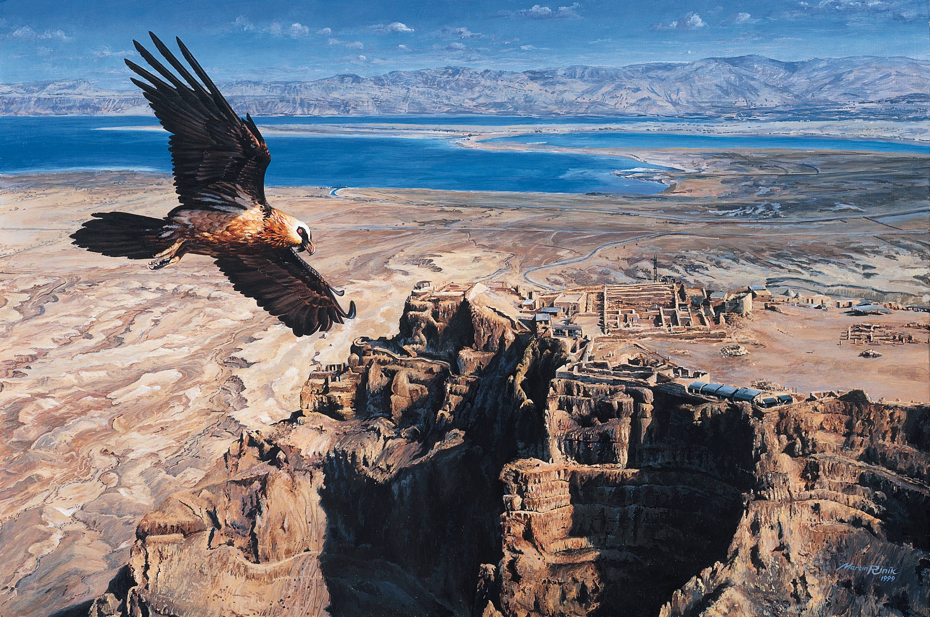
Migrating Birds Know No Boundaries

Slide 17
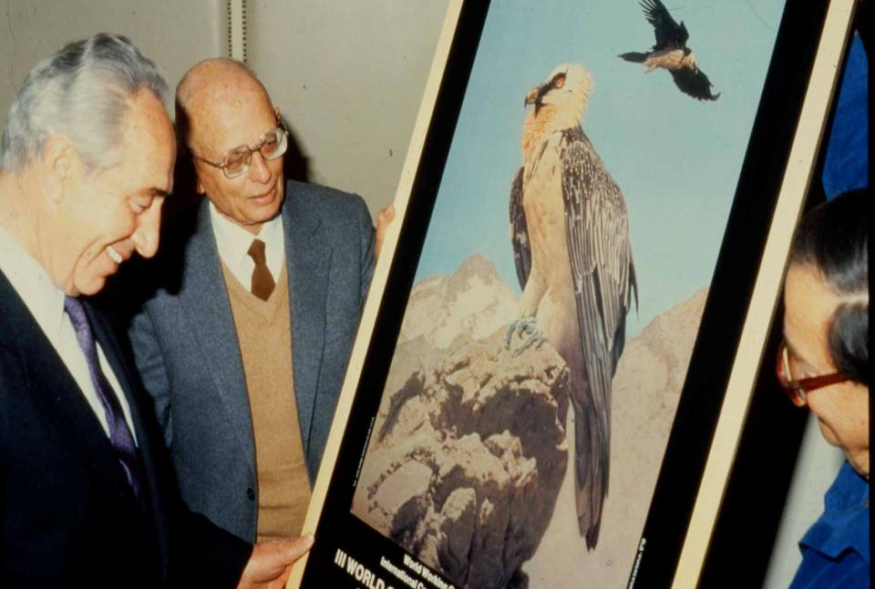
Example #1
March 1987 – WWGBP Conference,
Eilat – 450 participants

Slide 18
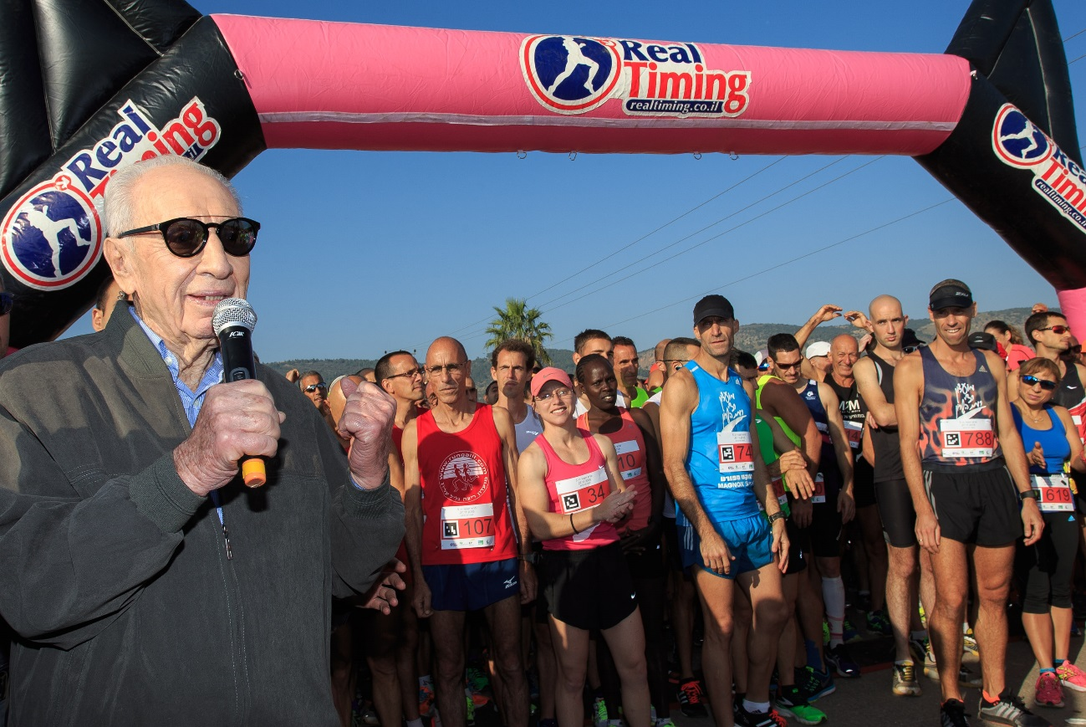
November 2015: Shimon Peres setting off the runners in “The Crane Race”

Slide 19
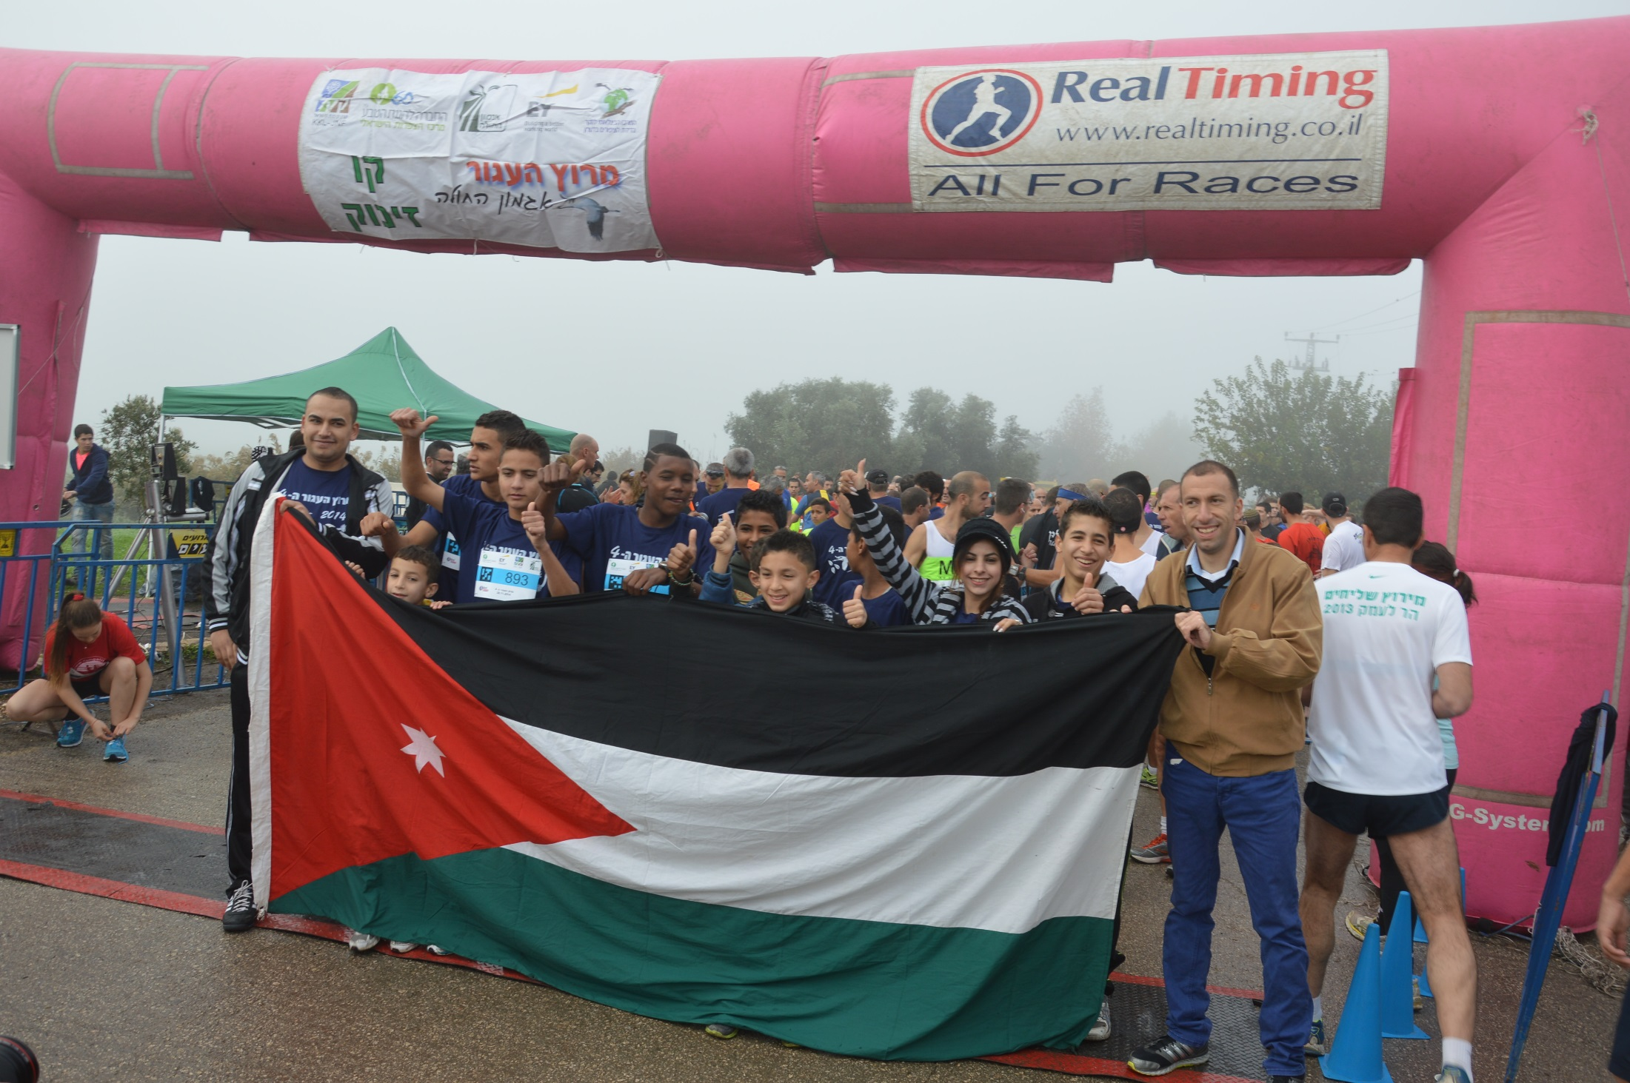

Slide 20
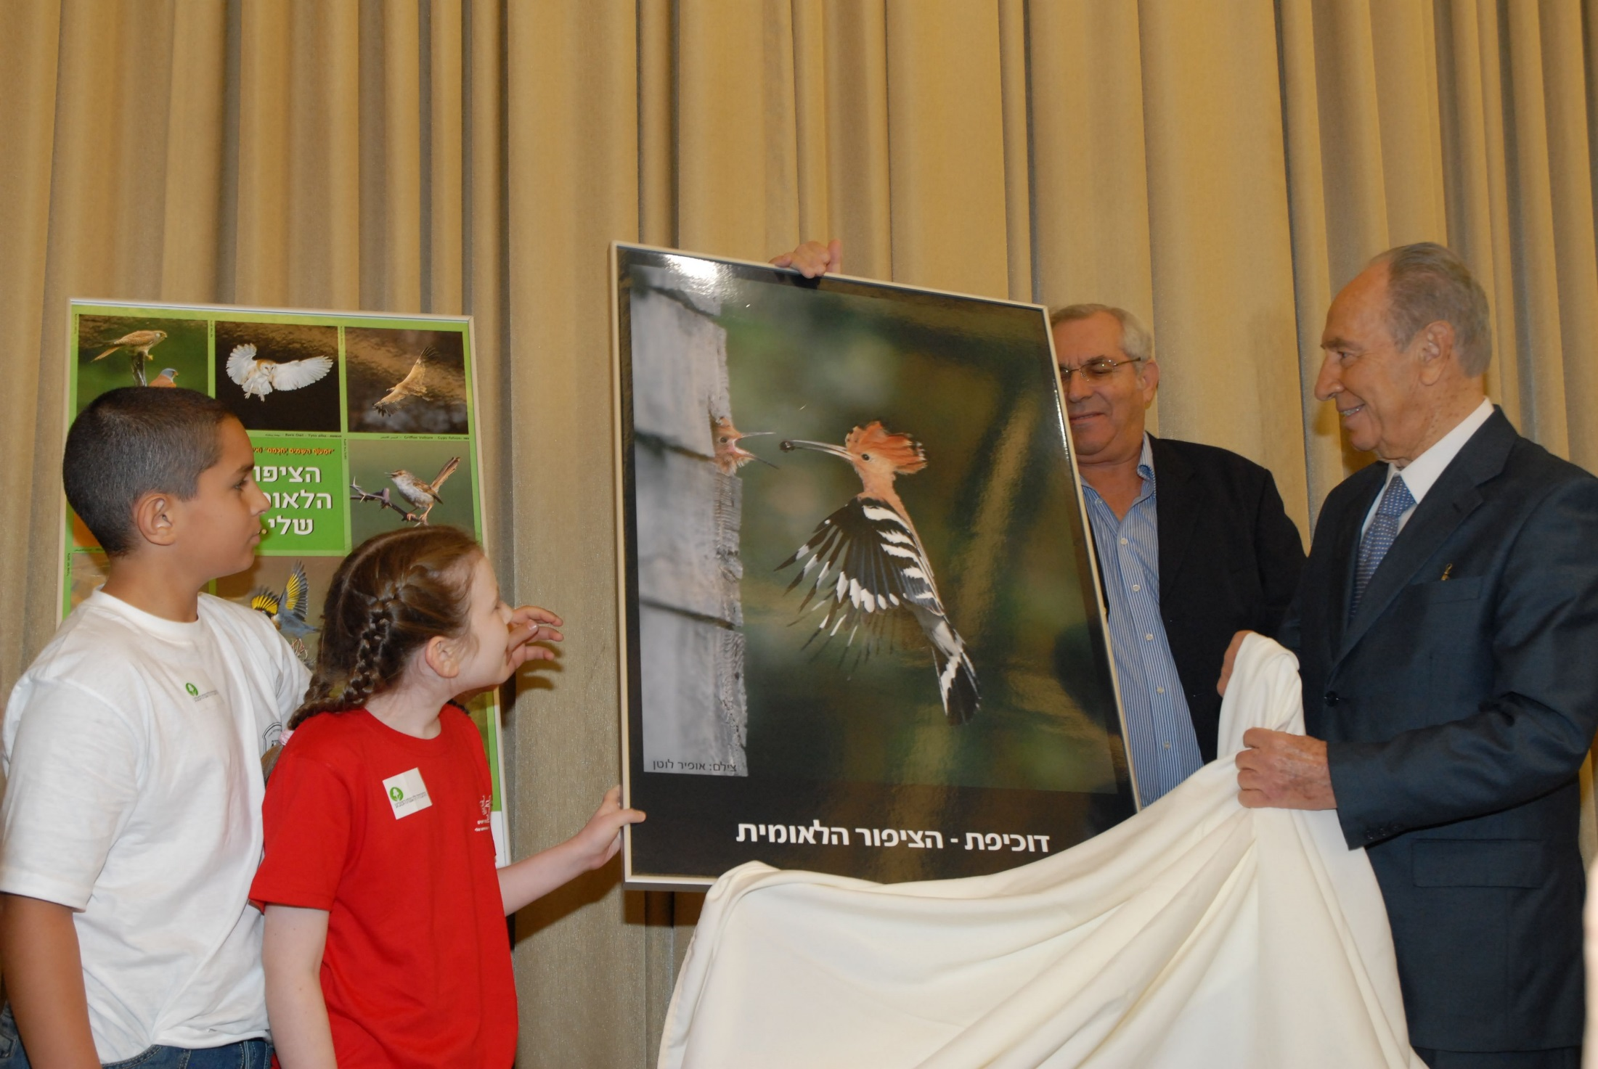
The National Bird Campaign – Israel’s 60th anniversary
Photo: Amir Ezer

Slide 21
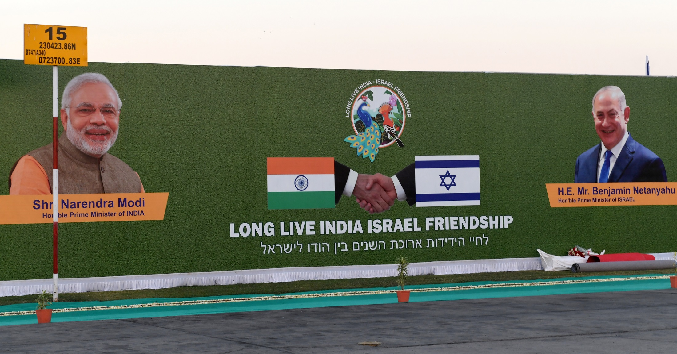
AMAZING SURPRISE!! January 2018 – the national bird of India
hugs the national bird of Israel as a symbol of friendship

Slide 22
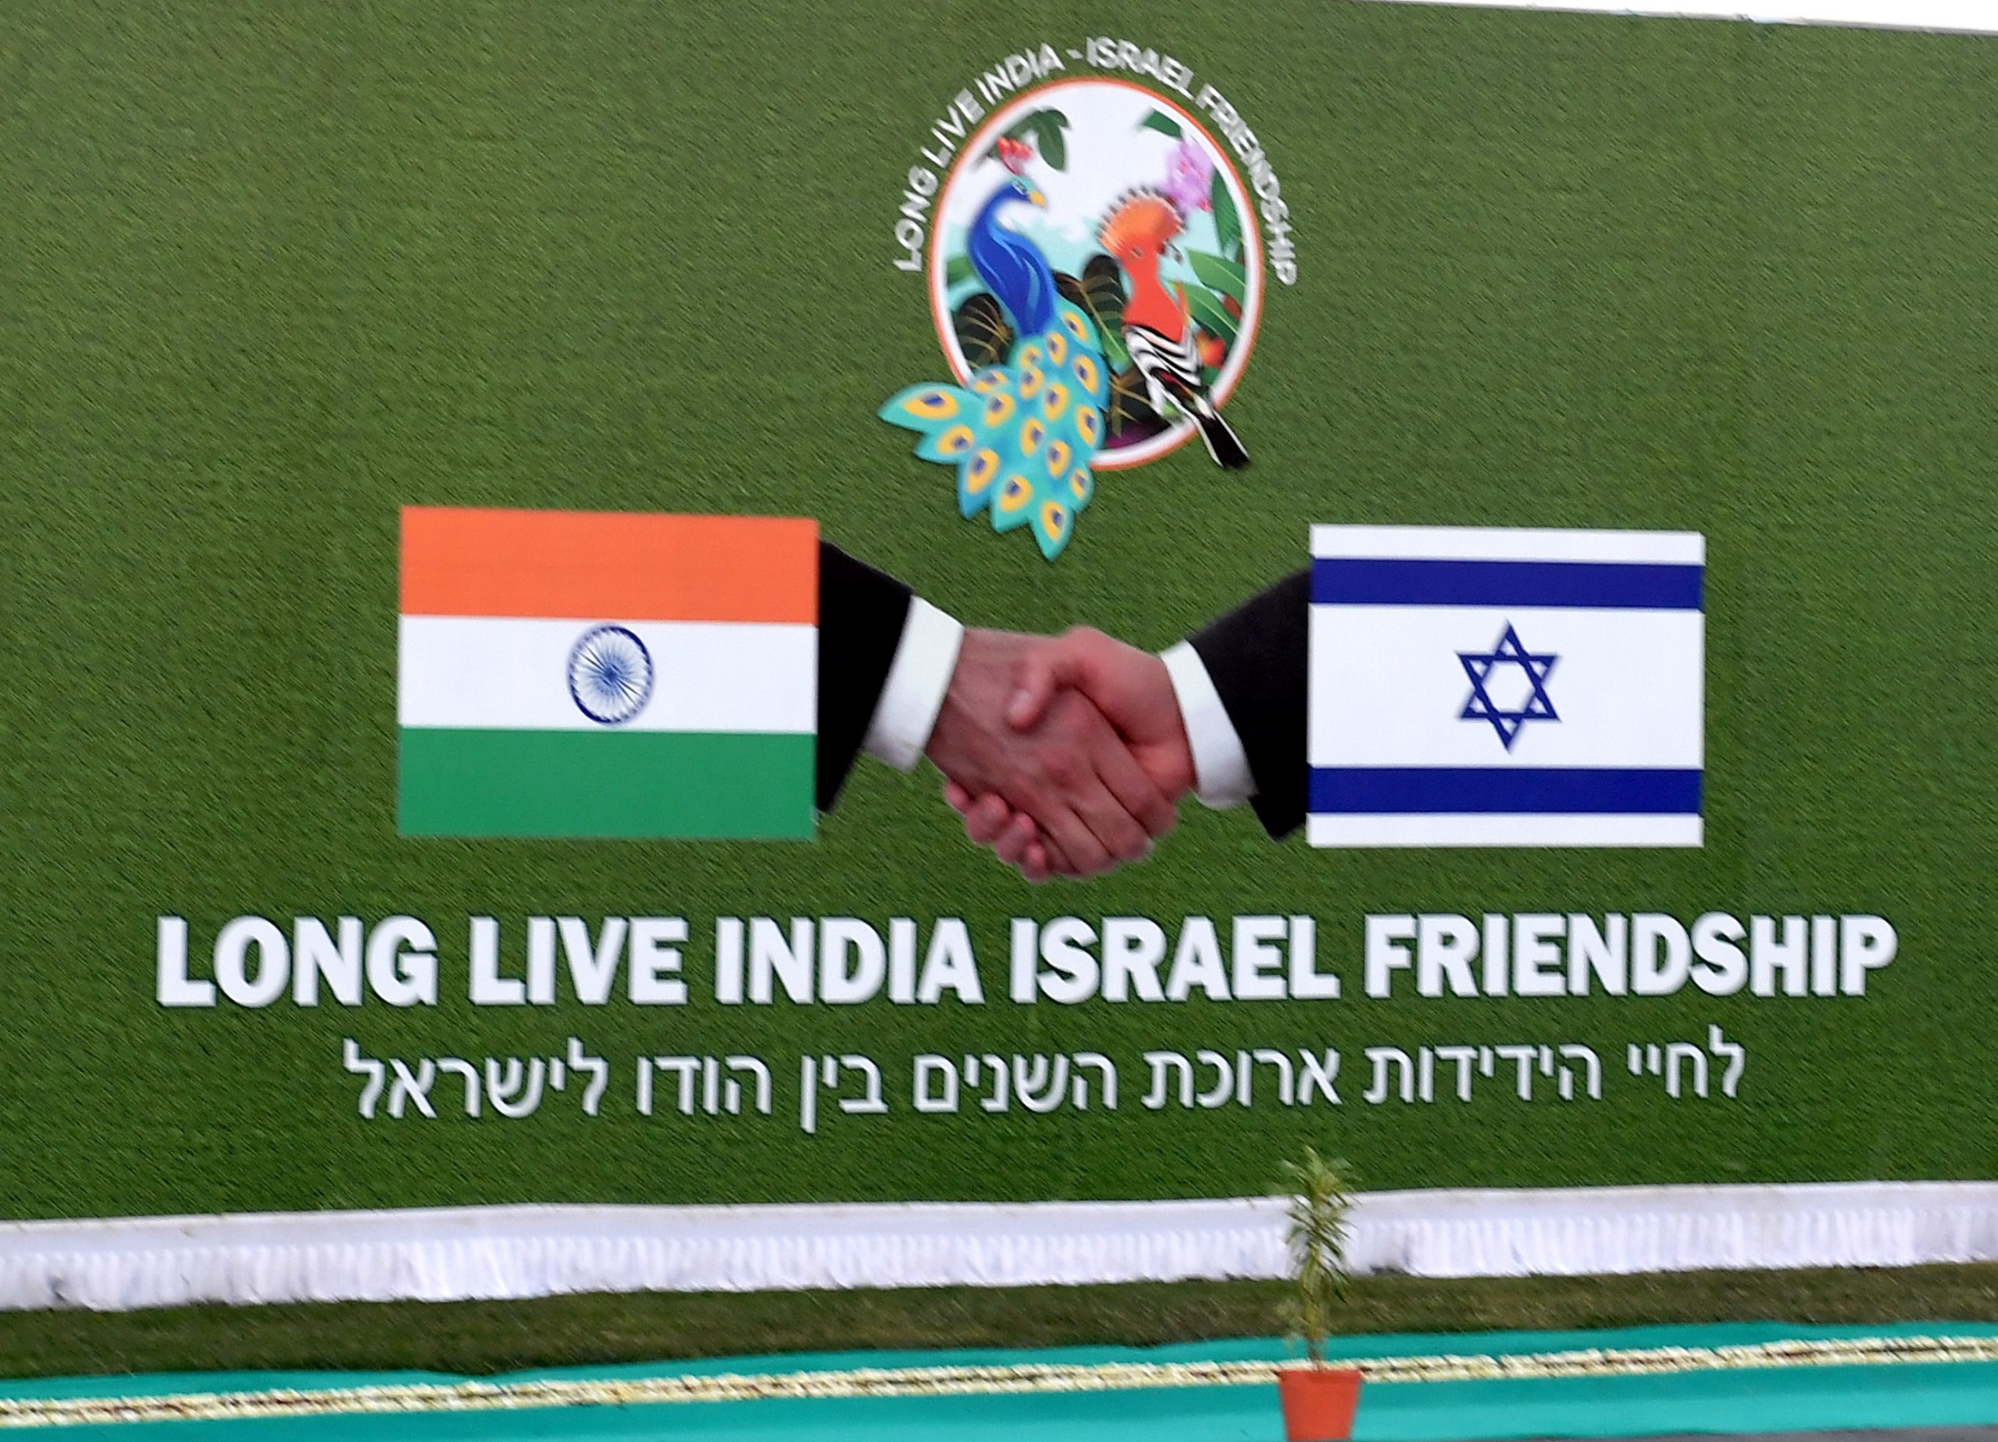

Slide 23
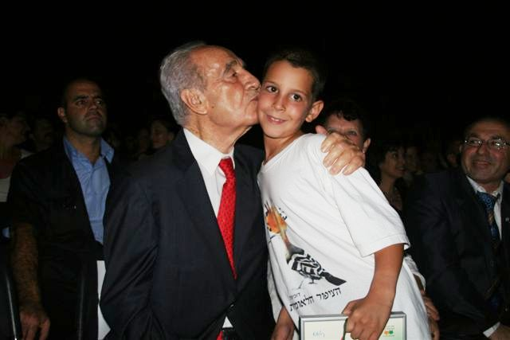
2008: Israel's 60-year anniversary events – 12 Israelis were awarded a prestigious prize for their contribution to nature and environmental conservation in Israel

Slide 24
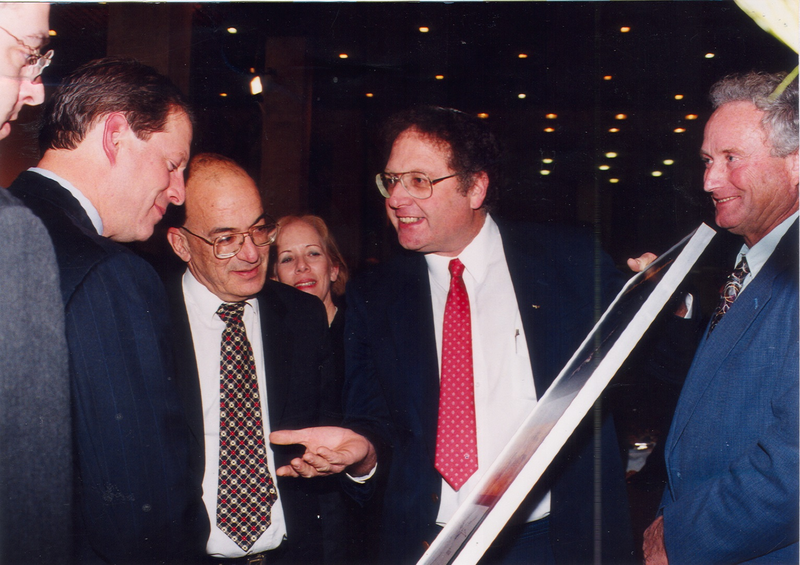
With Vice President Al Gore

Slide 25
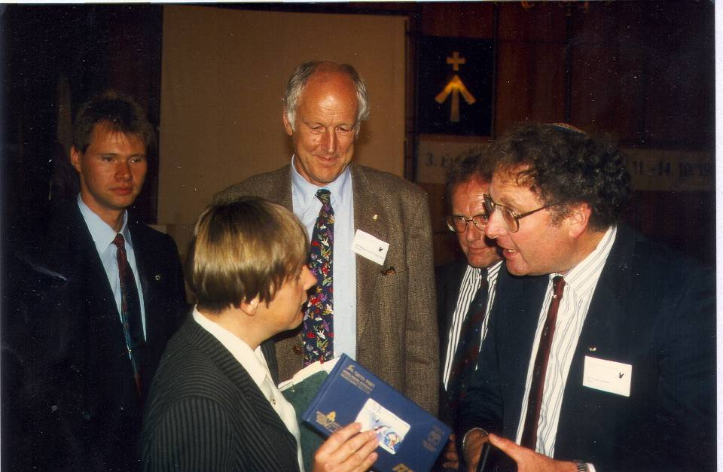
1998: Meeting with Dr. Angela Merkel,
then Minister for the Environment, Germany

Slide 26
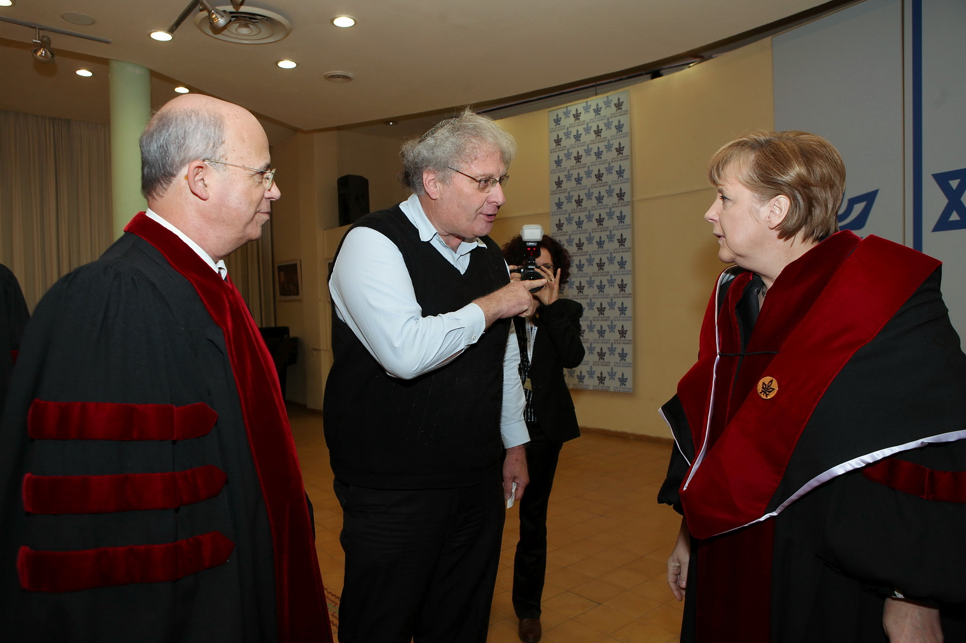
2011: Dr. Angela Merkel with the President
of the Tel Aviv University, Joseph Klafter
Photo: Koby Kantor

Slide 27
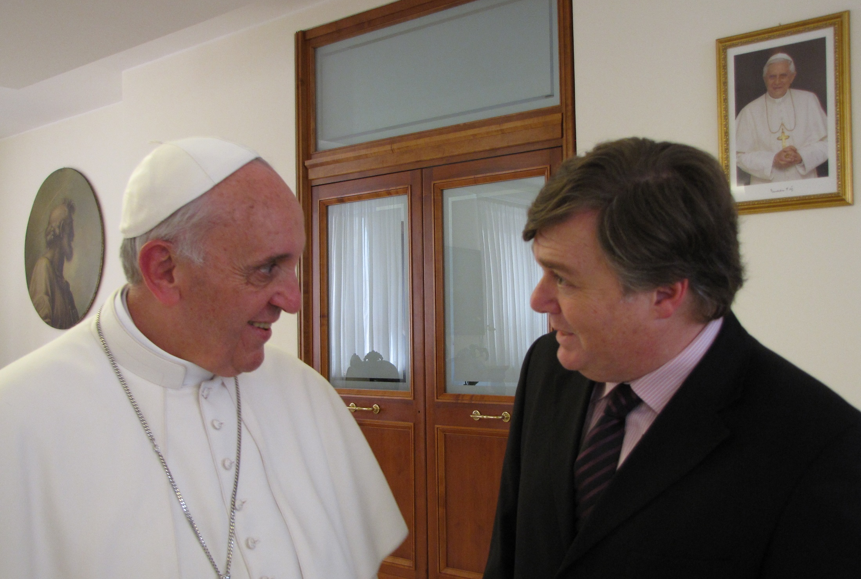
Pope Francis, with the journalist, Henrique Cymerman

Slide 28
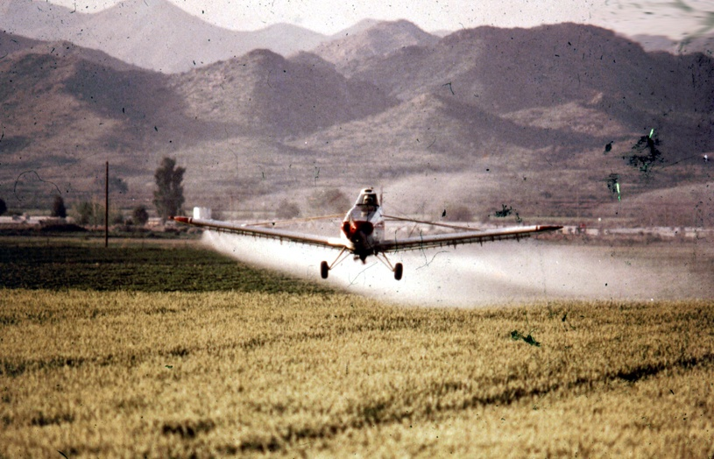
Reducing the use of pesticides
Example #2

Slide 29
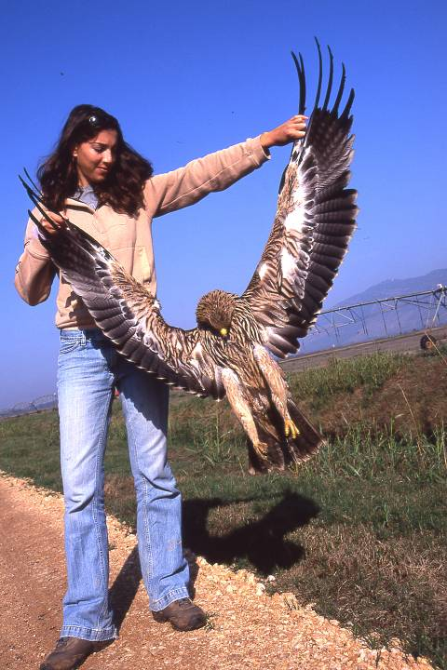
The use of pesticides - a disaster for migrating birds
Imperial Eagle poisoned in the fields
Photo: Yossi Eshbol

Slide 30
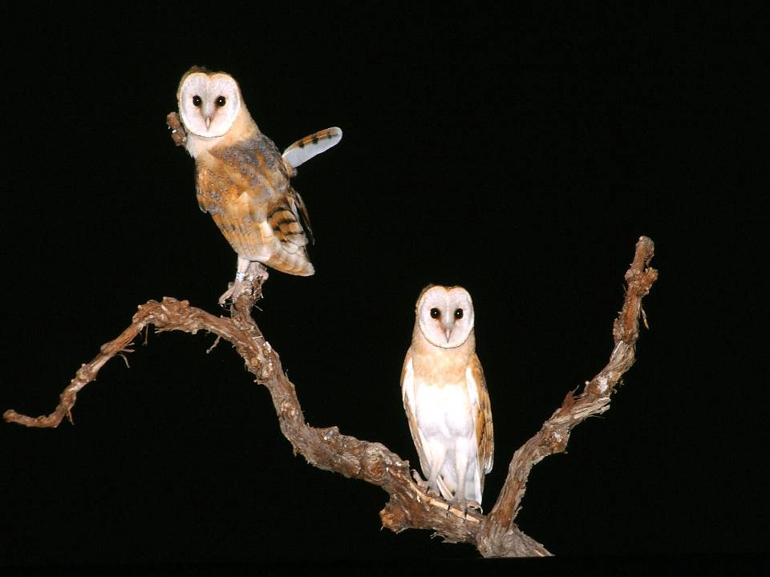
Barn Owl project at
Great Rift Valley
Israeli-Palestinian-Jordanian cooperation

Slide 31
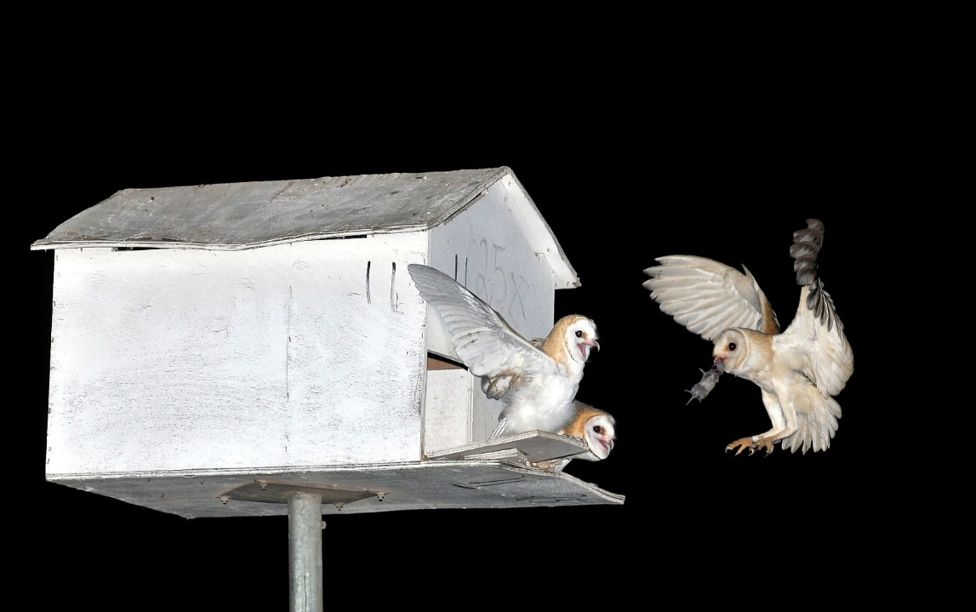
Barn Owls eat 2,000-6,000 rodents per year
Photo: Amir Ezer

Slide 32
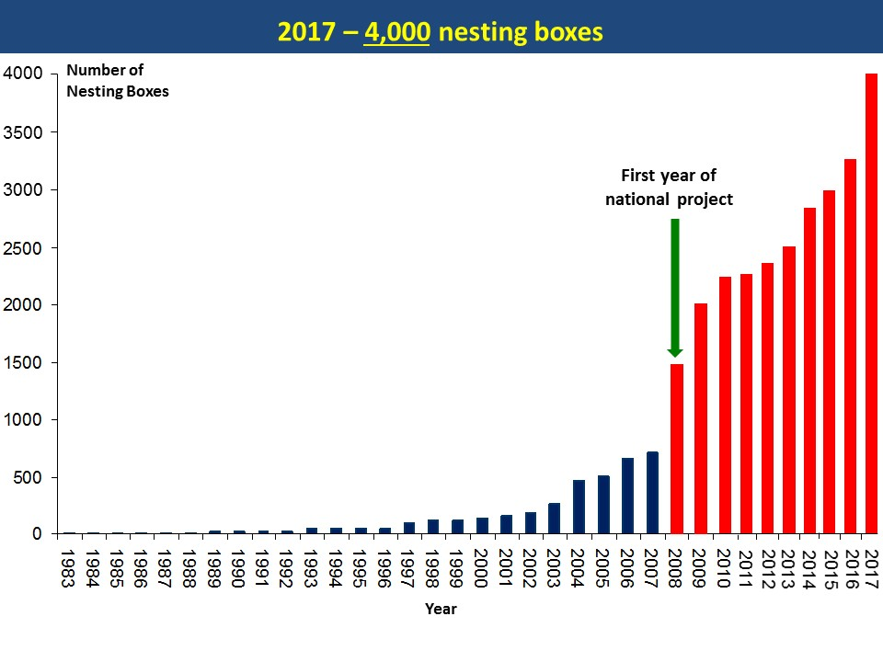
National project – Barn Owls as biological pest agents

Slide 33
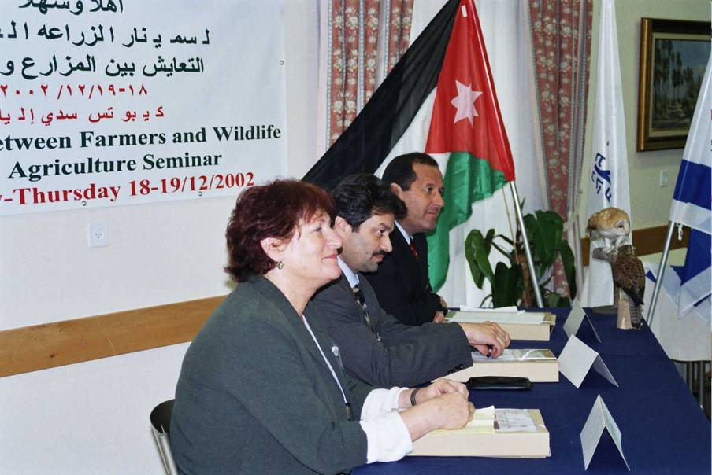
December 2002: Cooperation between Israeli,
Jordanian, Palestinian and Tunisian farmers

Slide 34
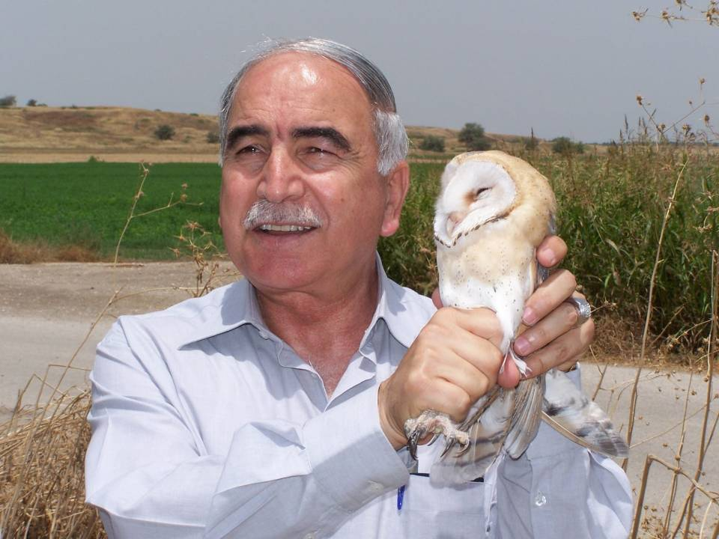

Slide 35
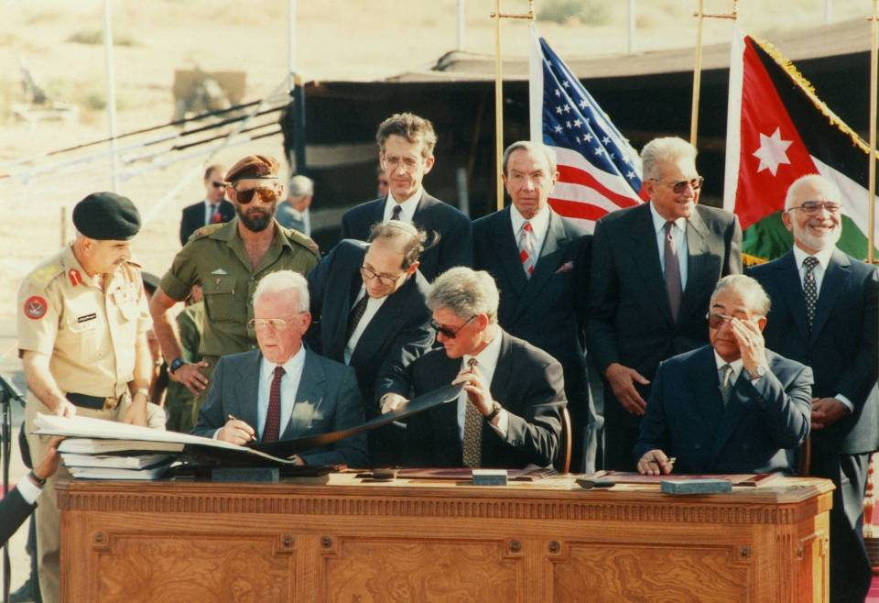

Slide 36
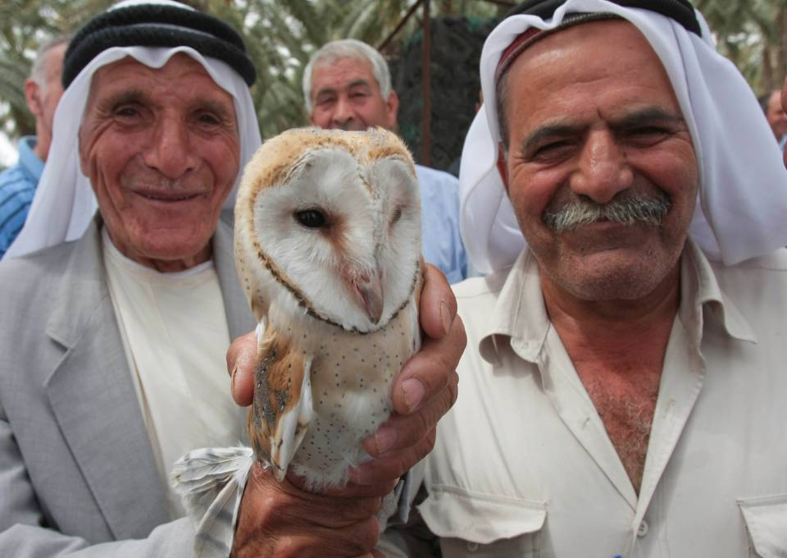
From bad luck to good luck!
Palestinian farmers

Slide 37
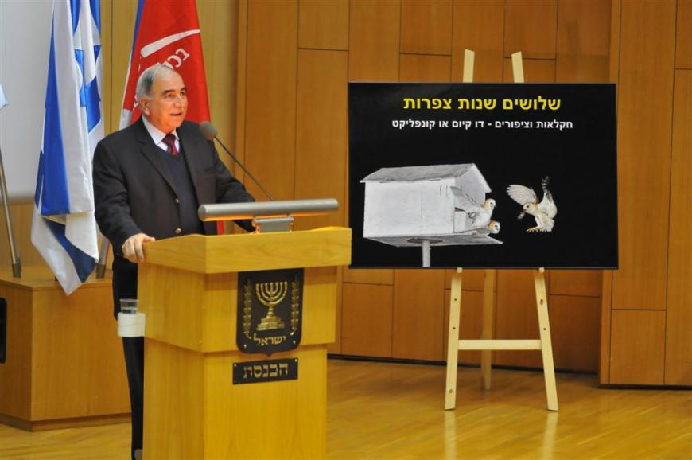
General Mansour at the Knesset (Israel Parliament)
Notes:
37

Slide 38
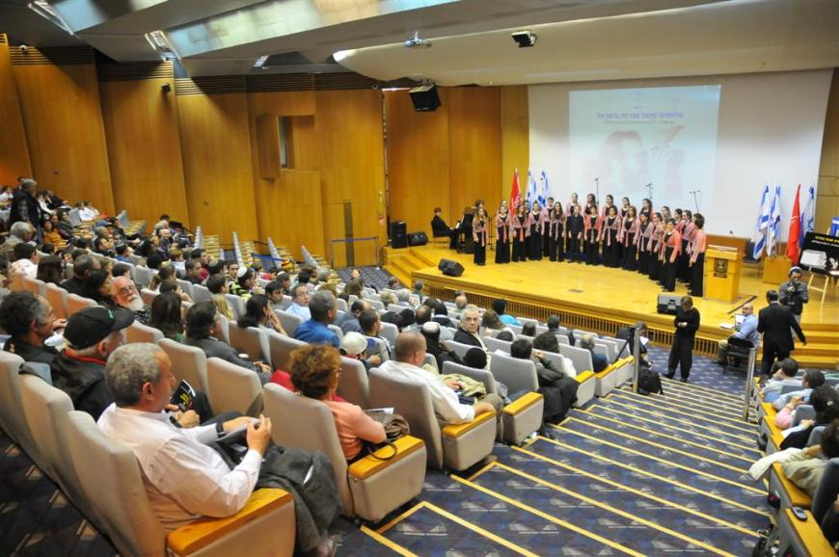
An audience of 400 in the Knesset auditorium for the festive event

Slide 39
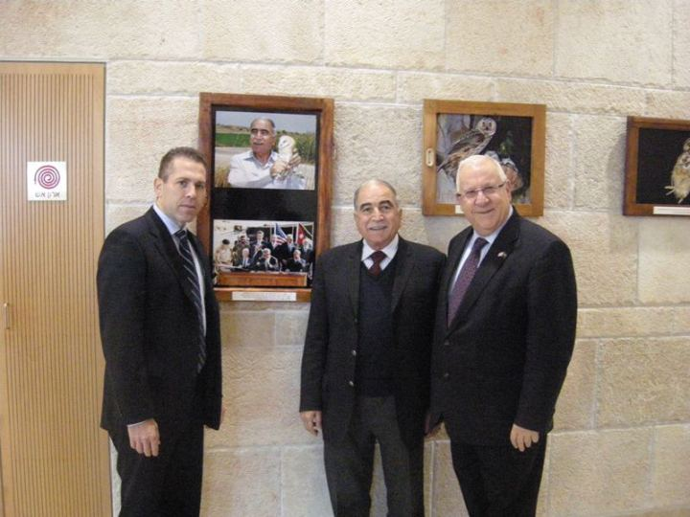
In the Knesset with the speaker Rubi Rivlin
and Minister of Environment Gilad Erdan

Slide 40
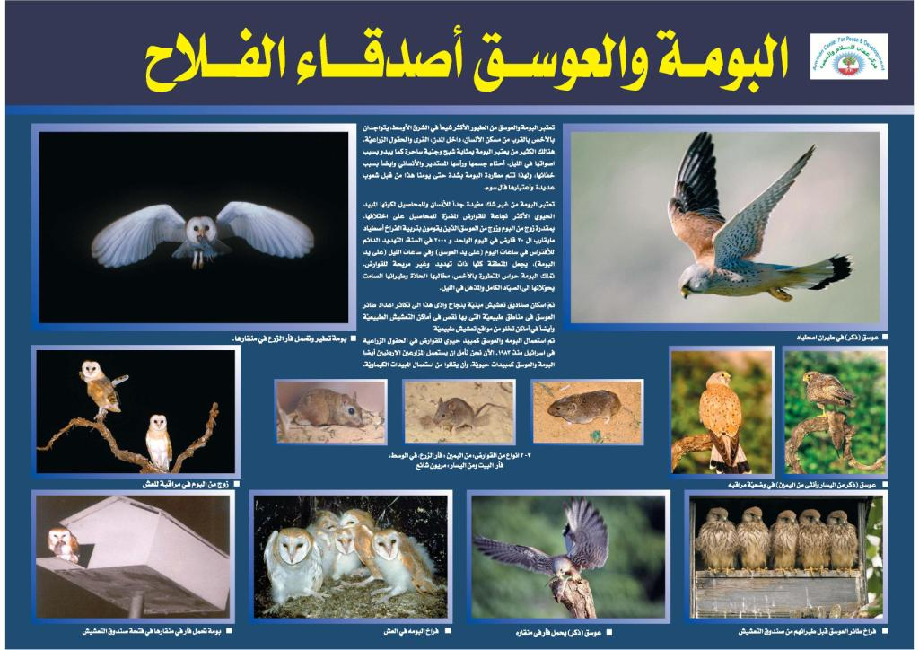

Slide 41
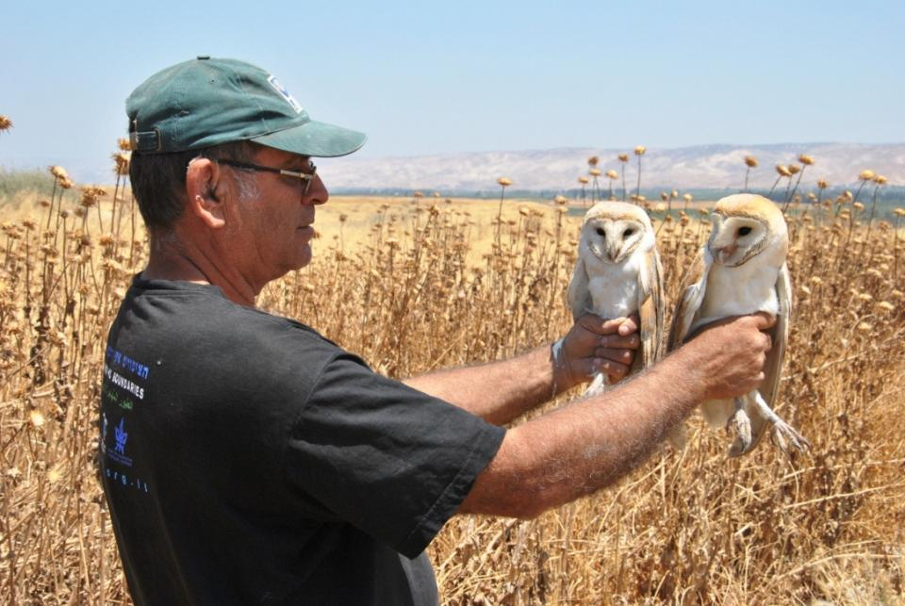
Israeli male, Jordanian female
Photo: Motti Charter

Slide 42
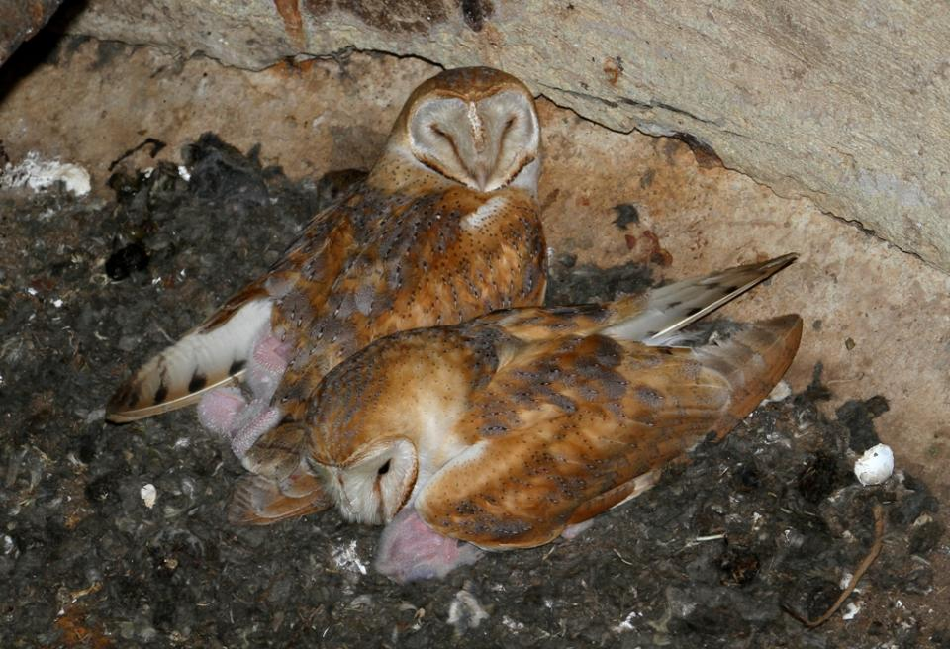
Learning from the Bedouin in Kiryat Gat – a male and two females – Bigamy

Slide 43
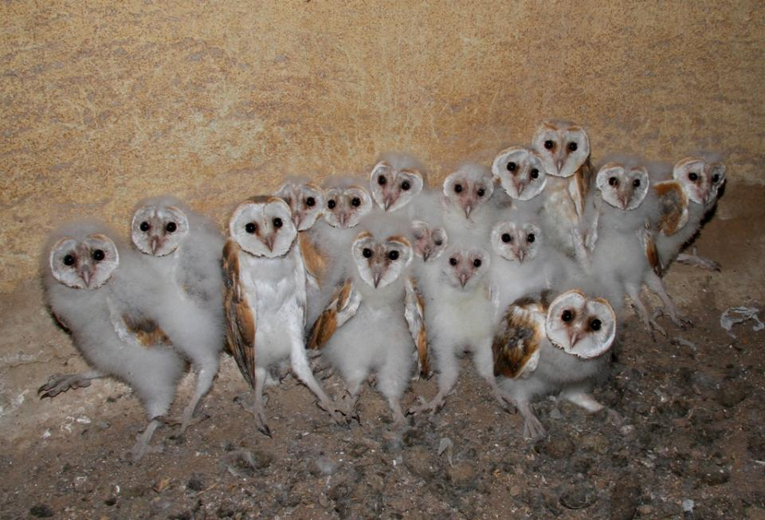
20 eggs were laid, 19 hatched and fledged out the nest

Slide 44
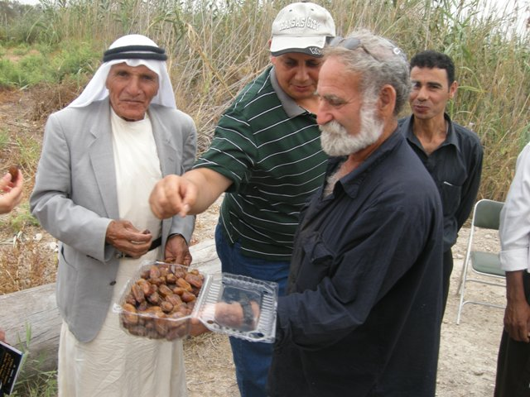

Slide 45
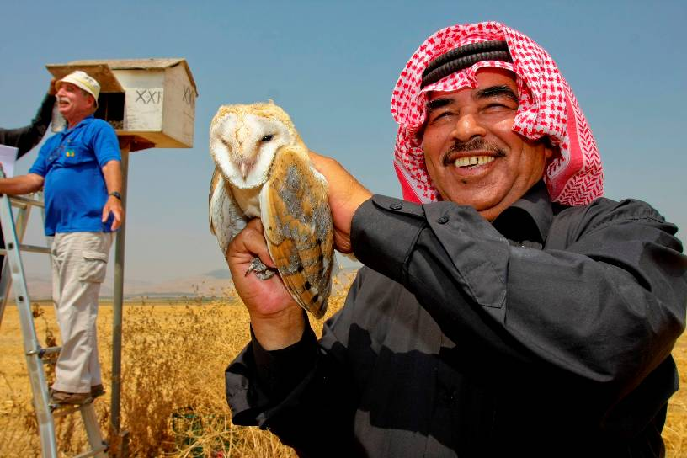
Birds as Peacemakers in the Middle East

Slide 46

November 2013: Israelis, Palestinians and Jordanians
dancing at the end of a seminar in Jordan

Slide 47

2008: Prof. Alexandre Roulin, UNIL, joined the project

Slide 48

IDF ammunition boxes
“They shall beat their swords into ploughshares...”
(Isaiah 2:4)

Slide 49

"They shall beat their swords into ploughshares
and their spears into pruning hooks." (Isaiah 2:4)
Notes:
49

Slide 50

It works!

Slide 51

And it works!!!

Slide 52

General Mansour, Brig. Gen. (Res.) Baruch Spiegel, Yossi Leshem and Alex Roulin lectured together at the WEF at Davos in 2016, on the topic of regional cooperation using Barn Owls

Slide 53


Slide 54

January 21st 2018: After dinner first meeting to introduce new friends
from the Middle East and around the Mediterranean

Slide 55

Courtesy of Prof. Alexandre Roulin

Slide 56

Courtesy of Prof. Alexandre Roulin

Slide 57

Example #3
Art & Music

Slide 58

Artist: Tuvia Kurtz

Slide 59

Poster of jointly prepared mural of the wildlife around the Dead Sea

Slide 60

120 schoolchildren from Amman, Azrak and the Jordan Valley
came to paint with the artists and learn about the regional cooperation
Photo: Adi Bashan

Slide 61

A group of Palestinian students from Jericho, the Palestinian Authority,
at the seminar "Artist for Nature" with the artists in Ein Gedi, Israel

Slide 62

Ibex next to the Dead Sea; Artist: Rosanne Guille, Isle of Sark

Slide 63

TREE OF HOPE by Mark Coreth
St. John Eye Hospital, The Old City of Jerusalem
Photo: Baruch Gian

Slide 64


March 2017 - Paul Winter Concert “Flyways” at YMCA, Jerusalem

Slide 65

Example #4
Fly Safely
IAF last 3 decades:
11 aircraft crashed
3 pilots killed
75 collisions ~10 million $ each
258 collisions per year

Slide 66


The conflict with the Israeli Air Force
December 1988,
Judean Desert
Lt. General Rami Ben-Ephraim

Slide 67


Slide 68


Slide 69

Flight Regulation:
“Bird Plagued Zone” Autumn BPZ
Bird Plagued Zone (BPZ) Map

Slide 70

Collisions (that caused damage) with birds in the IAF before
and after the BPZ research 1980 - 2015

Slide 71

1998: Meeting with the Royal Jordanian Air Force Commander, Major General Ababneh

Slide 72

600,000 White Storks twice a year

Slide 73

1996
Entering the satellite era

Slide 74

Storks migration animation

Slide 75








COST-ENRAM Project
29 Oct 2008: migration Netherlands → United Kingdom

Slide 76

Example #5
Education

Slide 77


Slide 78















Netherlands
Italy
Spain
Finland
UK
Scotland
Estonia
USA
Germany
Jordan
Israel
Palestine
Photos: Yossi Leshem, Yehuda Katz, Ori Peleg

Slide 79


Slide 80


Slide 81


Slide 82

The Next Goal!

Slide 83






Example #6
Nature Defense Forces (NDF)
Commanders Take Responsibility for their Environment
In partnership with:
Technological and Logistics Directorate

Slide 84

IDF Chief of General Staff, Lt. General Gadi Eisenkot, viewing the exhibition

Slide 85

2013-2018 NDF growth of projects

Slide 86


Slide 87


Slide 88


Slide 89


Slide 90


Lachish Training Command Base
Photo: Guilad Friedemann

Slide 91


Results – Reducing fires
No. of fires
From 30,000 dunams that were burned in 2013
to 1,100 dunams that were burned in 2016

Slide 92

May 30th 2016: Chief of General Staff, Lt. General Gadi Eisenkot,
just before releasing a Short-toed Eagle back to the wild
Photo: IDF Spokesperson's Unit

Slide 93

Second to release a Honey Buzzard is the Deputy Chief of General Staff, Maj. Gen. Yair Golan; over one million Honey Buzzards migrate in the spring over Israel

Slide 94

Maj. Gen. Kobi Barak, Head of the Technological and Logistics Directorate and IDF leader of the NDF project, prepares to release a Black Kite

Slide 95

The entire General Staff releases Common Kestrels back to the wild
at a Nature Defense Forces event

Slide 96


Slide 97

General Mansour’s wife talks to Alex’s wife (in Lausanne) on Skype during dinner

Slide 98

Example #7 – New Vision
Swifts & Religion
Tomi Muukkokonen
Notes:
98
לסיס כנפיים ארוכות וצרות והן מוטות כלפי מטה. בדיוק כשל מטוס קרב מתקדם.
כינויים להם זכתה: "ציפור 100 הימים" – "מבשרי האביב" - "מלכי התעופה"

Slide 99

Graham Catley
Notes:
99
הסיסים גם מזדווגים באוויר.
אתגר אמיתי לצלמי הציפורים

Slide 100

The Western Wall – Jerusalem
Notes:
100

Slide 101

Notes:
101

Slide 102


Slide 103

Notes:
103

Slide 104


Mayor of Jerusalem, Mr. Nir Barkat, welcomes the swifts

Slide 105

Over 500 guests attended the event

Slide 106

Swifts and religion in towns

Slide 107

The Church of Nativity in Bethlehem
Notes:
107

Slide 108

H.M. King Abdullah’s Mosque, Amman

Slide 109












Birds of the City
Regional Cooperation Seminar
May 14th-15th, 2012, Israel
Photo: Amnonn Hann

Slide 110

The Ferrari Scandal
Rabbi of the Western Wall, Rabbi Shmuel Rabinowitz:
"We made a huge mistake with the Ferrari exhibit at the Western Wall“ – Ynet
Photo: Ofir Gonen
Source: https://www.ynetnews.com/articles/0,7340,L-5038907,00.html

Slide 111



Summary: Swifts as an interdisciplinary concept
Nature conservation
Research
Awareness & sctions
Rehabilitation
People-to-people activities = Peace process
Eco-tourism = Economic value
Swifts and religion
Notes:
111

Slide 112

Do not move separately – JOIN FORCES !!

Slide 113

Can we “take off” with such an ambitious project?

Slide 114

Birders in the Sahara…

Slide 115

With a little optimism the answer is –Yes!

Slide 116

FOCUS ON YOUR TARGET

