Slide 1
Multi-facetted approach of Liberi di Volare for the conservation of swifts in Italy
S. Pesaro, M. Meola, S. Di Mauro, P. Vasca, B. Cimador, K. C. Prince

Slide 2
Liberi di Volare
Founded in 2012, in Trieste
Members:
subscription 51
active: about 17
955 followers on Facebook
www.liberidivolare2012.com

Slide 3
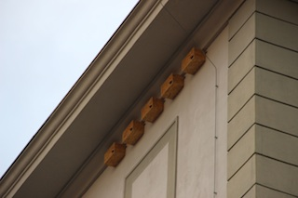
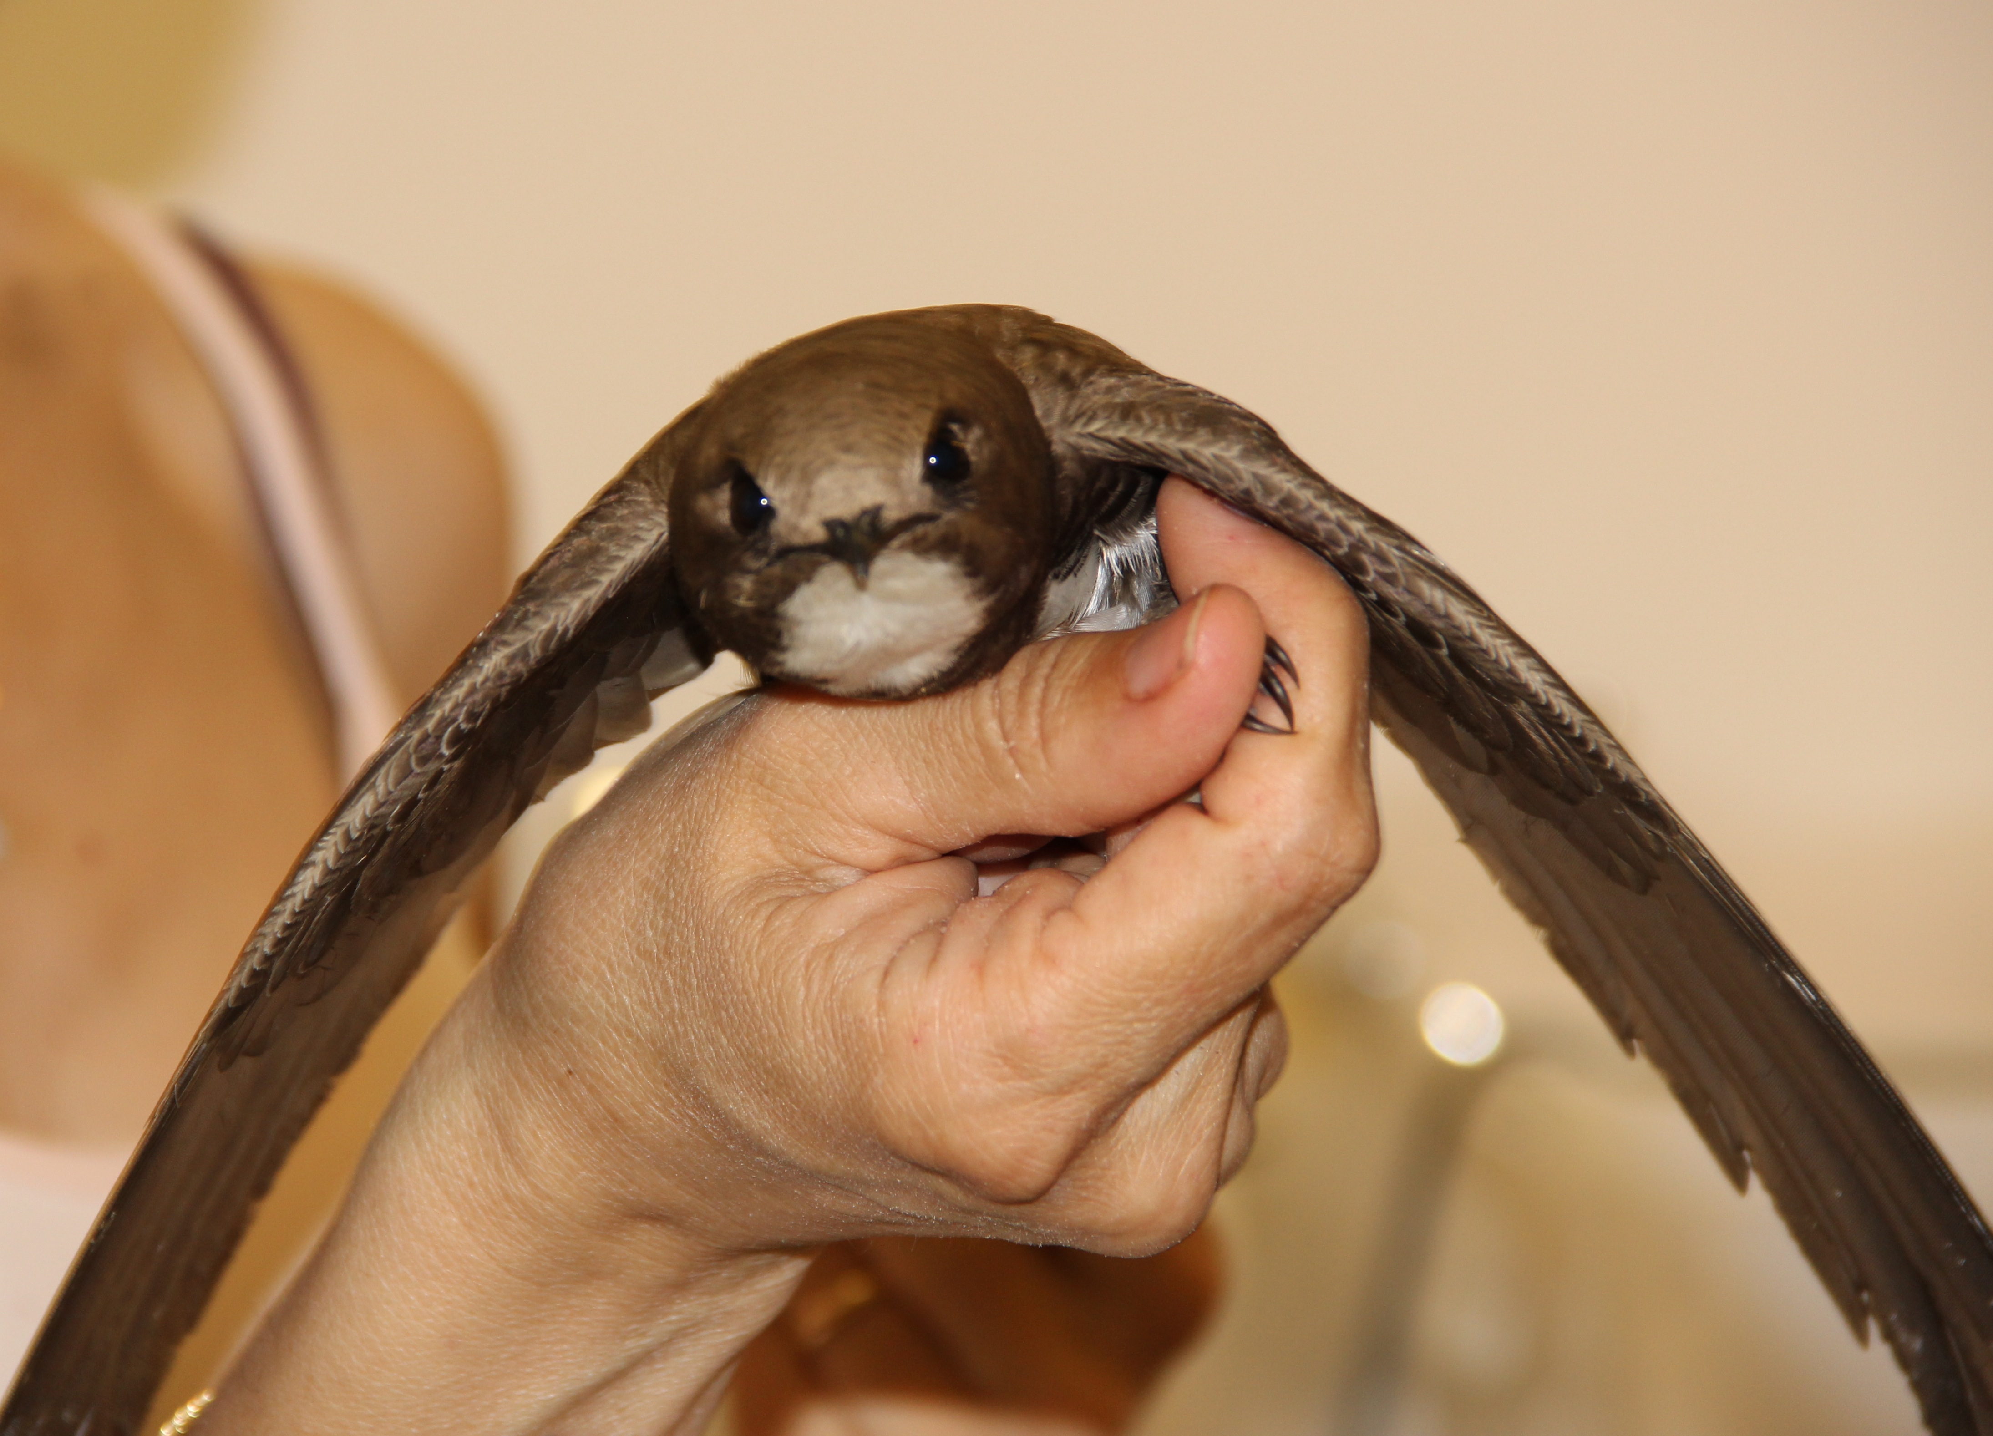
Liberi di Volare
Purposes
Rescue centre
Protection of species (nesting sites)
Education And Outreach
Research

Slide 4
Liberi di Volare
Rescue Centre the only one in Italy specific for these species
Numeri: 626 birds (Irundinidae, Apodidae)
      Common swift: 510
      Pallid swift: 12
      Alpine swift: 4

Slide 5
Rescue Centre

Slide 6
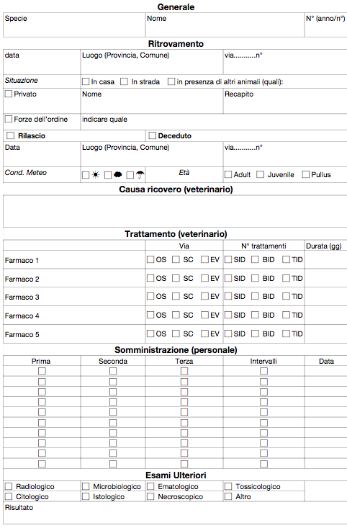
Rescue Centre

Slide 7

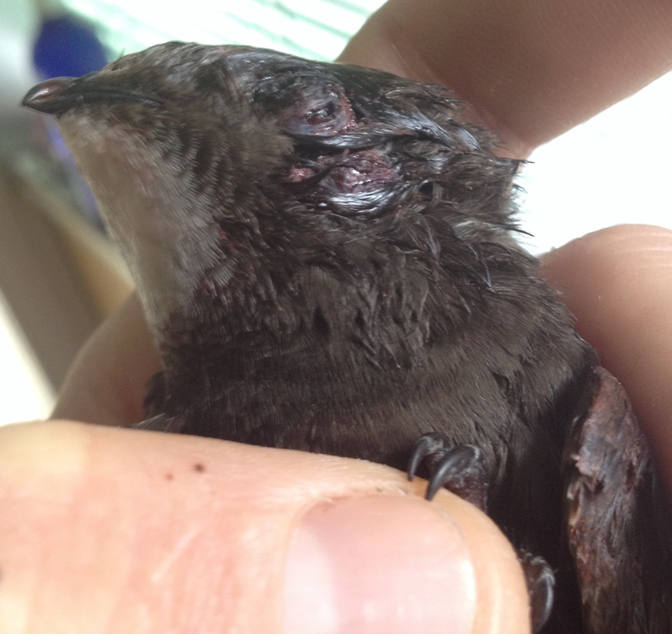

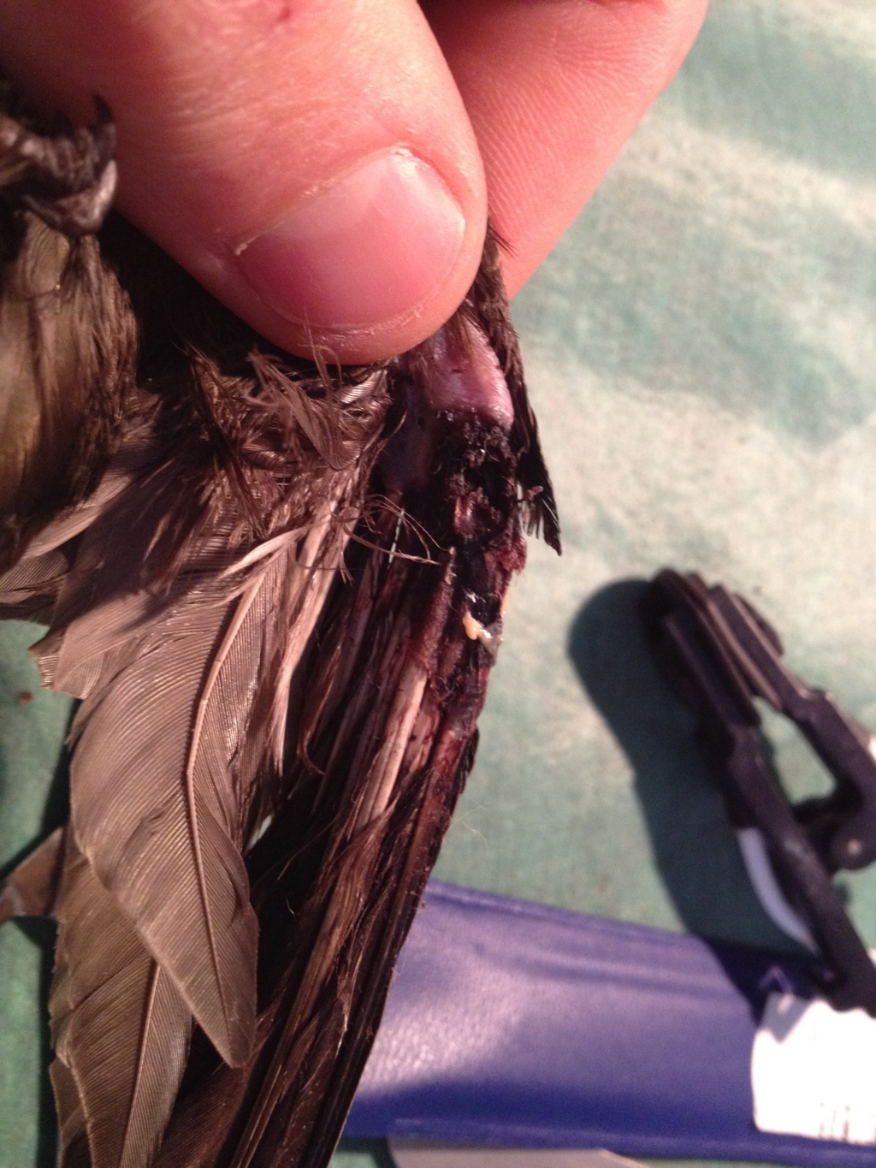
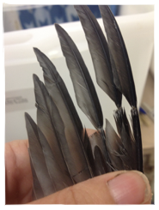
Rescue Centre

Slide 8
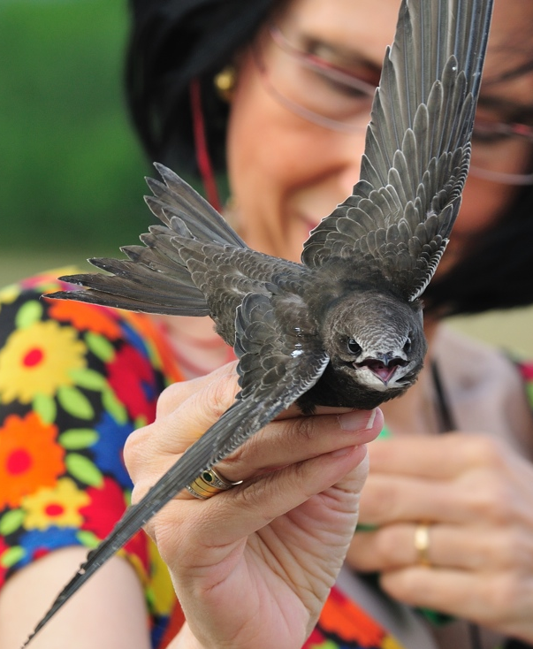
Rescue Centre
Ringing activity
Year | Alpine swift | Common swift | Pallid swift
2013 | 1 | 12 | /
2014 | / | 38 | /
2015 | / | 56 | /
2016 | 1 | 42 | /
2017 | 1 | 89 | 5
Successes:
  312 Swifts 79,79%
  5 Pallid swift 92%
  2 Alpine swift 100%

Slide 9
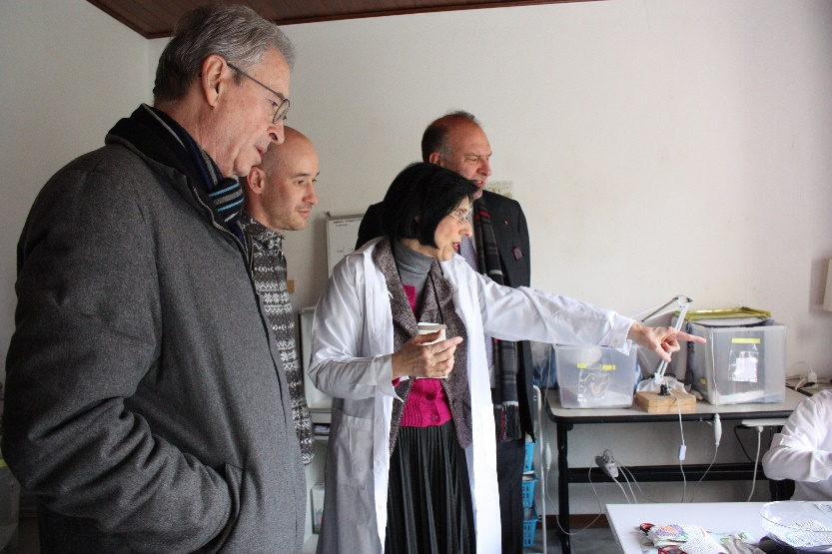

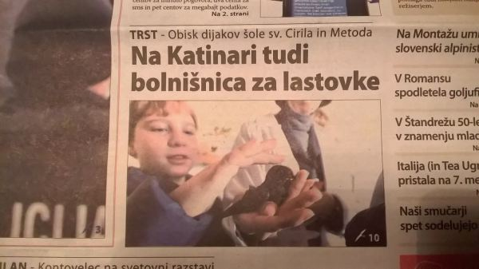
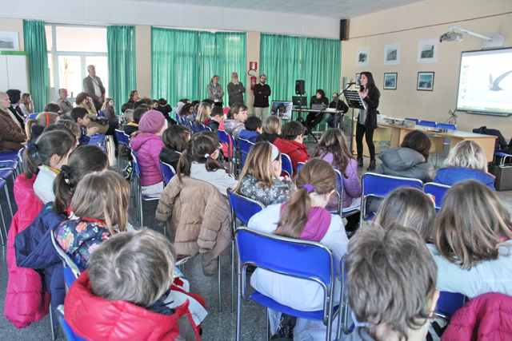
Present
Education and Outreach
Media (TV, News paper)
Direct conctact
Events
Projects
Locally and not only
Future
Slovene language newspaper report
on the visit of Slovene speaking school.
Slovene language newspaper report on the visit of Slovene speaking school.
Island of Elba, reading to school students.

Slide 10
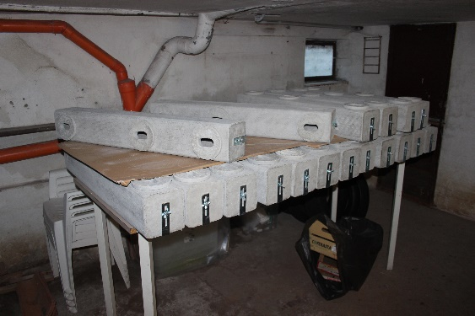
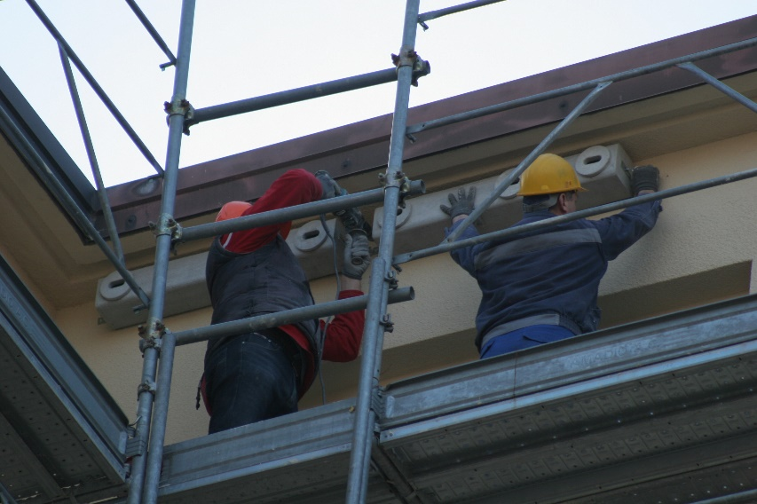
Protection of Nesting Sites
56 nests installed at the Dante Alighieri school, centre of Trieste. First phase: wooden nests. During renovation of the façade: cement nests, funded by AISPA.
Schools: Dante 54, Rossetti 12, Cirillo e Metodio 10, De Marchi 5.
Fire Brigate Station: 4
Natural History Museum: 5
Private: 25
115 nest boxes

Slide 11

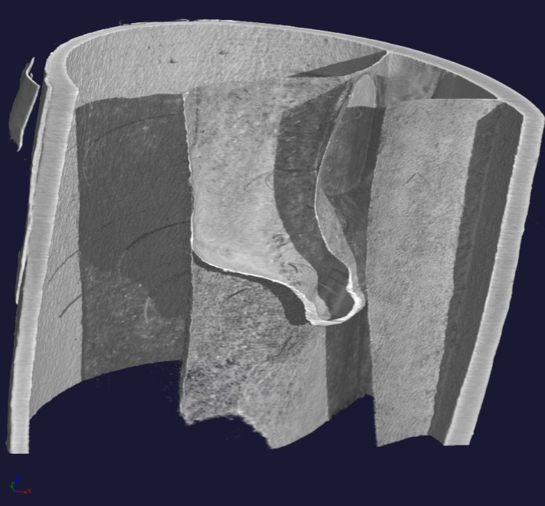
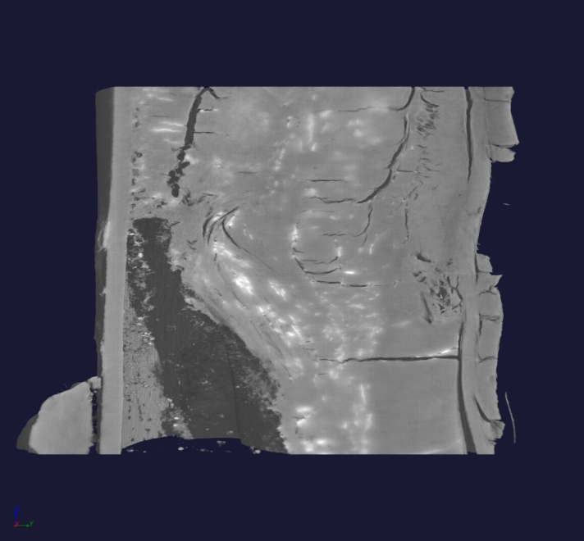
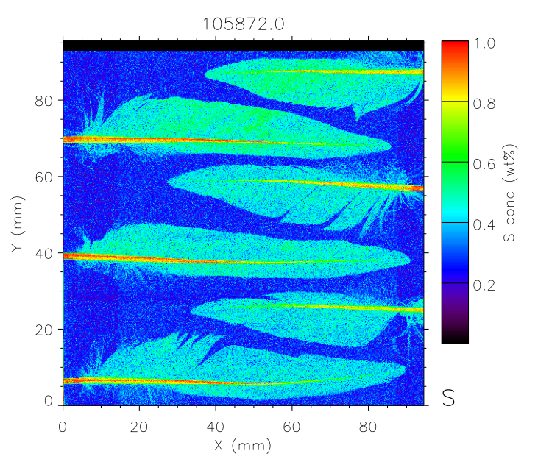
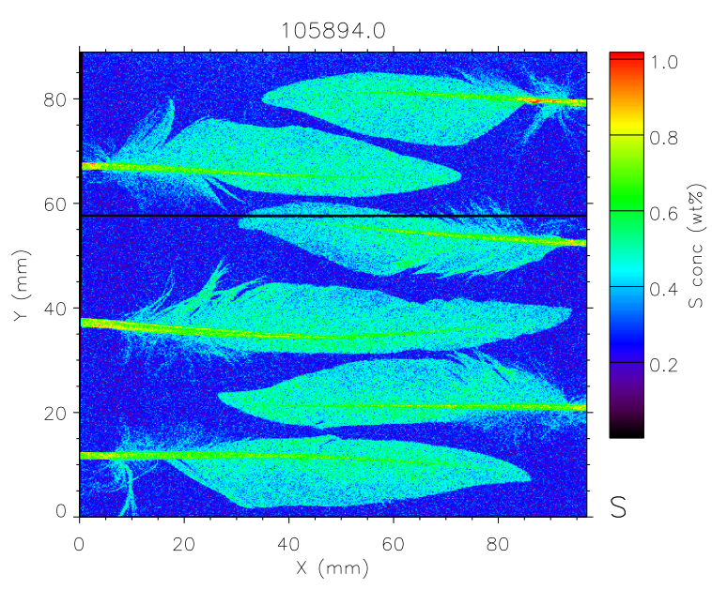


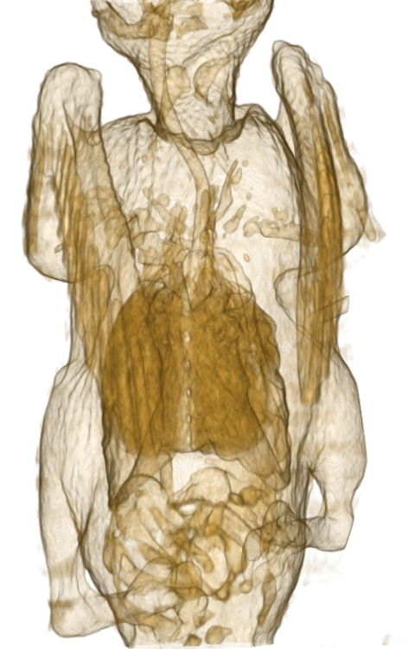

Research
Collaboration with University and Research Centers

Slide 12

Collaboration with Italian end European Associations for the conservation of swifts

Slide 13
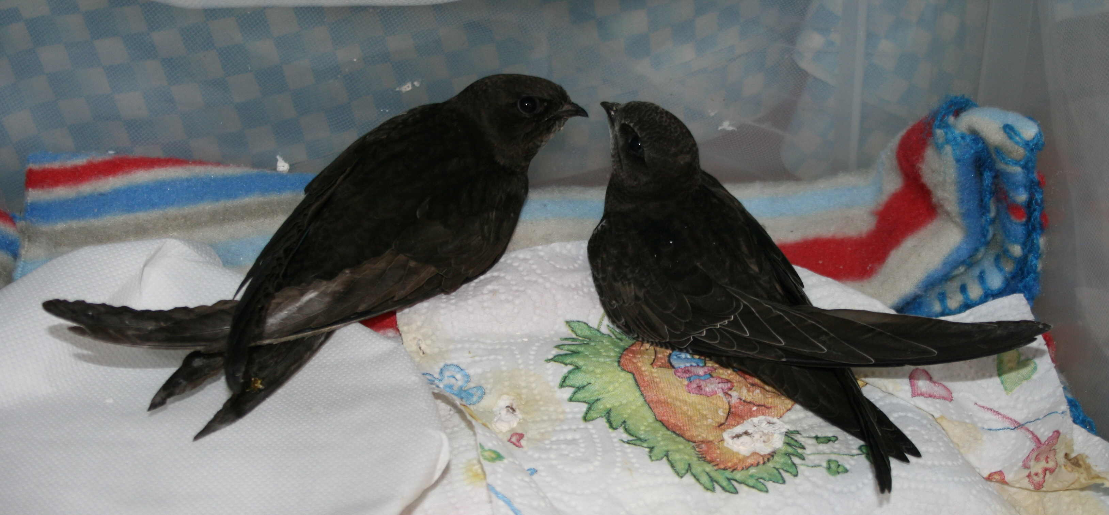
Conclusions
Protection of species
Education and Sensibilization
Rescue Centre
Research

Slide 14
6th International Swift Conference, Trieste 2020, Italy

Slide 15
Thanks to:
Silvana the founder and the Wonderwoman of Liberi di Volare
Animal keepers of the Association (Cristina, Nadia, Daniel, Michele, Tiziana, Matteo, Giorgia, Isabel, Valentina, Chiara).
Aispa
Mauersegler Klinik Germany (Christiane and Alexander)
APUS, Associazione protezione uccelli selvatici (Celia) Svizzera

Slide 16
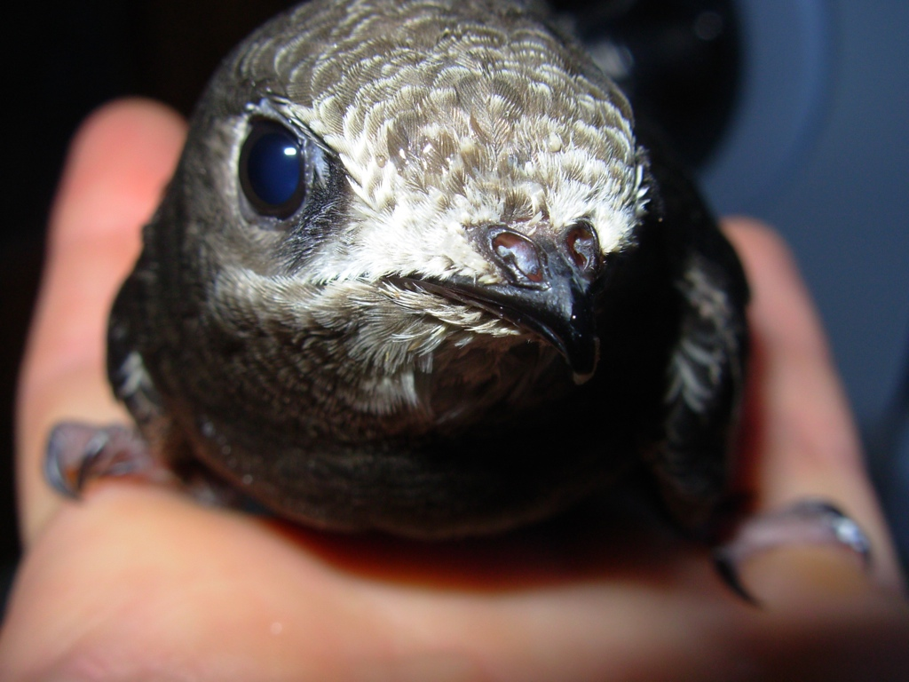
Thank you for your attention

